Slide 1
Monitoring resilience of infrastructure in cities & urbanized deltas Rolands Kromanis (UT, ET)

Slide 2
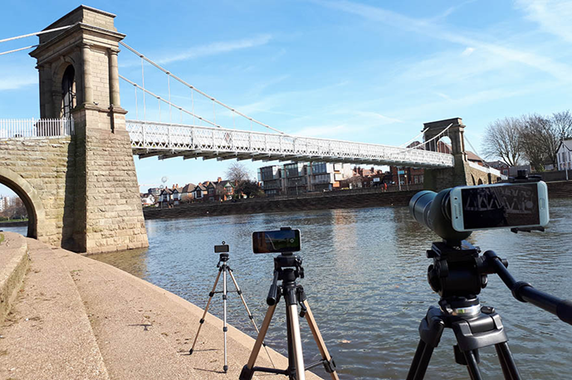
About me
Start at the University of Twente in September 2019
Lecturer at Nottingham Trent University since September 2015
Teaching in Civil Engineering: Structures, CAD, IT, Condition assessment
Research: Vision-based Structural Health Monitoring research group
Short courses and engineering consulting
PhD in Bridge monitoring, University of Exeter (UK), June 2015
Industrial experience
Engineering consultant
Structural engineer
Project management – low energy homes and
hydrological monitoring stations

Slide 3
Research interests
Monitoring
Structures & Infrastructure
Contact and non-contact sensing systems
Sensor fusion and Internet of things
“Making sense” of data
Input + system = output
Data characterization & interpretation
Monitor → inform → learn → implement (Artificial intelligence)
Future of science, technology and businesses (Betz et. al 2019)
Science advances -> Computer science
Technology advances -> AI, Analytics of big data
Notes:
SA: Computer Science 97.4%, Biological Science 102.6%, Medical science 89%
TA: Robotics, space travel

Slide 4
My role in the DeSIRE programme
Data collection strategies and analytics for monitoring resilience
Distributed sensor networks and sensor fusion
Assessment for system resilience; inform future designs
Collaboration with other TTs
Flood resilience, Asset management and maintenance, and more

Slide 5
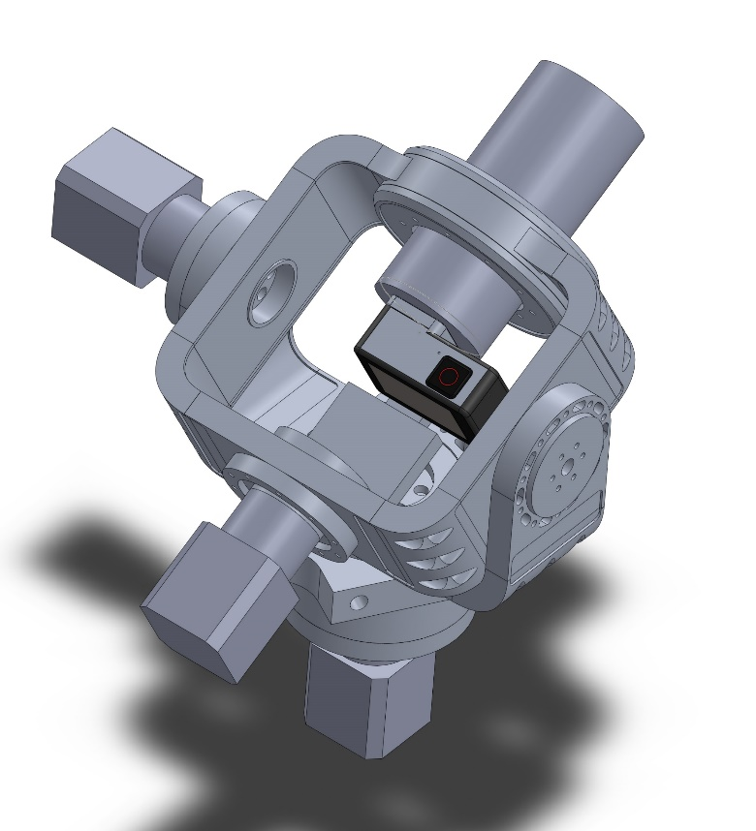
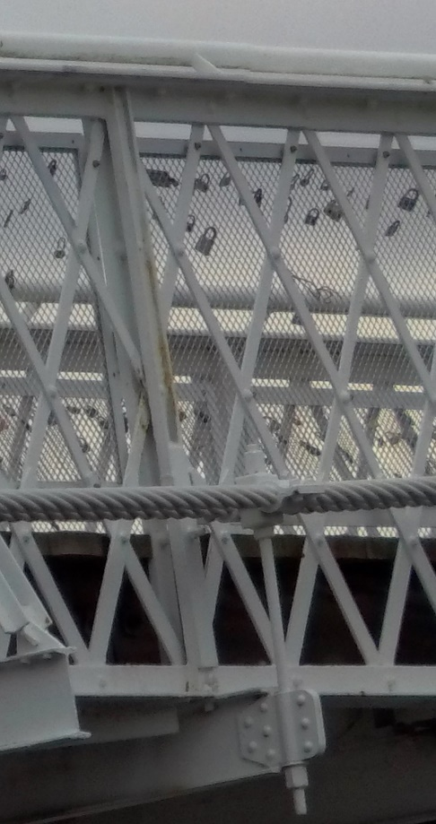
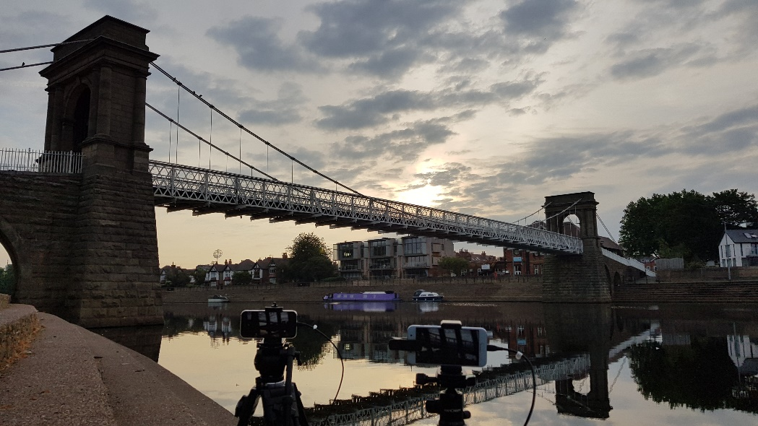
Computer vision for infrastructure monitoring
Availability, price & accuracy
Open source software
Robotic camera systems for infrastructure monitoring

Slide 6
Any questions?
Thank you for your attention!

