Slide 1
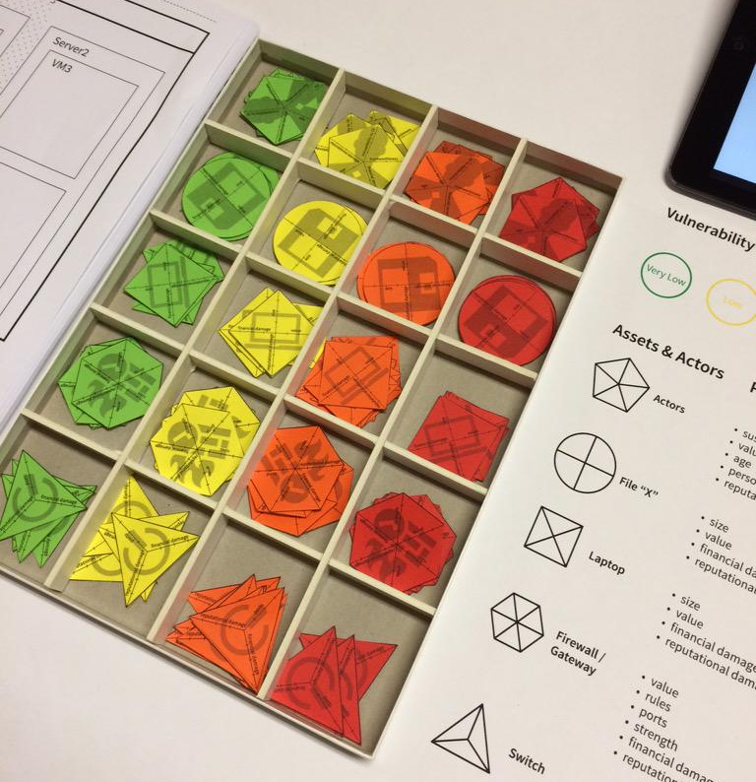
Cyber security = cyber risk management
Wolter Pieters & Jan van den Berg (TUD)
3TU cyber security specialisation kickoff

Slide 2
Problem: voting machine chip replacement

Slide 3
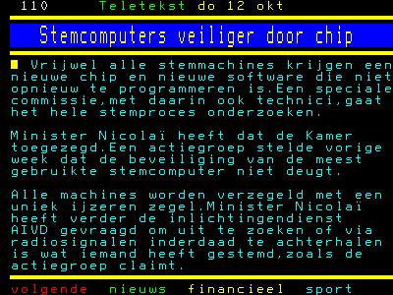
Proposed solution: seals & non-reprogrammable chips
Source: Teletekst / Wij Vertrouwen Stemcomputers Niet

Slide 4
Problem: Facebook invades users’ privacy

Slide 5
Proposed solution: more privacy settings
Hides users’ personal data from each other
But not from Facebook itself
Encryption? But what about the business case?

Slide 6
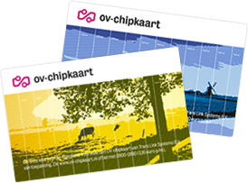
Problem: vulnerability in OV-chipkaart

Slide 7
Proposed solution: replace in 2 years time
“Limited gain for attacker” because fraud can be detected and stopped within 2 days
Individual fraud vs. business case for criminals

Slide 8
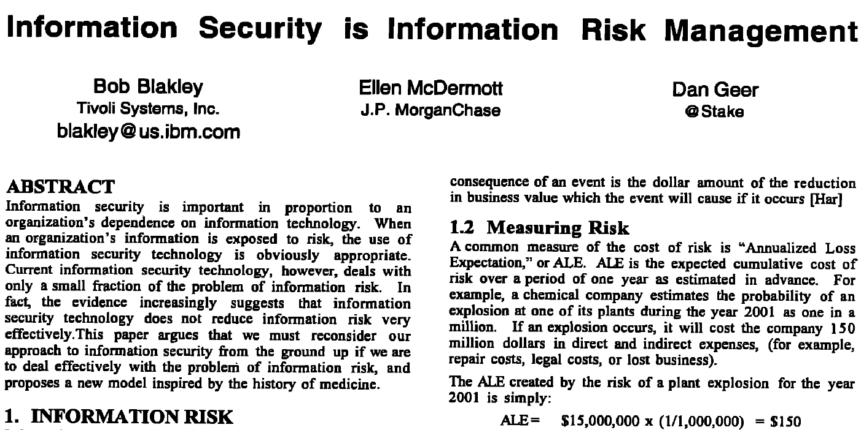
Back in 2001 (New Security Paradigms Workshop):

Slide 9
The big question
How do we evaluate which cyber security controls we should implement?
Preventive, detective, responsive

Slide 10
Risk mitigation
Wait until something happens
Checklists
Theoretical models
Evidence-based models

Slide 11
Return on security investment: effectiveness & cost

Slide 12
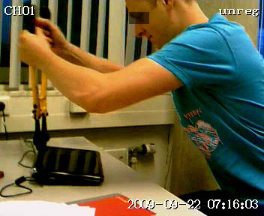
Traditional risk vs. adversarial risk

Slide 13
Attackers
Cryptographic assumptions: attacker cannot perform prime factorisation efficiently
Dolev-Yao: attacker controls the network, but cannot break crypto
Game theory: attacker maximises his utility
Goals, skills, resources, …

Slide 14
Scenarios / vulnerabilities
Exploiting digital weaknesses
Social engineering (e.g. phishing)
Physical access

Slide 15
Possible controls
More crypto
Hardening / patching
Locks / cards / biometrics
Training

Slide 16
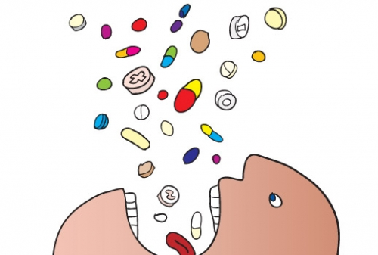
Factors
How to combine system, attackers and possible controls in making security decisions?
Can there be “evidence-based security” as there is evidence-based medicine?

Slide 17
Would you eat bananas?
“If you don’t eat bananas, you might be robbed”
(Herley & Pieters 2015)

Slide 18
Key takeaways
It’s not only about theoretical effectiveness of controls, but about their contribution to the system as a whole
Interesting achievements and challenges in measuring and predicting such contribution
See the upcoming courses!
CRM course: http://homepage.tudelft.nl/e7x9k/CRM/

