Slide 1
4TU.ResearchData
Repository service for FAIR data and software

Slide 2
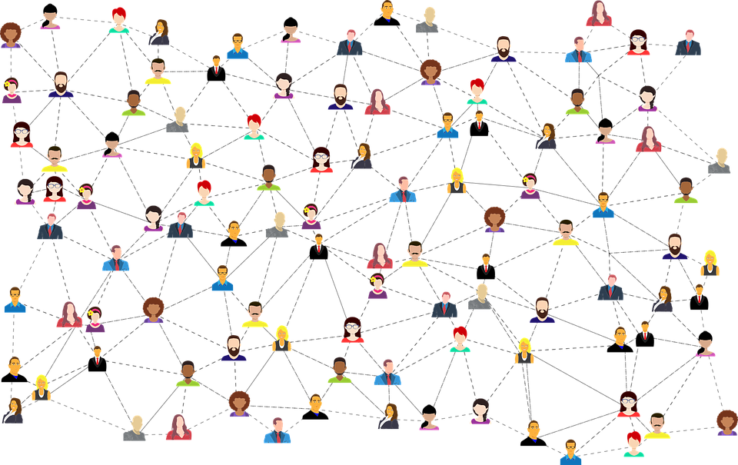
Repository for data and software from science, engineering and design
And a community around it

Slide 3
4TU.ResearchData Services and Activities
Data and software repository for science, engineering and design
Training - to teach skills needed for reproducible working with data and software
4TU.ResearchData Community - network of FAIR Data and Software leaders exchanging knowledge and practice
National and European Projects in Open Science
https://highlights.data.4tu.nl/highlights_2023

Slide 4

4TU.ResearchData Training
Teaching skills needed for reproducible working with data and software
Essentials for Data Support - key training for aspiring data stewards - as part of RDNL
Hands-on workshops for computational skills
Localised training at member universities (from October 2024)
  Tailored to university needs
  In person, once per year
  Full day
National training sessions – digital skills
  Spin-off of The Carpentries
  Software development
  Data management
  Online
Notes:
Currently, we have essential data support and hands-on workshops for computational skills. We can also add localized regional training—one training per year at each university, starting in October 2024. This training will be tailored to each university’s needs and will be in person. We will also offer a series of national training sessions, which will be spin-offs of the Carpentries. These will focus on software development and data management, covering topics like coding with Git and using Python. These national training sessions will be online and open to everyone from the four technical universities.
The Carpentries teaches foundational coding and data science skills to researchers worldwide.

Slide 5
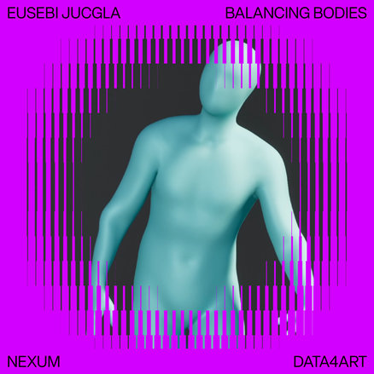
4TU.ResearchData Community
Network of FAIR Data and Software leaders exchanging knowledge and practice
Thematic Working Groups
  Six months
  AI Act Working Group
Engagement
  New Technical Community Manager to better connect
  repository and community
Events and Workshops
  Annual roadshow – next stops TU Eindhoven 20 June/WUR 17 Oct
  Community Day (September)
  Artistic projects May 30 - June 2
  V2_lab for Unstable Media
  Rotterdam
FAIR Data Fund – up to 5000 euro
Programme nexumdata4art.com
https://community.data.4tu.n
Notes:
Regarding the community, we have one active working group on the AI Act (Recommendations for managing AI-related academic projects).
Working groups are thematic, last six months, and welcome all members from the four technical universities. Each group produces an outcome, such as a report or recommendations. Ideas for working groups come from a survey sent to members. Based on the survey results, we selected the AI Act working group and will use the survey for upcoming groups in 2025.
Currently, Alex, the technical community manager, is bridging the gap between the community and the repository. We are working together to raise awareness about the repository within the community, particularly partner universities, and vice versa.
Roadshow on June 20th in Eindhoven, centered around a "bring your own dataset and software" theme, with a demo day for the repository.
We had a project translating datasets into artworks and performances to make data understandable to the broader public. While we are still planning for next year, you can mention this as an example of our community engagement activities.
We offer an annual funding opportunity called the FAIR Data Fund. The call opens in October, and winners are selected by year-end. The fund supports researchers in making their datasets and software FAIR, providing up to 5000 Euros for this purpose. We highlight the winners on our social media and support them at conferences.

Slide 6
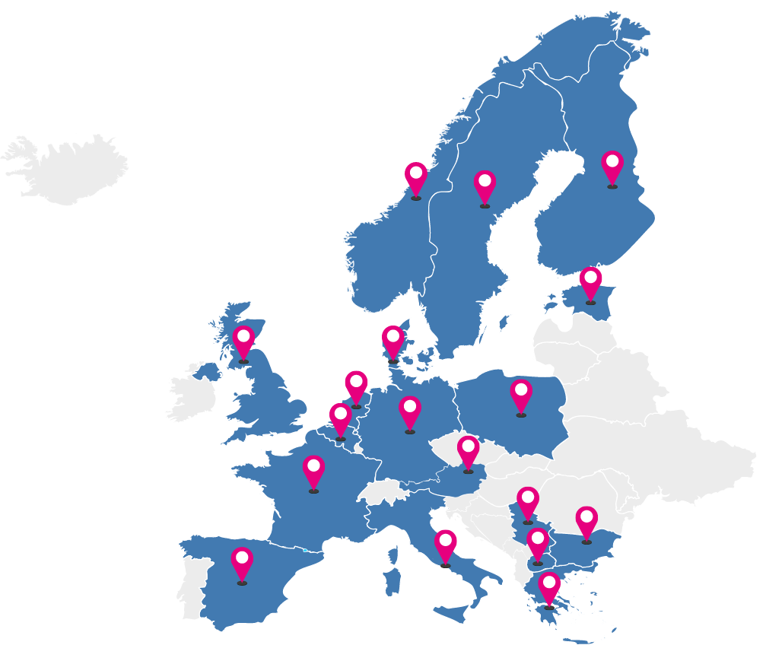





4TU.ResearchData Projects & Collaborations
Skills4EOSC – Skills for the European Open Science Commons
  Lead institution Work Package 6
  New RDM/Data Steward Networks
  New Open Science Communities
  Fellowship Programme for OS/Data Professionals
  FAIR Practices for AI and Health Technology Research
  Curriculum for Data Stewards Training
National Collaborations
  RDNL
  Nikhef
  eScience Center
  TDCC NES
Notes:
Nikhef’s institution repository is based on Djehuty.
Integrate software published at 4TU.ResearchData with the Research Software Directory

Slide 7
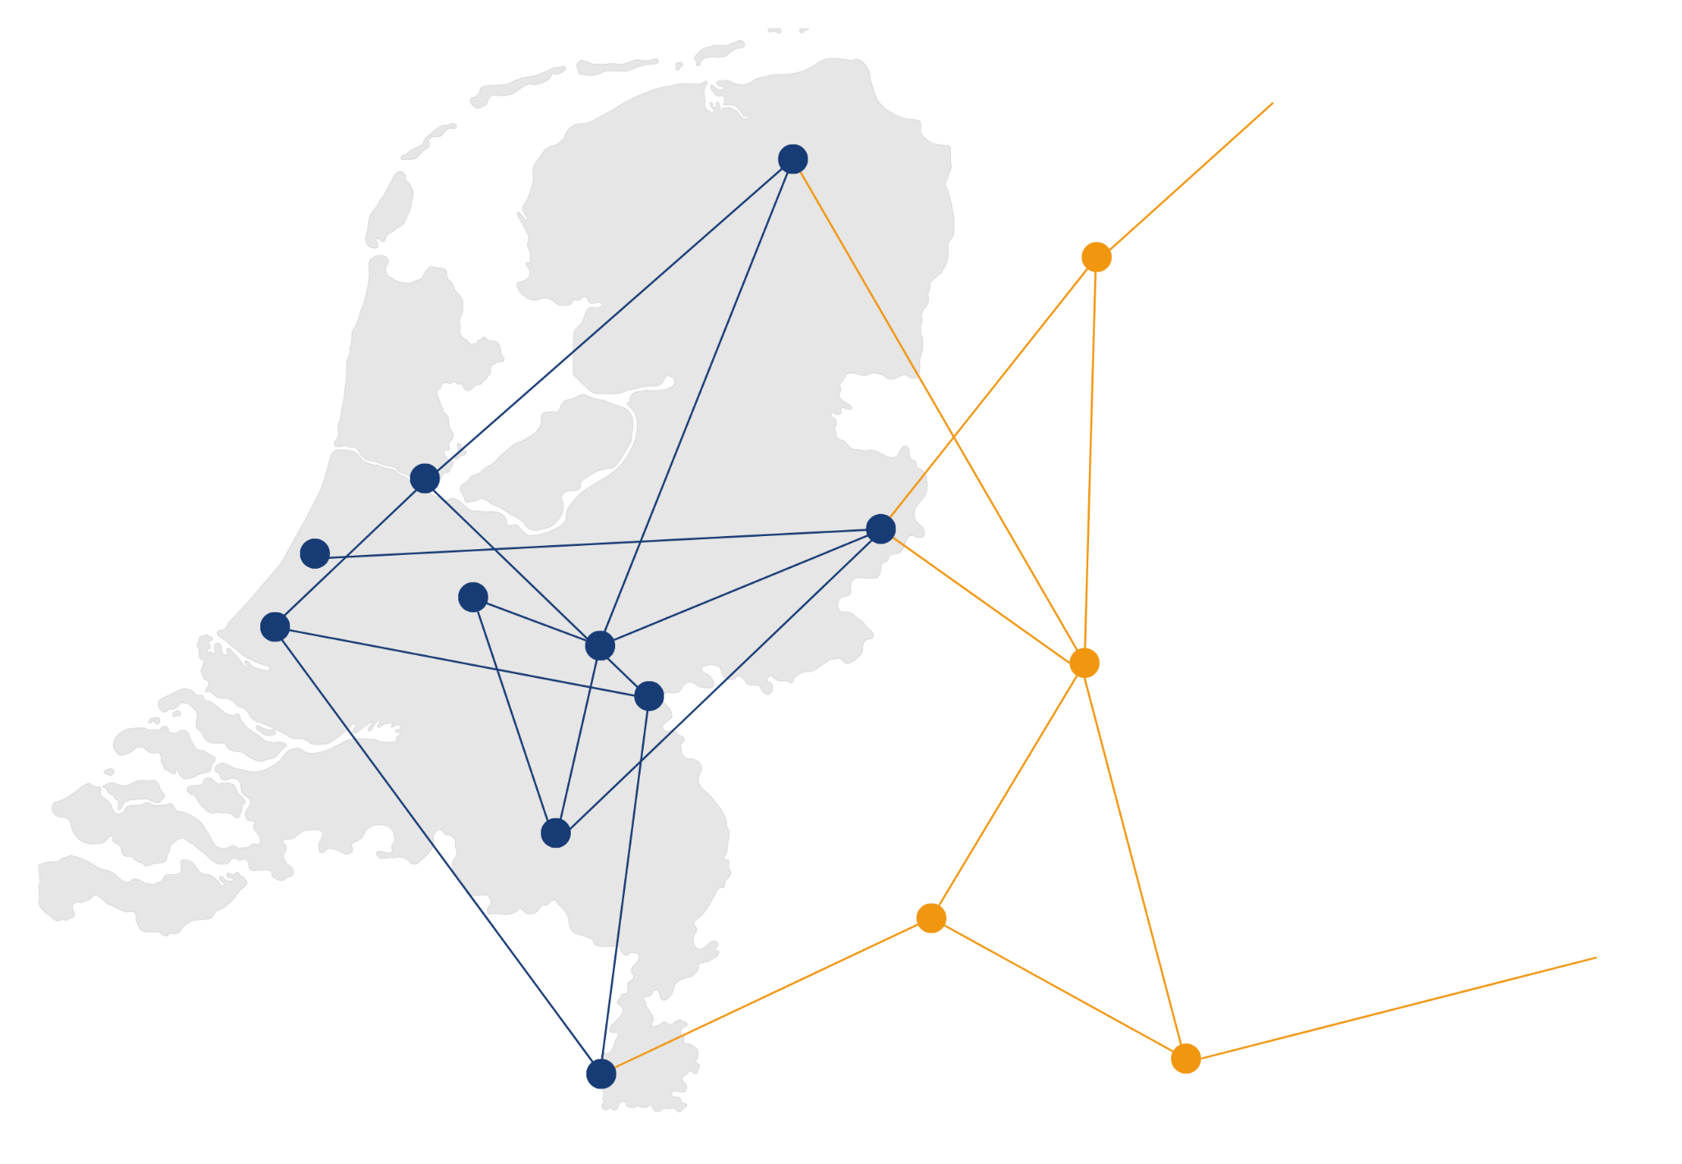

Thematic DCC for Natural & Engineering Sciences
Unique challenges within
Natural & Engineering Sciences
Building networks to encourage new ways of doing research
Open call for proposals - 800 k€ per year
2023-2024 call currently open
Extremely large datasets
Building (and funding)
collaborative projects
Research software sustainability & preservation
Fragmented landscape, needs international connection
Knowledge exchange between academic and support roles
Need for increased human capital & better connection between researchers & support
Cross-field collaborations
Need for improved FAIRness of data
Connections with international initiatives
and more …
tdcc.nl/nes
Notes:
Thematic Digital Competence Centre for NES is a 10 year long programme funded by the Dutch Research Council (NWO) and housed at 4TU.RD, with the aim to build networks that encourage new ways of doing research. It has a focus on digital competences related challenges specific to the NES domain – for example extremely large datasets, sustainability of research software and many more. We tackle these challenges by promoting knowledge exchange between academic and support roles, cross-field collaborations so that best bractices can flow between disciplines, and connections with international initiatives. We also build and fund collaborative projects related to these topics. We have 800k EUR yearly for project calls, and we currently have a call for project ideas open until 15 September 2024. - more info via the link.

Slide 8
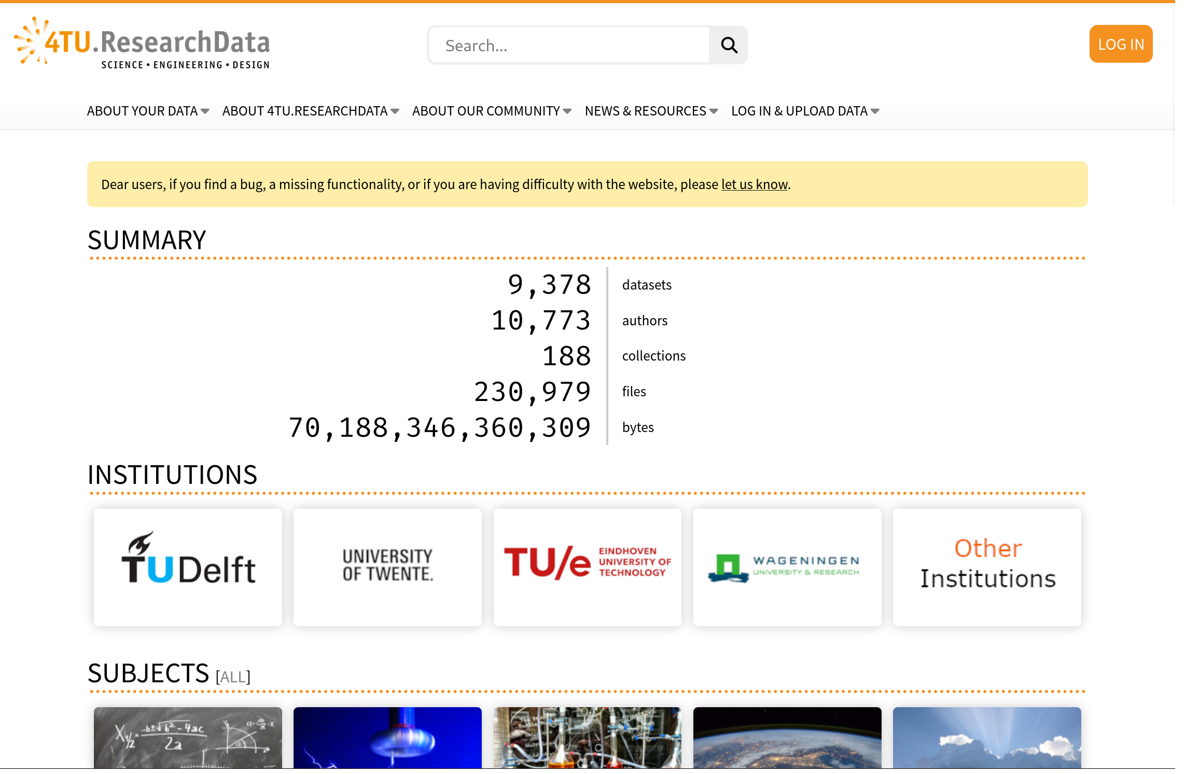

4TU.ResearchData repository service
https://data.4tu.nl

Slide 9
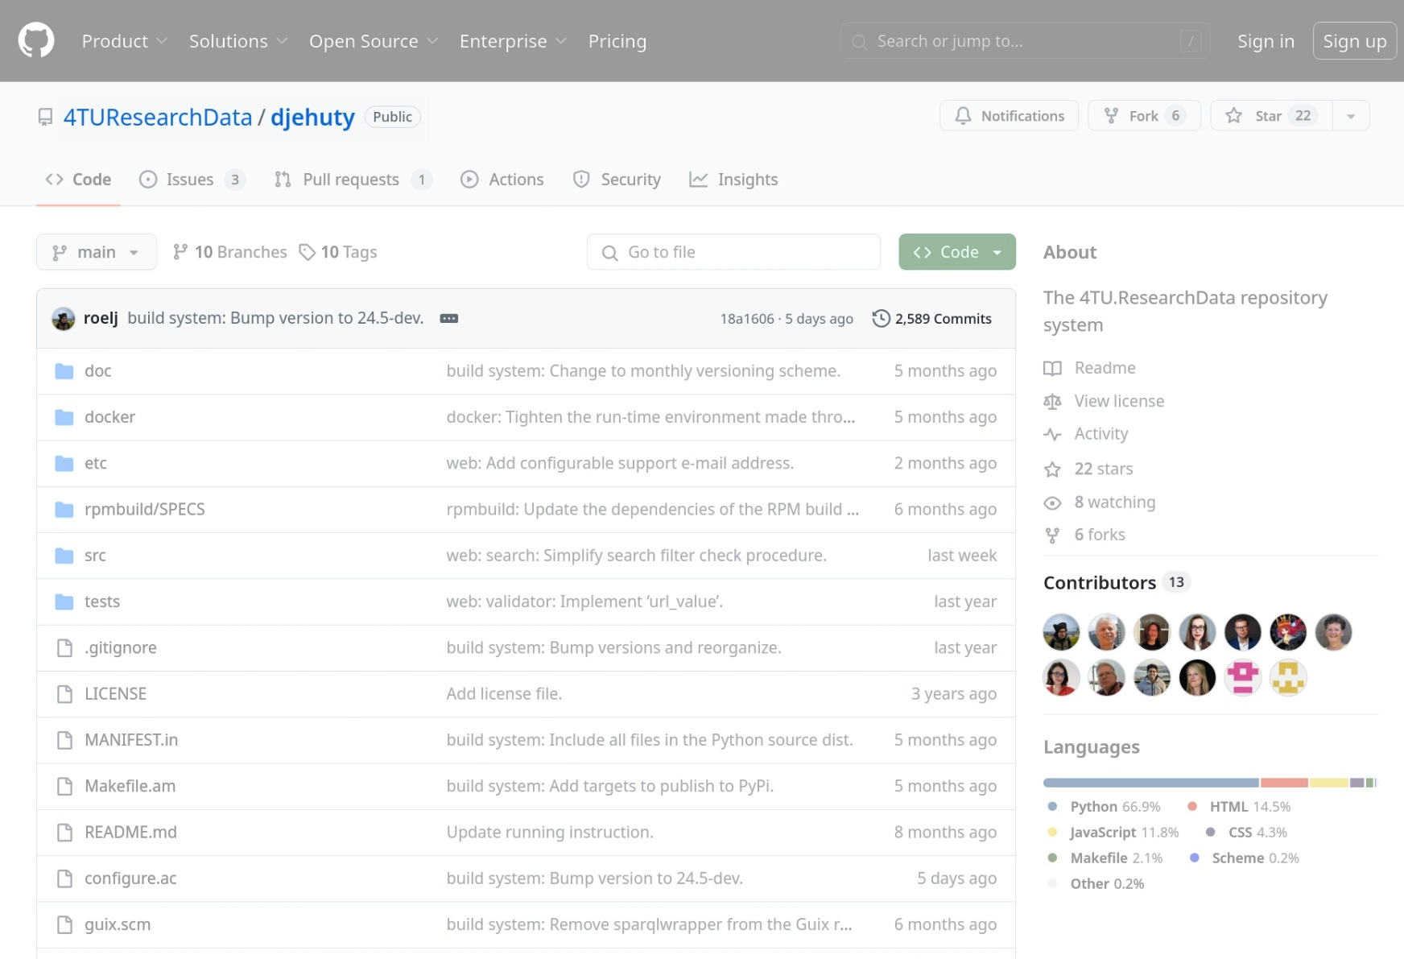
Free and Open Source Software
https://github.com/4TUResearchData/djehuty

Slide 10
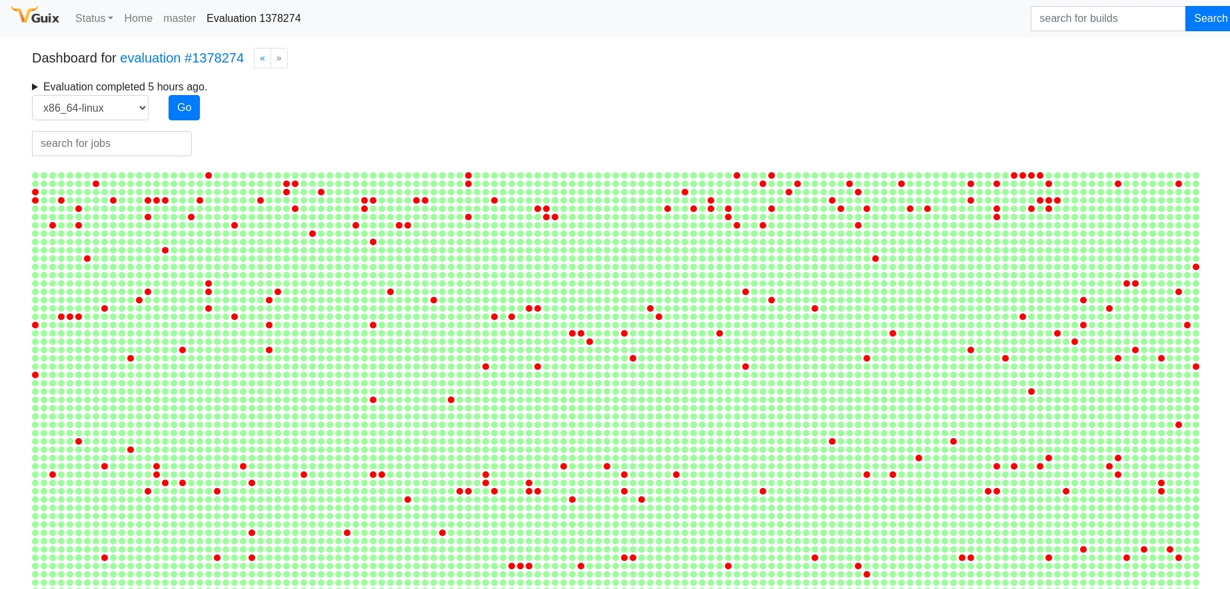
Part 1: Envisioned software reproducibility service
Purely Functional Deployment Model
Limited to Free and Open Source Software operating systems only

Slide 11
Part 2: Enhanced deposit workflow for ML/AI datasets
Add metadata fields to capture provenance, ethical (re)use
Assign review criteria to assess the metadata during the curation process

Slide 12
Part 3: Compliance to the EU AI Act
Determine criteria to quantitatively score a model on (based on Model Cards for Model Reporting (Mitchell et al, 2019))
Categorize the model on its risk/impact
Provide a badge for the dataset publication with the scoring and risk assessment

Slide 13
Call for action
We are open to discuss and collaborate on ANY part of the plan
Talk to us: researchdata@4tu.nl

Slide 14
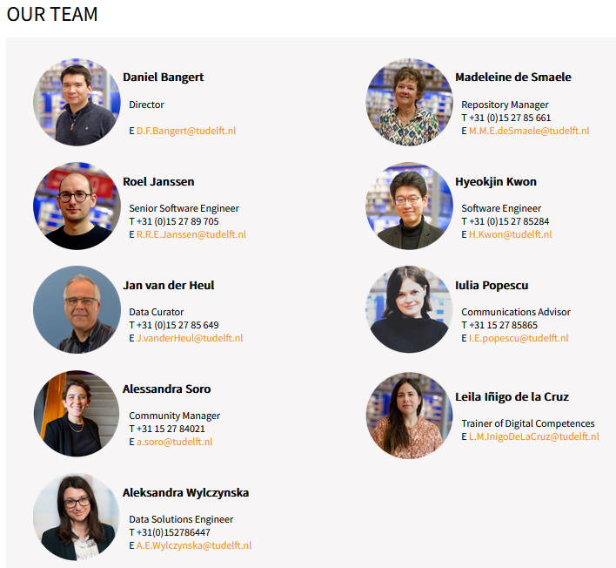
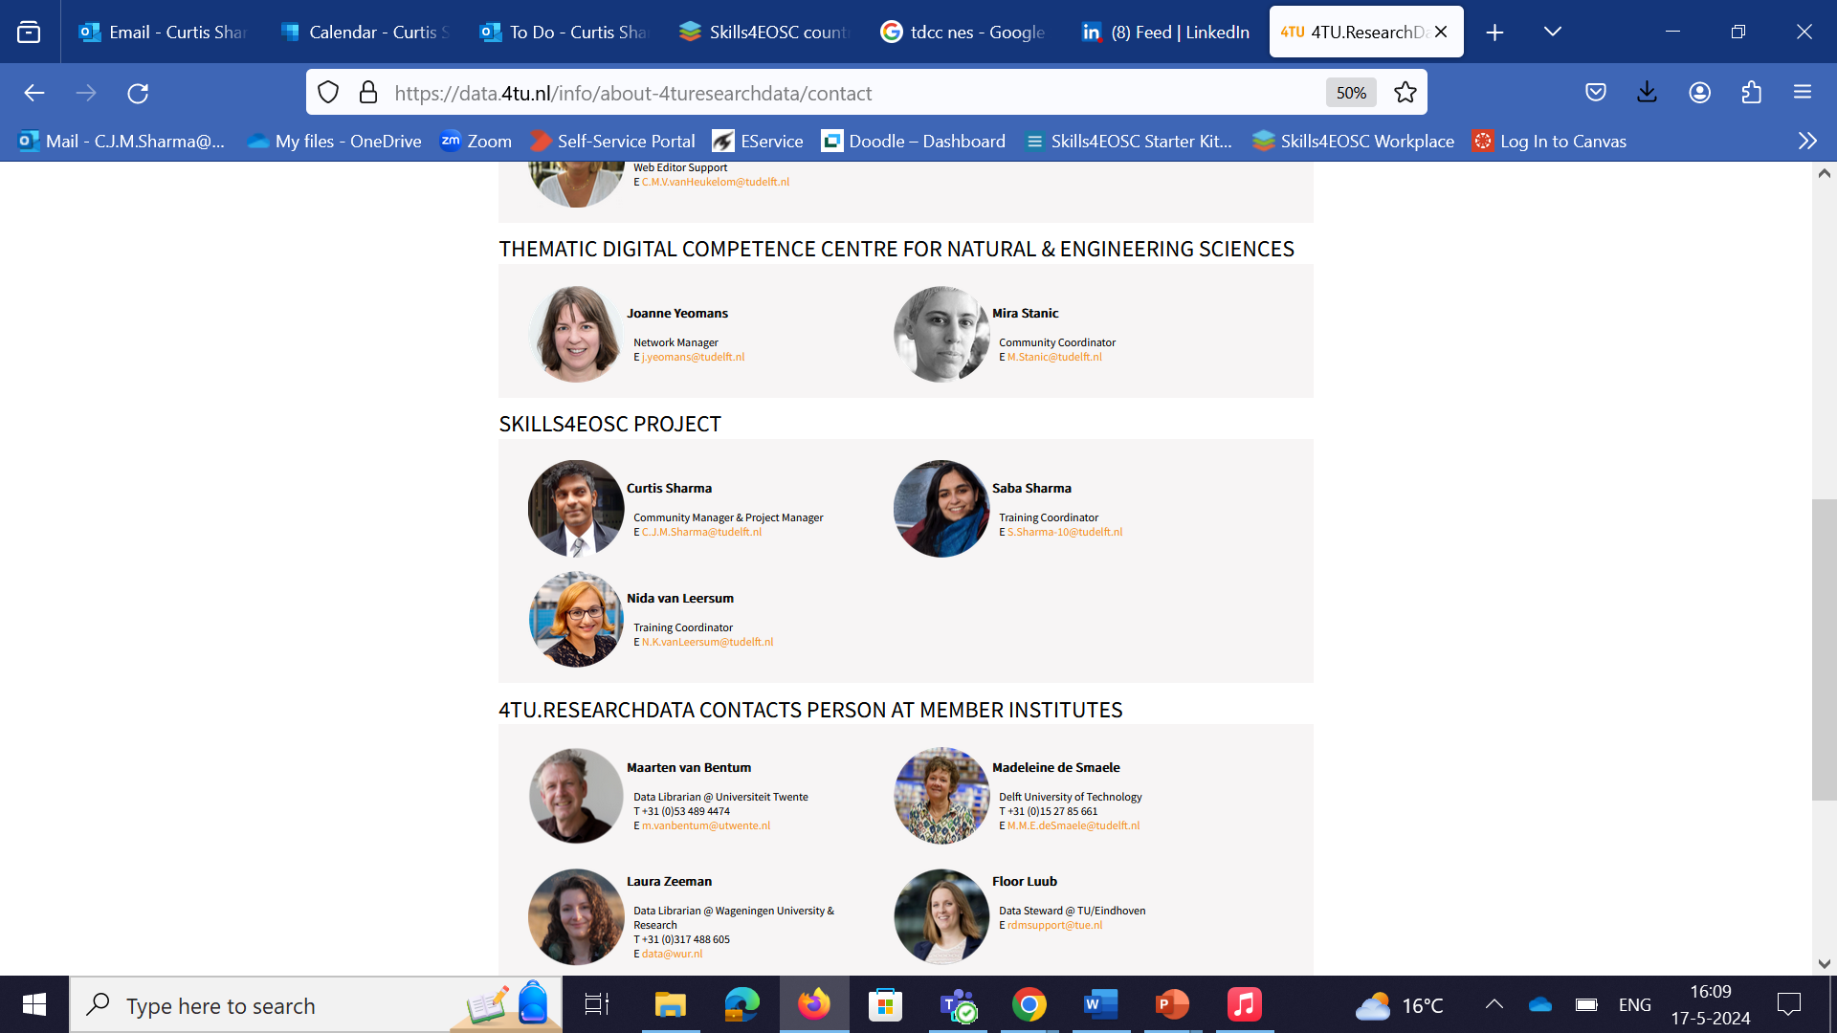
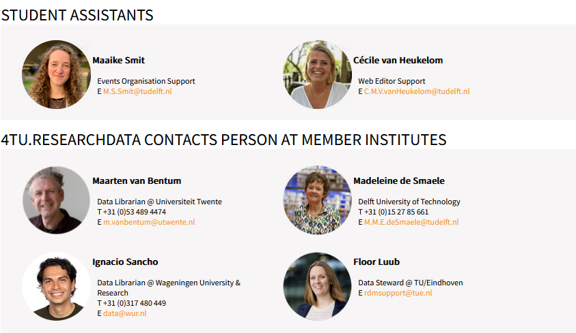
4TU.ResearchData Team

Slide 15

Thank you!
Madeleine de Smaele
Roel Janssen
researchdata@4tu.nl
@4TUResearchData

