Slide 1
Engineers in a global context
Integrating Stimulating learning approaches in a USE learning line

Slide 2
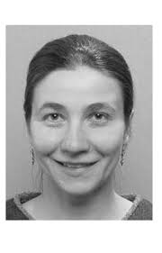



Who are we?
Johanna Höffken (Innovation Sciences -TIS);
Annelies Bobelyn (Industrial Engineering –ITEM);
Madeleine Gibescu (Electrical Engineering);
Masi Mohammadi (Built Environment)

Slide 3
Aim & Justification
Our project aims to explore and implement stimulating learning approaches, which link and integrate university education with the broader context.
Educate ‘T-shaped’ engineers:
students’ ability to communicate and collaborate not only across but also beyond their disciplinary and cultural boundaries.
Student’s ability to (inter)act with(in) a broader, transdisciplinary practice-context.

Slide 4
What we will do
Identify relevant approaches
In which:
university education “is taken to the outside context”
  visiting companies, societal organizations and/or government authorities
  working on assignments (co-)designed with external actors
the outside context is “brought inside the university”
Identify relevant forms of assessment
Integrate insights in a USE learning line on globalization (Engineers in a global context)

Slide 5
Expected outcomes
Students:
can communicate and interact with experts from outside the university;
Learn how to deal with diversity in practice
understand the relevance to consider the context when designing technology solutions;
account for/take up the insights gained through this context-exposure and interaction in their work/assignments.
Higher engineering education:
identify and underpin specific learning approaches of university-context education;
Identify assessment forms
reflect on changing roles and requirements of teachers aiming to apply these learning approaches in their education.

Slide 6
THANK YOU for your ATTENTION

