Slide 1
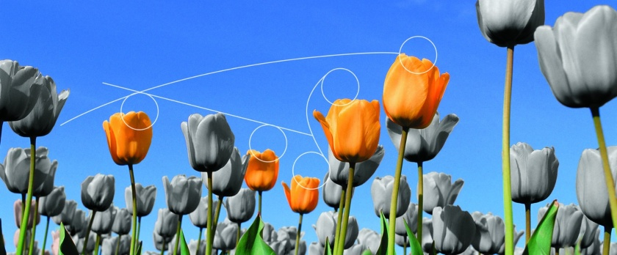

4TU.CENTRE FOR RESILIENCE ENGINEERING
Subtitle

Slide 2
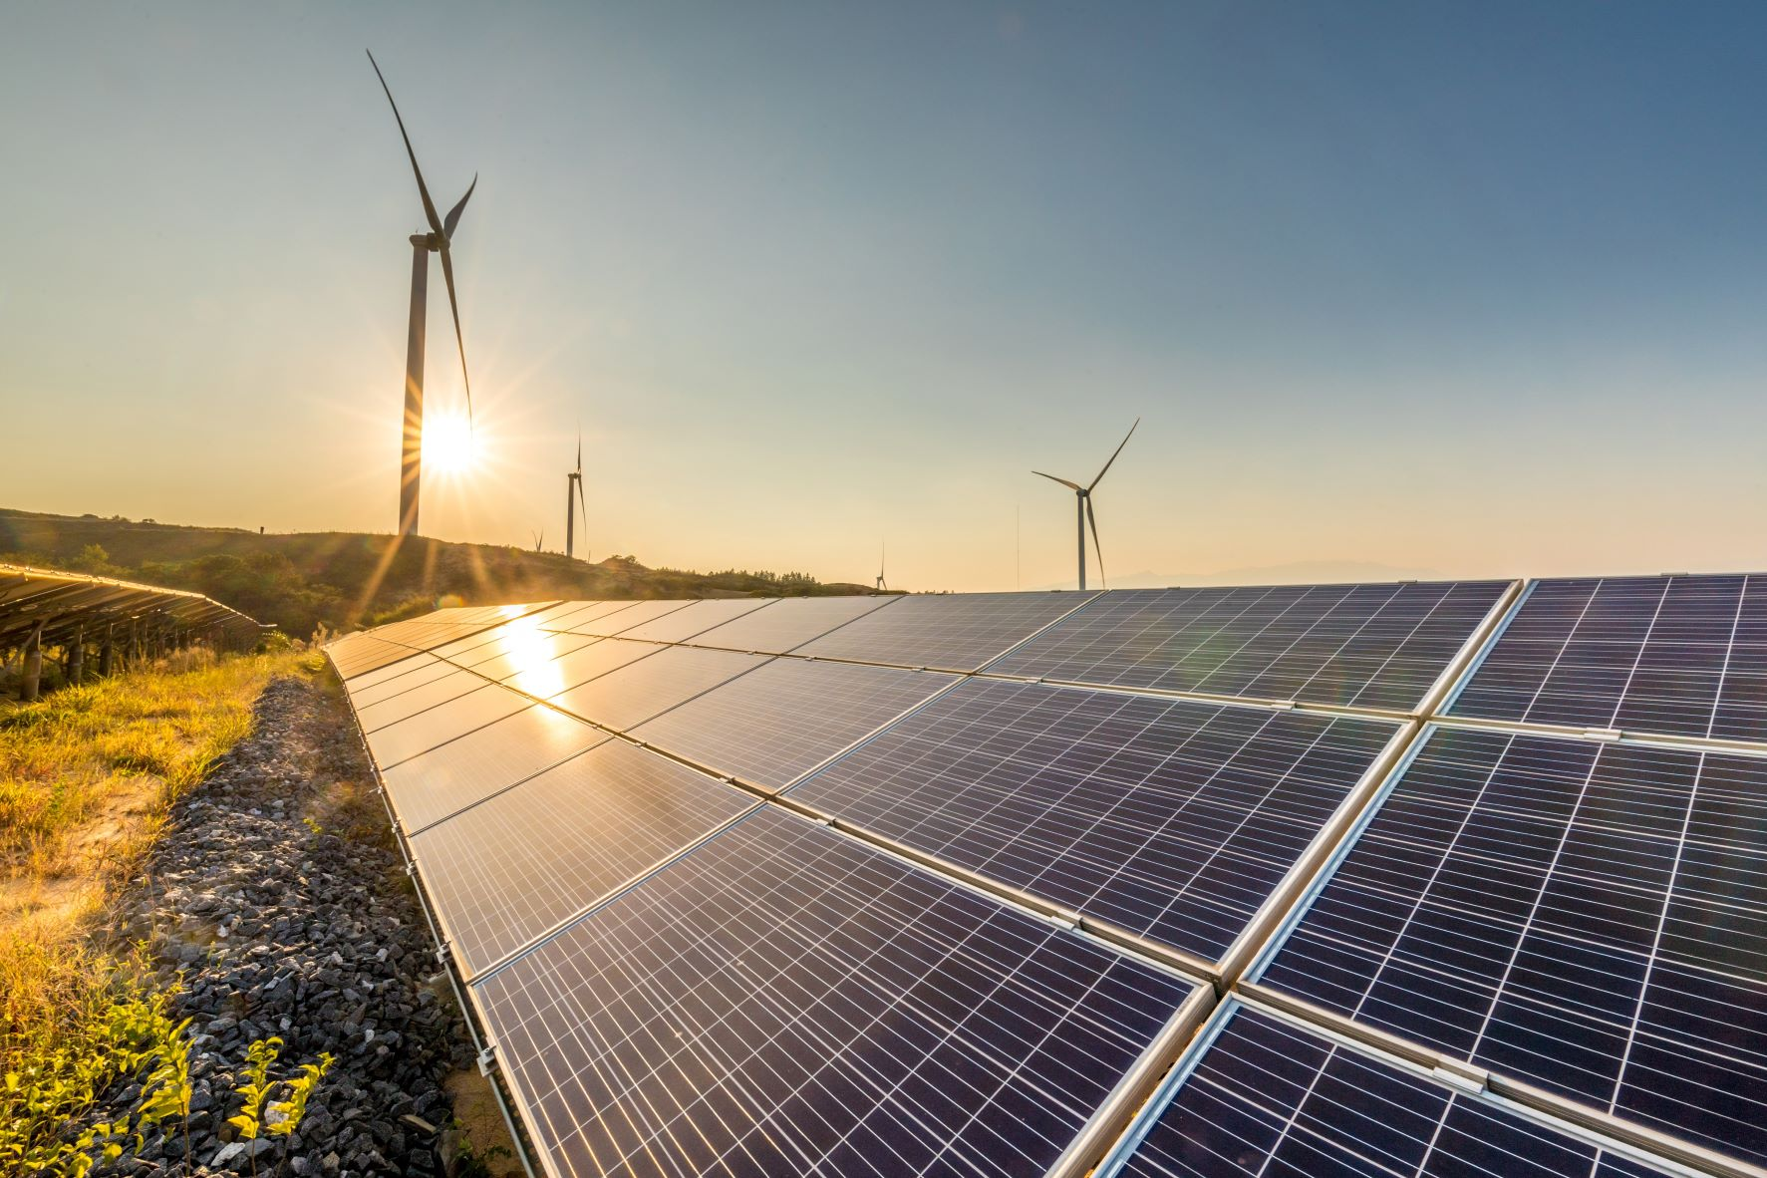
4TU Centre for Resilience Engineering
Introduction
Knowledge centre in Resilience Engineering
Initiative of the four universities of technology in the Netherlands:
Delft University of Technology; Eindhoven University of Technology;
University of Twente; Wageningen University & Research
We develop, apply and disseminate knowledge, methods and tools for making societies more resilient
We focus on engineering solutions (technical solutions and system designs) in interaction with social-ecological systems

Slide 3

Let’s start at the beginning
Resilience
The capacity of a system to sustain its functions and become better (through absorbing, adapting and self-organizing) under conditions of chronic stresses, abrupt shocks or disruptive innovations
Resilience Engineering
Making social-technological systems more resilient in situations of chronic stresses, abrupt shocks or disruptive innovations

Slide 4
Our aim
Improve the resilience design of increasingly networked systems
Measure, quantify and model resilience
Better coordinate and govern resilient social-technological systems

Slide 5
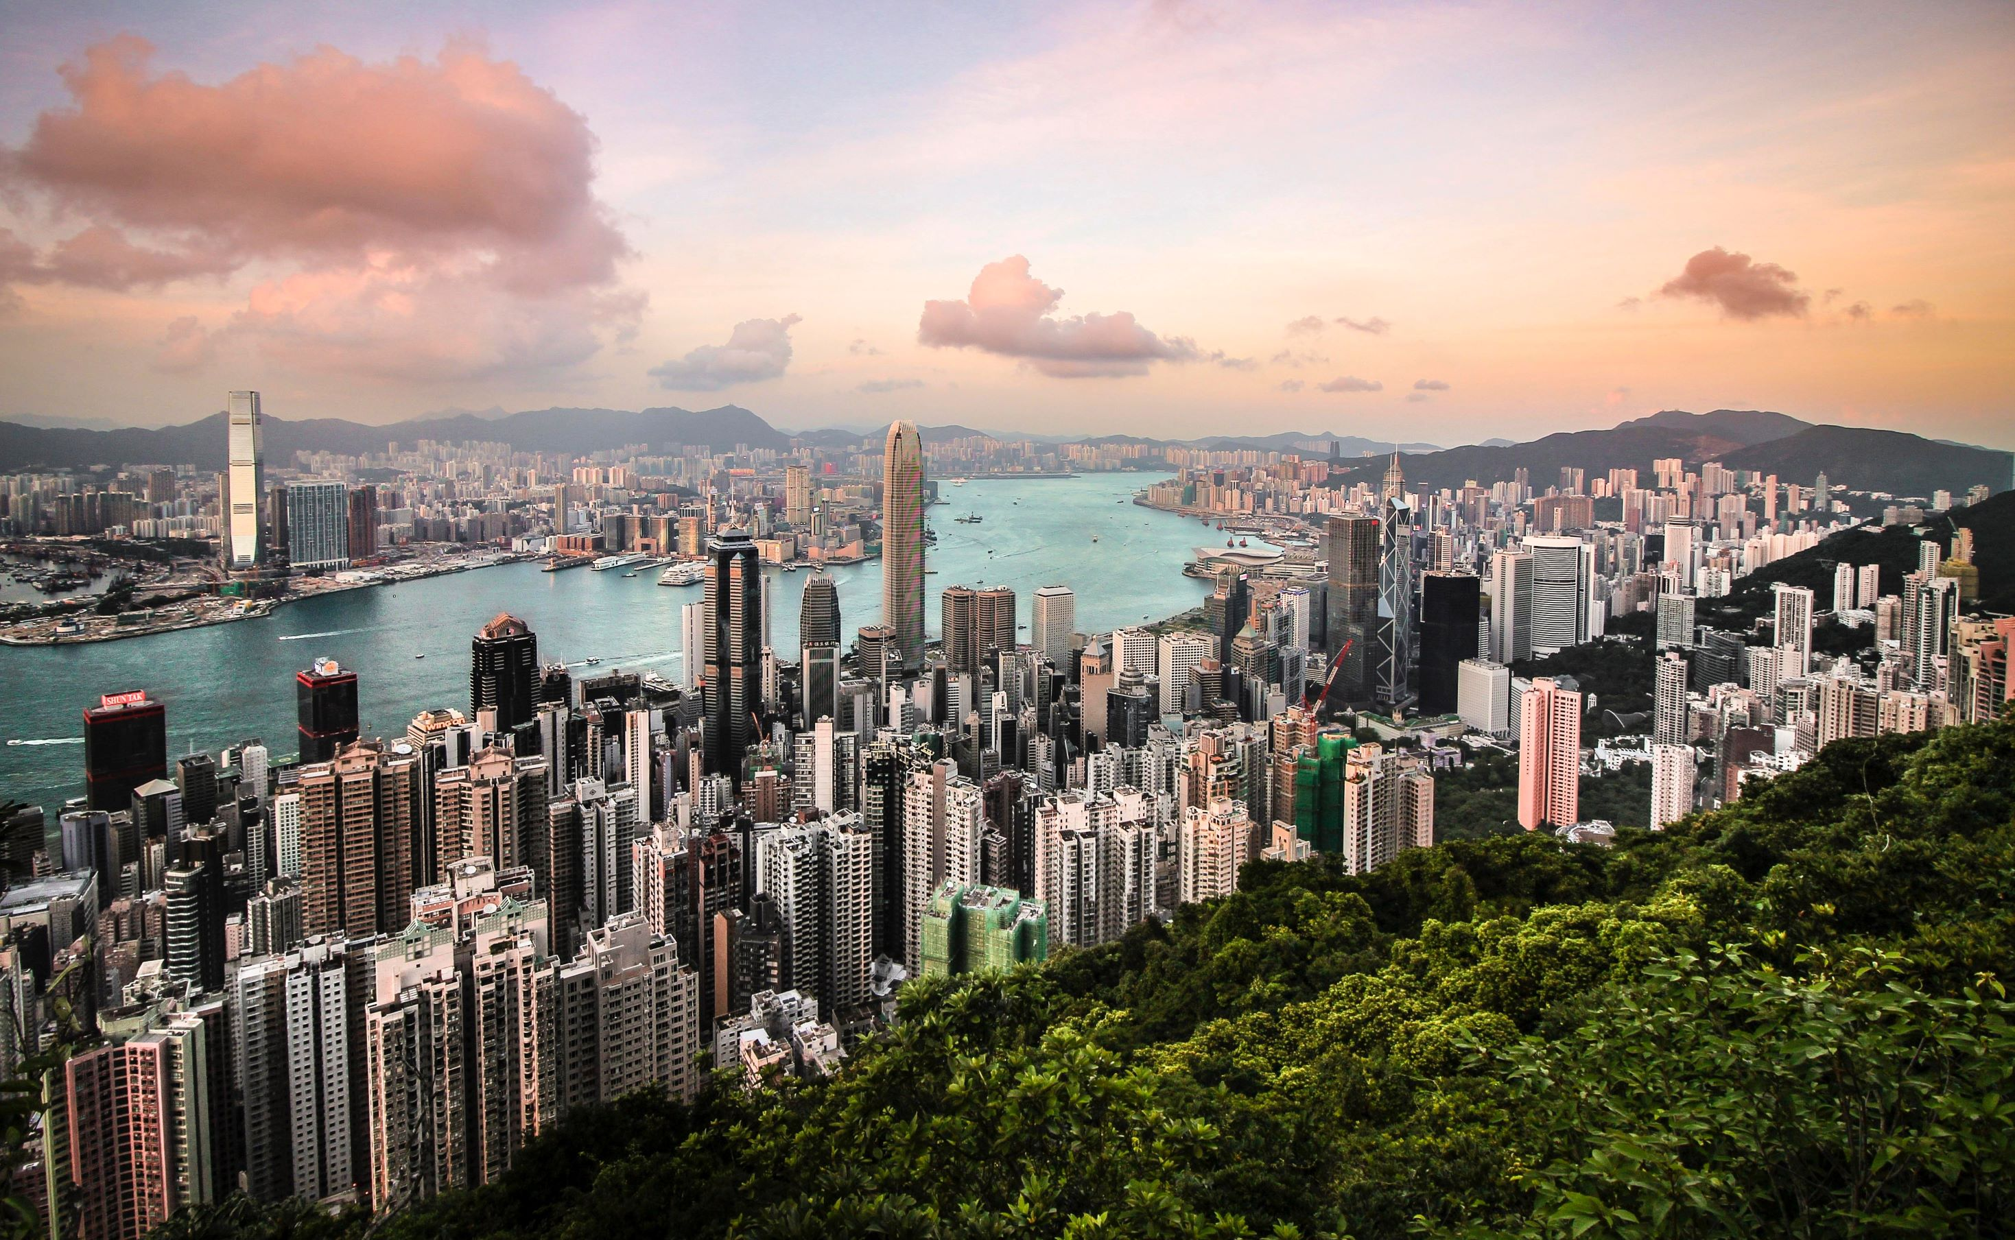
Our motivation
Technological and social developments are advancing at a rapid pace
We are highly interconnected through networks
Climate change forces us to mitigate and adapt, leading to major transitions of the energy, transportation, water, or food systems
Throughout these transitions, societies are confronted with incidents, crises and disasters
How do we deal with this? How can a city for example cope with prolonged heat stress? Or with a terrorist attack? How does farmland bounce back better after a flood?

Slide 6
Our motivation
Our social, technological and environmental systems are vulnerable, and highly connected
Collaboration between different resilience research areas is therefore essential and necessary
4TU Centre for Resilience Engineering:
Brings the expertise of different scientists and engineers together
Wants to anticipate the grand challenges societies will be facing
Focuses on engineering in interaction with social-ecological systems

Slide 7
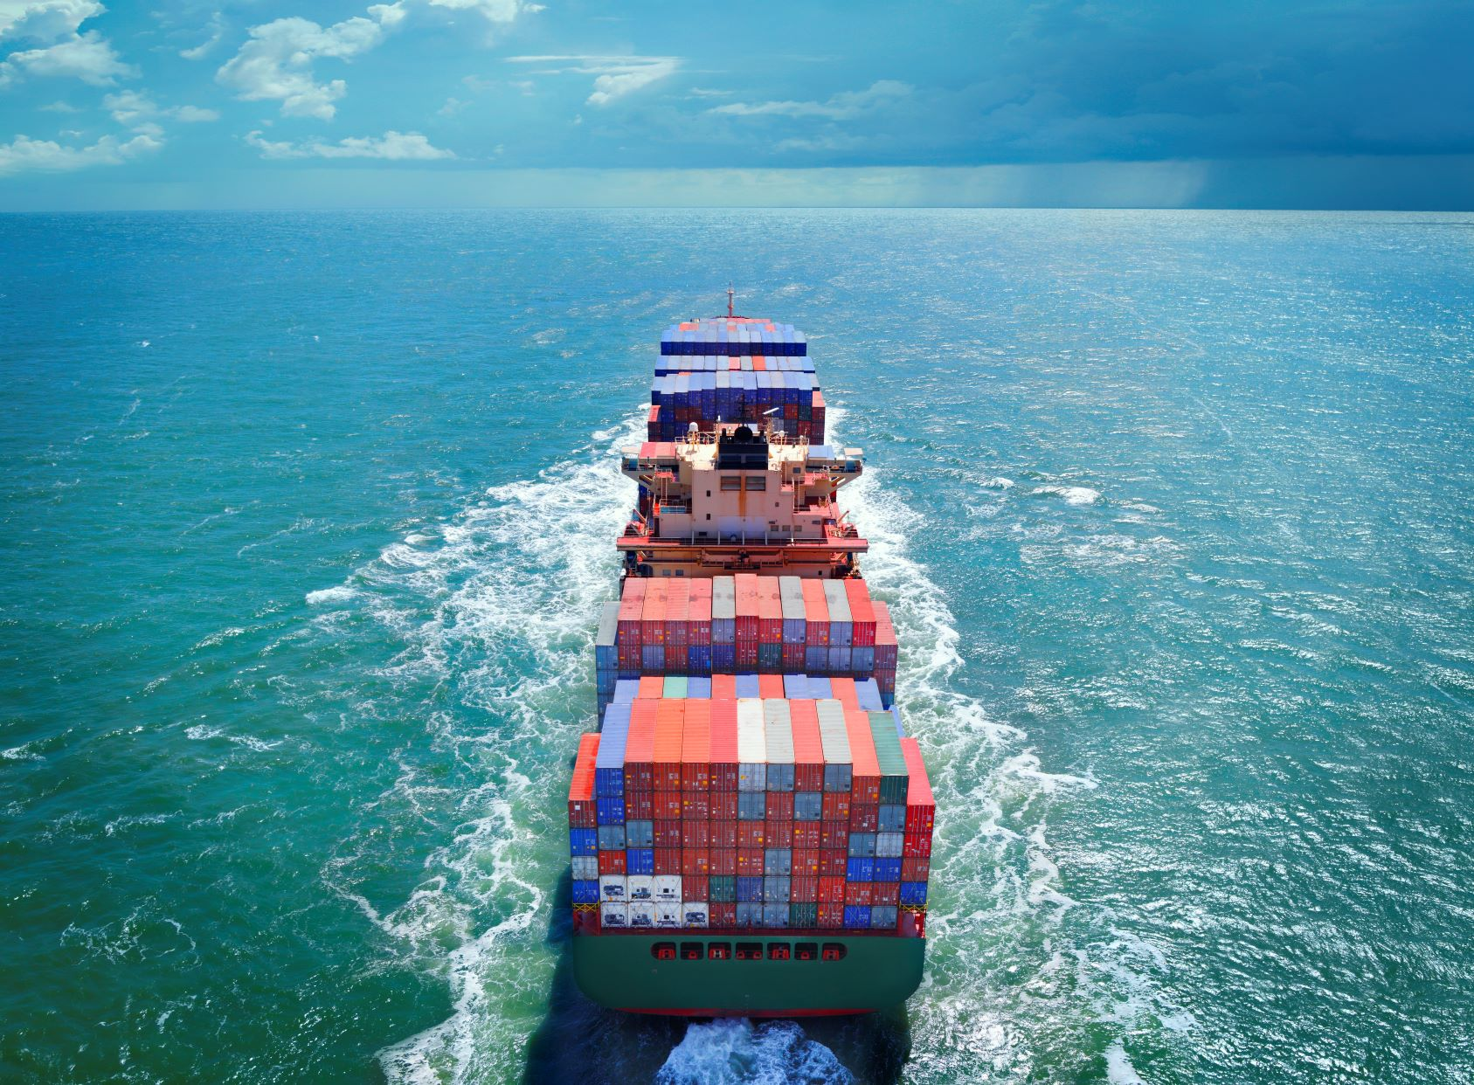
Our ambition
Become an international leading knowledge centre in Resilience
Engineering
Create and facilitate a Resilience Engineering movement
  Create awareness around resilience
  Make resilience an important fundamental principle for system design
  Make resilience an essential starting point for the governance of
  these systems

Slide 8
Our mission
Bring scientist and engineers from different research areas together to develop, apply and disseminate knowledge, methods and tools for making the complex technological systems in societies more resilient.

Slide 9

Our organisation
4TU.RE connects resilience experts from the four technical universities in the Netherlands

Slide 10
Our people
Managing Director:
Stephanie Hessing (UT) Managing director for the 4TU.Resilience Community
Board:
Geert-Jan van Houtum (TU/e) Maintenance Optimization, Reliability, Inventory Models
Stefan Aarninkhof (TU Delft) Coastal Engineering, Director of the Foundation EcoShape
Freek van der Meer (UT) Geothermal Energy, Earth Resources
Scientific steering group:
Tina Comes (TU Delft) Decision sciences, AI, Resilience, Humanitarian Disasters
Stephanie Hessing (UT) Managing director for the 4TU.Resilience Community
Maria Pregnolato (TU Delft) Hydraulic Engineering, Hydraulic Structures and Flood Risk
Ahmadreza Marandi (TU/e) Mathematical Optimization, High-tech Systems and Supply Chains
Remco Dijkman (TU/e) Data-driven Optimization of Business processes
Miranda Meuwissen (WUR) Risk Management, Resilience, Food Supply Chains
Maximilian Koppenberg (WUR) Economics and Resilience of Future Food Supply Chains
George van Voorn (WUR) Operational Measures for the Assessment of Resilience and Sustainability
Joanne Vinke - de Kruijf (UT) Climate Adaptation, Water Governance, Droughts

Slide 11
Our people
External Strategic Advisory Board:
Lilian van den Aarsen Ministry of I&W
Reintje van Haeringen CARE-NL
Sabrina Helmyr Arcadis
Hans Hilbrands Stichting Pioneering
Arnoud Molenaar Square Floating City
Stefan Nijwening Dutch Water Authority Vechtstromen
Elisabeth van Opstall NG Infra
Henk Ovink Kingdom of the Netherlands, Special Envoy for Int. Water Affairs
David van Raalten Hoogwaterbeschermingsprogramma (HWBP)
Theodoor van der Klaauw IBM Global Business Services
Inge Vianen CARE-NL, Climate Change & Resilience
Erik Roeten Director IT non-life insurance (ACHMEA)

Slide 12

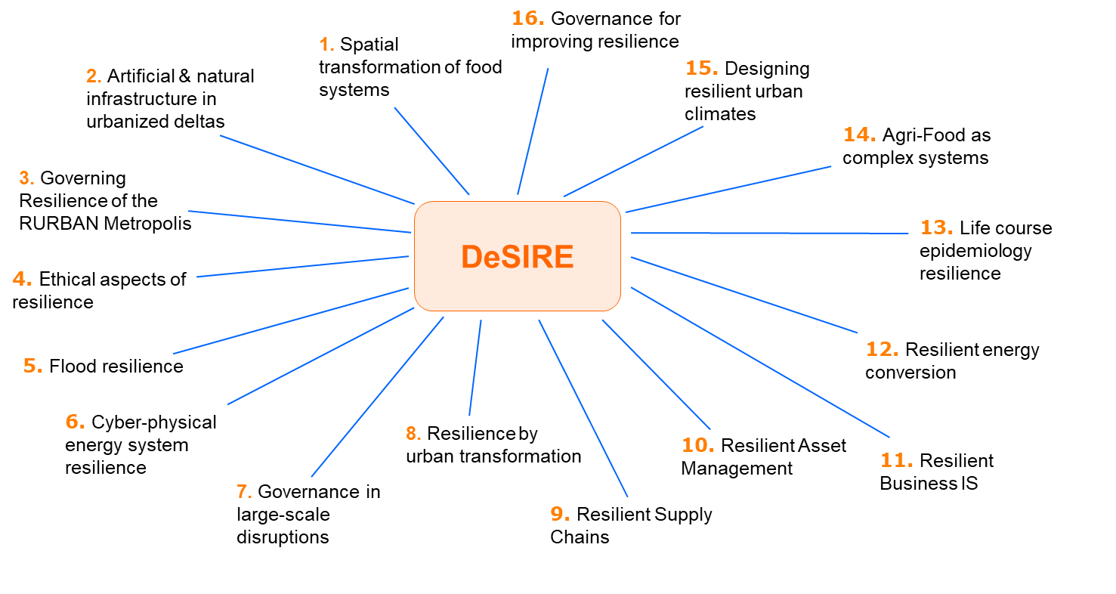
Our research
2018 – 2023 4TU.DeSIRE
DESIGNING SYSTEMS FOR INFORMED RESILIENCE ENGINEERING
Large scale, interdisciplinary research and capacity building program
4 universities
14 faculties
20 postdocs
17 tenure trackers
50+ resilience fellows

Slide 13
Our research
2023 and beyond
Nexus approach to system thinking
Based on the expertise of:
4 universities
14 faculties
20 postdocs
17 tenure trackers
50+ resilience fellows

Slide 14
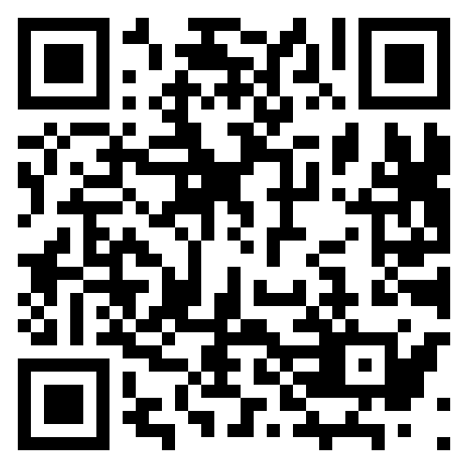
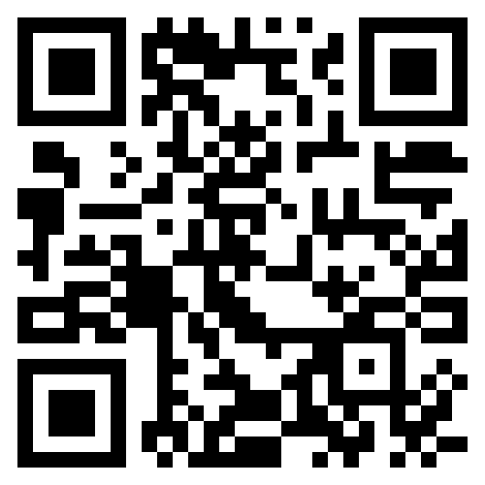
Any questions?
Thank you for your attention!
Follow us on LinkedIn
Visit our website and sign up for our 3-monthly newsletter

