Slide 1




Structural health monitoring of inland navigation structures
by Rolands Kromanis
r.kromanis@utwente.nl
Horst Room Z230
Structural health monitoring for smart infrastructure
Notes:
Designing Systems for Informed Resilience Engineering

Slide 2
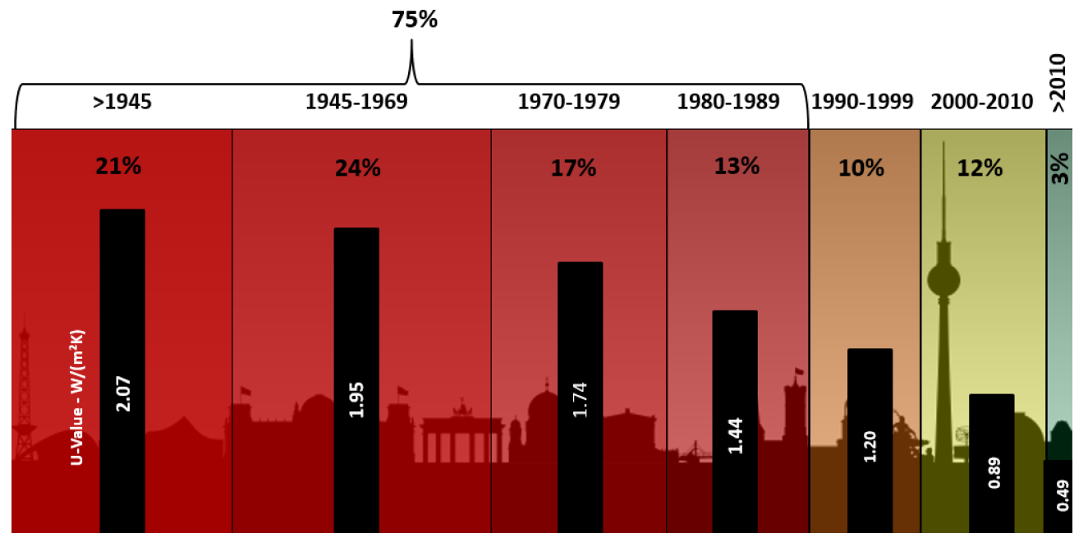
Current state of civil infrastructure
Aging infrastructure – buildings (residential/non-residential)
Source: EU Building Stock Observatory

Slide 3
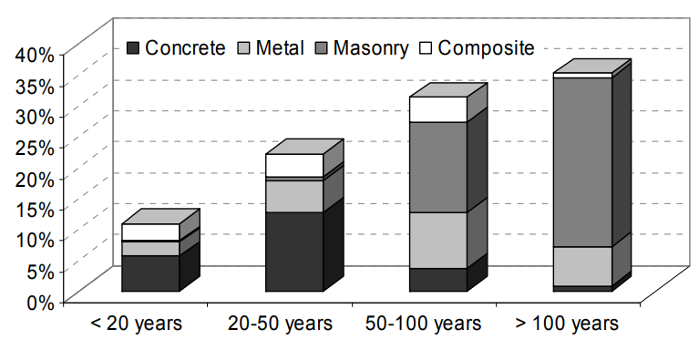
Current state of civil infrastructure
Aging infrastructure – railway bridges
Source: Guideline for Load and Resistance Assessment of Existing European Railway Bridges

Slide 4
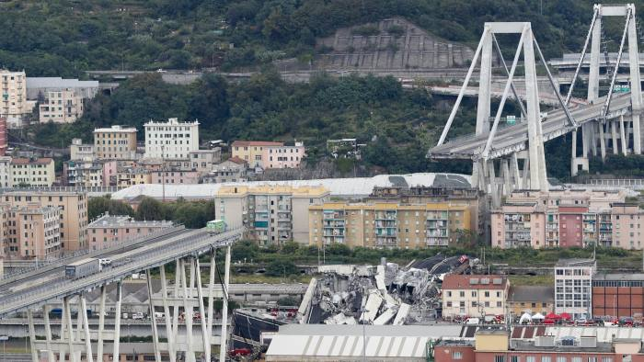
How do structures perform?
(Financial Times, https://www.ft.com/ [Accessed, Oct-2022])

Slide 5

How do structures perform?
(Norway Posten, https://www.norway.posten.com/ [Accessed, Oct-2022])

Slide 6
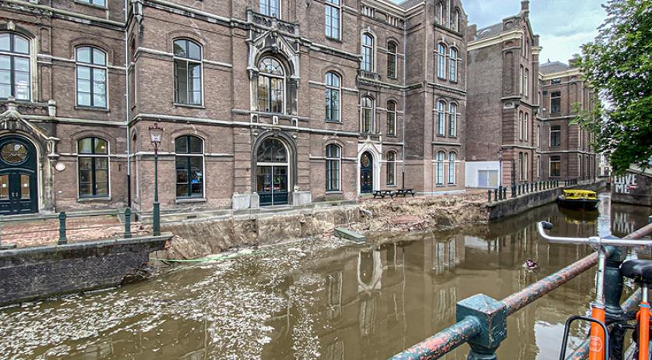
How do structures perform?
(NL Times, https://nltimes.nl/, [Accessed, Oct-2022])

Slide 7

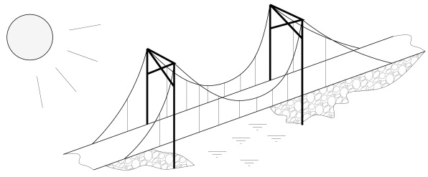



Structural health monitoring
Structural monitoring
Structural system
Structural condition/performance

Slide 8
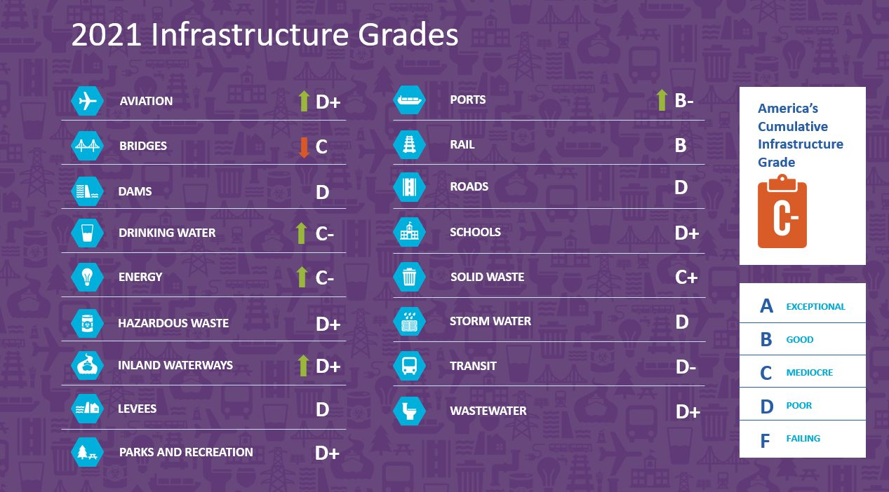
Condition of structures and investments
ASCE report card 2021

Slide 9
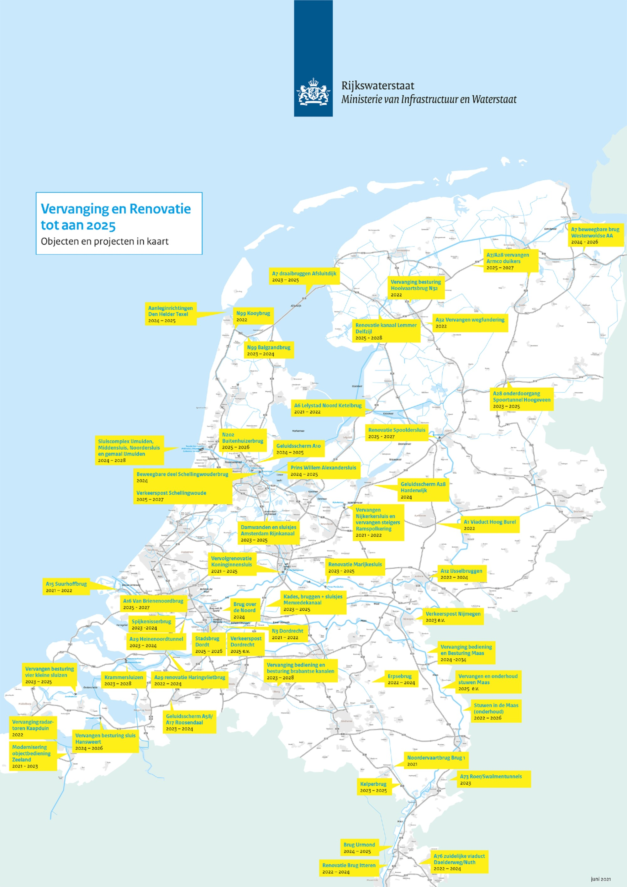
Condition of structures and investments
Rijkswaterstaat, Replacement and Renovation up to 2025

Slide 10
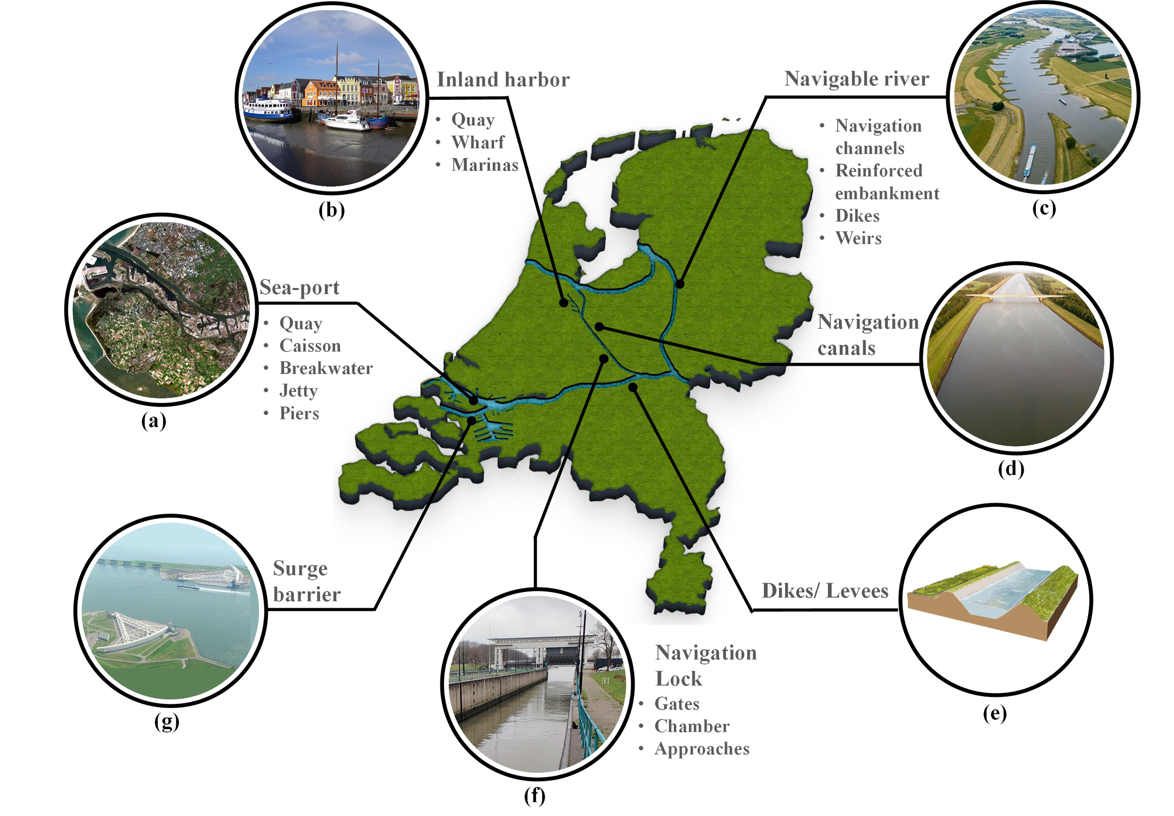
SHM of inland navigation structures
Prateek Negi,
Rolands Kromanis,
André G. Dorée,
Kathelijne M. Wijnberg

Slide 11
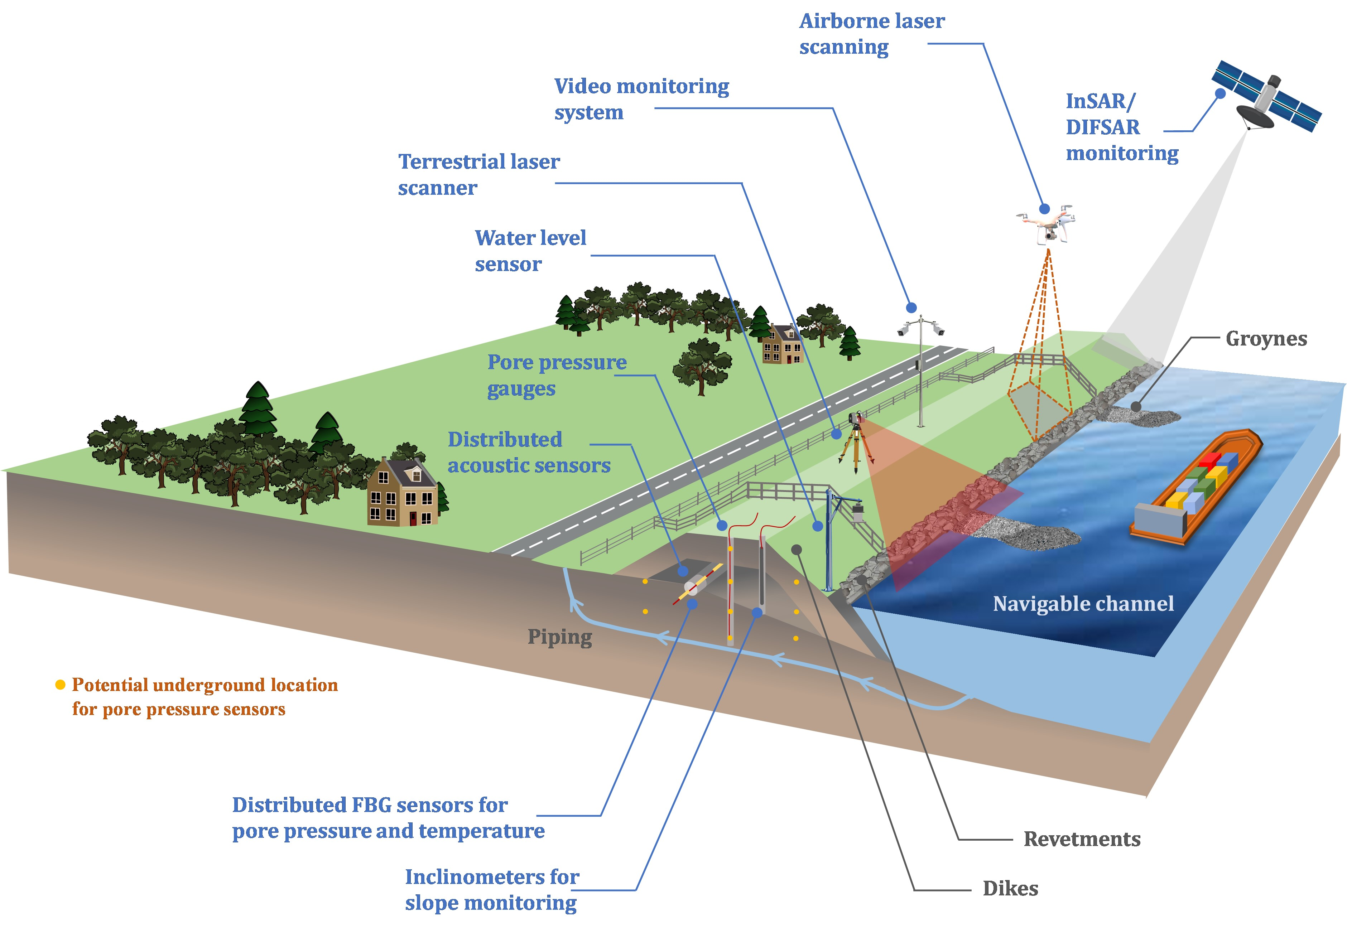
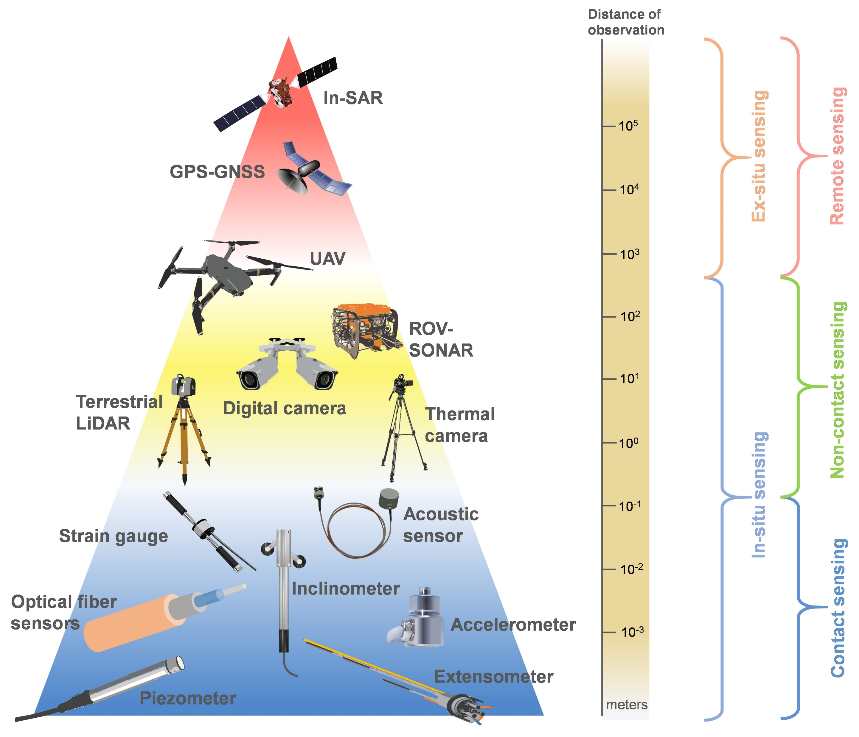
SHM of dikes

Slide 12

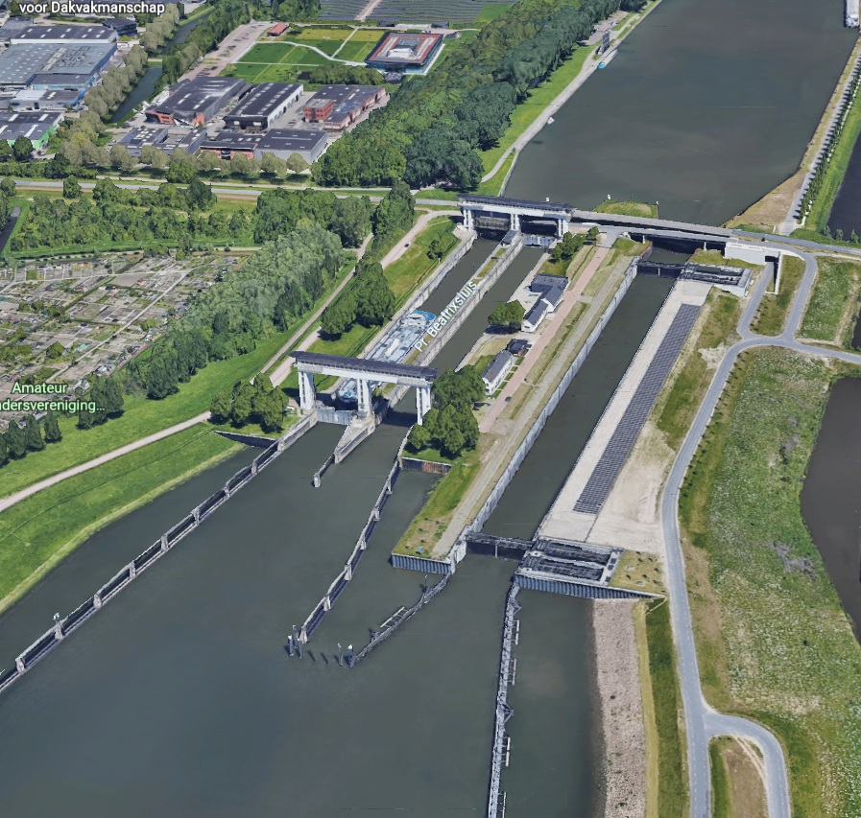
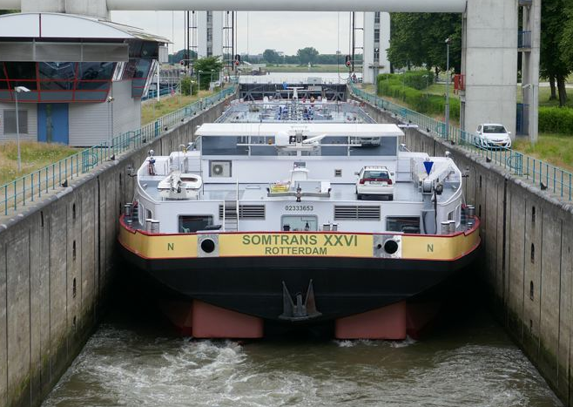

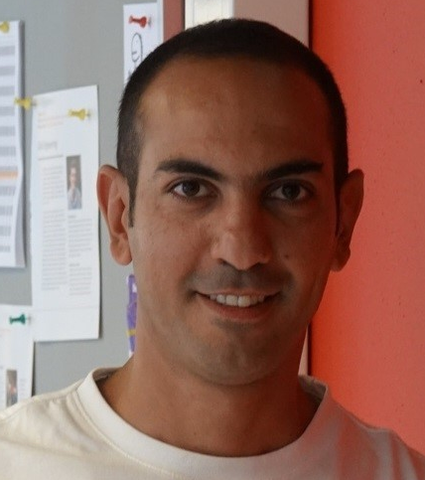
Beatrix lock monitoring system
Twin chambers
Constructed in 1938
Ships up to Va class
25,000 passages annually
Amsterdam
Rotterdam
The Netherlands and shipping on inland waterways
Flow
EngD candidate Mohsen Bastani
https://virtual-world.nl/ Prinses Beatrixsluis, Netherlands (17-06-2017)

Slide 13
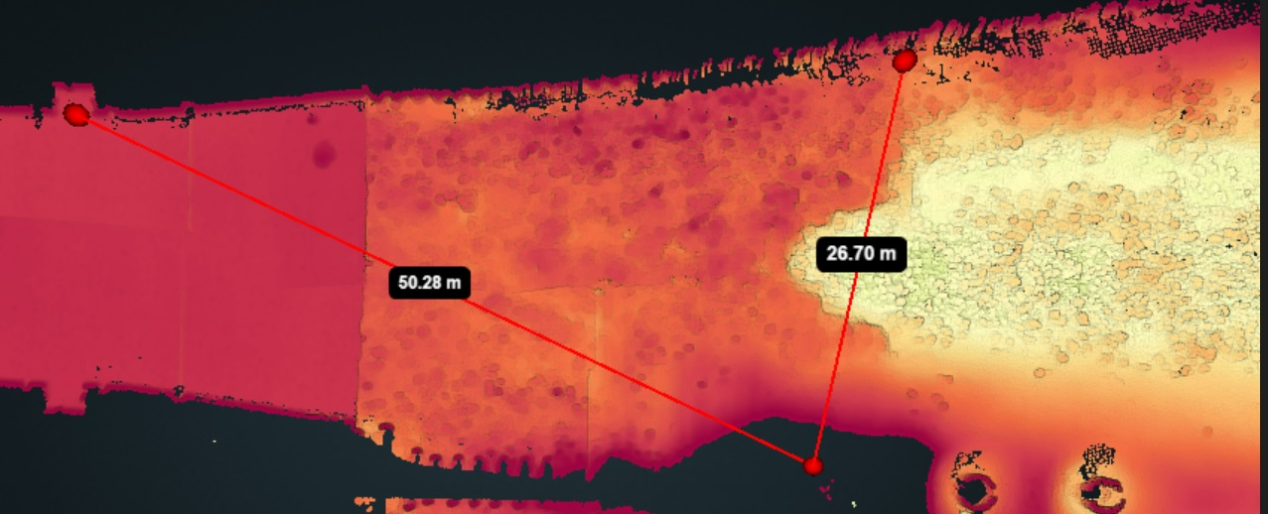
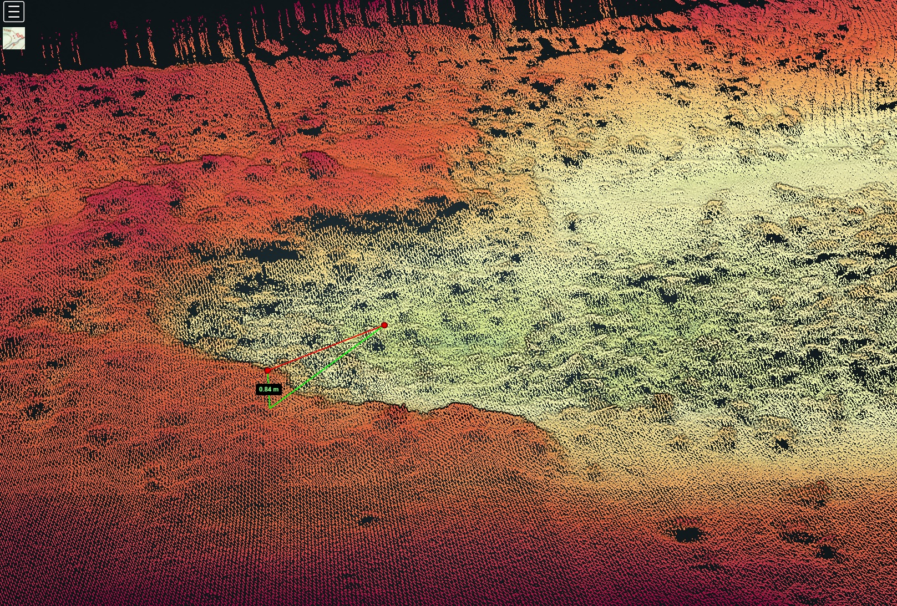
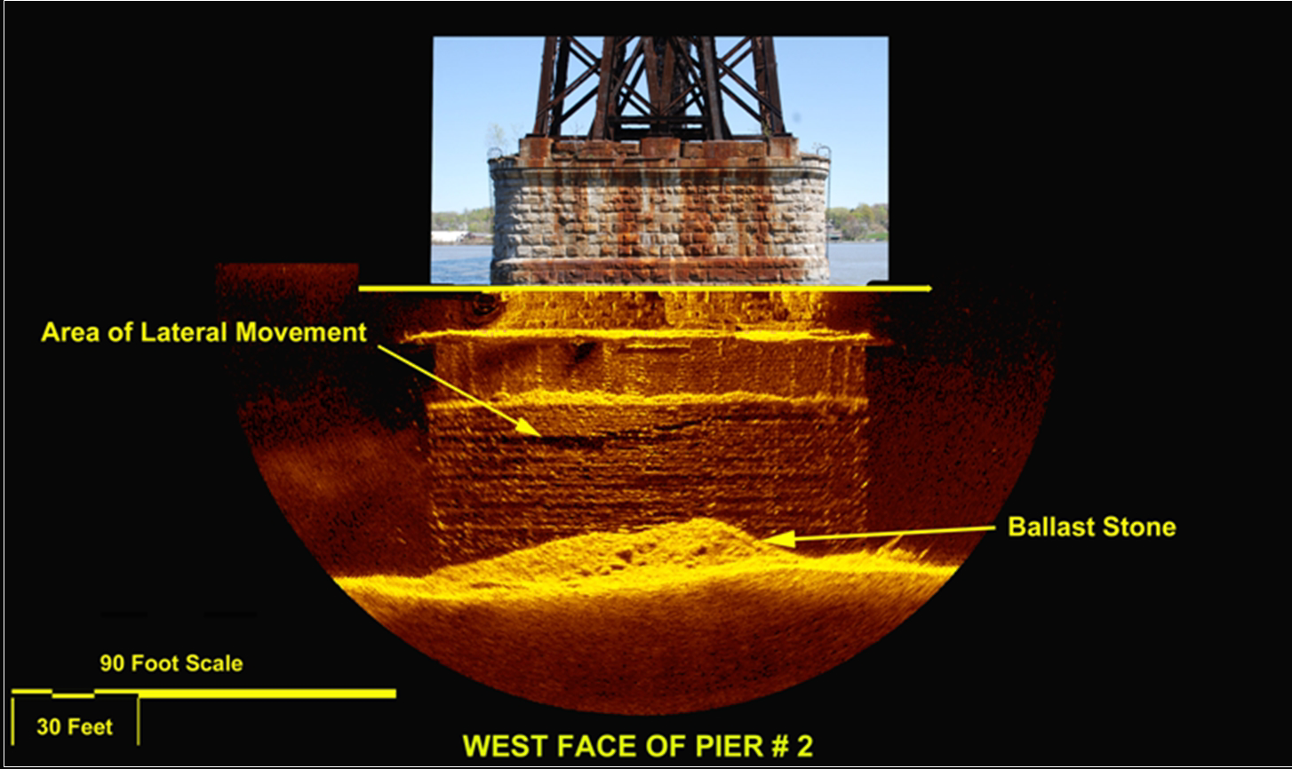

Beatrix lock monitoring system
Bathymetry
Scour
The concrete floor-bed protection

Slide 14
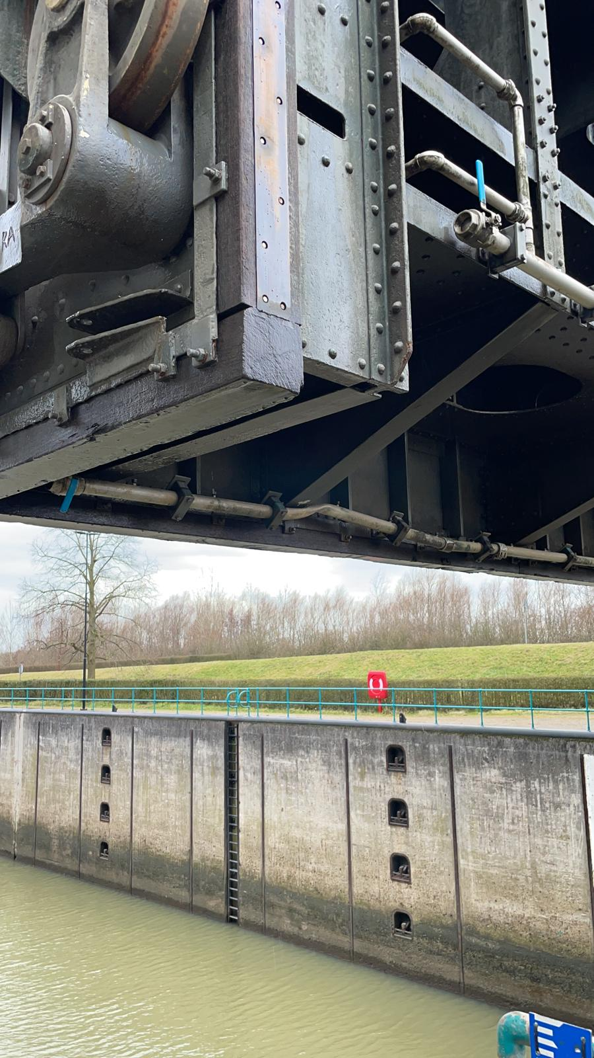
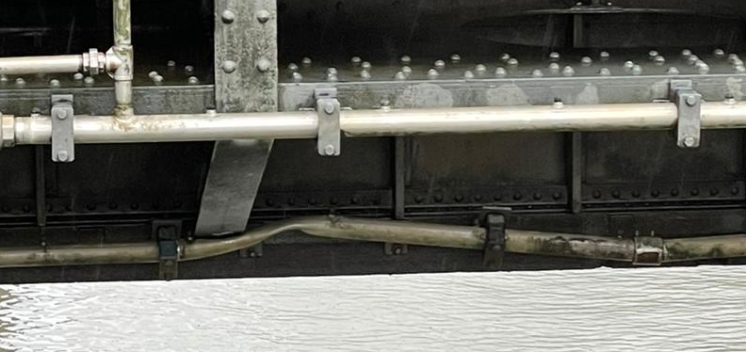
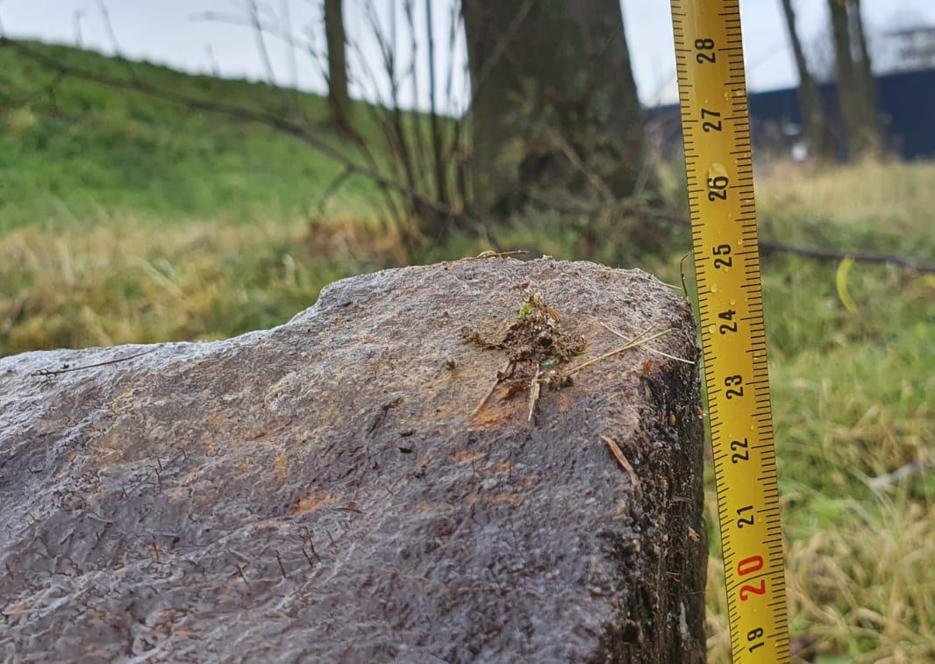
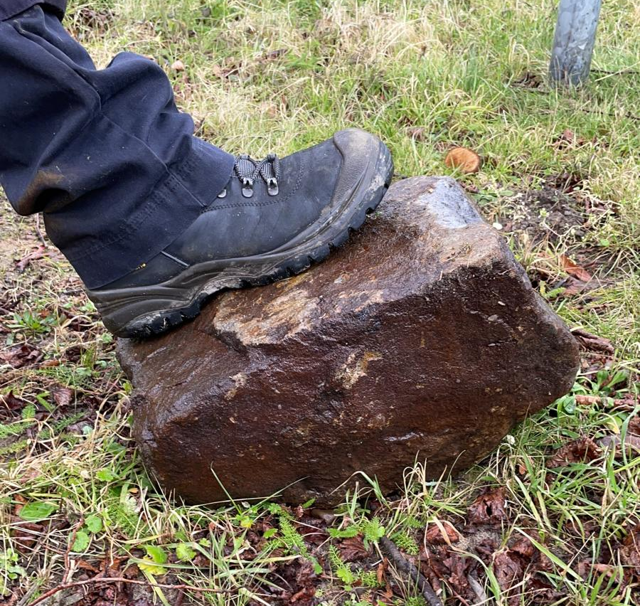
Beatrix lock monitoring system
Northside (Downstream) chamber 1
18-02-2021

Slide 15

THANK YOU!

