Slide 1
Resilience and so-called social chronic stresses
Camilo Benitez Avila
Postdoc
Ethics/Philosophy of Technology
Values, Technology and Innovation

Slide 2
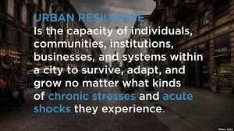
The motivation for my research stands from the observation that resilience turned into a paradigm for governing social life beyond its application in engineering and complex adaptive STE systems.
Greater Miami: Racializing Resilience
One New York: Resilience and Justice
Rotterdam: Balanced Society
Social issues are important aspects that we must care about. Nevertheless, I challenge the conceptual fitness of resilience (and its use in social policy practice).

Slide 3
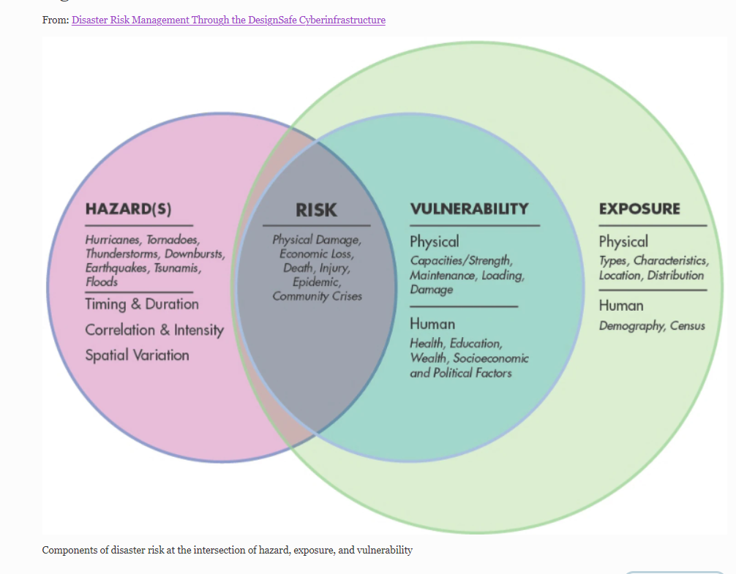
Social resilience emerges as a concept emphasizing the pay-offs of collective action, addressing external hazards
SOCIAL CAPITAL
Pinelli, JP., Esteva, M., Rathje, E.M. et al. Disaster Risk Management Through the DesignSafe Cyberinfrastructure. Int J Disaster Risk Sci 11, 719–734 (2020).

Slide 4
Social resilience emerges as a concept emphasizing the pay-offs of collective action, addressing external hazards
A clear-cut distinction is problematic when thinking about the hardship of living in society for those who are less well-positioned in social structures
Social structures
(positions)
Unprivileged
positions
Your social position is your hazard!
SOCIAL CAPITAL
Is “social capital” a practical indicator for predicting resilience to hardship endogenous to societal positions?
Pinelli, JP., Esteva, M., Rathje, E.M. et al. Disaster Risk Management Through the DesignSafe Cyberinfrastructure. Int J Disaster Risk Sci 11, 719–734 (2020).

Slide 5
Socio-economic
Status
(SE)
d2 (+)
Sense of Mastery
(MA)|
a1 (+)
Positive Adaptation
(PA)
The socially dependent capacity to perform given the skills provided by your social position is psychologically manifested with a sense of Mastery;
Mastery: “the extent to which one regards one's life-chances as being under one's own control in contrast to being fatalistically ruled” (Pearlin and Schooler, 1978).
So, we test the extent to which this embodied social skills due to one’s position in society predict positive individual adaptation.
Benitez-Avila, Schuberth, Copeland

Slide 6
e1 (+)
Socio-economic
Status
Neighbourhood Cohesion
b1 (+)
b2 (+)
d2 (+)
Sense of Mastery
a1 (+)
Positive Adaptation
d2 (+)
c2 (+)
Primary Networks
Association Adscription
c1 (+)
e1 (+)
Additionally, we studied the role of socio economic-status, and sense of mastery along with the resilience returns of social capital constructs.
Method: PLS-SEM and a public survey conducted by the Central Office of Statistics in the Netherlands of 1,915 capturing inhabitants’ perceptions about their living situation in 2018.
Benitez-Avila, Schuberth, Copeland

Slide 7
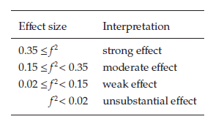
β= 0.077; f² = 0,006
Socio-economic
Status
Neighbourhood Cohesion
β= 0.065; f² = 0,006
β= 0.056; f² = 0,004
β= 0.402; f² = 0,181
Sense of Mastery
R² = 0.231
β= 0.513; f2 = 0,300
Positive Adaptation
R² = 0.325
β= 0.118; f² = 0,017
β= 0.067 f² = 0,005
Primary Networks
Association Adscription
NS
NS
The results show that Neighborhood Cohesion and Membership in Voluntary Associations' impact on Positive Adaptation is unsubstantial and insignificant.
The role of those drivers is mediated by an individual’s sense of Mastery, even when their positive association is rather weak.
Social capital appears to only marginally offset social position, which actually explains mastery and individuals' positive adaptation.
Benitez-Avila, Schuberth, Copeland

Slide 8
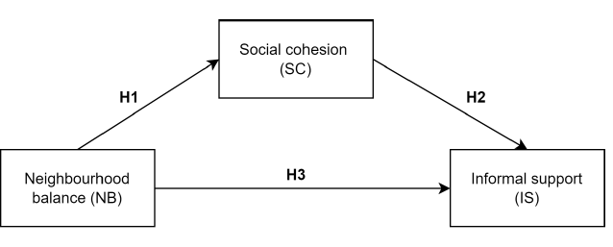
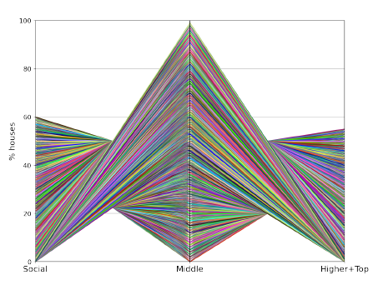
Insights from other quantitative works – PLS-SEM + spatial econometrics (problematic use of social resilience in Rotterdam and the housing policy/crisis/gentrification - 2018)
Assumption: “Balanced” neighborhood enables social cohesion and resilience (as solidarity/informal support).
Balanced in terms of value property – Rotterdam Resilience Strategy/ Woonvisie (market segment)
Empirical results:
The definition of “balanced” is ambiguous, leading to empirically multiple possible distributions of value property fitting the policy (3,162 possible models)
Data show the alleged relation between in only 2.1% of cases (fitting the model)
When the relationship exists, the results are counter-intuitive: Polarized value distribution predicts social cohesion leading to informal support.
TUDelft- EPA Master 2022
Guillermo Prieto Viertel

Slide 9
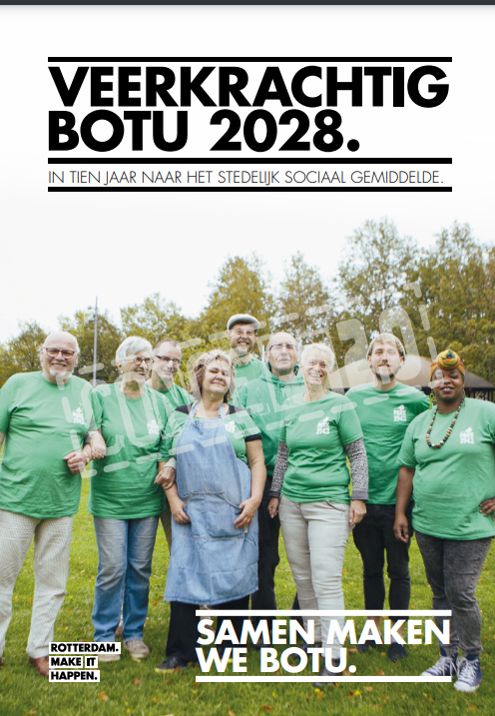
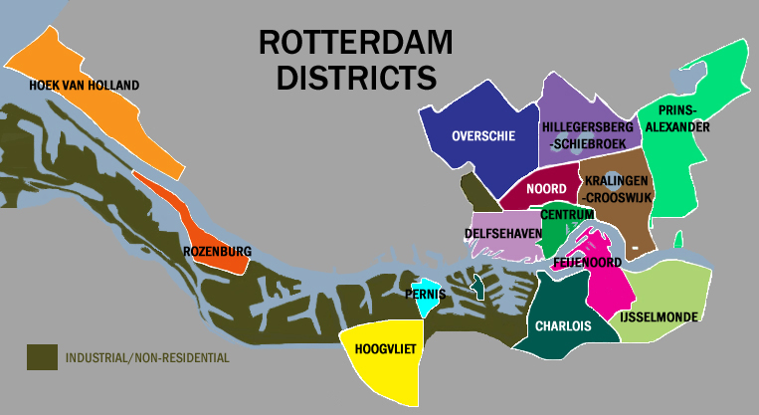
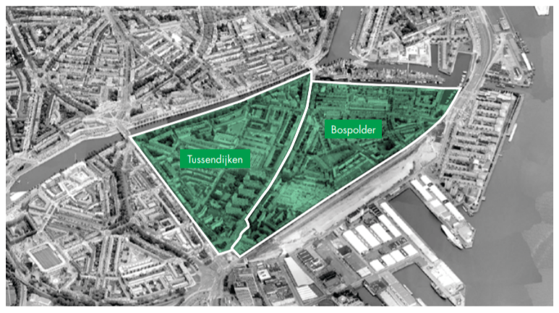
Insights from other qualitative works (discursive contradictions of resilience in Rotterdam – BoTu2028)
Assumption: Win-win resilience imaginary
The deprived citizen is a entrepreneur in the position to join an organizational partnership with the market and the government
Empirical results:
BoTu2028 is a successful experiment because of the solidarity of informal networks providing relief and support (emergency management Covid-19)
However, the financial inviability of public-private-community partnerships
"Business cases" are elusive for bottom-up communitarian activities
Discursive contradictions
Communitarian self-organization
A residual and marginal to the economic imaginary inspired in the 4th industrial revolution and, at the same time,
The core of the contemporary network governance for successfulness
Benitez-Avila, Copeland

Slide 10
Conclusion
Use social capital as a reference for social resilience only if that does not blur the centrality of Mastery and satisfaction with one’s social position.
Let’s discuss underlying organizational logic in implementing bottom-up resilience (what self-organizational path do we want to shape?)

