Slide 1
DeSIRE Design Workshop on
Spatial Design for Resilience
3 November - 14.00

Slide 2
PART One

Slide 3
4TU Centre for Resilience Engineering Introduction
Knowledge centre in Resilience Engineering
Initiative of the four universities of technology in the Netherlands (Delft University of Technology, Eindhoven University of Technology, University of Twente and Wageningen University and Research)
Wants to develop, apply and disseminate knowledge, methods and tools for making societies more resilient
Focuses on engineering solutions (technical solutions and system designs) in interaction with social-ecological systems

Slide 4
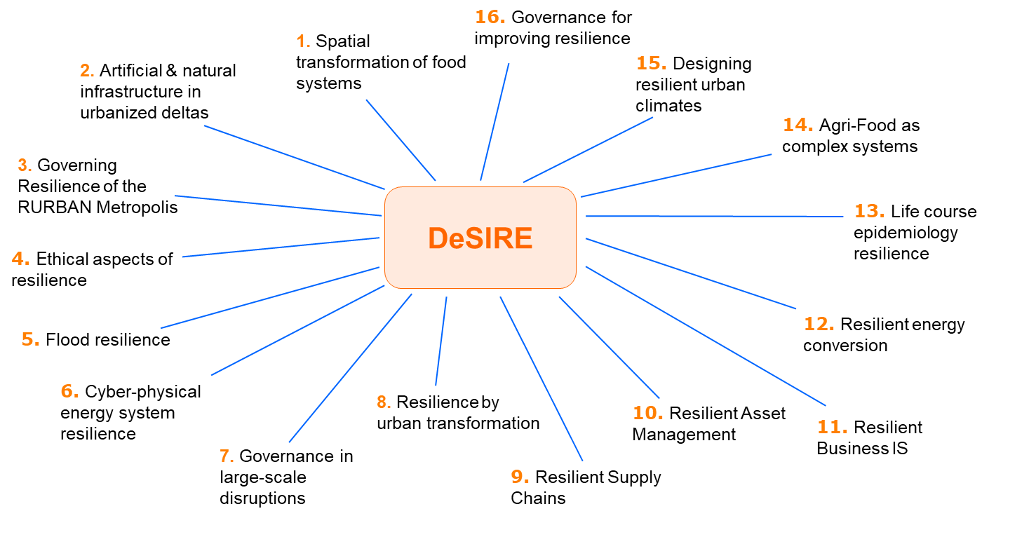
Our research
DeSIRE: Designing systems for Informed Resilience Engineering

Slide 5
The aim of
DeSIRE Design Workshop
Leftover Spaces
The workshop brings together students, young designers, and young professionals from different disciplines, as well as stakeholders, including municipal representatives, to develop design solutions that transform leftover spaces into resilient urban spaces. The method, previously developed at TU Delft, aids the development of social-ecologically integrated spatial interventions.
Design solutions
Urban
Resilience

Slide 6
What is
Resilience
The word resilience is often used in the sense of "returning to equilibrium" (Klein et al, 2003), which refers to the design of cities with less vulnerability and more flexibility. Another concept that focuses on resilience is the dynamic interaction between ecological and social change. Resilience was defined as “a measure of the persistence of systems and of their ability to absorb change and disturbance” (Holling, 1973). In this study, leftover spaces are investigated as latent opportunities in resilient landscape.

Slide 7
What is
Urban Resilience
A growing number of recent studies have focused on the ‘resilience’ in the urban settings (Davoudi et al. 2012, Feliciotti, 2015) to explain the ‘city’ capabilities in confronting the systemic threats (Vale, 2014). Some of such threats the urban theory is trying to find solutions for through the resilience concept include Emergencies (Liao 2012), climatic change (Brown et al. 2012), catastrophic events (Paton and Johnston 2001), and recovery from disaster (Vale and Campanella 2005). The resilience thinking is now in its initial stages—despite the urban design—and needs extensive investigation (Allan and Bryant 2011; Ahern 2013; Marcus and Colding 2014; Pickett, Cadenasso and McGrath 2014; Roggema 2014).

Slide 8
What is the
resilience
Social-ecological
Social-ecological resilience has been considered as a way to understand the dynamics of change in urban systems characterized by multilevel complexity, unpredictability, and non-linearity (Davoudi et al. 2012), contributing to catching the patterns of alteration, inconstancy, and the interrelationships between intricate social and ecological systems (Chapin et al., 2009).

Slide 9
RESILIENCE PROPERTIES
CONNECTIONS
OPEN SPACES
INTEGRATION
SCALES

Slide 10
RESILIENCE PROPERTIES
SPATIAL / FUNCTIONAL
PROPERTIES / ELEMENTS
CONNECTIONS

Slide 11
RESILIENCE PROPERTIES
SPATIAL / FUNCTIONAL
PROPERTIES / ELEMENTS
OPEN SPACES

Slide 12
RESILIENCE PROPERTIES
SPATIAL / FUNCTIONAL
PROPERTIES / ELEMENTS
INTEGRATION

Slide 13
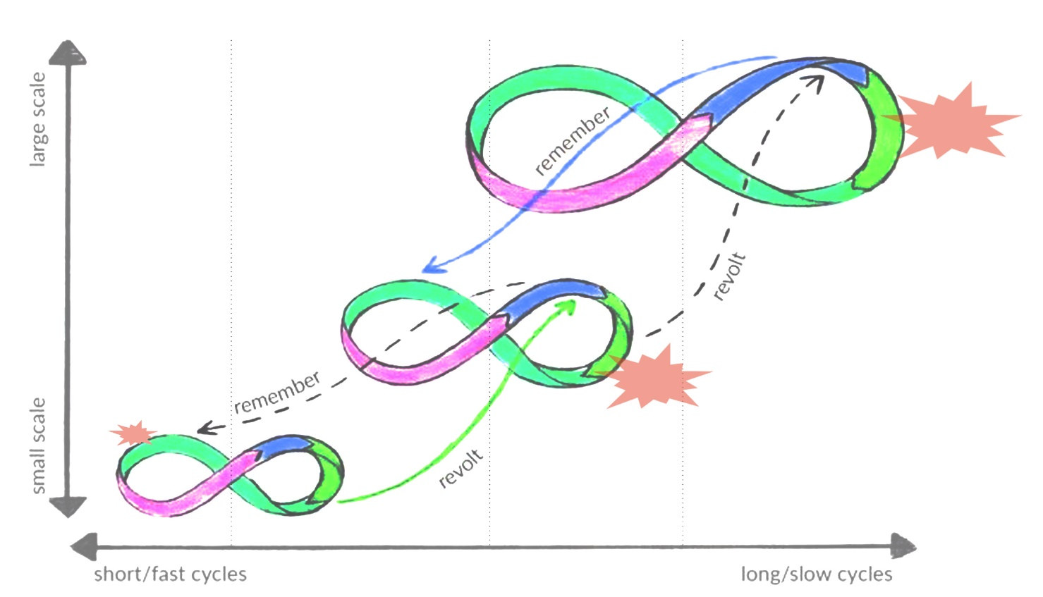
Ref: The adaptive cycle (adapted & expanded from Gunderson & Holling 2001), and The adaptive cycle as a dynamic map for resilience thinking | by Daniel Christian Wahl
RESILIENCE PROPERTIES
SPATIAL / FUNCTIONAL
PROPERTIES / ELEMENTS
SCALES

Slide 14
PART Two

Slide 15
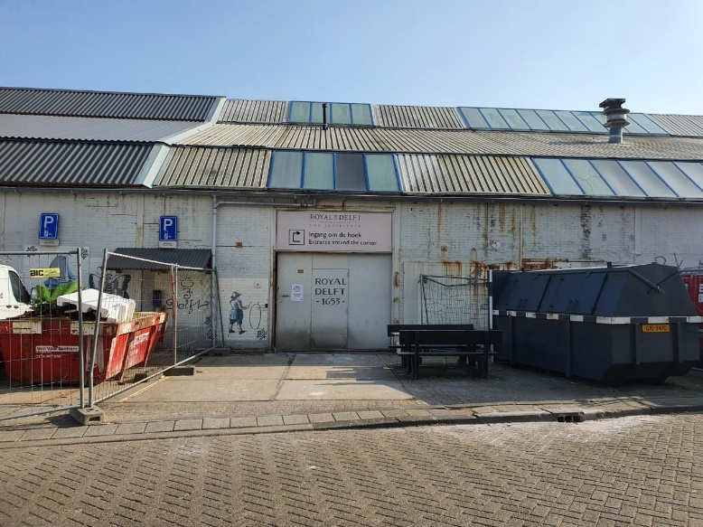
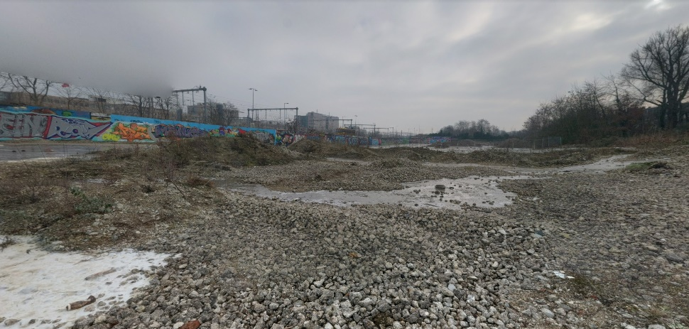
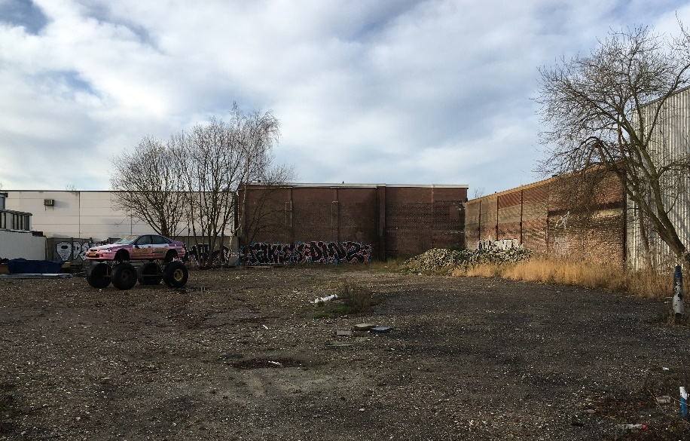
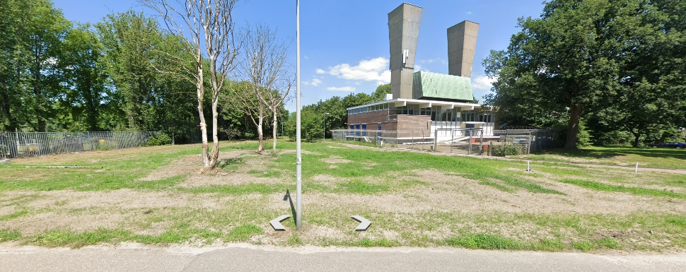
What is the
Leftover Space
Abandoned spaces are defined by many equivalent terms, such as Lost Space, Residual Space, Junk Space, Leftover Space, Informal Space, etc., these areas are essential as latent opportunities for change (Armstrong, 2006; De Sola-Morales, 1996). Therefore, there has been an increase in transforming these informal spaces into formal space in landscape (Burkholder, 2010; Rupprecht & Byrne, 2014).
Despite the socio-ecological potential, due to the lack of awareness about the possible benefits of the leftover spaces in urban design, a large number of them have been still overlooked and undervalued.

Slide 16
(YAO LIN , 2012)
The University of Texas

Slide 17
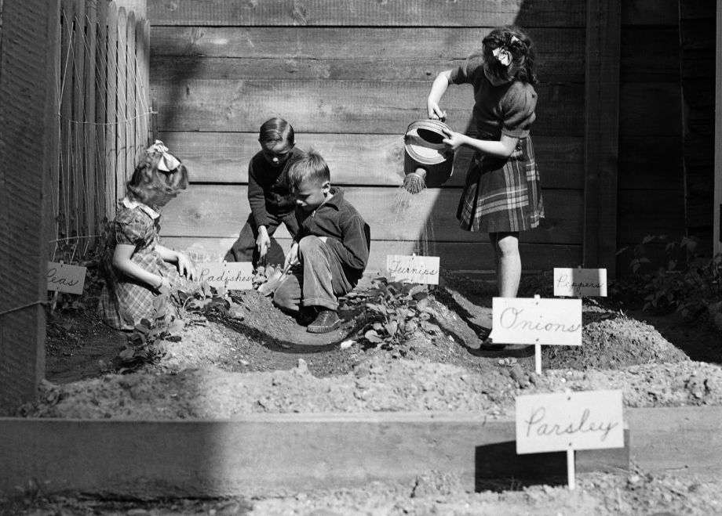
In this 1942 photo, children in New Orleans prepare and plant a World War II Victory Garden. The city had encouraged owners of vacant lots to loan their property to the cause (Alan Mallach, 2018) (AP Photo/Horace Cort)
Notes:
Many cities, though, have barely scratched the surface; thousands of lots remain untreated and are at best intermittently mowed and cleaned.
The first problem is lack of resources. Although the cost of greening or maintaining any individual lot is modest, the vast number of vacant lots in legacy cities means that the total cost can easily become substantial???
Long-term sustainability of greening projects is another challenge. Maintaining attractive green spaces can be labor-intensive: While many neighborhood-based greening projects last for years, others tend to fade away as the individuals who provided the initial impetus move away or on to other things.

Slide 18
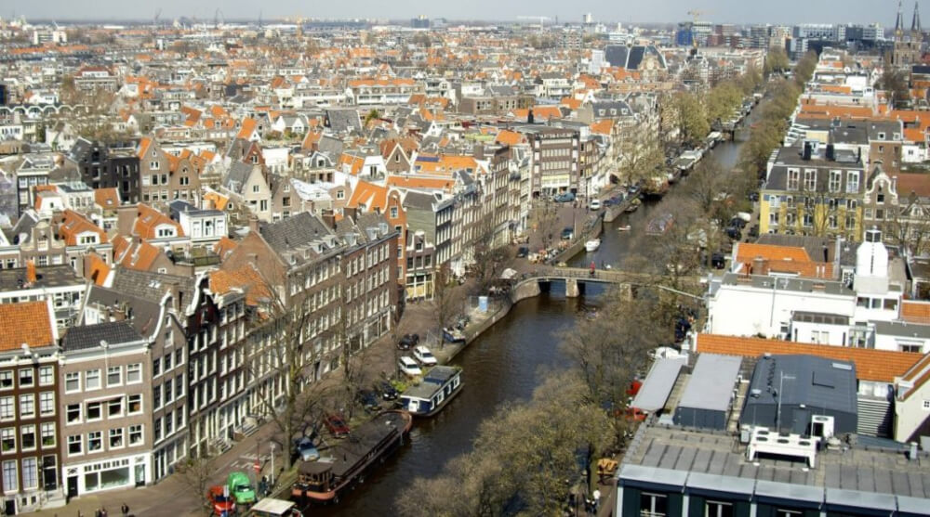
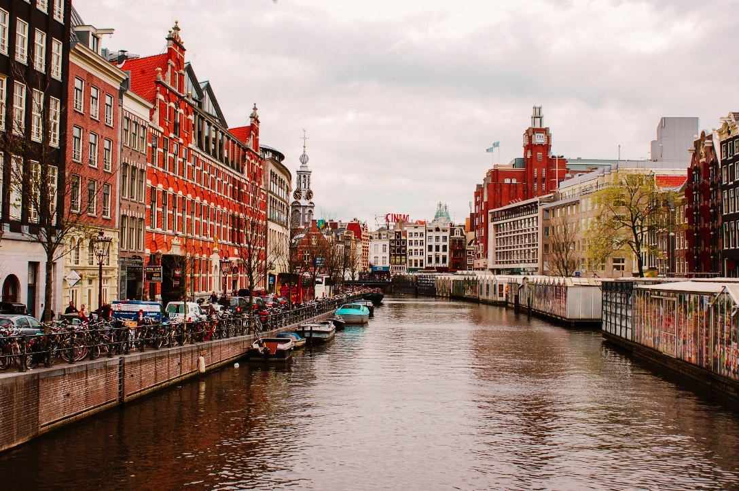
Importance of
for urban resilience
leftover spaces
Urban areas have faced limited and high-density challenges, and the first problem is lack of resources.
Notes:
Seen from a landscape perspective, cities are highly fragmented lands that consist of built and vacant areas. Although porosity refers to spatial fragmentation and discontinuity, a porous system can contribute to be resilient. Identifying resilience properties in landscape discipline can deepen researchers' interest worldwide.

Slide 19
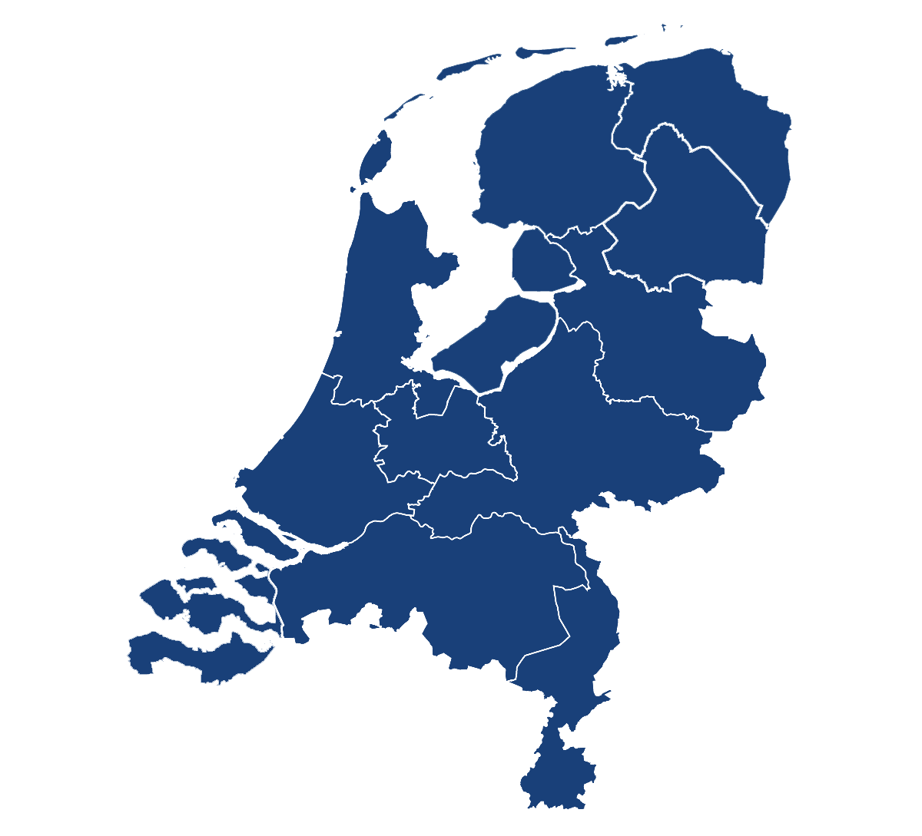
Amsterdam
Utrecht
Delft
Rotterdam
C a s e S t u d y

Slide 20
DeSIRE Design Workshop on Spatial Design for Resilience.
14:00 - 14:15 | Introduction Resilience Leftover spaces Case studies Workshop process
14:15 - 14:45 | INDIVIDUAL and TEAM work (15 MINUTES INDIVIDUAL WORK + 15 MINUTES GROUP WORK) 15 MINUTES INDIVIDUAL WORK STEP 1 | Review the resilience properties and spatial/functional properties/elements (Page 3) STEP 2 | Generate as many ideas about building resilience through urban design as you can! (Page 5-A3) 15 MINUTES GROUP WORKING STEP 3 | Design the site (Page 6- Sheet A3) Use sketching papers and markers to generate your ideas, and design the selected site. STEP 4 | Write a narrative about your approach to building resilience through urban design (Page 4)
14:45- 15:00 | Discussion Please Use the QR Code / URL or Email (C.Forgaci@tudelft.nl) to share your sheets.
tiny.cc/78k0vz

Slide 21
Thank you for your attention!
Notes:
Here are all about why TRANSFORMING LEFTOVER SPACES INTO RESILIENT U R B A N LANDSCAPE is an important topic.

