Slide 1



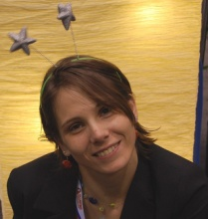





Gamification Works! or
How I Learned to Stop Worrying and Love to Teach
Dr. Alexandru Iosup,
Otto Visser, Dr. Ana Lucia Varbanescu,
Tim Hegeman, and Jesse Donkervliet
The images used in this lecture courtesy of many generous content producers. See last slide.
Notes:
Web cloud logo = http://www.clker.com/cliparts/p/K/8/u/T/d/world-wide-web-hi.png

Slide 2


The “Leaking Faucet”
Major technical university in the
Netherlands
“P-in-een” of an important BSc track
Completion “in time” of the BSc
(What do students think about it?)
<40%
<50%
* THE-QS world rankings, 2013—2016.
Notes:
Dripping fawcet: http://cf.ltkcdn.net/homeimprovement/images/std/127577-284x423-leaking-kitchen-faucet.jpg
http://onderzoek.elsevier.nl/onderzoek/beste-studies-2014/7/technische-universiteit-delft/376

Slide 3
Exercise: The Blame Game
Team work, first 2 minutes
  Form team of 2-3 persons
  Think about own experience
  Convince your team before proposing an answer
Open discussion, next 2 minutes
  Tell everyone the answer
Q: Who is responsible for the
current yield of higher education?
Voting on best answer

Slide 4

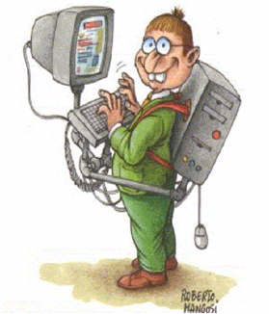
We’re In This Together
(My Answer)
New generation of students
New types of students,
especially multi-culti
It’s not you, it’s me
New ambition of our faculty,
but cannot select students
https://quotablequoteunquote.files.wordpress.com/2008/08/walkingcomputergeek.jpg
Notes:
Reality is Broken: Why Games Make Us Better and How They Can Change the World [Kindle Edition]
Jane McGonigal

Slide 5
We’re In This Together (My Answer)
New generation of students
New types of students,
especially multi-culti
It’s not you, it’s me
New ambition of our faculty,
but cannot select students
The main challenges for the future?
Every student counts!
Every student is different!
https://quotablequoteunquote.files.wordpress.com/2008/08/walkingcomputergeek.jpg

Slide 6
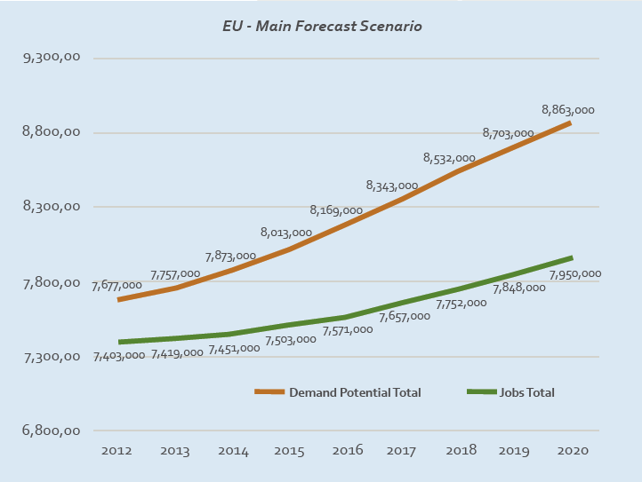
Let’s Extrapolate to Europe:
The Workforce Gap in ICT
910k
510k
NL: 20k
NL: 50k
Source: e-Skills for Jobs in Europe, 2014
Notes:
Source: Korte et al., e-Skills for Jobs in Europe: Measuring Progress and Moving Ahead, 2014. on behalf of the European Commission, Enterprise and Industry Directorate General.

Slide 7
Let’s Extrapolate to Europe:
The Workforce Gap in ICT
The main challenges for the future?
Every student counts!
Every student is different!
910k
510k
NL: 20k
NL: 50k
Source: e-Skills for Jobs in Europe, 2014
Notes:
Source: Korte et al., e-Skills for Jobs in Europe: Measuring Progress and Moving Ahead, 2014. on behalf of the European Commission, Enterprise and Industry Directorate General.

Slide 8
Let’s Extrapolate to Europe:
The Workforce Gap in ICT
The main challenges for the future?
Every student counts!
Every student is different!
910k
510k
Rhetorical Q:
Which teaching technique can help?
Source: e-Skills for Jobs in Europe, 2014
Notes:
Source: Korte et al., e-Skills for Jobs in Europe: Measuring Progress and Moving Ahead, 2014. on behalf of the European Commission, Enterprise and Industry Directorate General.

Slide 9
Agenda for Today or Gamification. Because Every Student Counts!
Time
Units
1
Introduction
An intuition behind gamification
A practical framework for gamification in higher education
(getting your courses gamified)
  Refresher on higher-education basics
  Understanding student types
  Designing the gamified experience, focus on the MDA* framework
  Designing the gamified experience, focus on dynamics and mechanics
  Designing the gamified experience, focus on assessment
  Playtesting for fun and motivation, and against common pitfalls
  Operating a gamified course
Does gamification work?
Wrap-up
1
5½
½
1
½
½
1
1
1
½
½
1 Time Unit (TU) ~ 10 minutes.
Total time 8.5 TUs ~ 90 minutes.
* Mechanics, Dynamics, Aesthetics

Slide 10
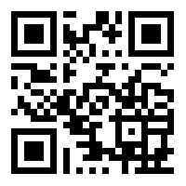


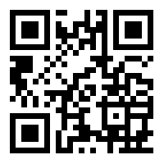
What is Gamification?
A: Game Thinking + Techniques
Q: What is gamification?
A: The use of thinking and techniques designed for gaming in non-gaming settings, e.g., in education.
^{http://goo.gl/V97zSW}
What is the intuition behind gamification?
How can gamification be used?
http://goo.gl/ILSNeb
Notes:
Document icon http://www.clker.com/cliparts/f/M/Y/M/W/n/article-md.png
https://www.the-qrcode-generator.com/ for the QR code

Slide 11













Designing a course is
like creating a complex puzzle
Lab
Tutorial
Win!
Group Study
Lectures

Slide 12
Agenda for Today or Gamification. Because Every Student Counts!
Time
Units
1
Introduction
An intuition behind gamification
A practical framework for gamification in higher education
(getting your courses gamified)
  Refresher on higher-education basics
  Understanding student types
  Designing the gamified experience, focus on the MDA* framework
  Designing the gamified experience, focus on dynamics and mechanics
  Designing the gamified experience, focus on assessment
  Playtesting for fun and motivation, and against common pitfalls
  Operating a gamified course
Does gamification work?
Wrap-up
1
5½
½
1
½
½
1
1
1
½
½
* Mechanics, Dynamics, Aesthetics

Slide 13
This Gamification Masterclass
“By taking this course, you will be able to”
  Identify student types and
  design their paths of advancement.
  Identify and explain the mechanics and
  dynamics that are most likely to motivate students.
  Design assessment that is most likely to
  challenge students yet avoid common pitfalls.
  Understand basic concepts in how to
  construct, playtest, and operate a gamified course.
  Try out your gamification skills, in short exercises.

Slide 14
A Framework for Gamification in Higher Education
Decide on Learning Objectives and related content.
Describe the perfect student.
Design the gamified experience*.
Playtest your design and check for fun!
Operate your gamified course.
* Mechanics, Dynamics, Aesthetics
(Assuming you want to gamify a traditional course.)
Notes:
Decide on Learning Objectives and content to support them (the traditional education path).
Describe the perfect student.
Design the gamified experience: mechanics, dynamics, aesthetics
Playtest your design and check for fun!
Operate gamified course.

Slide 15




Have You Read These? Or Similar? Or Followed the BTQ (BKO) Courses?
Decide on Learning Objectives and related content.
Learning how to learn
Significant learning
Group work
Assessment
Planning, team
Grading
From the trenches…
Notes:
Creating Significant Learning Experiences: An Integrated Approach to Designing College Courses Paperback – August 26, 2013
by L. Dee Fink
Tools for Teaching Paperback – February 3, 2009
by Barbara Gross Davis
McKeachie's Teaching Tips: Strategies, Research, and Theory for College and University Teachers Paperback – January 1, 2010
by Marilla Svinicki (Author), Wilbert J. McKeachie (Author)
What the Best College Teachers Do Hardcover – May 30, 2004
by Ken Bain

Slide 16
Course Design, In 5 Easy Steps…
Decide on Learning Objectives and related content.
Team work, first 2 minutes
  Form team of 2-3 persons
  Think about own experience
  Convince your team before proposing an answer
Open discussion, next 1 minute
  Tell everyone the answer
Q: How do you design a course in higher education? (What do you show
to your Director of Education?)
Voting on best answer

Slide 17
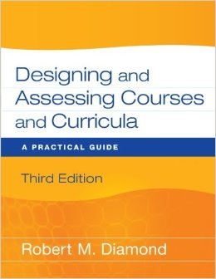
Decide on Learning Objectives etc.
(or, the basics of education)
Decide on Learning Objectives and related content.
Goals
  High-level descriptions, e.g., “EDU601 Modern Education Techniques”
Outcomes
  Low-level descriptions
  Measurable verb + Limitations + Performance
Teaching method(s)
  Teaching facts, concepts, procedures, systems
  Lectures [, flipped classroom?], Lab, etc.
  [Learning learning? Teaching teachers?]
Assessment method(s)
  Of students. Of the course itself.
  [Of the teaching methods?]
Operation of the course
  Team, including SAs, co-teacher, etc.
Notes:
Designing and Assessing Courses and Curricula: A Practical Guide: Robert M. Diamond: 9780470261347
http://www.amazon.com/Designing-Assessing-Courses-Curricula-Practical/dp/047026134X

Slide 18
What’s Wrong With the
Perfect Student?
Describe the perfect student.
The perfect student does NOT exist. (And yet we are all here.)
Achieves all course objectives
Explores new directions
Socializes with students around
Excels in all tests, early
https://quotablequoteunquote.files.wordpress.com/2008/08/walkingcomputergeek.jpg
Notes:
Reality is Broken: Why Games Make Us Better and How They Can Change the World [Kindle Edition]
Jane McGonigal

Slide 19
Acting
Players
World
Interacting
Richard Bartle’s “Players who suit MUDs”

Slide 20
Acting
Achievers
Players
World
Interacting
Richard Bartle’s “Players who suit MUDs”

Slide 21
Acting
Achievers
more/more difficult challenges
Players
World
Interacting
Richard Bartle’s “Players who suit MUDs”

Slide 22
Acting
Achievers
more/more difficult challenges
Players
World
Explorers
open/creative challenges
Interacting
Richard Bartle’s “Players who suit MUDs”

Slide 23
Acting
Achievers
more/more difficult challenges
Players
World
Socializers
Explorers
team/discussion-based challenges
open/creative challenges
Interacting
Richard Bartle’s “Players who suit MUDs”

Slide 24
Acting
Winners
Achievers
competitive/single-winner
challenges
more/more difficult challenges
Players
World
Socializers
Explorers
team/discussion-based challenges
open/creative challenges
Interacting
Richard Bartle’s “Players who suit MUDs”

Slide 25
Exercise: The “Who Are You?” Game
Acting
Winners
Achievers
competitive/single-winner
challenges
more/more difficult challenges
Q: Which best describes you?
Players
World
Socializers
Explorers
team/discussion-based challenges
open/creative challenges
Interacting
Richard Bartle’s “Players who suit MUDs”

Slide 26
Exercise: The “Who Are You?” Game
Acting
Winners
Achievers
competitive/single-winner
challenges
more/more difficult challenges
Q: How would you use other
taxonomies of student types?
Players
World
Socializers
Explorers
team/discussion-based challenges
open/creative challenges
Interacting
Richard Bartle’s “Players who suit MUDs”, etc.

Slide 27

Content Unlocked!
2 x
L
I
Z
Notes:
At this point, you know enough to be able to choose your own path of advancement. You can either solve this, in your minds, or follow me.

Slide 28
A Framework for Gamification in Higher Education
Decide on Learning Objectives and related content.
Describe the perfect student.
Design the gamified experience.
  Gamification is not the BLT sandwitch of education
  Focus on the Mechanics-Dynamics-Aesthetics Framework
  Focus on Mechanics and Dynamics
  Focus on Assessment
Playtest your design and check for fun!
Operate your gamified course.
Notes:
Decide on Learning Objectives and content to support them (the traditional education path).
Describe the perfect student.
Design the gamified experience:
mechanics, dynamics, aesthetics
Playtest your design and check for fun!
Operate gamified course.

Slide 29


Gamification Is NOT Only:
Design the gamified experience.
Playing a game in the classroom
Points
Badges
Leaderboards
PBL = The BLT sandwich
Notes:
http://www.mcdonaldsmenu.mobi/wp-content/uploads/2013/12/mcdonalds-Premium-Crispy-Chicken-Ranch-BLT-Sandwich.png

Slide 30
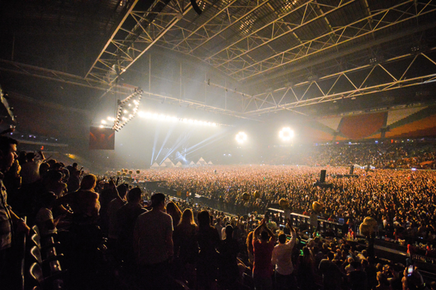
Q: What’s in a game?
A:
Over 250,000,000 active players
  Social Gaming =
  100,000k+ players who
  benefit from social engagement
  Mechanics
  Explore, do, learn,
  socialize, compete
  +
  Dynamics
  Player progress and interaction, …
  +
  Game Content*
  puzzles, challenges, extra-projects, culture
Gamification scales in practice
(better than traditional in-class methods)
* Art class pending.
http://djmag.com/sites/default/files/article/image/DJMagArenaPicsPt4%20(13%20of%2017)_0.jpg

Slide 31
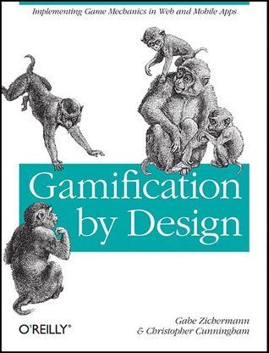
Gamification Mechanics
Mechanics = how the system turns inputs into outputs
  Points
  Badges
  Leaderboards
  Game states, such as winning, losing, cheating, etc.
  Challenges for each player type
  Rules, tutorials, guidelines, helpers, checklists
  Feedback
  Unlocked content
  … so many more
Mechanics are applied directly, by the system (course staff),
without further interaction from students.
Q: Which mechanics have I already demonstrated
in this session?
Don’t read this slide!
Don’t read this slide!
Read this article →
Iosup,Epema, …On Using Gamification in Technical Higher Education, ACM SIGCSE’14. http://goo.gl/V97zSW
Notes:
Gamification by Design: Implementing Game Mechanics in Web and Mobile Apps Paperback – August 22, 2011
by Gabe Zichermann (Author), Christopher Cunningham

Slide 32
(Social) Gamification Dynamics
What is my status?
How to get closer to winning?
When can I make a choice?
Individual dynamics (so, regardless of what others do)
  Students can spend their points for some reward
  Students earn access to more advanced content
Group dynamics (so, regardless of what students outside the group do)
  Peer-reviews are discussed with the group (mechanic),
  and result in bonuses/additional discussion (dynamic)
Cohort dynamics (so, all students acting)
  Top-20% participate in extra lectures
  Bonus/brownies for best student/group of the day

Slide 33
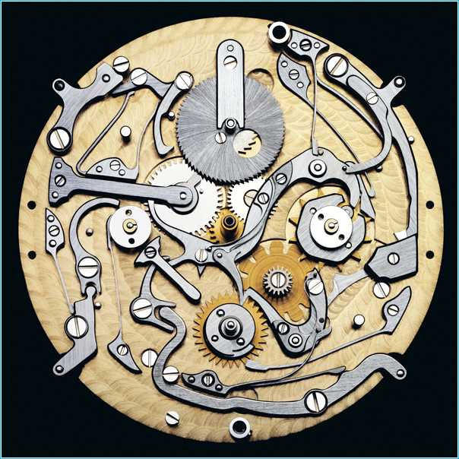
Gamification Mechanics & Dynamics in Our Courses
Too many to list here
  Scoring system is but one element
  Badges? Only for B.Sc., some “random”
Onboarding (mechanics)
  Entry quiz
  Story every lecture
Social Learning (dynamics)
  In-class teams, competing casually
  Self-study as team effort, competing
  Involve Winners and Achievers in class
  Involve Winners and Explorers in self-study
Different player types → different MDA
  Ladders, ranking, end-lecture quiz: mostly for Winners
  Content unlocking (dynamics): Explorers and Achievers
* Manga cum laude
Don’t read this slide!
Don’t read this slide!
Read this article →
Iosup,Epema, …On Using Gamification in Technical Higher Education, ACM SIGCSE’14. http://goo.gl/V97zSW
Notes:
http://www.kunstbuch-shop.de/images/guido-mocafico-movement-03_462.jpg

Slide 34
Assessment That Motivates!
10,000 points for a 10
+50 for good activity
+1,000 for most challenging activity
Badges, unlocked content

Slide 35

Our Diverse Scoring System
1. Course Points
2. Access Tokens
3. Brownie Points
10,000 for straight 10
Start with 1
+1,000 team self-study
+1,000 lab bonus #2
Bonus Lab
assignments
I will bake
brownies for you!
(but not force
you to eat them)
+500 lab bonus #1
+300 correct exam Q
Advanced topics
(GPUs, clouds)
+50 activity in
Lab/Lecture/Tutorial
Discuss w Lecturer
+25 correct end-lecture quiz
Propose Exam Qs
+500 entry quiz
Rec. letter

Slide 36
Gamification a la Carte
(5 minutes work + 5 minutes talk)
  Mechanics
  Explore, do, learn,
  socialize, compete
  +
  Dynamics
  progress/learning graph,
  social engagement, others
  +
  Game Content
  puzzles, challenges, extra-projects, culture
Groups of 3-4
Convince your team before writing down an answer
Discussion (talk) at end
Q: Which mechanics and dynamics would you like now to use in your own course?
“I would use … because …”
Voting on best answer

Slide 37
A Framework for Gamification in Higher Education
Decide on Learning Objectives and related content.
Describe the perfect student.
Design the gamified experience.
  Focus on the Mechanics-Dynamics-Aesthetics Framework
  Focus on Mechanics and Dynamics
  Focus on Assessment
Playtest your design and check for fun!
Operate your gamified course.
Notes:
Decide on Learning Objectives and content to support them (the traditional education path).
Describe the perfect student.
Design the gamified experience:
mechanics, dynamics, aesthetics
Playtest your design and check for fun!
Operate gamified course.

Slide 38
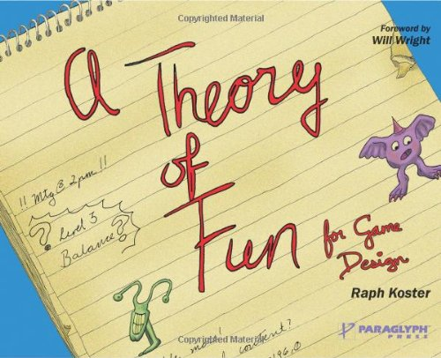
Playtest Your Own Course!
Playtest your design and check for fun!
Fine-tune fun
Are you increasing student motivation?
Mastery, Access, Autonomy, Higher Goal
Balance different paths of advancement
Balance + (challenge ~ growth → flow)

Slide 39
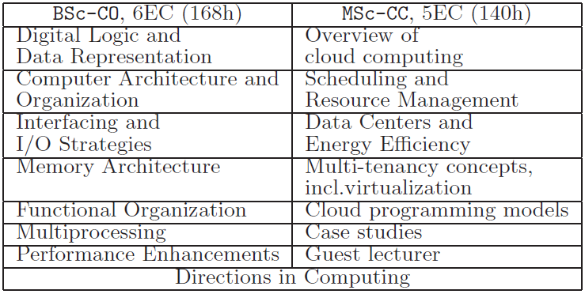

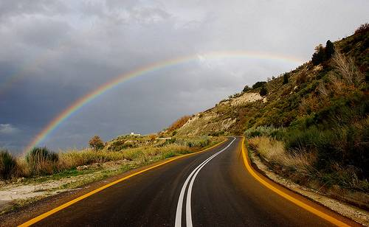
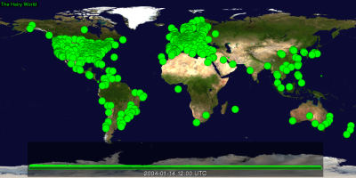
Challenging and Diverse Content to
Activate Diverse Students
Learning Objectives
Try something else
Try something else
Industry
state-of-the-art
Topics touch
today’s research
Social relevance
Photos: (left) courtesy Google Inc. (middle) http://www.flickr.com/photos/dimitrisotiropoulos/4204766418/
(right) personal library of A. Iosup.

Slide 40
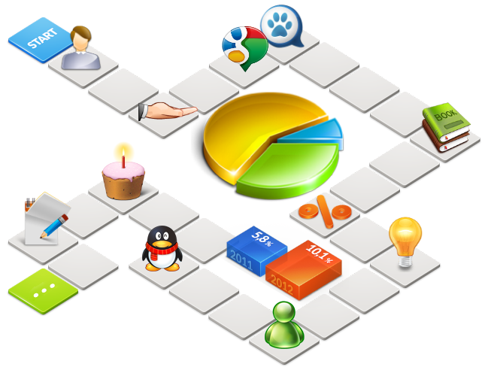
Experience Operating Our Courses
Operate your gamified course.
Learning graph overview
  Analyze shortcuts
  Make sure students know how to
  navigate the puzzle
Public overview (student’s view)
  Updates often & complete
Private overview (your & your team’s view)
  Statistics: how many and which students are lagging behind?
Notes:
Image: http://www.alcorsistemi.net/portals/0/overview_img1.png
Graph: if you don’t have the overview of the course: your students for sure don’t. Autistic students especially really need this overview! Might be hard to combine with explorer student who doesn’t want checklist though..
Private overview stats: are certain paths not taken? Are students starting but not finishing a path (ti1406 selfstudy edition 2013)? Did you underestimate this cohort of students? Can you still fix it? (exam edition 2013)

Slide 41
Agenda for Today or Gamification. Because Every Student Counts!
Time
Units
1
Introduction
An intuition behind gamification
A practical framework for gamification in higher education
(getting your courses gamified)
  Refresher on higher-education basics
  Understanding student types
  Designing the gamified experience, focus on the MDA* framework
  Designing the gamified experience, focus on dynamics and mechanics
  Designing the gamified experience, focus on assessment
  Playtesting for fun and motivation, and against common pitfalls
  Operating a gamified course
Does gamification work?
Wrap-up
1
5½
½
1
½
½
1
1
1
½
½
* Mechanics, Dynamics, Aesthetics

Slide 42
T
x 2
L
I
Does gamification work?
Z
L
I
L

Slide 43
>10+ Operational Years Since 2007
B.Sc. Courses
  TI140x Computer Organization (5+ years)
M.Sc. Courses
  IN4392 Cloud Computing (4+ years, co-teaching)
  IN4391 Distributed Computing Systems (3+ years)
Main lesson: manage course dynamics

Slide 44
Gamification Works!
Gamification works!
Bonus: Every year, we make the course more difficult.
Notes:
Passing rates at least as in
traditional approach
Max >80% vs ~60%
Much higher student satisfaction
Only with gamification
45% students involved in
extra-activities
10-15% students involved in
non-graded activities
2-5% students involved in
fully creative assignments

Slide 45
What Happens When A Student Does Not Like the Course Topic?
“
I want to thank you for showing that even though I'm not
that good at written exams, I still can excel at other points in my study. I'd love to have a copy of my badge, as physical reminder of a course that made me eager to learn about things. Even when some of those things will never really have my interest.
This course, and the way it was given, learned me a few things about what motivates me, and only for that reason it was totally worth getting up for every lecture.
”

Slide 46

There’s No Free Lunch!
Gamification takes time and energy
  One week to consider gamification elements +
  One day per lecture for adaptation +
  Continuous adaptation +
  Continuous assessment, e.g., end-lecture quiz +
  Explaining a new system to students +
  The nitty-gritty details
Gamification takes personal effort
  A new system has to conquer inertia
  A new system has to conquer doubt
You are not alone, we are here to help!

Slide 47
Agenda for Today or Gamification. Because Every Student Counts!
Time
Units
1
Introduction
An intuition behind gamification
A practical framework for gamification in higher education
(getting your courses gamified)
  Refresher on higher-education basics
  Understanding student types
  Designing the gamified experience, focus on the MDA* framework
  Designing the gamified experience, focus on dynamics and mechanics
  Designing the gamified experience, focus on assessment
  Playtesting for fun and motivation, and against common pitfalls
  Operating a gamified course
Does gamification work?
Wrap-up
1
5½
½
1
½
½
1
1
1
½
½
* Mechanics, Dynamics, Aesthetics

Slide 48
Designing a course is
like creating a complex puzzle
L
T
T
Z
x 4
x 4
x 2
L
T
I
L
T
Z
I
L
L

Slide 49

Gamification as
concept & intuition, mechanics & dynamics, …
Lumaxart Trophy Winner

Slide 50
A Framework for Gamification in Higher Education
Decide on Learning Objectives and related content.
Describe the perfect student.
Design the gamified experience.
  Focus on the Mechanics-Dynamics-Aesthetics Framework
  Focus on Mechanics and Dynamics
  Focus on Assessment
Playtest your design and check for fun!
Operate your gamified course.
Gamification works!
Notes:
Decide on Learning Objectives and content to support them (the traditional education path).
Describe the perfect student.
Design the gamified experience:
mechanics, dynamics, aesthetics
Playtest your design and check for fun!
Operate gamified course.

Slide 51


Thanks from our team.
Alexandru Iosup
Gamification
Researcher &
Professor
Otto Visser
Gamification
Engineer &
Professor
Ana Lucia Varbanescu
Gamification Professor
Tim Hegeman
Gamification
SA
Jesse Donkervliet
Gamification
SA

Slide 53
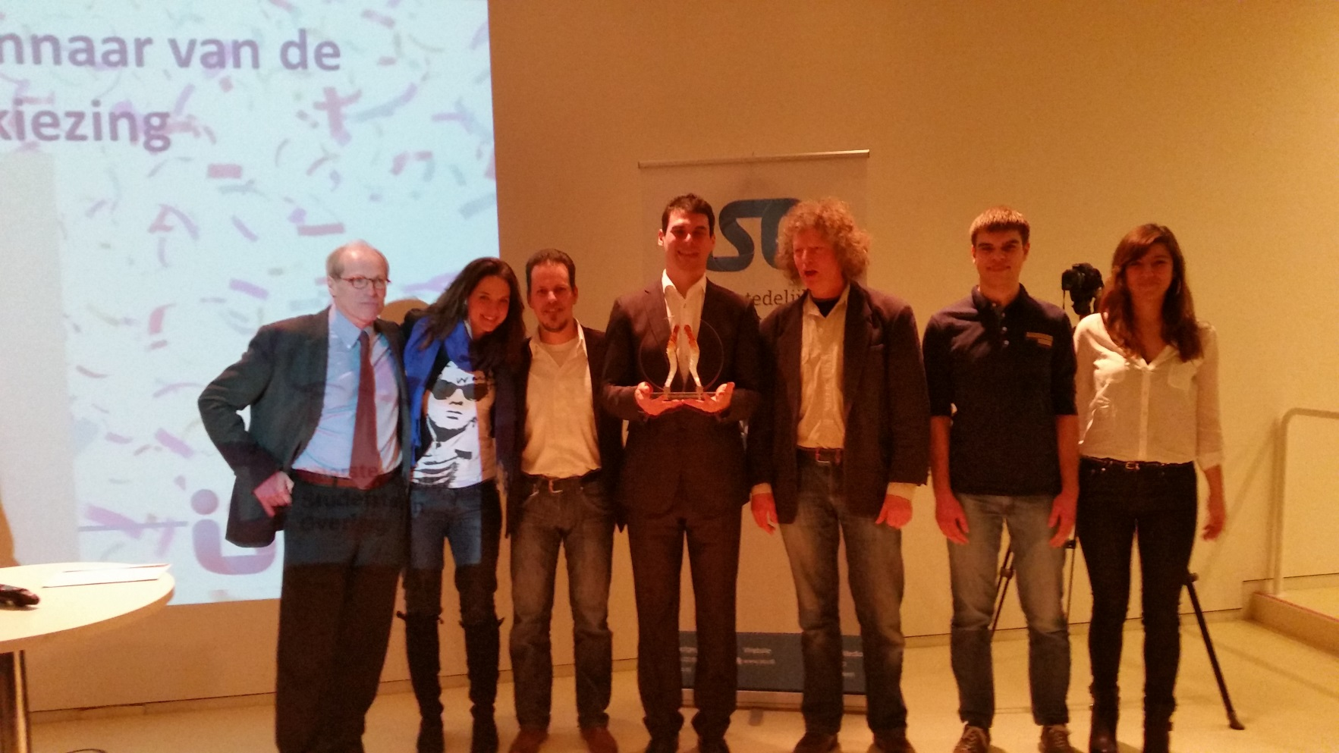
Does Gamification Work for Me?
Q: But, Alexandru, surely not every course can use gamification!? I mean, there is no technique for my concept / activity / entire course…
Notes:
I learned to say ICT, not computers
It took me 20 years to go
from computer games to gamification
I switched from football to basketball

Slide 54


A: Wonderful Advances in Gaming, Last 10 Years: diverse individual challenges
Beyond eyes
Notes:
http://www.beyondeyes-game.com/

Slide 55
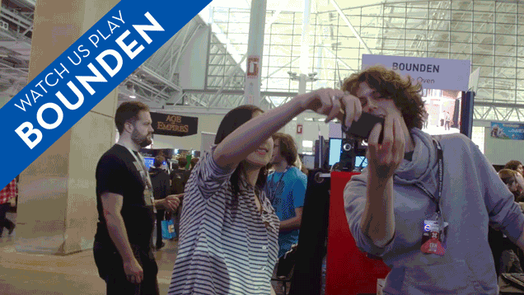
A: Wonderful Advances in Gaming, Last 10 Years: diverse social challenges
Notes:
Bounden by Adriaan de Jongh (Game Oven) and Ernst Meisner (Het Nationaal Ballet) is a social game of dancing.
http://playbounden.com/

Slide 56
Gamification Mechanics & Dynamics
Mechanics = how the system turns inputs into outputs
  Points
  Badges
  Leaderboards
  Game states, such as winning, losing, cheating, etc.
  Challenges for each player type
  Rules, tutorials, guidelines, helpers, checklists
  Feedback
  Unlocked content
  … so many more
Mechanics are applied directly, by the system (course staff),
without further interaction from students.
A. Iosup and D. Epema, An Experience Report on Using Gamification in Technical Higher Education, ACM SIGCSE’14. http://goo.gl/V97zSW
Notes:
Gamification by Design: Implementing Game Mechanics in Web and Mobile Apps Paperback – August 22, 2011
by Gabe Zichermann (Author), Christopher Cunningham

Slide 57
Gamification Mechanics & Dynamics
Dynamics = how the players and the system interact
  Progress / Learning graph, with challenges as nodes,
  tested progress as edges, points etc. as properties of edges
Individual dynamics (so, regardless of what others do)
  Students can spend their points for some reward
  Students get access to more advanced content
Group dynamics (so, regardless of what students outside the group do)
  Peer-reviews are discussed with the group,
  can result in bonuses/exclusions
Cohort dynamics
  Top-20% participate in extra lectures
  Best group wins cookies
  Bonus for best student/group of the day
http://www.kunstbuch-shop.de/images/guido-mocafico-movement-03_462.jpg
A. Iosup and D. Epema, An Experience Report on Using Gamification in Technical Higher Education, ACM SIGCSE’14. http://goo.gl/V97zSW

Slide 58

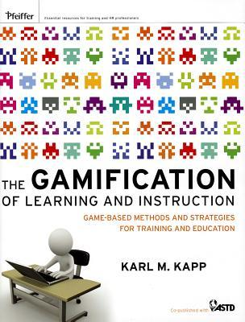
Possible Games for Teaching Facts, Concepts, Procedures, and Systems
What? | How? Common teaching elements
Facts | Story w terms, acronyms, and jargon Taxonomies and Venn diagrams Games of repetition, recognition, matching
Concepts | Story w metaphors Boundary examples Games to experience, classify, compare sort
Procedures (Rules) | Top-to-bottom view, story w Why? What? Role-playing (Mechanics + feedback)
Systems | Tutorials to experience under guidance Using all the other elements for complete XP
Notes:
How to Do Things with Videogames (Electronic Mediations) by Bogost, Ian
The Gamification of Learning and Instruction: Game-based Methods and Strategies for Training and Education Hardcover – May 1, 2012
by Karl M. Kapp

Slide 59
It’s The People
You
  Time management
Co-teacher
  Verify and reflect on your ideas and adaptations
Student assistants
  What are they going to do? How many? How to co-involve in design?
Students
  How many? Is this cohort the same as last year?
  Have they seen a gamified course before?

Slide 60
Tools: Missing?
BlackBoard?
  Contract ends end of 2015; tender for replacement is started
  We are involved in testing possible candidates
Excel?
FeedbackFruits?
  Promises basic gamification support for 2015/2016
Dropbox? → SurfDrive!

Slide 62

Do You Know This Person?
By Eunice Szpillman, via Wikimedia Commons
Notes:
By Eunice Szpillman (Alexey Pajitnov) [CC BY-SA 2.0 (http://creativecommons.org/licenses/by-sa/2.0)], via Wikimedia Commons
http://commons.wikimedia.org/wiki/File:Alexey_Pajitnov_-_2575833305_(crop).jpg

Slide 63
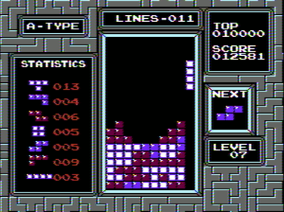
By Damian Yerrick, via Wikipedia
Notes:
Screenshot made by Damian Yerrick of the video game Tetris for NES, published by Nintendo. Game is © Elorg/Nintendo
Damian Yerrick asserts fair use in the article Tetris to depict the game that is the subject of the article.
http://en.wikipedia.org/wiki/File:Tetris_NES_play.png

Slide 64
O
L
I
Z
T

Slide 65
O
Designing a course is
like creating a complex puzzle
L
I
Z
T

Slide 66
I in the Box
I

Slide 67
I in the Box
I

Slide 68
I in the Box
I

Slide 69
I in the Box
I

Slide 70
I in the Box
I

Slide 71
I in the Box
I

Slide 72
I
I
I
I

Slide 73
I

Slide 74
What Leads to Fun?
Playtest your design and check for fun!
Surprise
Recognition
Belonging
Fantasising
Just playing
…
Notes:
http://ecx.images-amazon.com/images/I/51tvpTzuwdL.jpg
R. Koster and W. Wright: Theory of Fun for Game Design, 2010.

Slide 75

2. What Leads To Motivation?
Extrinsic Motivation
  Fun!
  Rewards, achievements, badges
  Passing the course
  Top of the ranking
  …
But ... one trigger may be
extrinsic for some, and
intrinsic for others
Intrinsic Motivation
  Fun!
  Mastery of subject, your way
  Be you! Access and, later, Autonomy
  Higher purpose, your way
  (also Maslow’s Hierarchy of Needs)
Notes:
http://ecx.images-amazon.com/images/I/51tvpTzuwdL.jpg

Slide 76

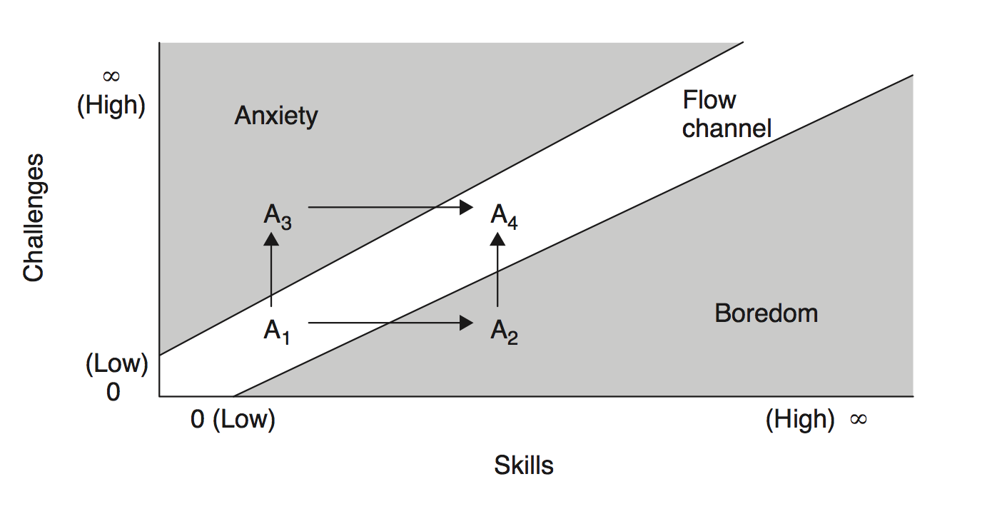
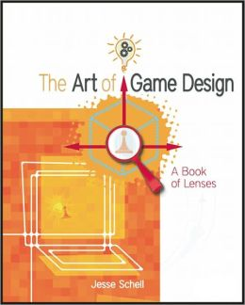
3. Balance Leads to Flow
Flow = mind state of being focused exclusively on one activity (“being in the zone”, “the flow channel”)
Balance between challenge increase and skill growth
Notes:
Flow Paperback – 1990
by Mihaly Csikszentmihalyi
The Art of Game Design: A book of lensesAug 4, 2008
by Jesse Schell

Slide 77
The Learning Graph
Q: How to build the learning graph for your course?
Lab
Tutorial
Win!
Group Study
Lectures

Slide 78
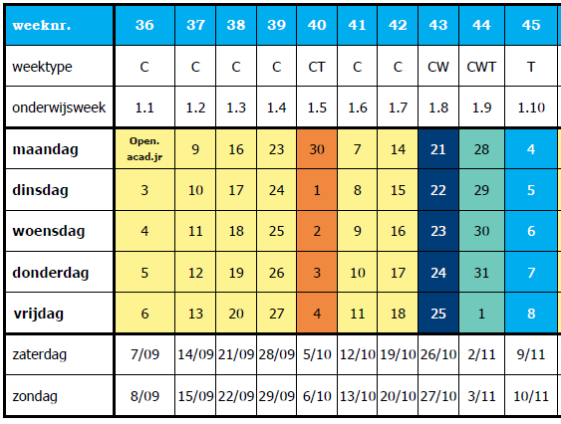
A: From the Course Schedule
Q: How to build the learning graph for your course?
Lecture (Hoorcollege) Lab (Practicum)
Tutorial (Instructie)
Exam

Slide 79
A: From the Course Schedule
Q: How to build the learning graph for your course?
L
L
L
L
L
L
P
L
P
P
T
T
T
T
T
T
L
L
L
L
L
L
L
E
E
Lecture (Hoorcollege) Lab (Practicum)
Tutorial (Instructie)
Exam

Slide 80
From the Course Schedule
Q: How to build the learning graph for your course?
Extract activities from the Course Schedule
L
L
L
L
L
L
P
L
P
P
T
T
T
T
T
T
L
L
L
L
L
L
L
E
E
Lecture (Hoorcollege) Lab (Practicum)
Tutorial (Instructie)
Exam

Slide 81
From the Course Schedule
Q: How to build the learning graph for your course?
Add dependencies between activities
L
L
L
L
L
L
P
L
P
P
T
T
T
T
T
T
L
L
L
L
L
L
L
E
E
→ Assessment
Lecture (Hoorcollege) Lab (Practicum)
Tutorial (Instructie)
Exam

Slide 82
From the Course Schedule
Q: How to build the learning graph for your course?
Add dependencies between activities (continued)
L
L
L
L
L
L
L
P
P
P
T
T
T
T
T
T
L
L
L
L
L
L
L
→ Assessment
E
E
Lecture (Hoorcollege) Lab (Practicum)
Tutorial (Instructie)
Exam

Slide 83
From the Course Schedule
Q: How to build the learning graph for your course?
Add important states, such as Winning
L
L
L
L
L
L
L
P
P
P
T
T
T
T
T
T
L
L
L
L
L
L
L
→ Assessment
E
E
Lecture (Hoorcollege) Lab (Practicum)
Tutorial (Instructie)
W
Exam

Slide 84
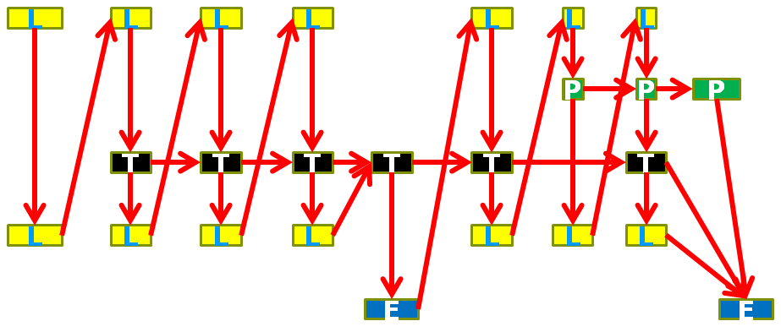
From the Course Schedule
Q: How to build the learning graph for your course?
Extract activities from the Course Schedule
Add dependencies between activities
Add important states, such as Winning
Annotate edges (points, etc.)
Identify paths of advancement on the resulting graph
(Iterate, finer granularity)
→ Assessment + Points
0-100
0-1,000
0-3,000
0-7,500
W

Slide 85
From the Course Schedule
Q: How to build the learning graph for your course?
Q: How to add to the learning graph
self-study (homework) activities?
L
L
L
L
L
L
L
P
P
P
T
T
T
T
T
T
Q: How to add to the learning graph
an entry quiz?
L
L
L
L
L
L
L
→ Assessment
E
E
Lecture (Hoorcollege) Lab (Practicum)
Tutorial (Instructie)
W
Exam

Slide 86
References (Shortlist, brief info)
A. Iosup, D. Epema: An experience report on using gamification in technical higher education. SIGCSE 2014.
Jane McGonigal: Reality is Broken: Why Games Make Us Better and How They Can Change the World, 2011.
Robert M. Diamond: Designing and Assessing Courses and Curricula: A Practical Guide, 2008.
L. Dee Fink : Creating Significant Learning Experiences: An Integrated Approach to Designing College Courses, 2013.
B. Gross Davis: Tools for Teaching, 2009.
M. Svinicki, W. J. McKeachie: McKeachie's Teaching Tips: Strategies, Research, and Theory for College and University Teachers 2010.
K. Bain, What the Best College Teachers Do, 2004.
G. Zichermann, C. Cunningham: Gamification by Design: Implementing Game Mechanics in Web and Mobile Apps, 2011.
I. Bogost: How to Do Things with Videogames (Electronic Mediations), 2011
K. M. Kapp: The Gamification of Learning and Instruction: Game-based Methods and Strategies for Training and Education, 2012.
R. Koster and W. Wright: Theory of Fun for Game Design, 2010.
M. Csikszentmihalyi: Flow, 1990.
J. Schell: The Art of Game Design: A book of lenses, 2008.

Slide 87
Images used in this lecture courtesy of the Computer History Museum, Mountain View, California, USA, http://www.computerhistory.org/ ; the German Museum of Technology (Deutsches Technikmuseum Berlin, Germany, http://www.sdtb.de/Englisch.55.0.html ; the Science Museum, London, UK, http://www.sciencemuseum.org.uk/;
and many anonymous contributors via Google Images. Many thanks!

