Slide 1
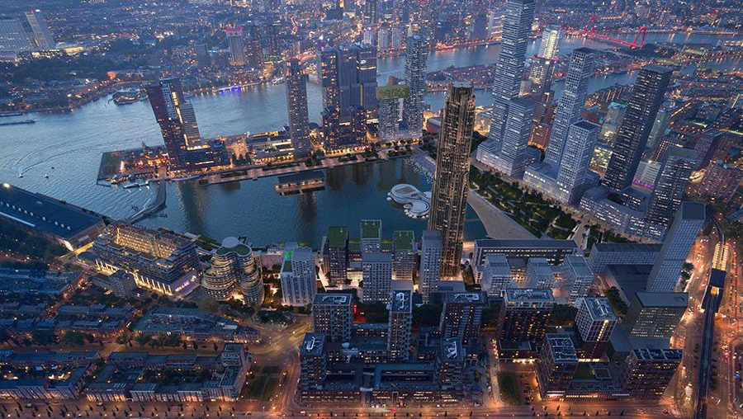
RESILIENT
DEVELOPMENT
OR CLIMATE GENTRIFICATION?
Linking Real Estate Finance with Social Equity
Zac J. Taylor
November 2, 2022
Image: Powerhouse Company

Slide 2
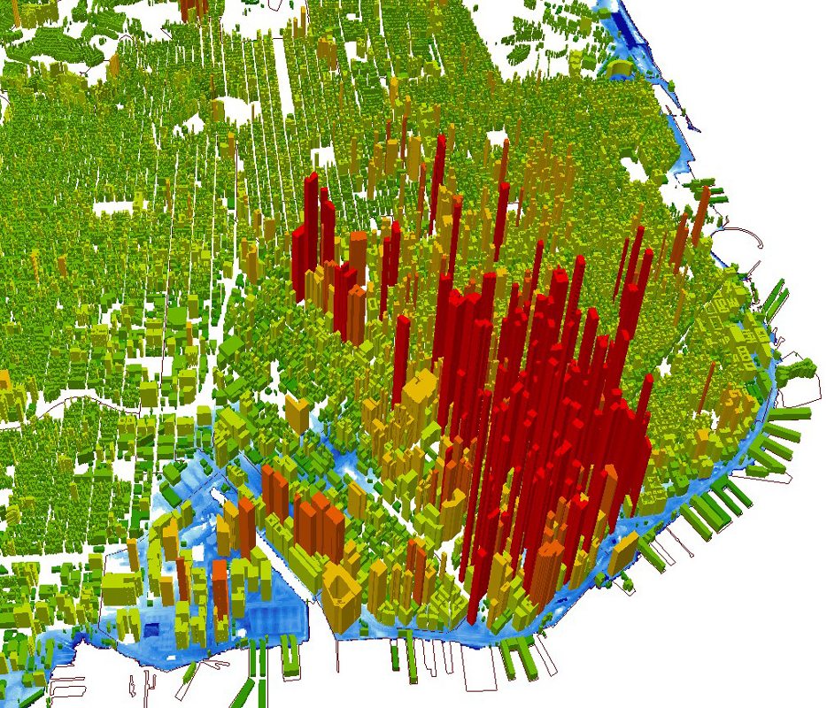
Climate Risk, Finance and the Global Search for “Resilient” Real Assets
Image: PGGM – Climate Risk Assessment in Global Real Estate
Image: City and County of San Francisco/ RMS

Slide 3
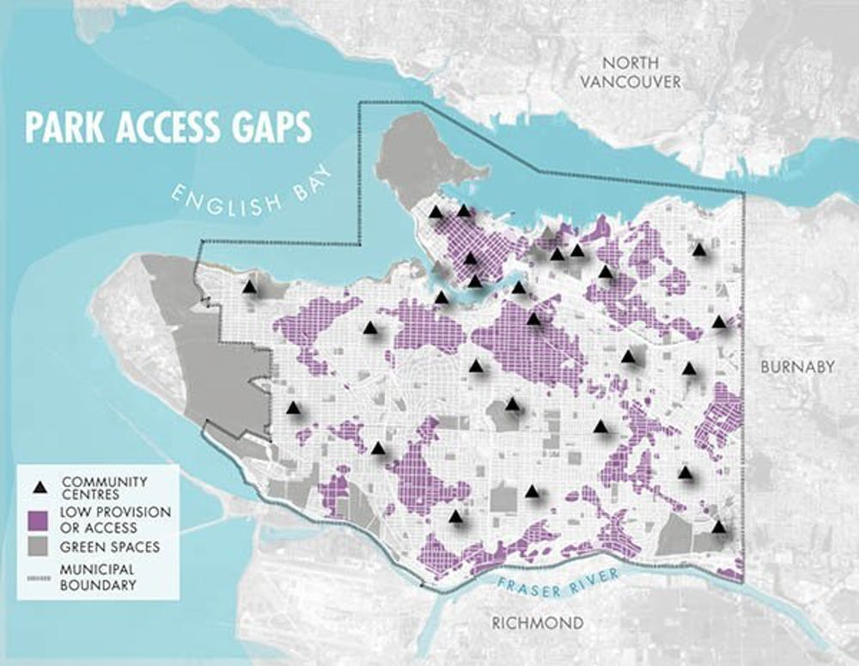
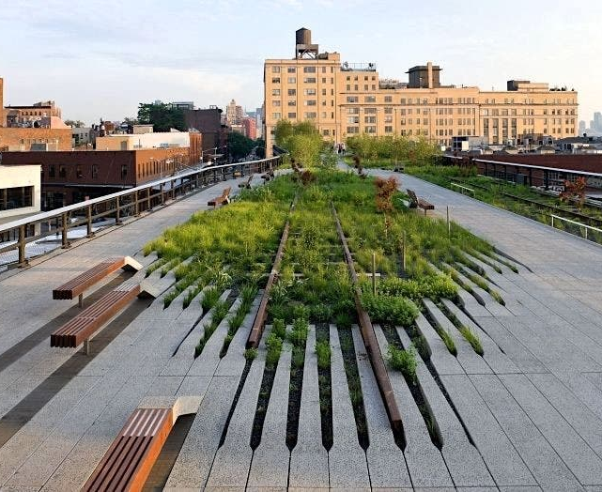
Climate Gentrification: Linking Spatial Intervention with Equity and Justice
Image: City of Vancouver
Image: New York City Department of Parks & Recreation

Slide 4
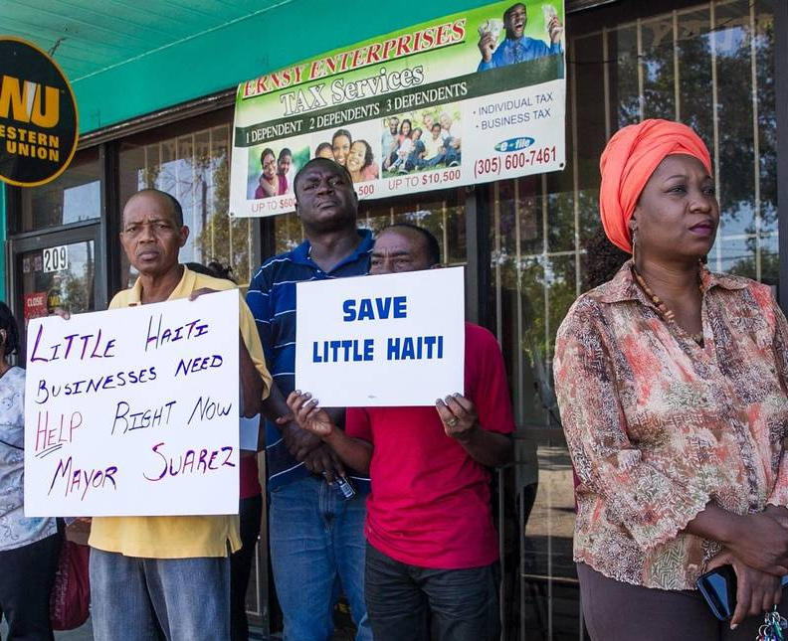
The Deconstructive Approach: Reading Real Estate-Finance Climate Risk Strategies through Greater Miami
Image: ‘The Invading Sea’ project
Image: Zac Taylor

Slide 5
The Reconstructive Approach: Co-Creating Knowledge with Large Institutional Real Estate Investors
Images: Climate Migration and Real Estate Investment Decision-Making. Urban Land Institute (2022).

Slide 6
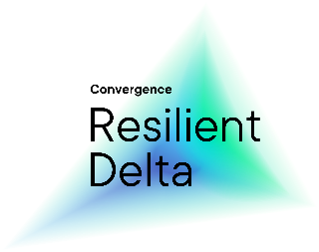
A Combined Approach? Integrated Real Estate Climate Risk Management in the Netherlands with RED&BLUE

Slide 7
Thanks!
Zac Taylor
Assistant Professor
Department of Management in the Built Environment
TU Delft
Academic Coordinator, Delta Systems
Resilient Delta Initiative
RED&BLUE
www.redblueclimate.nl

