Slide 1
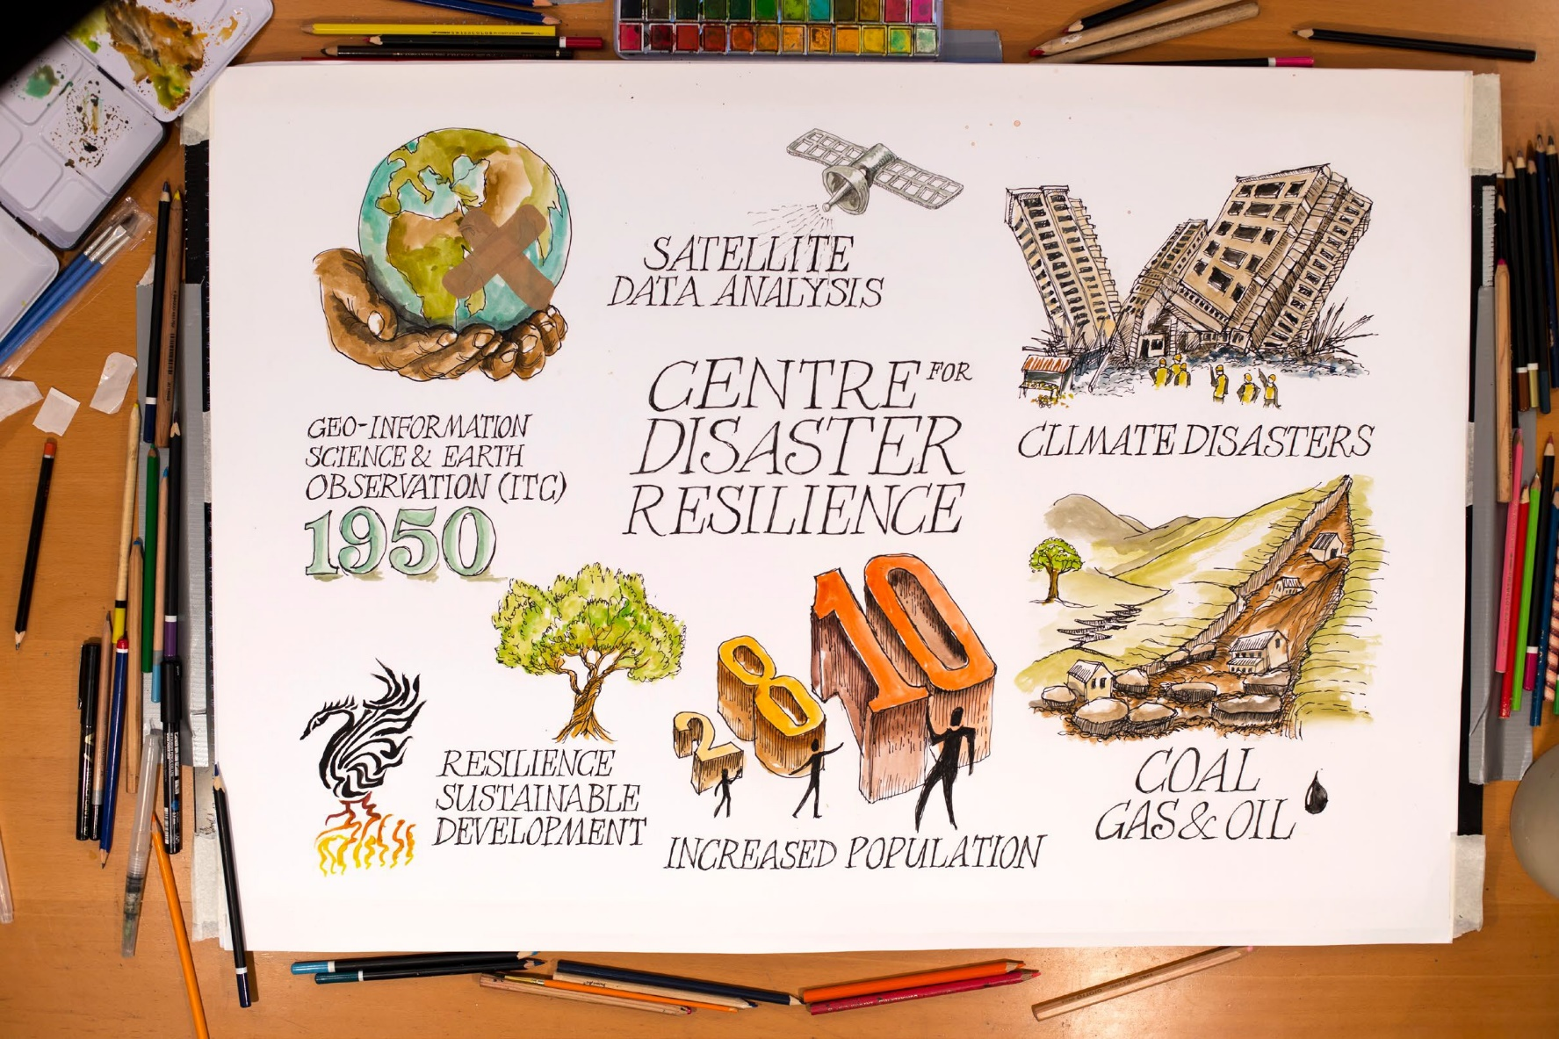

Carey Marks, Scarlet-design.co.uk
Carey Marks, Scarlet-design.co.uk
Honorable Mention

Slide 2
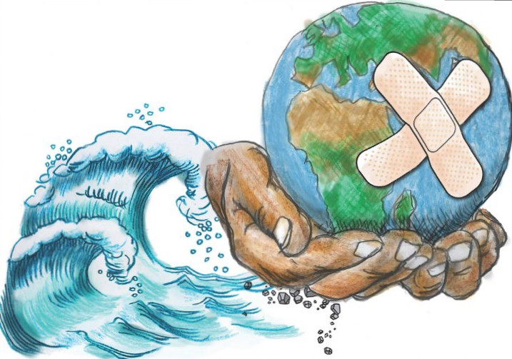



CENTRE FOR DISASTER RESILIENCE
www.itc.nl/cdr
@DisasterResil
Carey Marks, Scarlet-design.co.uk
Dr Irene Manzella
Associate Professor and Head of the CDR
i.manzella@utwente.nl twitter: @Irene_Manzella

Slide 3

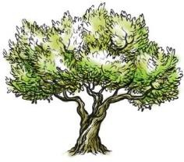

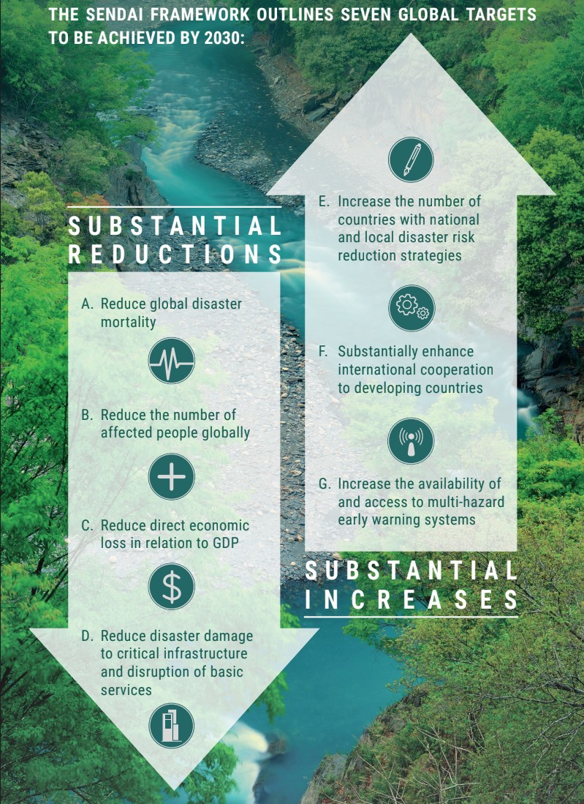






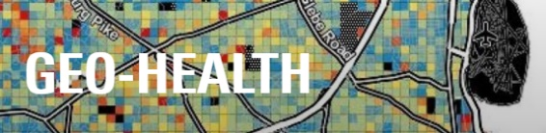
SOCIETY IN 2030: CONTRIBUTING TO A FAIR, SUSTAINABLE AND DIGITAL SOCIETY

Slide 4
REACH OUT AND CONNECT
SYNERGETIC AND COMMON EFFORT
KNOWLEDGE HUB
KNOWLEDGE SHARING
MAKE OUR WORK USEFUL, USABLE, OPEN SOURCE
INCREASE COHERENCE AND VISIBILITY

Slide 5
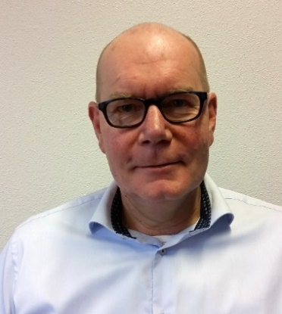
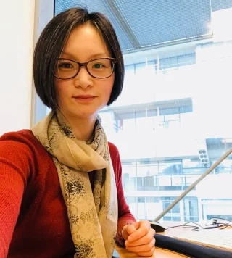
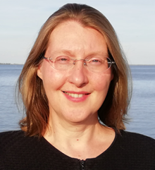
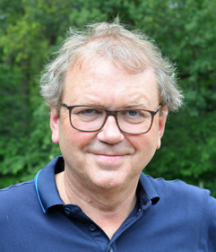
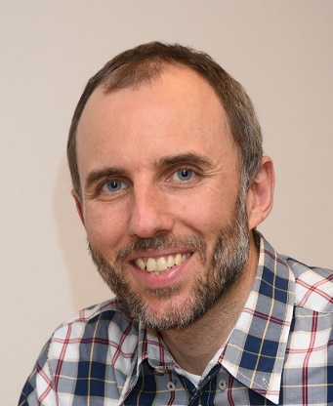
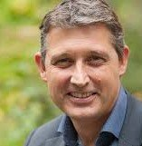
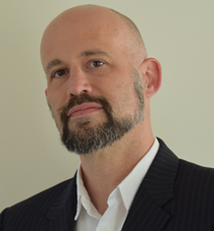
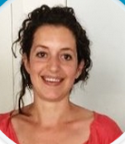

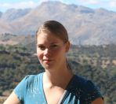
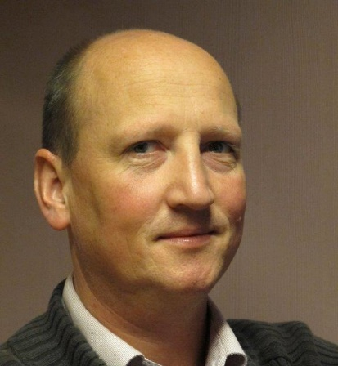
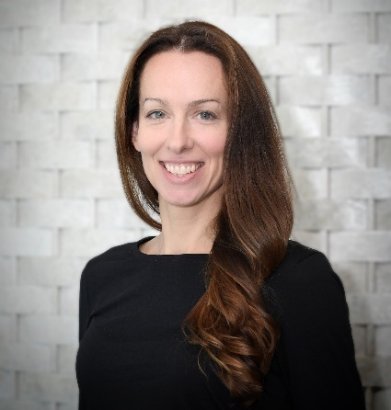
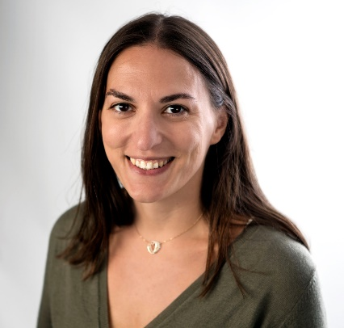
WHO?
Andy Nelson
Freek van der Meer Dean of ITC
NRS
Richard Sliuzas
Ling Chang
Daphne van der Wal
PGM
EOS
Cees van Westen
WRS
AES
Stephanie Hessing
Frank Ostermann
GIP
4TU.Resilience Engineering Center
Dinand Alkema
Project Officer
Heather Handley
Expert Communicator
Irene Manzella
Leader/Coordinator
Lise-Lotte Westerhof-Smit
Administrator
Lisa Timmerman
Ingenuity project manager

Slide 6
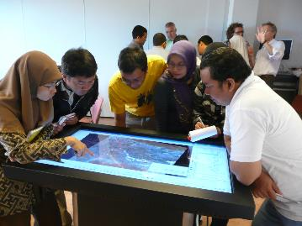
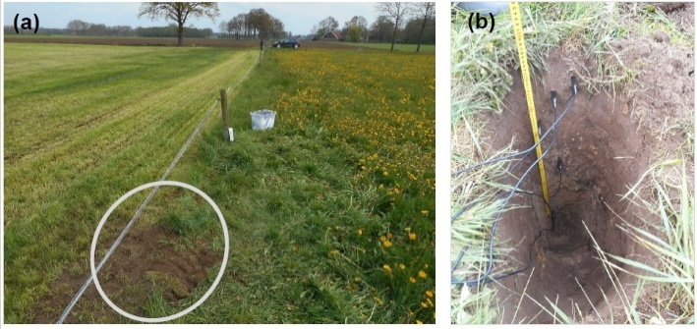
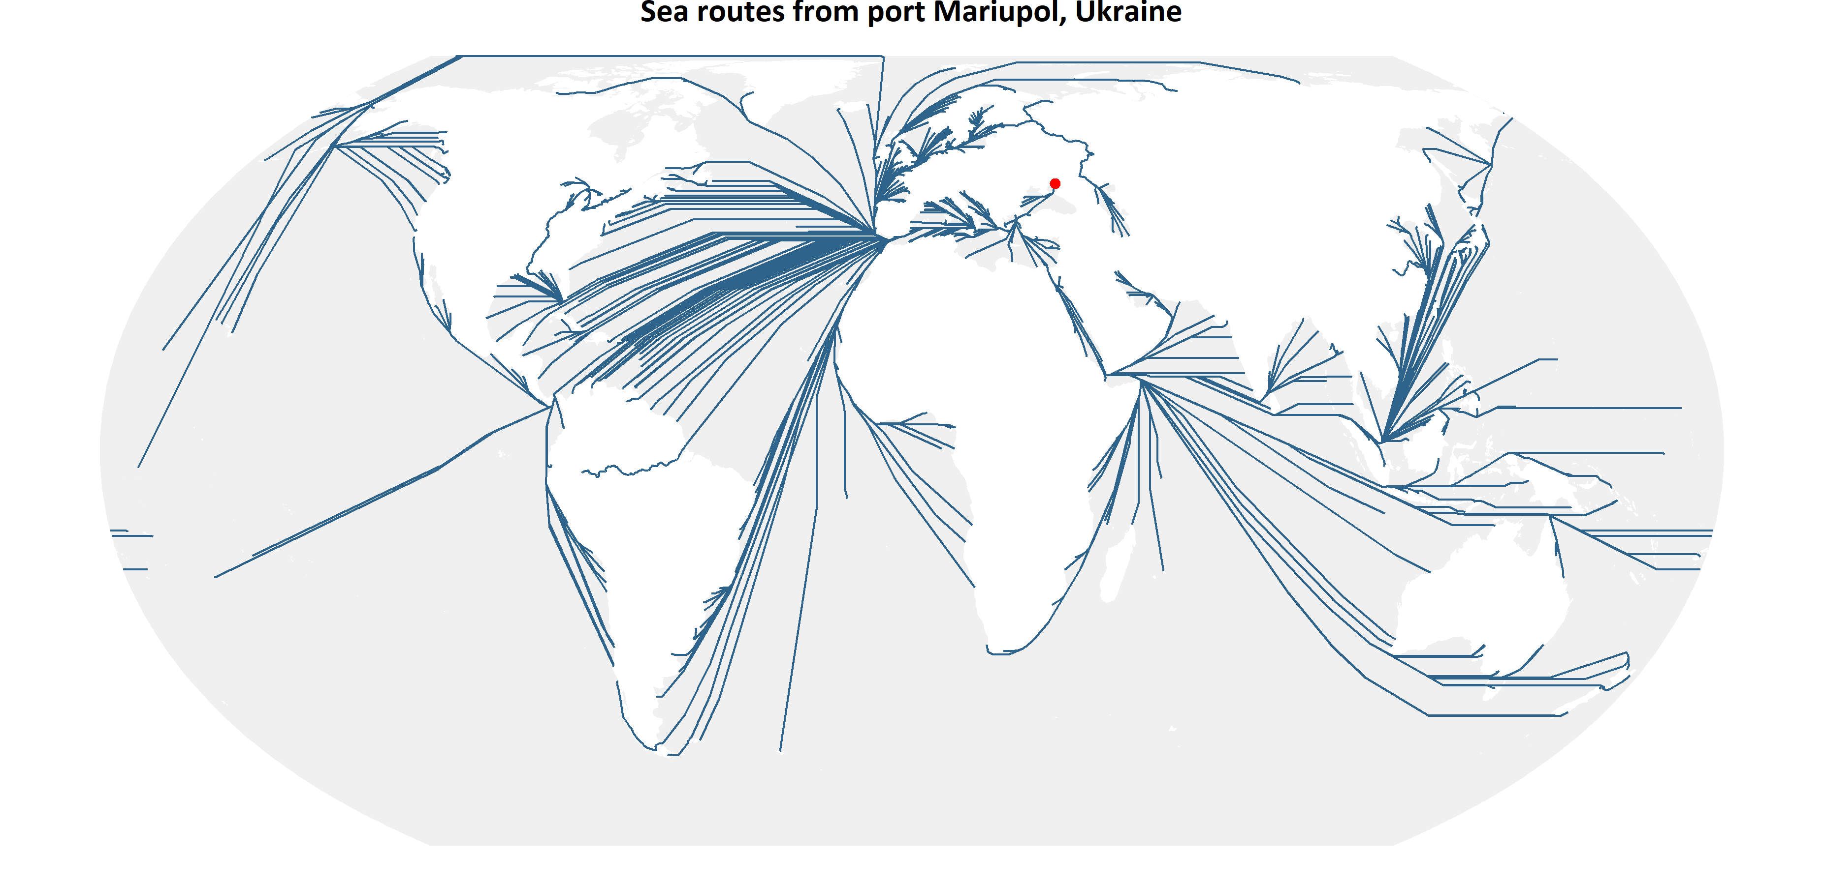
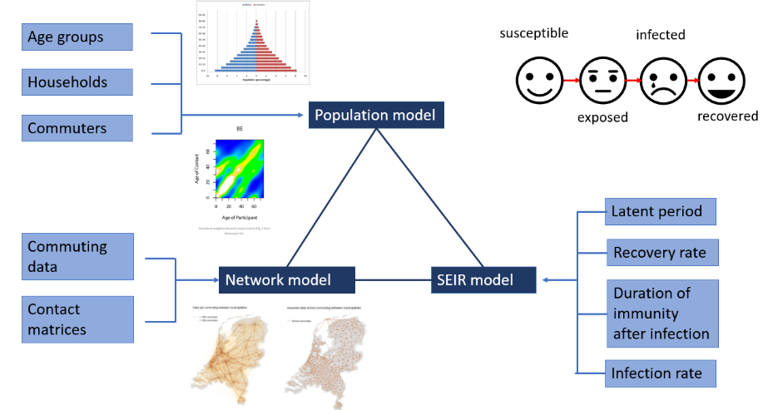
WHAT? Participatory approach and innovative technology
Engage stakeholders for inclusive resilience building spatial strategies.
Sustainable water use, water management and climate resilience
Soil moisture
network Twente
(Benninga, van der Velde)
Building Resilient food transport networks
Nelson et al (2021)
Geosocial media analysis for responding to rapid-onset disasters and spatio-temporal modelling and machine learning for responding to slow-onset disasters
Photograph: NASA/REID WISEMAN/EPA

Slide 7
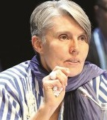

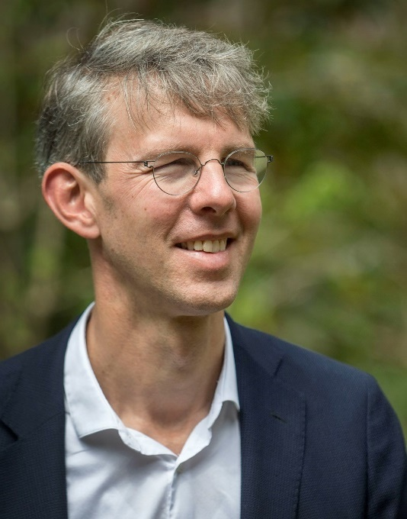
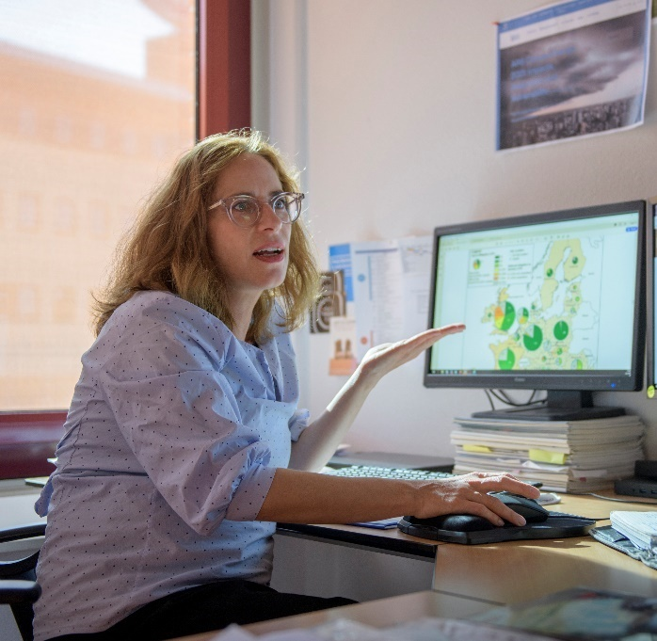
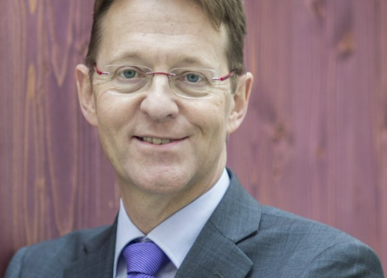
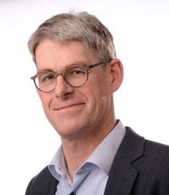
WHAT? Policy making, Climate Action and Sustainability at the regional, national and international level
Climate action and National Research Programme
Climate Resilience and Ministry OCW
Sustainibility in the East of Netherlands
European Scientific Advisory Board on Climate Change
Intergovernmental Panel on Climate Change (IPCC)
KNMI and RCCC close collaborations and partnership
Debra Roberts
Maarten Van Aalst
Viktor Jetten
Diana Reckien
Gerard van der Steenhoven

Slide 8

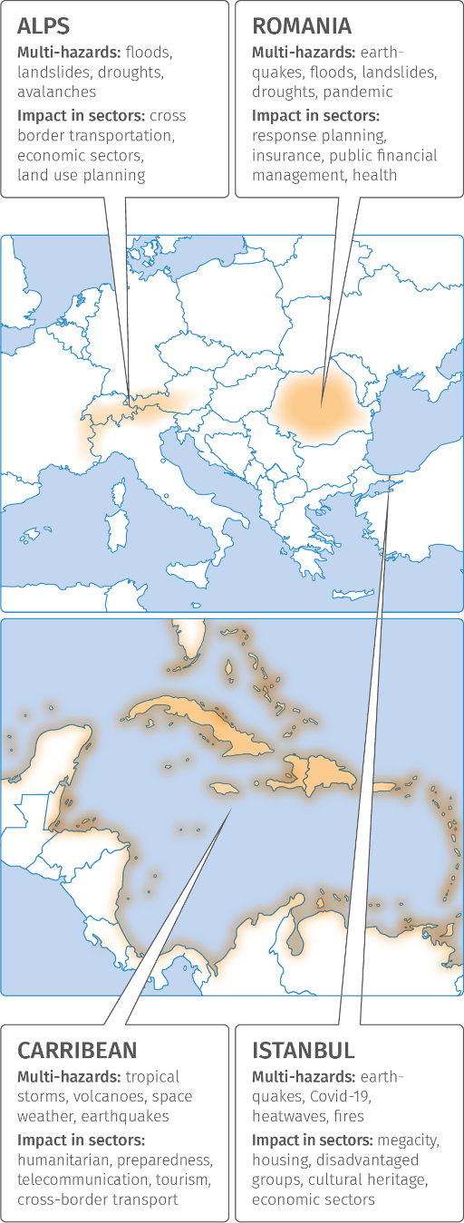
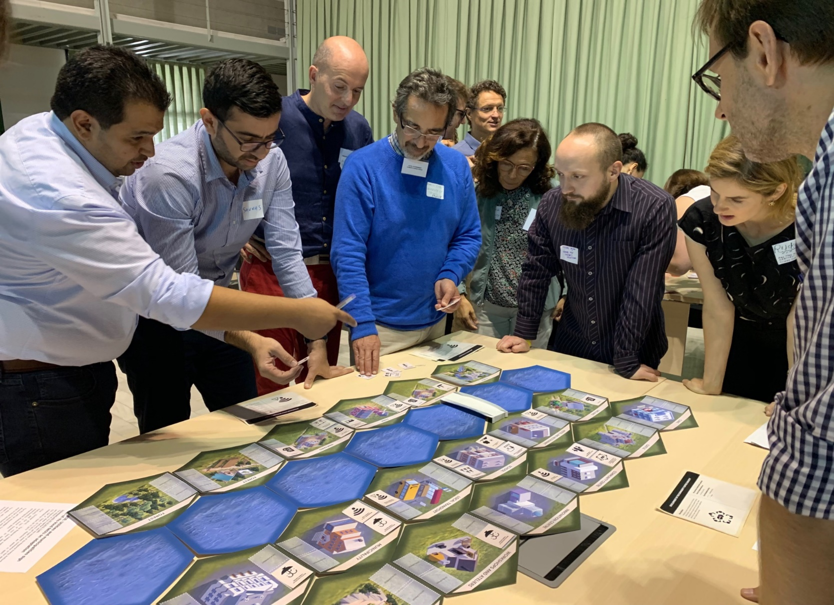
Increasing Preparedness And Resilience Of European Communities By Co-Developing Services Using Dynamic Systemic Risk Assessment

Slide 9
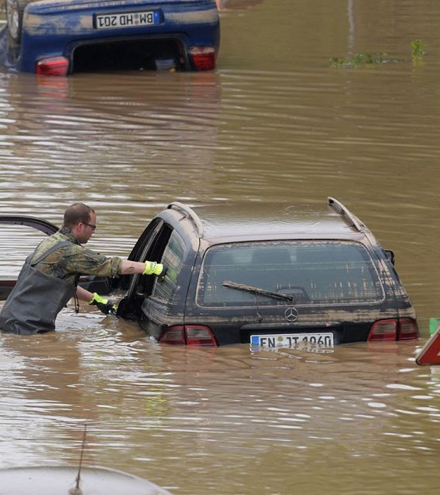
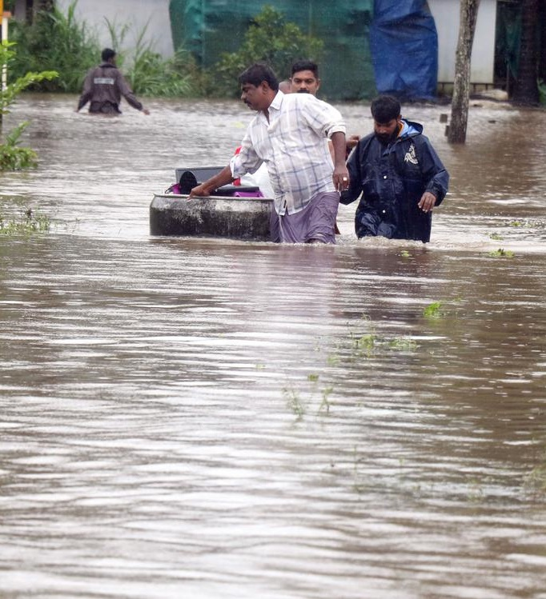

Slide 10
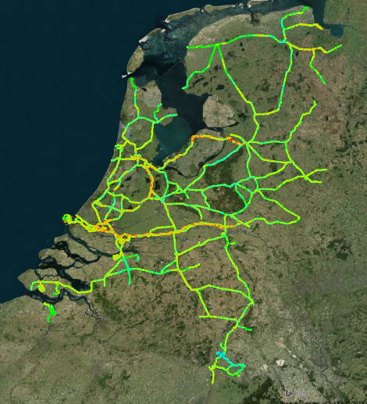
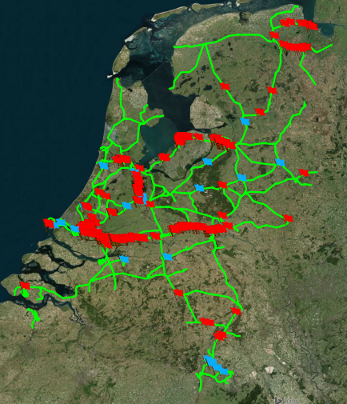
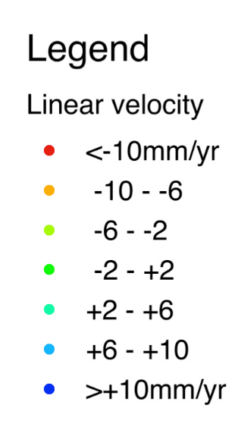
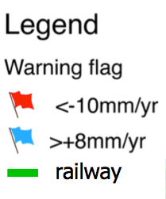
Nation-wide rail-deformation
Risk-map example
Radarsat-2 data [2010.06 – 2015.08]
Radarsat-2 data [2010.06 – 2015.08]
Chang et al, 2018
Notes:
Use of satellite image to assess risk

Slide 11
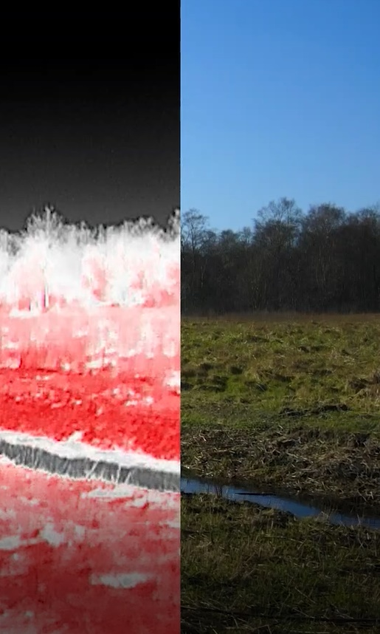
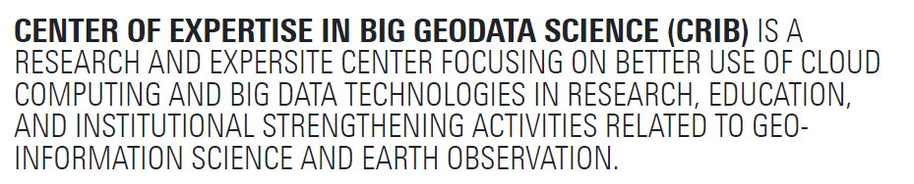

UAV CENTRE
Problem identification > Data collection >
Analysis
WWW.ITC.NL/UAV-CENTRE
CRIB
WWW.itc.nl/big-geodata
DIGITAL TWINS
https://www.itc.nl/research/research-facilities/labs-resources/digital-twin-itc/

Slide 12
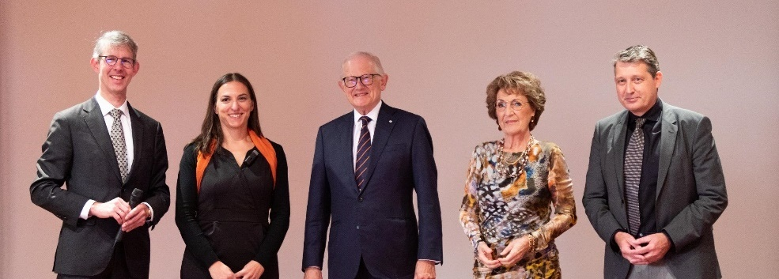
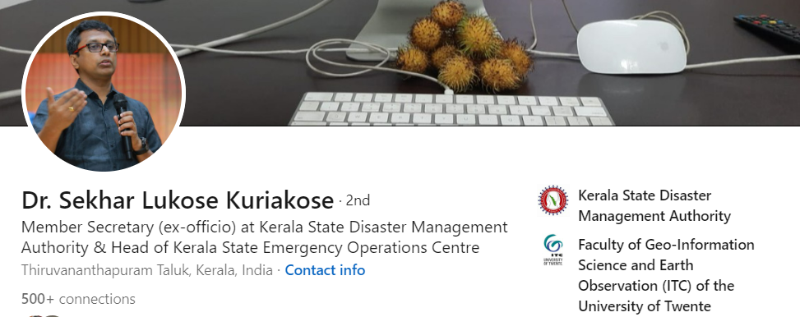
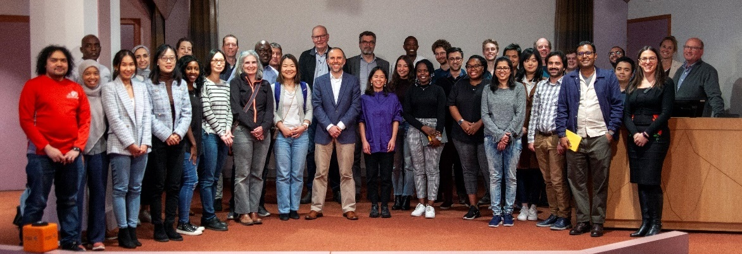
WHAT WE DID @CDR?
Official opening by H.R.H. Princess Margriet
ITC symposium: Resilience in Science and Science in Resilience
Dr. Sekhar L. Kuriakose visiting scientist and 4 incoming ones this year
Kerala – ITC collaboration
3 postdocs
  Food transport resilience
  Drought Resilience
  Climate Financing
Earth Future Festival
Symposium M²R²

Slide 13

WHAT WE ARE PLANNING TO DO?
Short courses
Annual Conference
Workshops
Tools for Disaster Responses and Resilience
Projects development
Call for postdocs (every year, 2 positions)
Call for Visiting scientists (every year 4-6 positions)
… and many other activities
NEXT POSITIONS ADVERTISED END OF JANUARY!

Slide 14

To find together new ways to build a more resilient society and a sustainable future for all
So that the we can not only be part of the change but be the ones who drive the change
www.itc.nl/cdr
@DisasterResil
Thank you all for your attention

