Slide 1

Droughts and dikes: The stress that amplifies the shock on flood defence systems
Juan Pablo
Aguilar-López
Tenure Tracker on Flood Defence Resilience
Hydraulic Engineering Department
CEG- Delft University of Technology

Slide 2

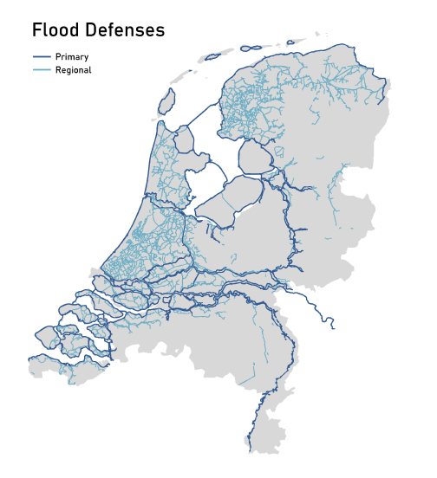
My Motivation
We are protected by 3500 km of primary flood defences and 14,500 km of regional flood defences.
More than 90% of the flood defence line is composed of hetereogenous soil based dikes.
Climate change (floods+droughts and sea level rise)is reducing dike’s reliability.
Figure by Jorijn Holstvoogd

Slide 3
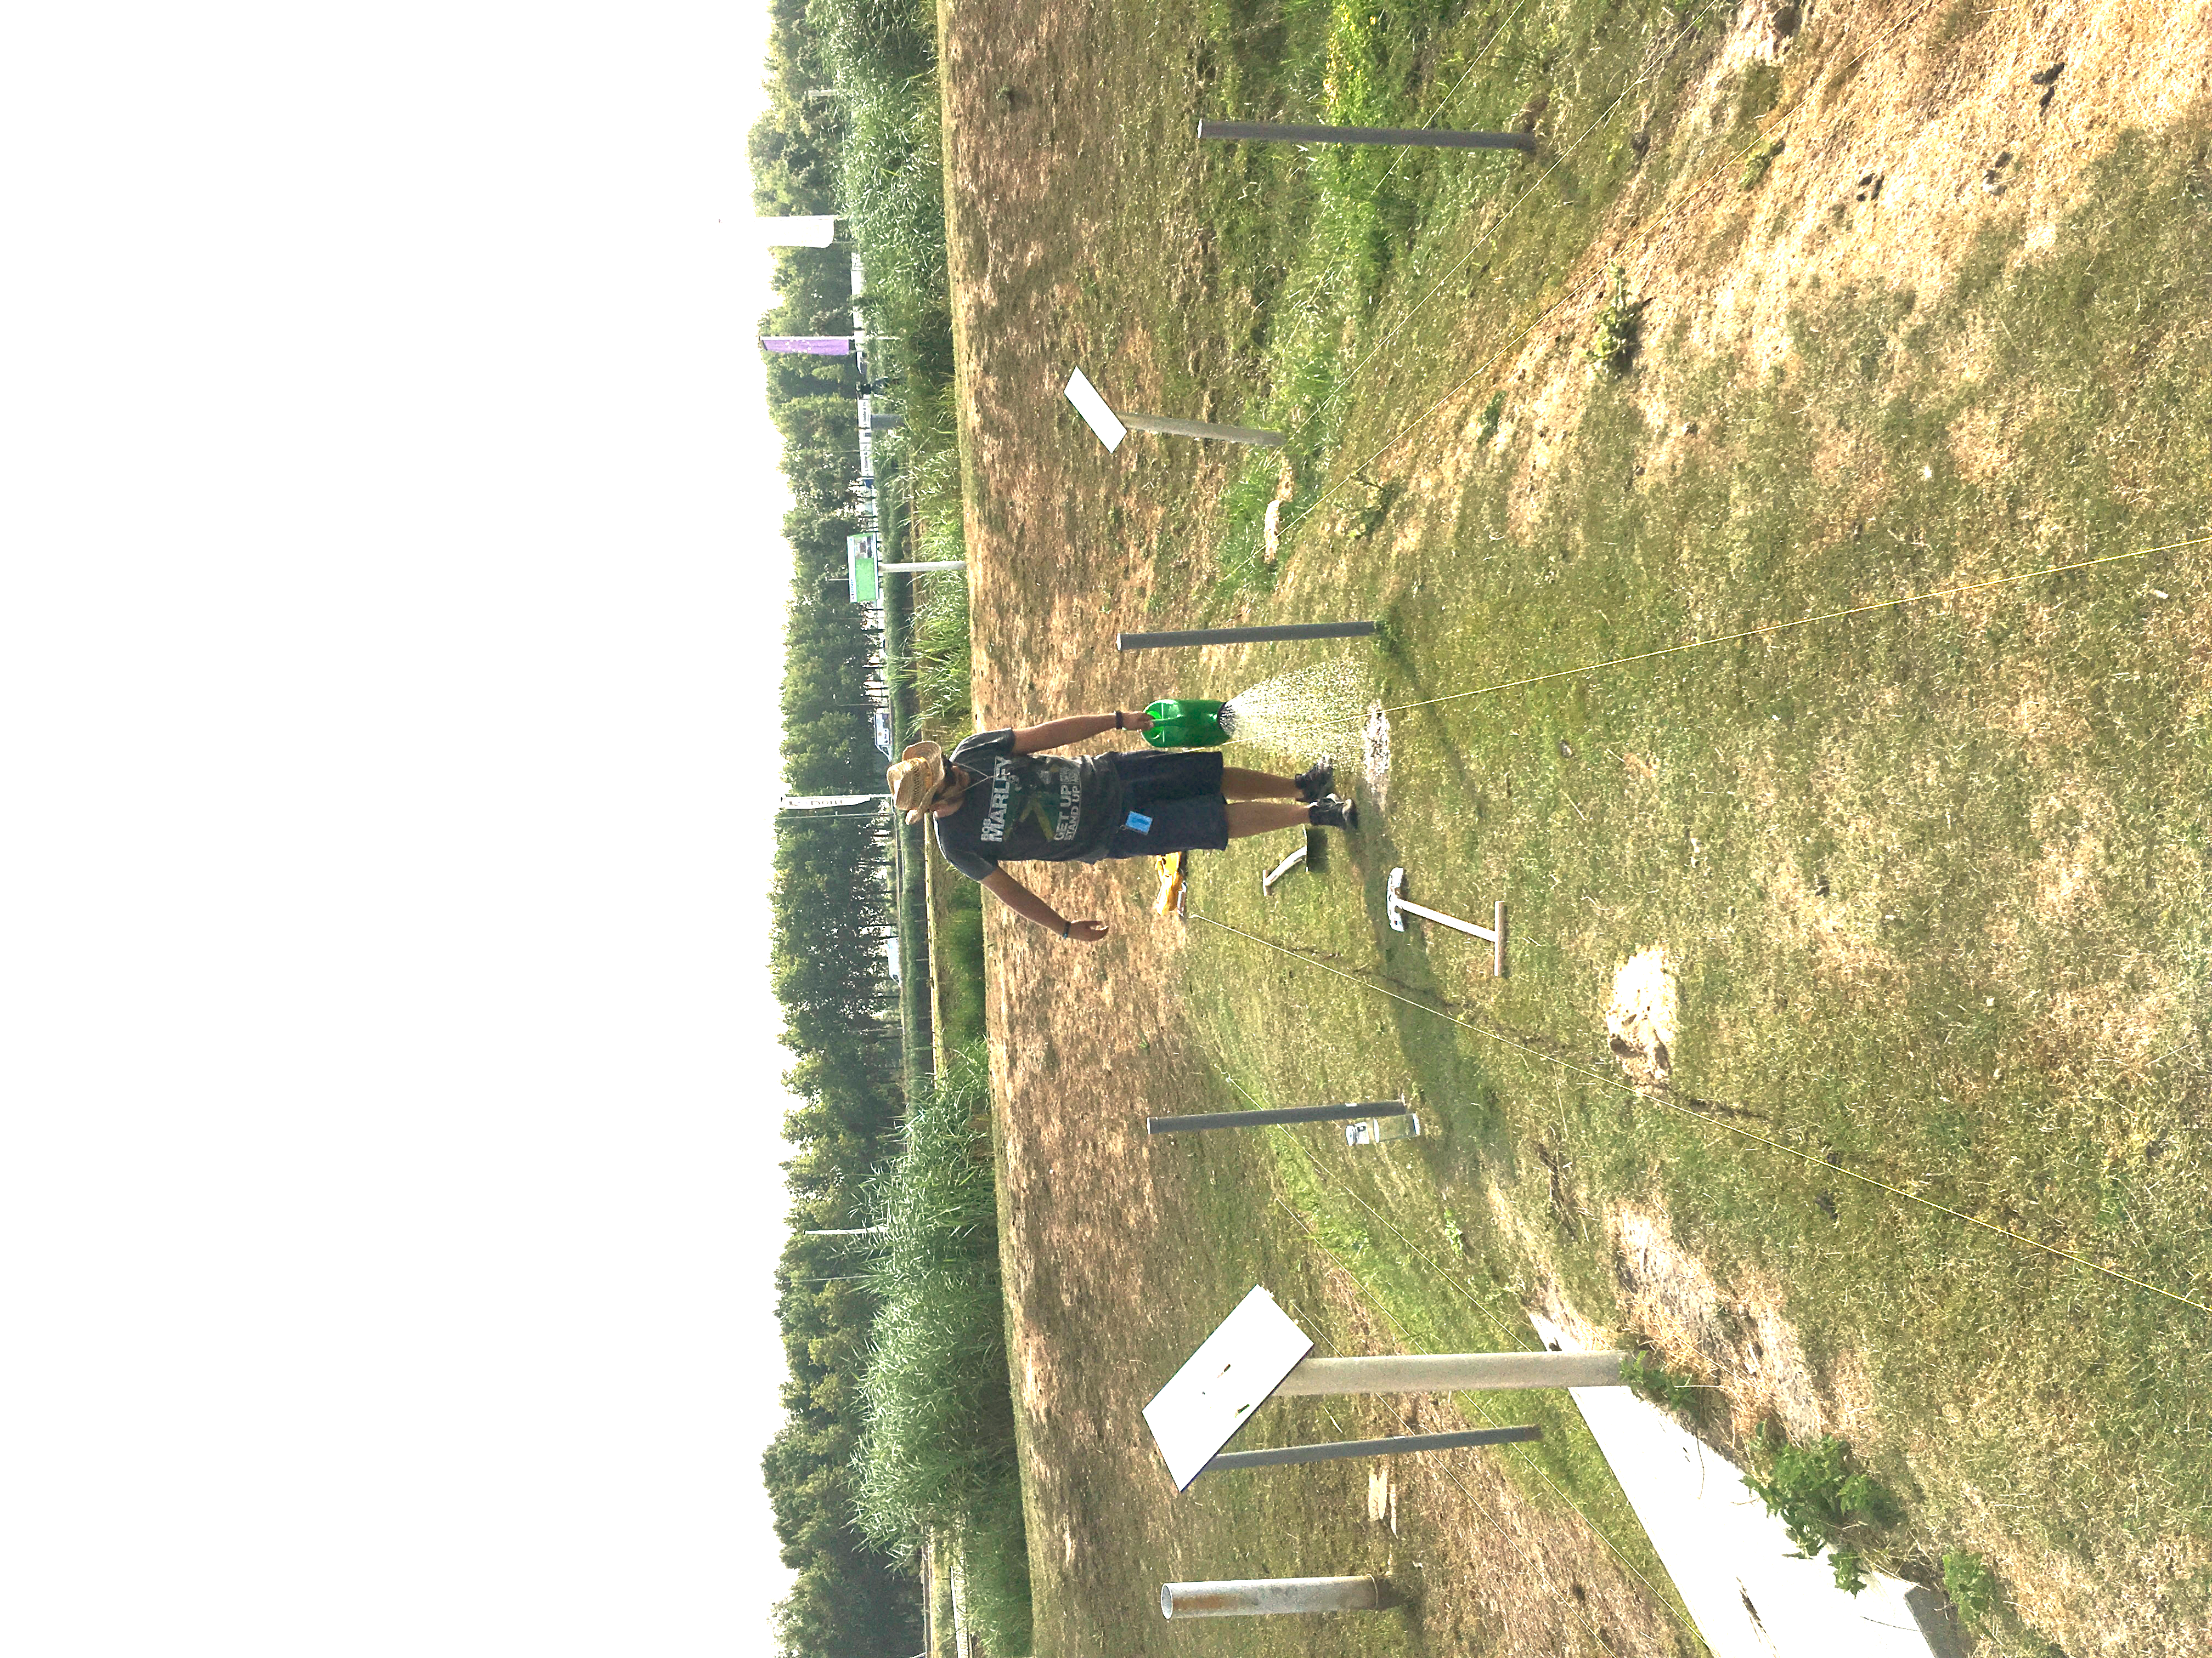
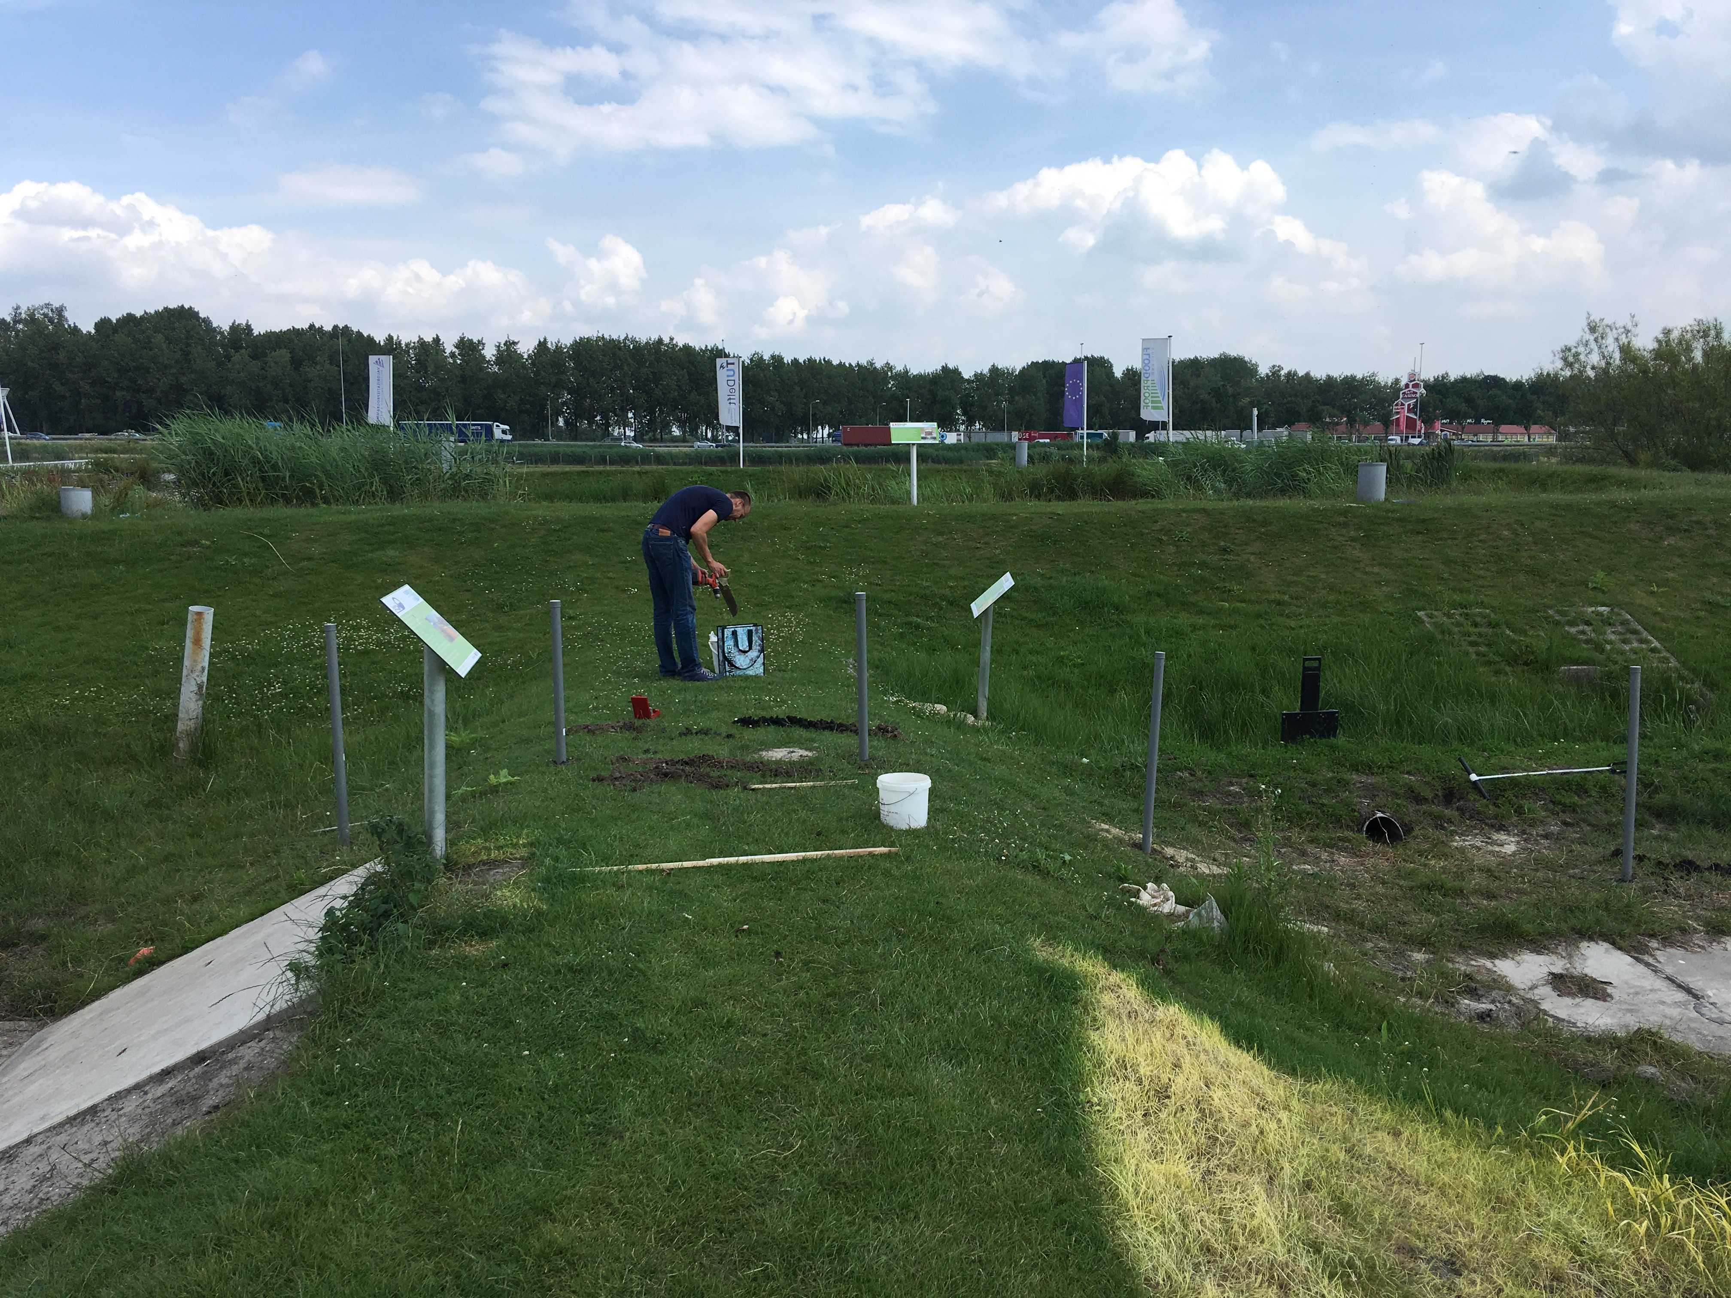
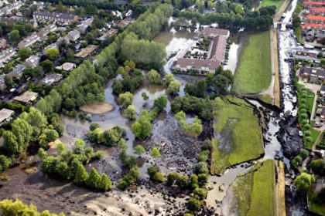
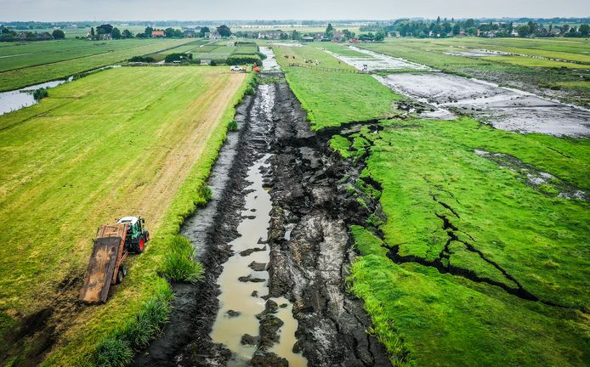
The scientific challenges
1. Flood defences are also hydrological systems
(Flood+drought cycles)
2. We require more detailed modeling of dikes to improve our understanding of flood defence systems
(drought and rainfall).
3. We need to Predict and Monitor at higher frequency and finer spatial resolution.
3. We need to Faster modeling for Real time and reliability purposes.
FPH 15 June 2018
FPH 15 July 2018
2003 (Wilnis)
2021 (Reeuwijk)

Slide 4
Flood Defence Resilience
Modeling
Monitoring
Uncertainty

Slide 5
Flood Defence Resilience
Drought effects (e.g. cracks)
Modeling
Monitoring
Uncertainty

Slide 6

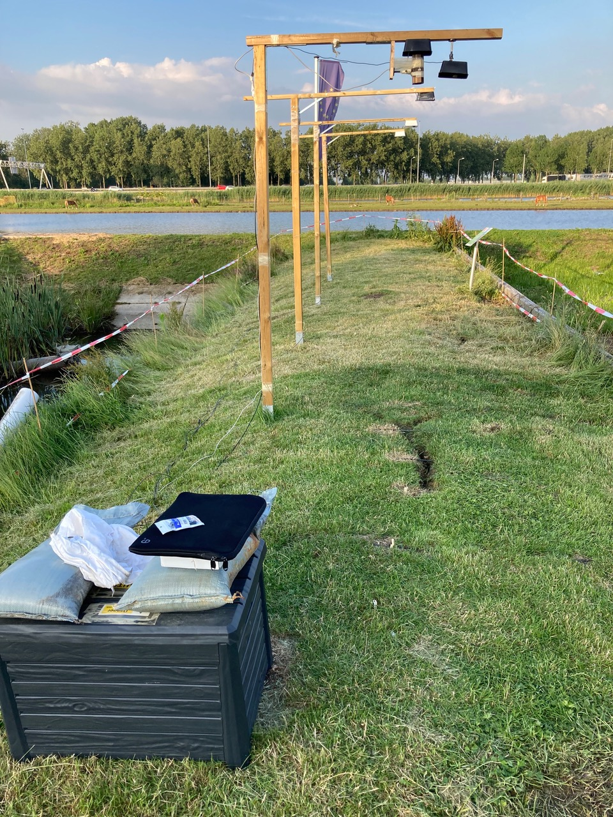
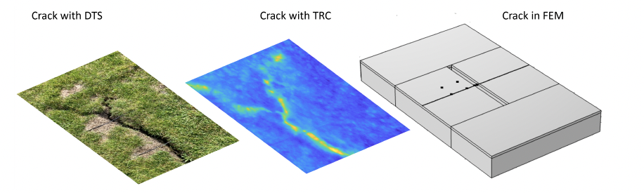
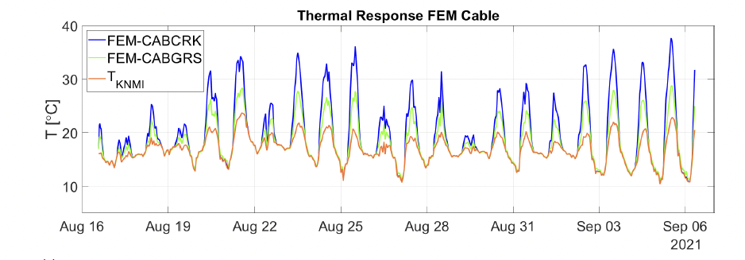

1. Monitoring cracks on dikes with Fiber optics sensors:
MSc Thesis Ir. Simone de Roos (2022)
2. DTS Vs THERMAL CAM Vs FEM Model
1. FPH Experiment
Note: Part of NWO-IDG Personal Grant for ”cracks and FOS”
PostDoc Leonardo Duarte-Campos
3. Cable always hotter due to radiation

Slide 7
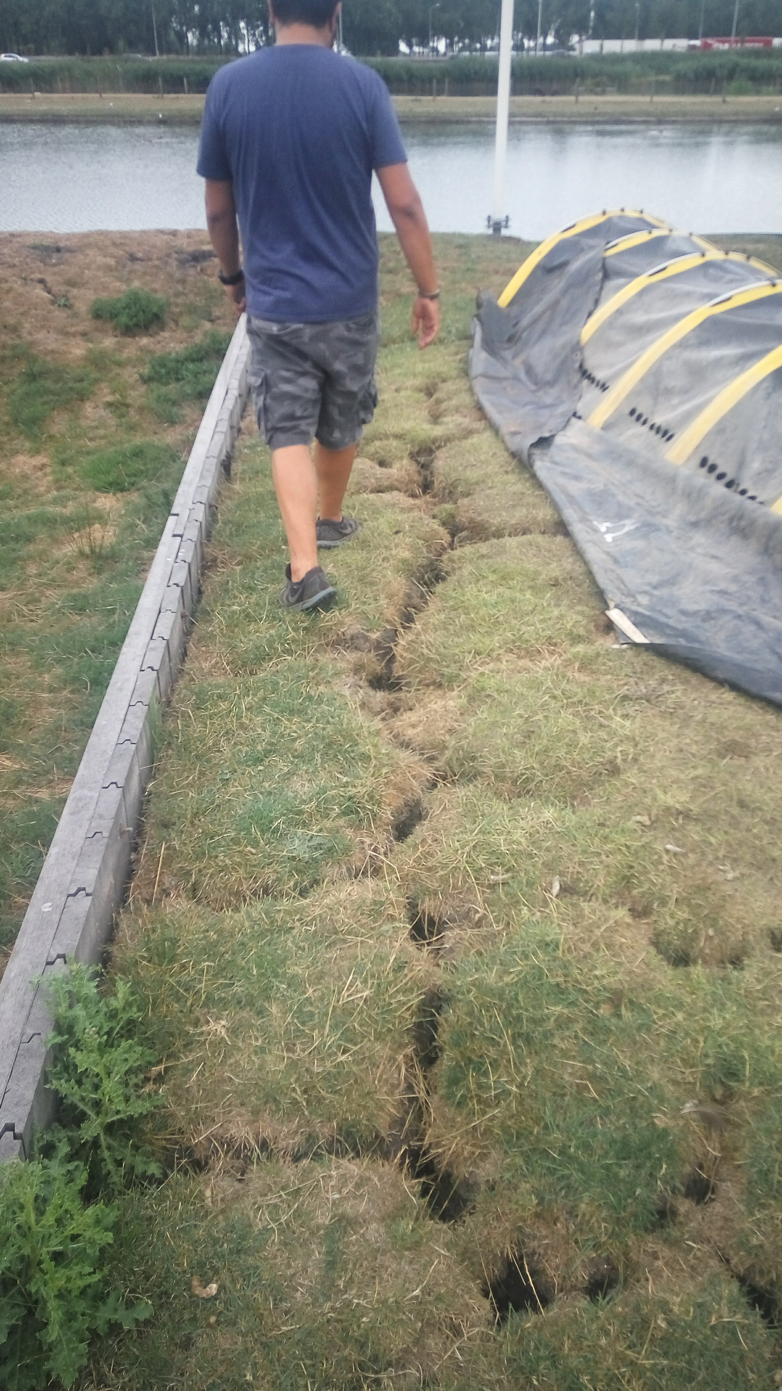
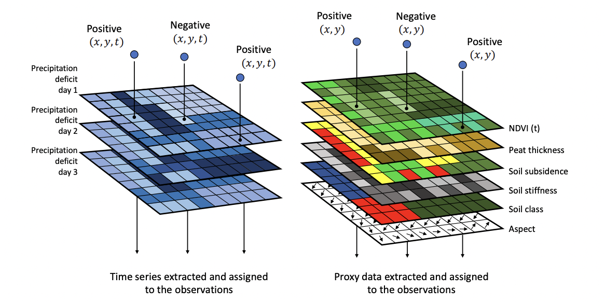
2. Predicting dessication
cracks on dikes:
Chotkan, S., van der Meij, R., Klerk, W. J., Vardon, P. J., & Aguilar-López, J. P. (2022). “A data-driven method for identifying drought-induced crack-prone levees based on decision trees.” Sustainability, 14(11), 6820.
1. Database of observed cracks
2. Spatially distributed proxy variables

Slide 8
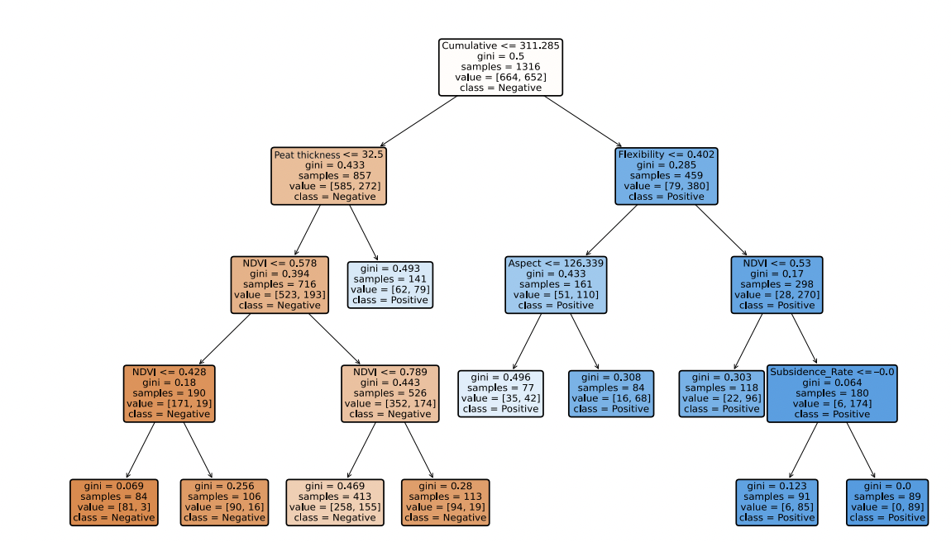
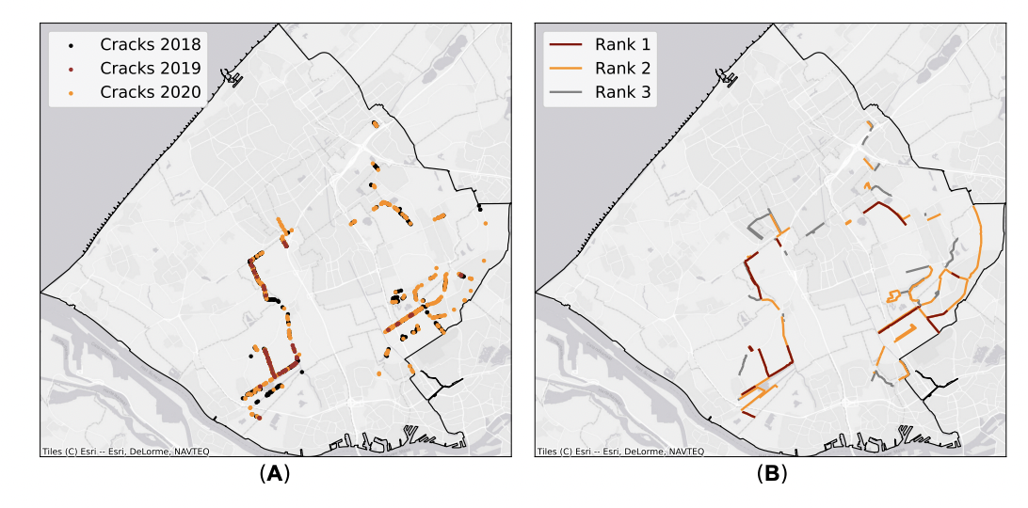
2. Predicting dessication
cracks on dikes:
Chotkan, S., van der Meij, R., Klerk, W. J., Vardon, P. J., & Aguilar-López, J. P. (2022). “A data-driven method for identifying drought-induced crack-prone levees based on decision trees.” Sustainability, 14(11), 6820.
3. Decision Tree Algorithm for supervised classification
4. Hazard map of crack prone dike stretches for inspection planning.

Slide 9
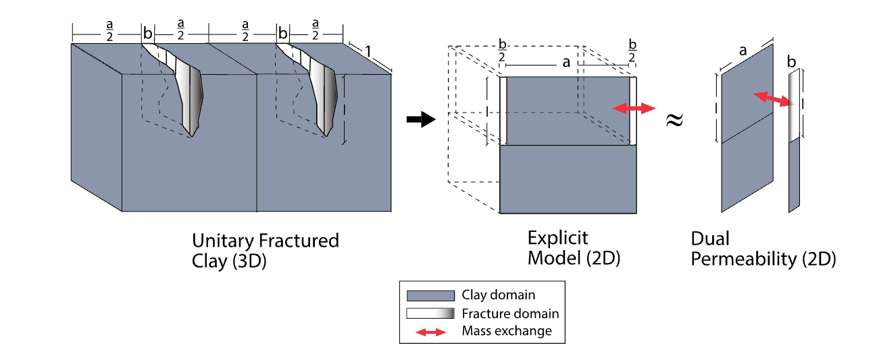
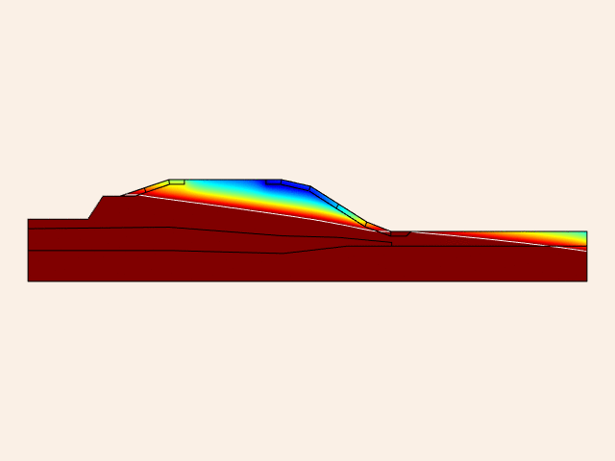
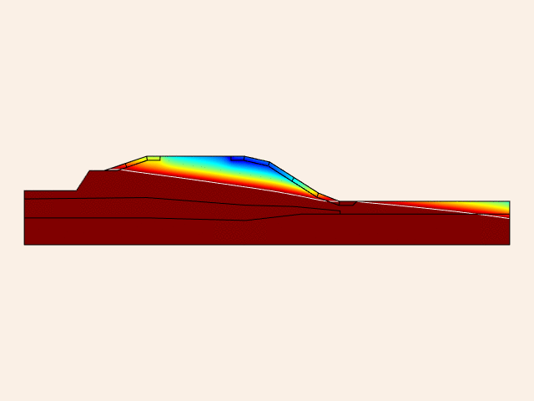
3. Modeling slope stabiltiy due to rainfall including cracks :
1. Represent fractures model in a dike.
2. FEM model of dike with cracks for water content.
Aguilar‐López, J. P., Bogaard, T., & Gerke, H. H. (2020).
Dual‐permeability model improvements for representation of preferential flow in fractured clays.
Water Resources Research, 56(8), e2020WR027304.
MSc Thesis Jorijn Holstvoogd (2022)
Images and animation by Jorijn Holstvoogd

Slide 10
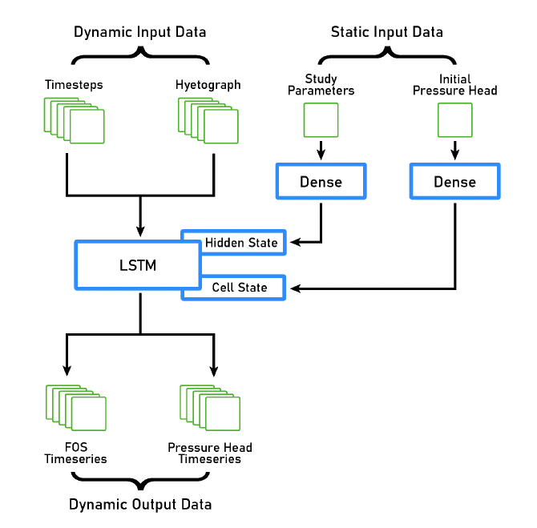
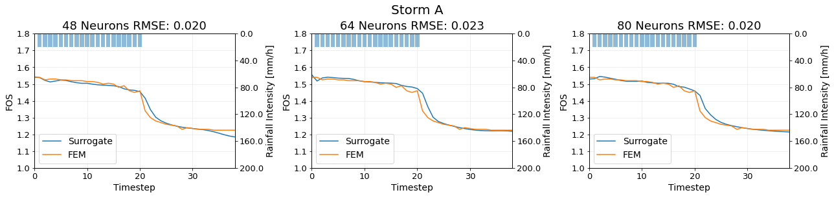
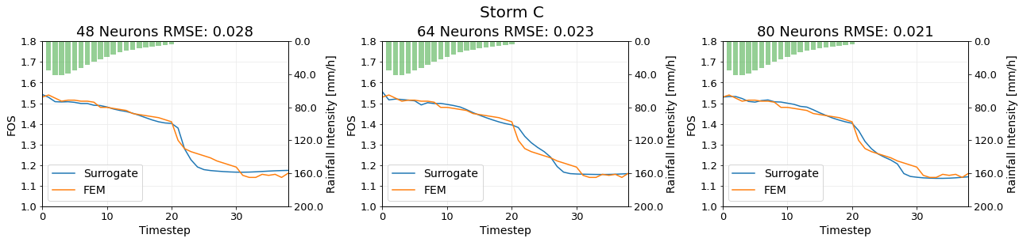
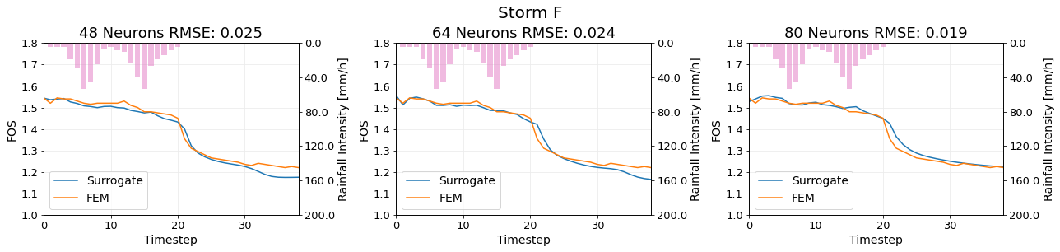
4. Uncertainty under detailed modeling:
3. Surrogate model of FEM based on
Recurrent neural network of long short-term memory (RNN-LSTM).
3. Different Rainfall storm shapes with SAME volume.
MSc Thesis Jorijn Holstvoogd (2022)

Slide 11

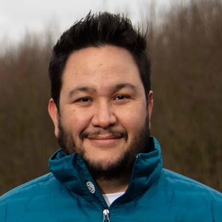



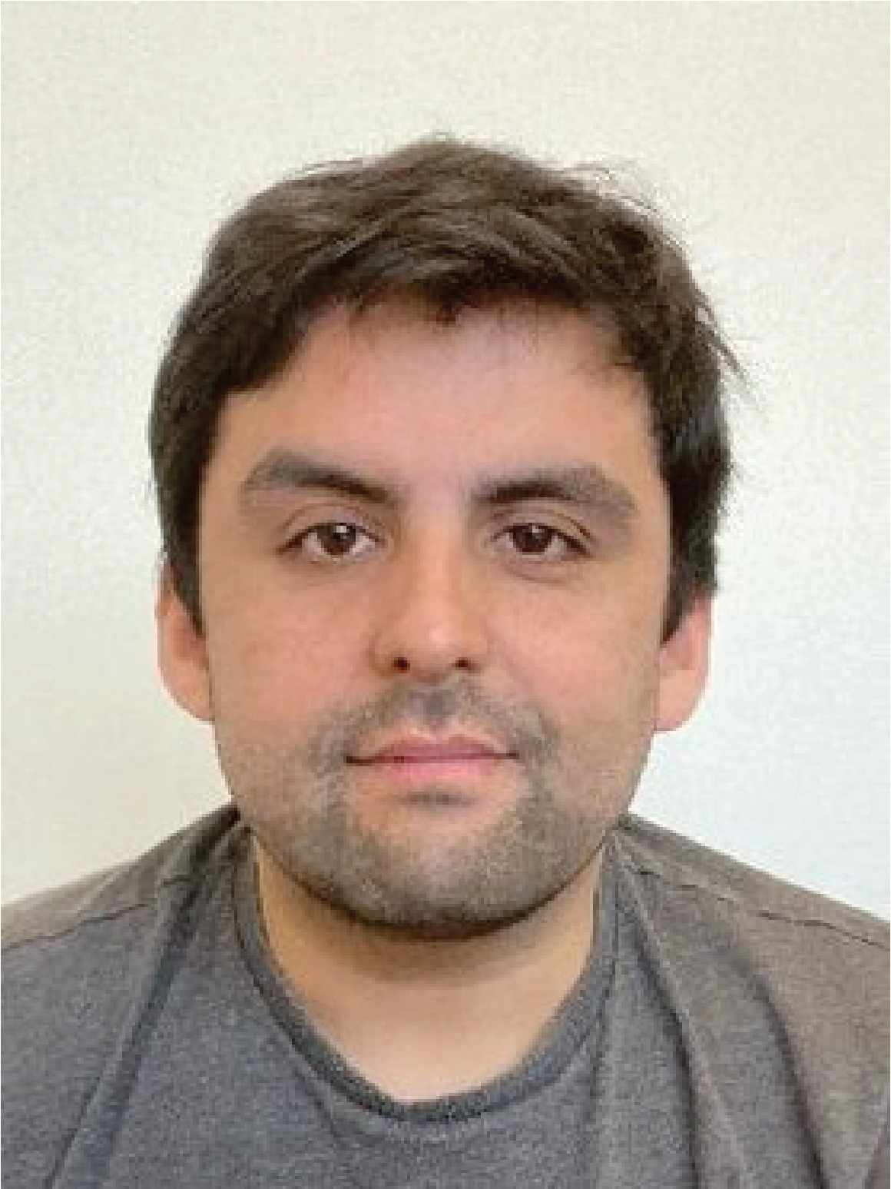
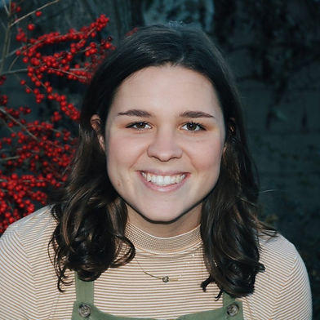
People to make it happen
Dike monitoring
(sensors)
Dike failure
deep learning
Piping erosion
Numerical modeling (PhD)
?
?
Future PhD
(Perspectif)
Future PhD
(TKI)
Piping erosion
Physical
Modeling (PhD)
Deep Learning
Flood
Modelling
Ir. Lisa
van der Linde
(TU Delft)
FOS Dike crack
Monitoring
(PostDoc)
Subsidence impact
on flood Resilience
Ir. Manuel
Wewer (TU Dresden)
Ir. Thomas
Stolp
(TU Delft)
Dr. Leonardo
Duarte
(TU Delft)
MSc. Raychel
Bahnick
(Rice University)

Slide 12
Future proespects for flood
defence resilience group …
Develop modeling and reliablity (safety) methods for design and assesment of flood defences under drought conditions.
Monitor flood defences in real time in hourly time frequency for streches of at least 10 KM.
Develop robust flood defence surrogate models based on AI/Deep Learning capable of real time probabilistic assesment.
Develop robust 2D Flood modeling surrogate models based on AI/Deep Learning to integrate with flood defence models for real time response, early warning and evacuation purposes.
Develop conceptualization of flood defence system under flood resilience quantification metrics.

Slide 13

Thanks

