Slide 1
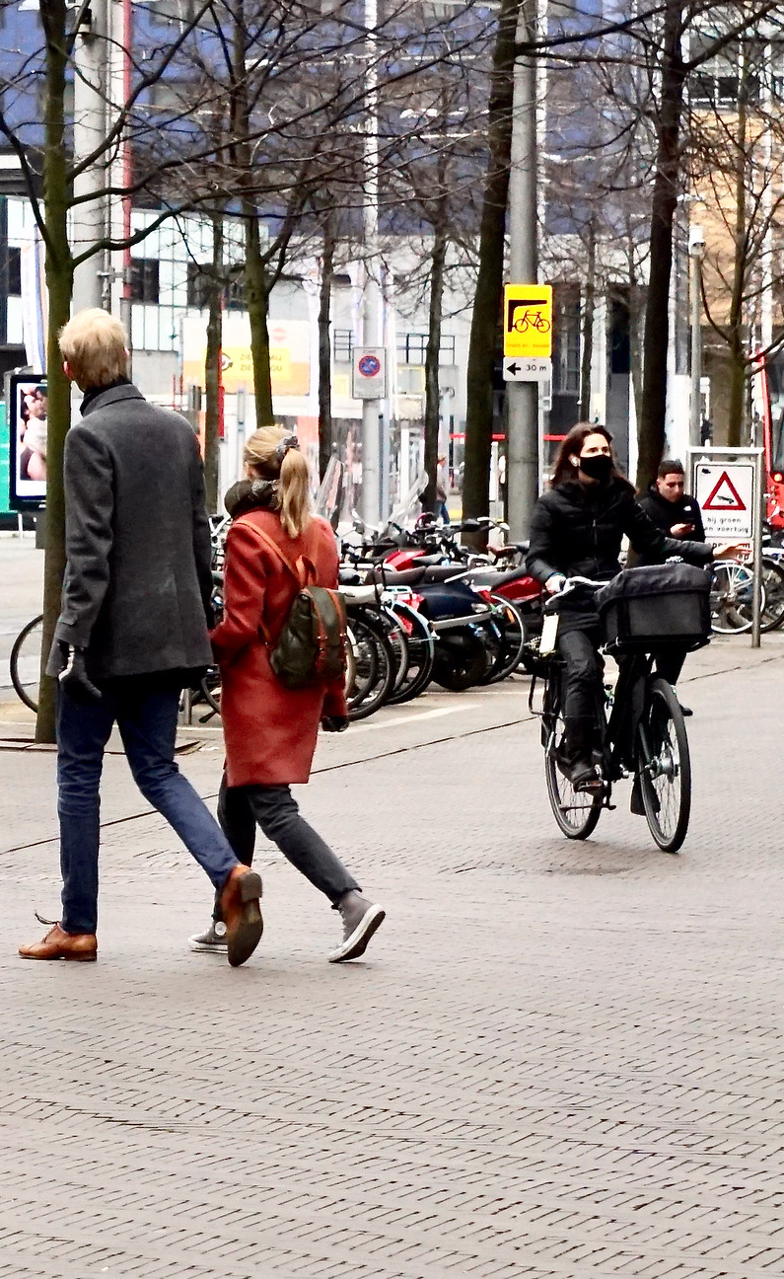


Towards
Post-Pandemic
Urban Resilience Strategies
Carissa Champlin
Assistant Professor of Participatory Design
Climate Action Programme Tenure Tracker
DeSIRE Fall Event
November 3, 2022

Slide 2
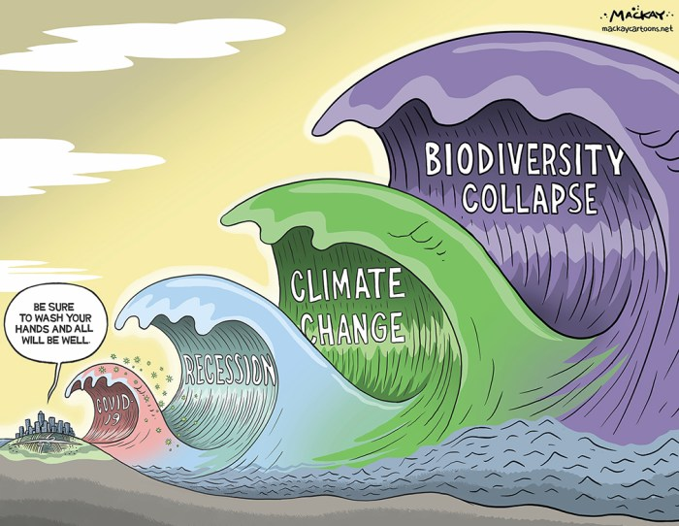
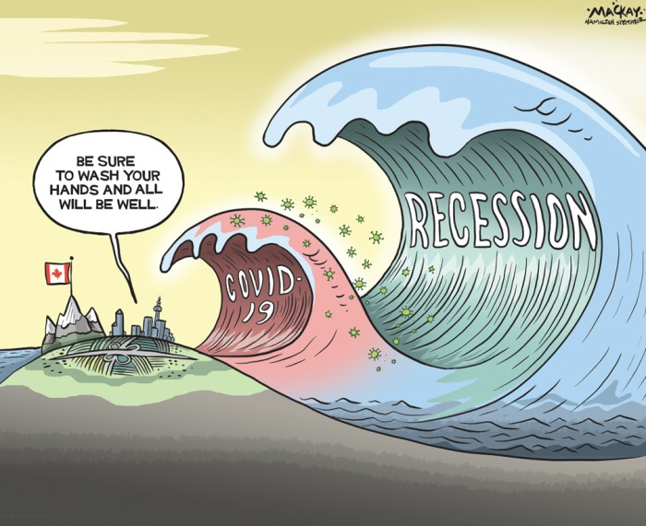
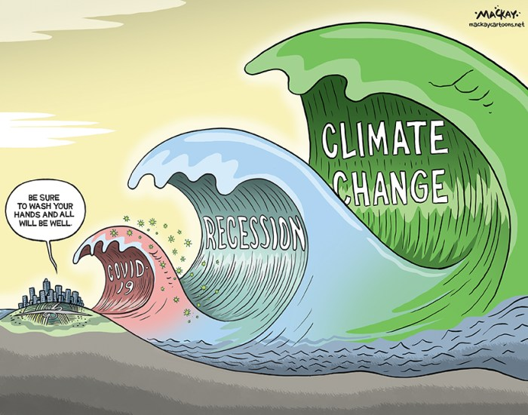
How can we build resilience to crises in the short-, medium- and long-term?
Strategy Making
“is a virtual
construction site where planning actors actively link knowledge of different types to make sense of the complexity of (urban) problems and development long-term actions for improvement.”
- te Brömmelstroet, 2010
Fig.1 - Editorial cartoons by Graeme Mackay. Used with artist’s permission.

Slide 3

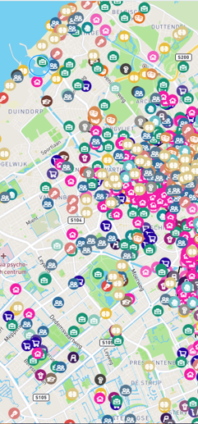
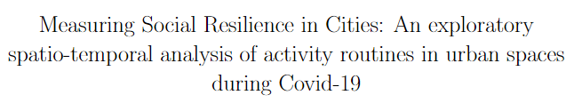
01.
Building urban resilience in the short term
Measuring Social Resilience in Cities project
Engage citizens in resilience strategy making
Embrace decentralized (digital) participation
1077 respondents from 3 districts
Map-based survey of activities during Covid-19 third wave in The Hague
Fig.2
Research collaboration with Mikhail Sirenko & Tina Comes

Slide 4
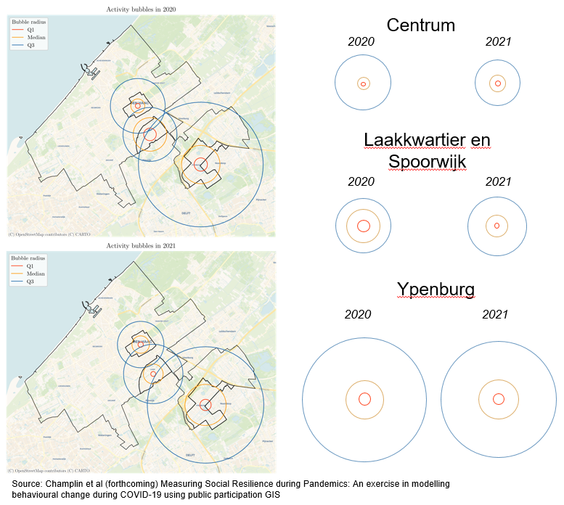
01.
Building urban resilience in the short term
What we’re learning
Dynamic rather than static measurements of resilience
Mapping behavioural change in space and time
Multiple manifestations of social resilience
Fig. 3 - Changes in people’s spatial activity bubbles in 3 case neighborhoods from 2020 to 2021
Research collaboration with Mikhail Sirenko & Tina Comes

Slide 5
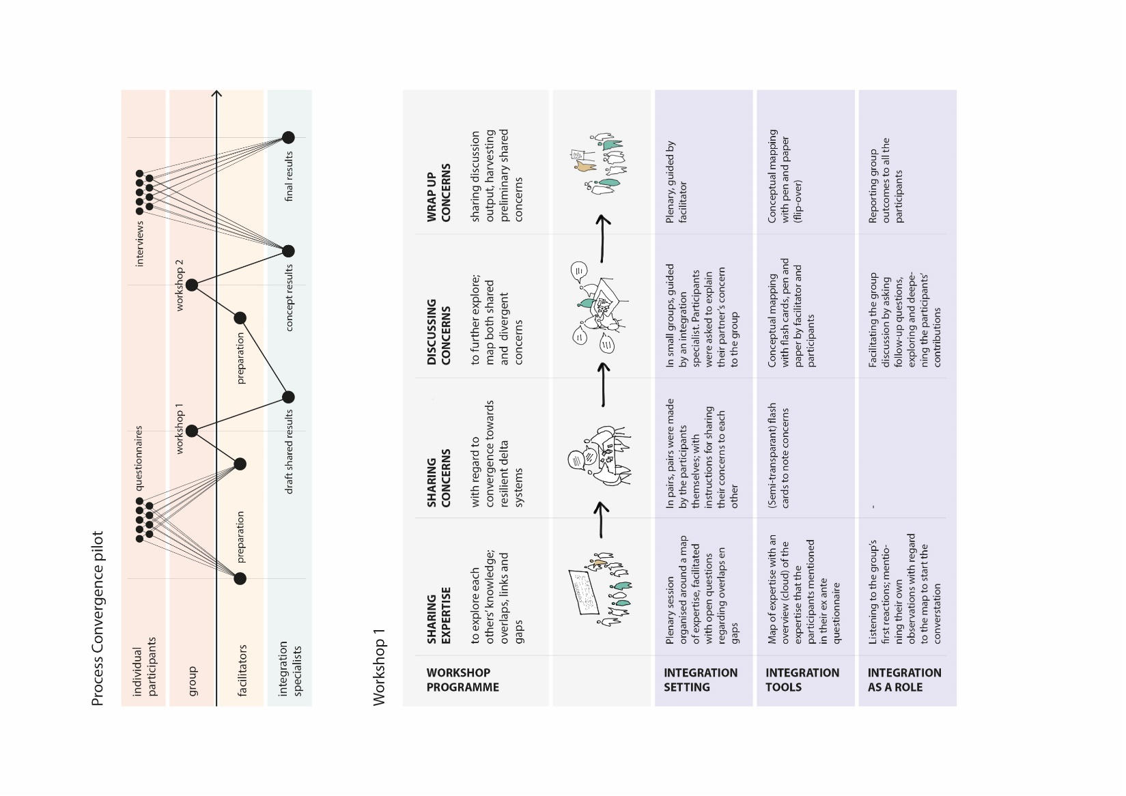
02.
Building urban resilience in the medium term
Convergence Pilots with the Resilient Delta Initiative
Collaborate on complex societal challenges
Integration: junctions, settings, tools and roles
What we‘re learning
Lack of engaged peripheral actors
Fig. 4 – Convergence workshop setup and integration roles
Research collaboration with Nikki Brand, Hanneke Stenfert & Steven Flipse

Slide 6
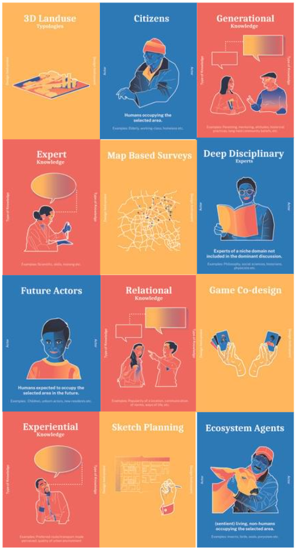
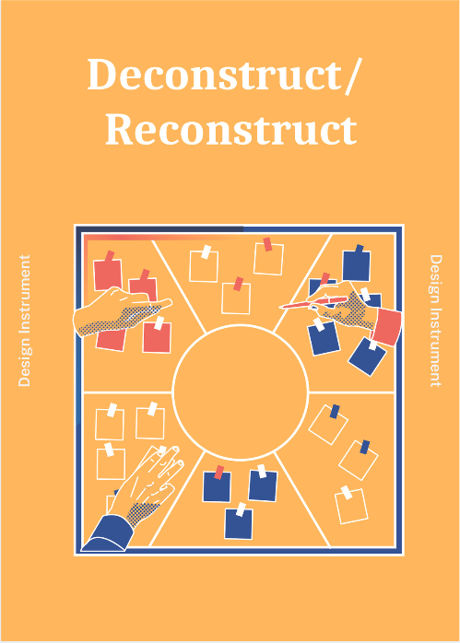
Contribution from Athanasios Votsis
03.
Building urban resilience in the long term
Amplifying Weak Signals (AWeS)
Selection of AWeS methodology building blocks
Engaging peripheral actors
Actors, knowledge types and instruments as building blocks
Contribution from Carissa Champlin
Research collaboration with Claudiu Forgaci, and student assistants Ruta Vittkute, Ann Eapen & Janne Groot
Fig.5
Contribution from Claudiu Forgaci

Slide 7
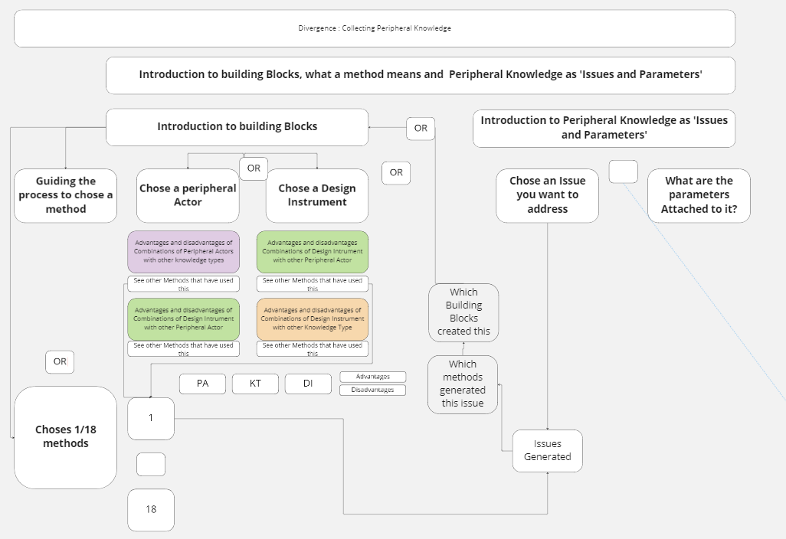
03.
Building urban resilience in the long term
AWeS: What we’re learning
Fig. 6
Guidelines for peripheral knowledge integration
Moving from fixed instruments to guidelines for method co-design
Adapting existing instruments to knowledge needs and contexts
Research collaboration with Claudiu Forgaci, and student assistants Ruta Vitkute, Ann Eapen & Janne Groot
Fig. 6 – Guidelines for peripheral knowledge integration

Slide 8
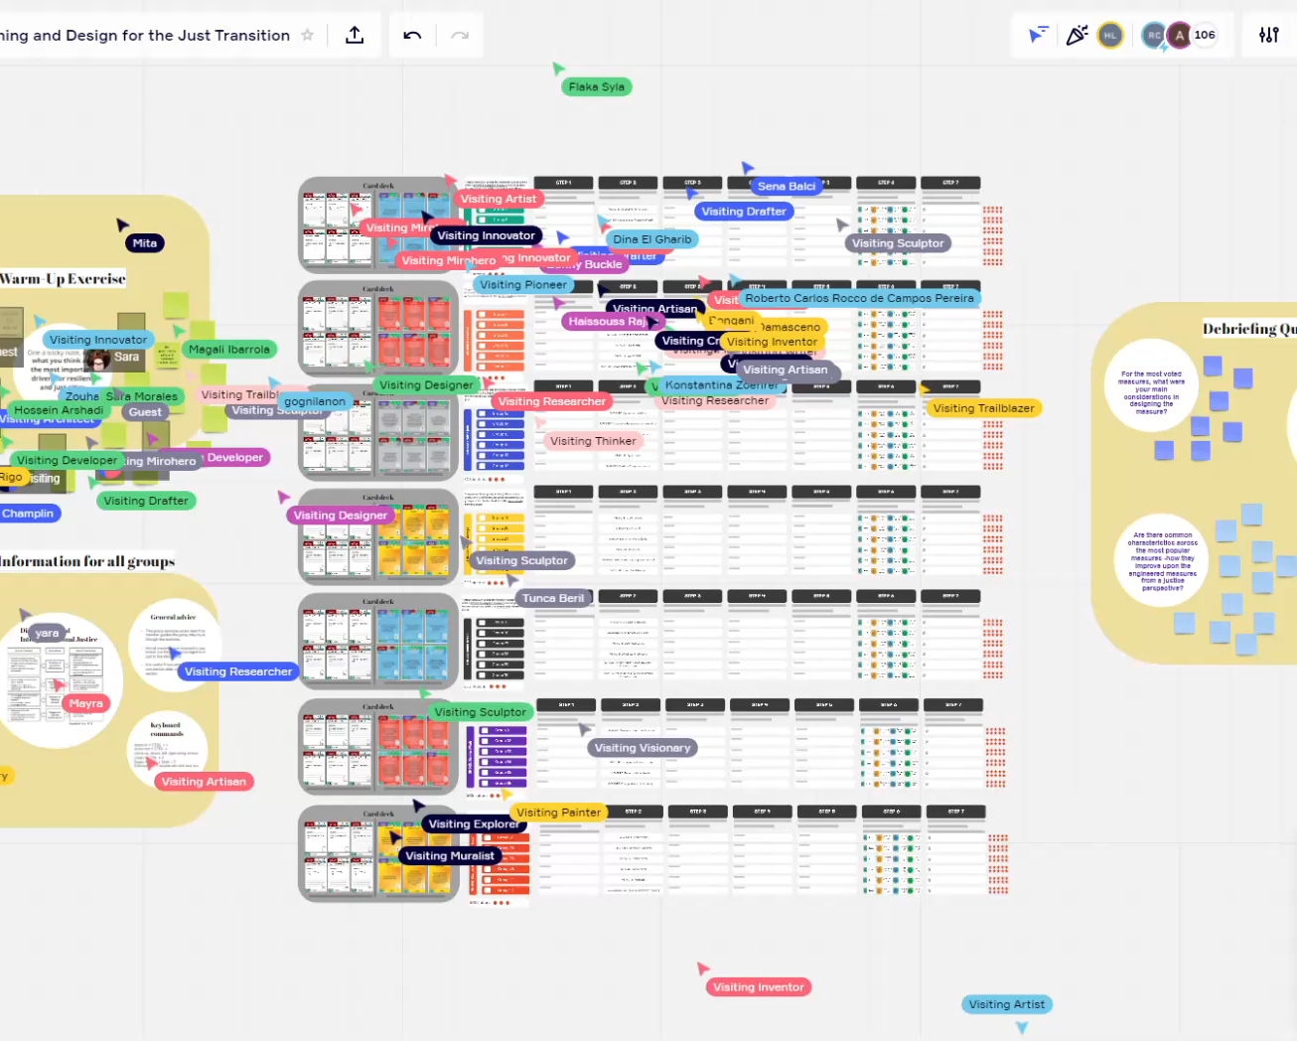
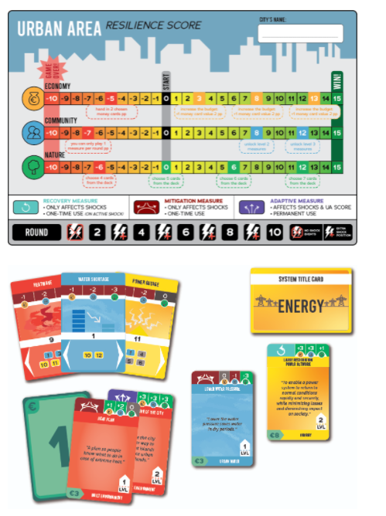
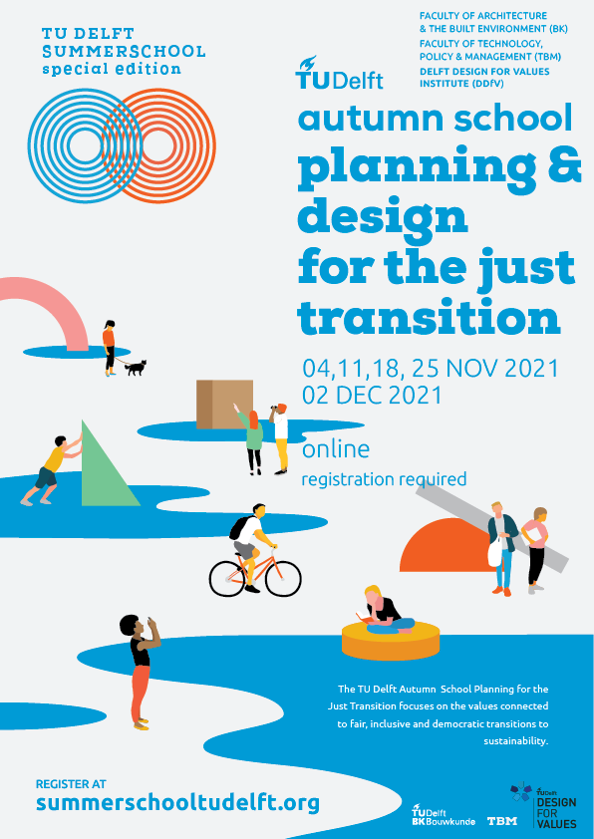
04.
What’s needed for urban resilience strategy making
Adapting existing
instruments
Towards *just resilience engineering measures
Harnessing potential of citizen and student contributions
Fig. 7 - 166 students participating in 72 countries online during Autumn School Planning & Design for the Just Transition
Fig. 8 – RElastiCity game of the 4TU.RE, available for download at edusources.nl/

Slide 9
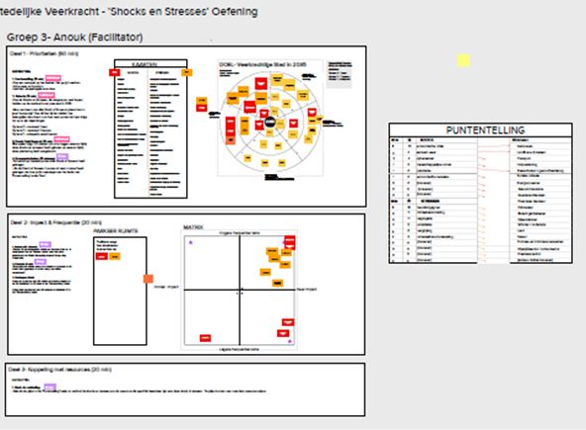
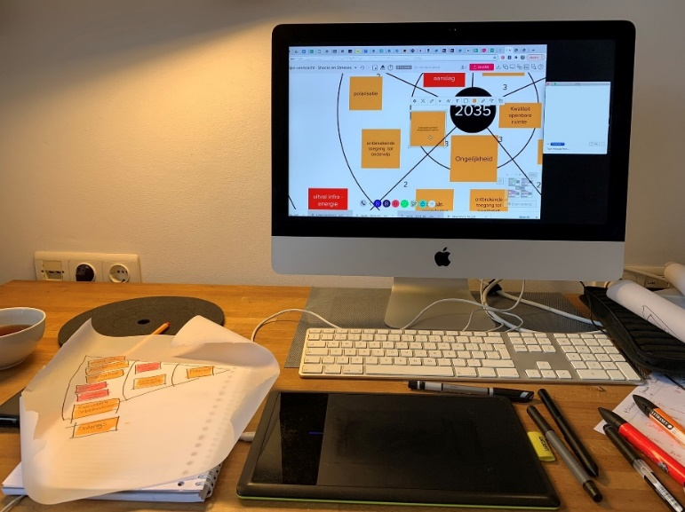
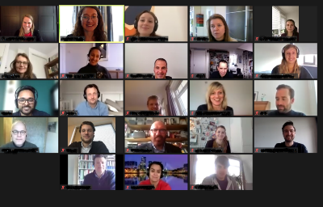
04.
What’s needed for urban resilience strategy making
Increased collaboration for impact
Fig. 9 - Resilience strategy making Mural board
Strategy making trainings
Long-term collaboration with municipality
Embracing digitalization
Semi-open data sharing among institutions
Fig. 10 - At-home setup for online resilience strategy making session with Metropoolregio Den Haag-Rotterdam

Slide 10
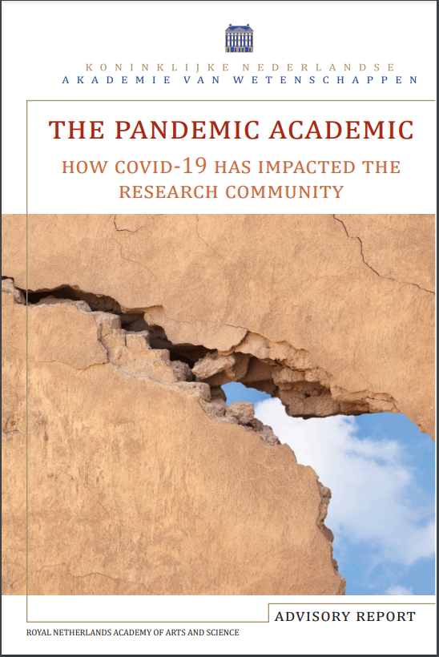
05.
Takeaways
KNAW Pandemic Academic Workshop
Increased dialogue and societal engagement
Embrace digitalization
Collaborate on complex societal challenges
Open up science for impact
OCW Minister Robbert Dijkgraaf:
“we collected an enormous amount of data during the pandemic. We must not let this opportunity go to waste. We must study it and learn from it.” - paraphrased
Available at www.knaw.nl > publicaties

