Slide 1
Exploring innovative digital assessment questions
Converting paper based questions
into digital questions

Slide 2
Agenda
Introduction
General introduction of scenario questions
Two Examples of question conversion into scenario question
Step by step conversion
  Work on your own example

Slide 3
Introduction
Who we are
  Celine Goedee (O&S assessment specialist)
  Meta Keijzer-de Ruijter (ICT digital assessment specialist - MapleTA)
Our pilot project
  Improving quality of digital tests using scenario questions
  Materials Science (2nd year mechanical engineering)
  Data from:
    Teacher input
    Think aloud protocols (practice exams)
    Student interviews
    Results and analysis of exam
    Evasys results

Slide 4
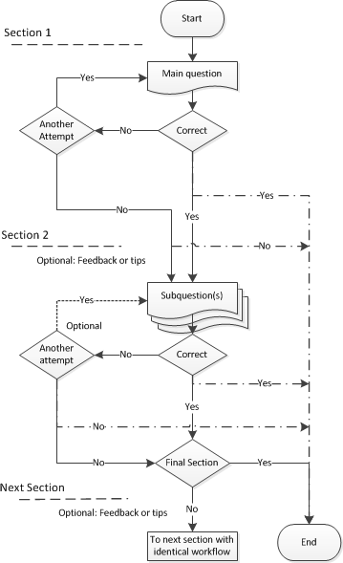
Workflow Scenario’s
General set-up:
Question is divided into 2 or more sections
Sections are presented consecutively
Each section has at least one response field
Each response field must be automatically gradable
When verifying the response the only 2 options are available:
  Continue to the next section* (within the question)
  Finish
*There is no possibility for “parallel” sections: if correct one set of sub questions, if incorrect another set.

Slide 5
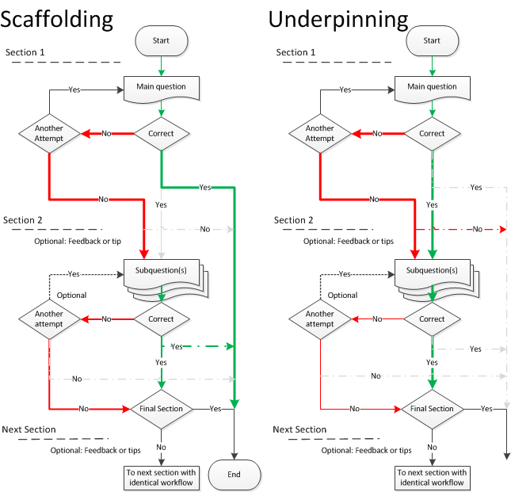
Workflow Scenario’s
Combining different section outcomes determines the main scenario:

Slide 6
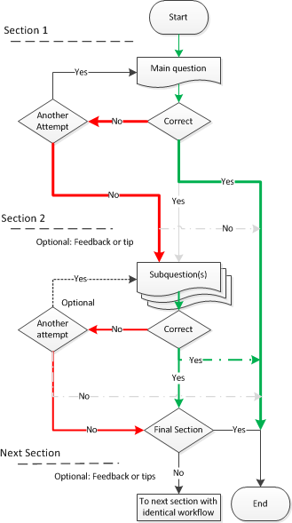
Scenario - Scaffolding
Main question is posed first (can students figure out a way to solve the problem by themselves?)
Alternate route (Section 2) checks knowledge through a set of additional questions
  Give the necessary equations
  Calculate the parameters you need for the final calculation
  Question that evaluate the knowledge of the critical concepts

Slide 7
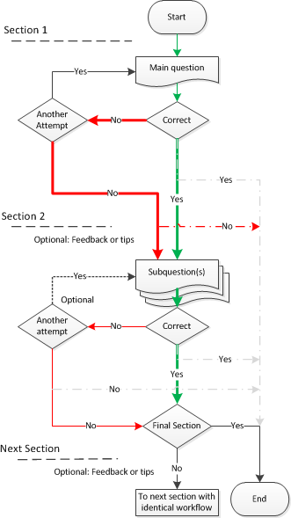
Scenario - Underpinning
Main question is posed first
Section 2 should corroborate knowledge through a set of additional questions

Slide 8
Advantage and disadvantage
Advantages
Ability to measure if students can solve the problem by themselves
(students are not provided with the steps to solve the problem)
Give feedback when needed (formative)
Students can show their skills in small steps (summative)
In case of mc question: eliminate guessing
Disadvantages
Limited possibility for self correction along the path of solving a problem.
Correct programming of the main question is essential, since it might have serious consequences
Student anxiety when getting immediate feedback

Slide 9
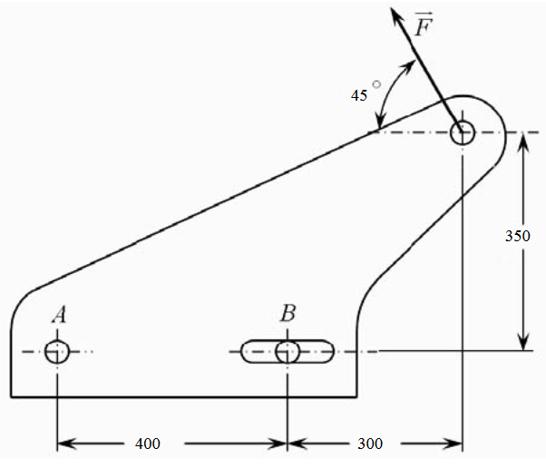
Example question on paper
A force F = 1000 N works at a given angle of 45° on
a support block of a pneumatic cylinder.
The support block is attached to the surface with bolts A and B.
Bolt B is situated in a notch.
Calculate the forces on both bolt A and Bolt B.

Slide 10
Description Example 1
Scaffolding scenario
Formative setting
Feedback and tips along the ‘road’
Multiple sections (5)

Slide 11
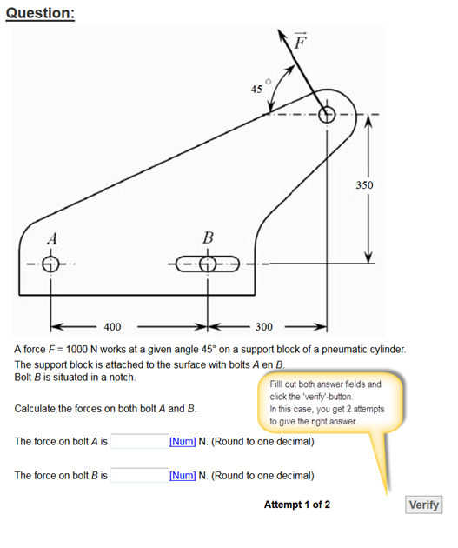
Scaffolding example section 1

Slide 12
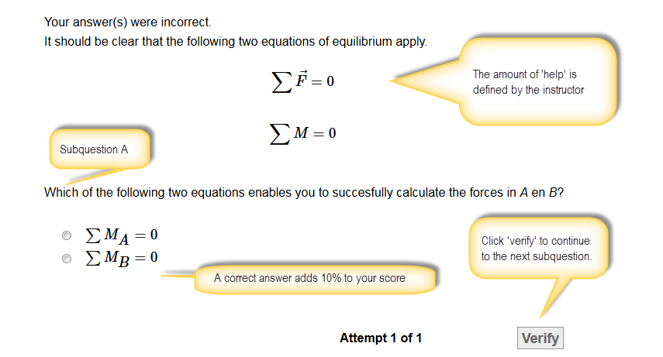
Scaffolding example section 2

Slide 13
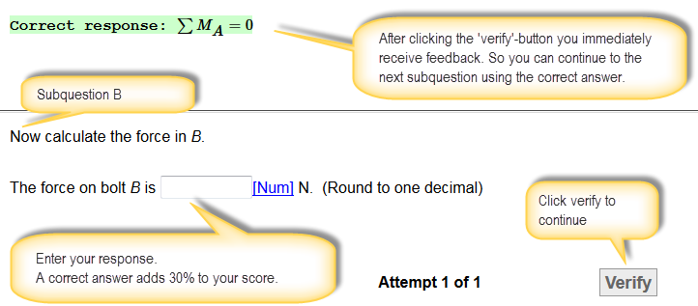
Scaffolding example section 3

Slide 14
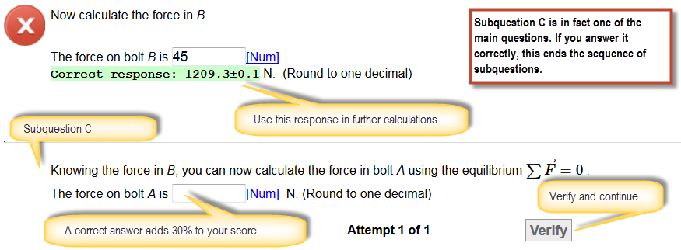
Scaffolding example section 4

Slide 15
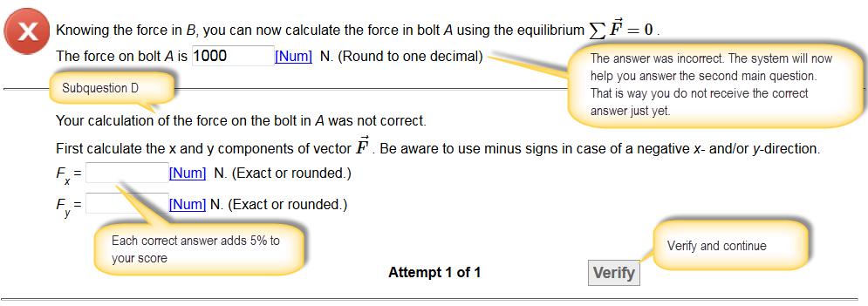
Scaffolding example section 5
Optional: as a last step repeat main question

Slide 16
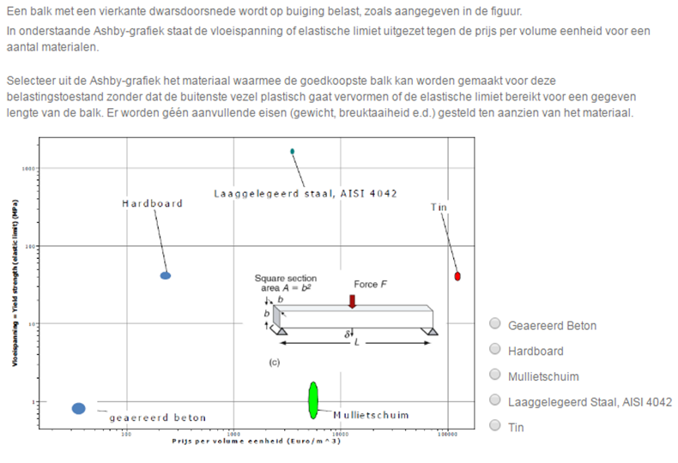
Example 2: On paper

Slide 17
Description Example 2
Underpinning scenario
Summative setting
Eliminate Guessing
2 sections
Score: All or nothing

Slide 18
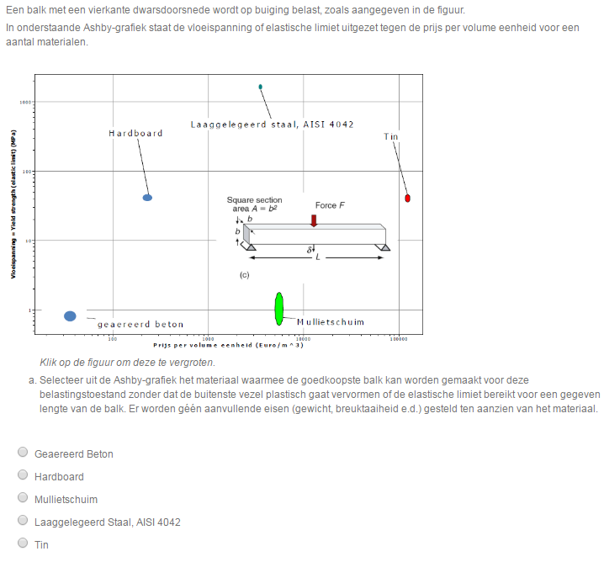
Underpinning example section1

Slide 19
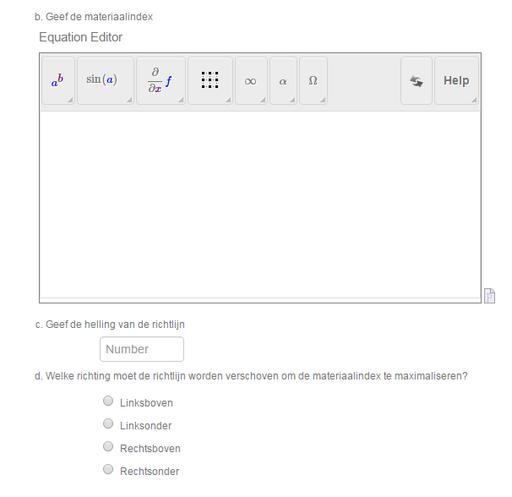
Underpinning example Section 2

Slide 20
1 – Choose example
Form groups of 2
  Select one paper-and-pencil question to transform to a digital adaptive question.
      Solving the problem requires multiple steps (calculations or reasoning)
      Response must be automatically gradable
      Summative: First have students solve it on their own
      Formative: Step-by-step instructions (and feedback)
      Formative: Some students will be able to solve it by themselves

Slide 21
2 – Analyse problem
What level of knowledge do you want to measure?
(remember, understand, apply, analyse, evaluate, create)
Is the focus on process/strategy or final answer?
Are different strategies possible?
Do you want to measure one specific strategy?
What are common mistakes of students?
Does this paper based question measure what I want?

Slide 22
3 – Create scenario question
Choose formative or summative setting
Choose a scenario (scaffolding or underpinning)
Formulate a main question
Formulate sub questions
(single or multiple questions per section)
  Determine which mistakes (do not) weigh heavily.
  (partial grading is possible)
Evaluate your scenario question
  Do you make concessions?

Slide 23
Wrapping Up
Feedback on this session
Any one interested in a follow up?
(creating exam questions in MapleTA)

Slide 24


How to contact us
Celine Goedee
  Mail: c.goedee@tudelft.nl
Meta Keijzer – De Ruijter
Blog: https://maderuijter.weblog.tudelft.nl
Mail: m.a.keijzer-deruijter@tudelft.nl

