Slide 1
Investigating the resilience and viability of European arable farms
Thomas Slijper, Yann de Mey, and Miranda Meuwissen

Slide 2
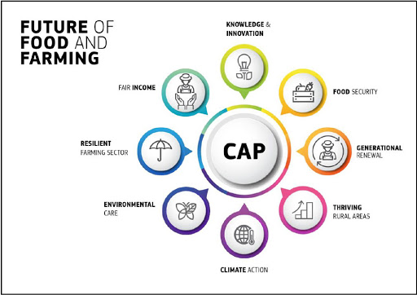
What does the future of food and farming look like?

Slide 3
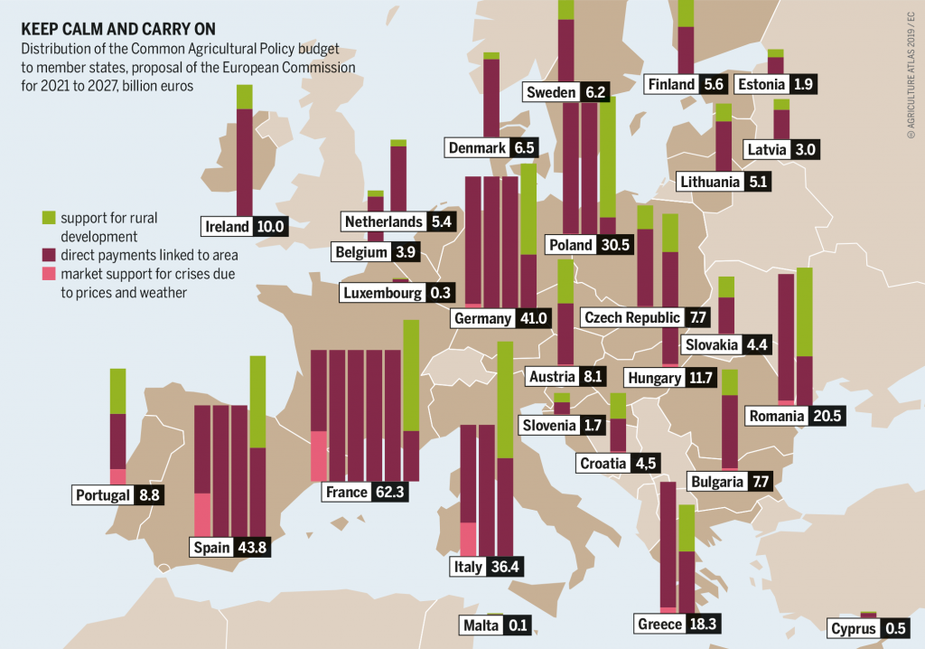
EU’s Common Agricultural policy in practice
Most of the budget is spent on direct payments (more than 270 billion EUR in 2013-2020).

Slide 4
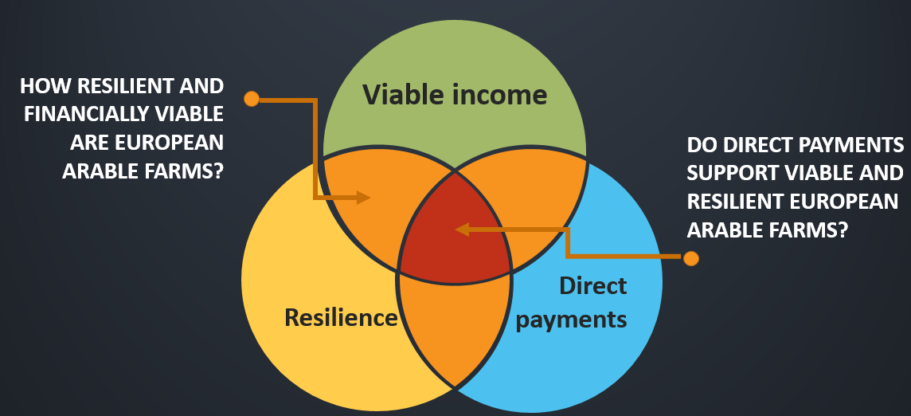

Slide 5
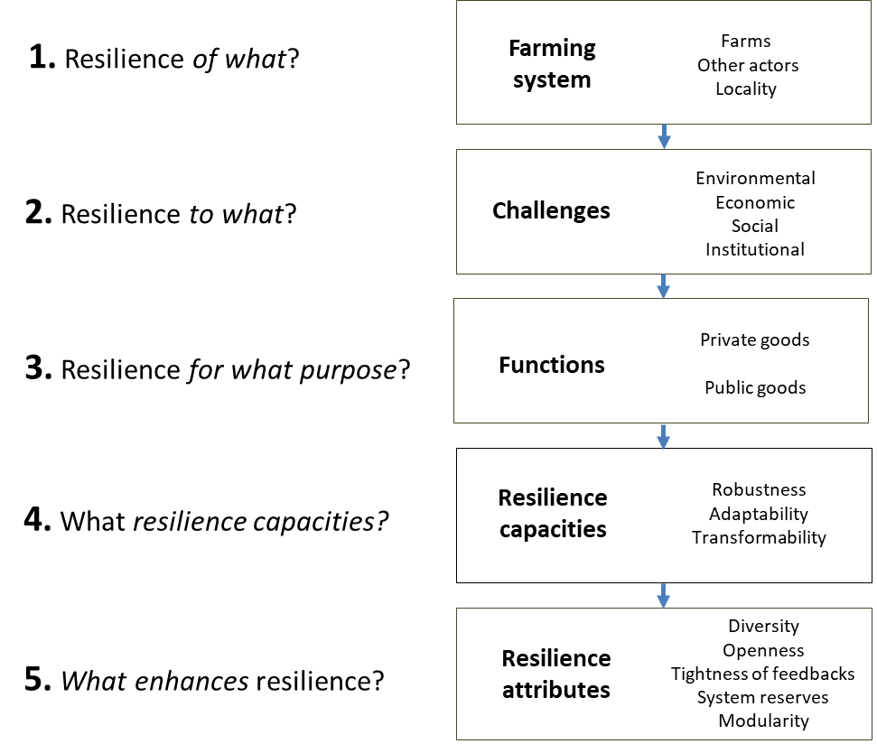
Assessing resilience
Meuwissen et al, 2019, Ag Systems

Slide 6
How resilient are European arable farms?
Robustness
Adaptation
Transformation
Slijper et al, 2022, ERAE

Slide 7
How viable are European arable farms?
7.5 out of 10 European arable farms are short-term viable
4 out of 10 European arable farm(er)s are long-term viable
Notes:
Key message: Most arable farmers in our sample are short-term viable but not long-term viable (i.e. when accounting for the opportunity costs of capital, most European arable farmers are better off working at minimum national wage than working on farm).
Not presented: heterogenous across Europe. Long term viability rates are in general higher in Eastern Europe (Bulgaria, Romania) → likely due to low minimum wage.

Slide 8
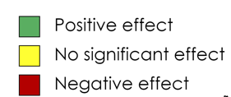
Do direct payments support farm viability?
Short-term viability
Long-term viability

Slide 9
Take home messages
Trade-off between maintaining status-quo (robustness) and the ability to change (adaptation and transformation)
75% of the arable farms is short-term viable but only 42.5% is long-term viable
Heterogenous effects of direct payments on farm viability, there is heterogeneity over space time

Slide 10
Impact of the DeSIRE Agri Working Group
Network building and expanding (also beyond duration of DeSIRE)
Regular opportunities for providing and receiving feedback (soundboard)
Opportunities for training (such as the workshop for Resilience Engineers)
Joint scientific publications
Joint work on grant applications
Interesting seminars

Slide 11
4TU-HTSF 2023/28: Redesign
Title: High-tech & data-driven agri-food system of the future
Aim: Linking local consumer wishes in a smart & appealing way with local production of fruits and vegetables in protected environments
Consortium with (ao) HBOs
Highlights: Joint-use case, chain game, city events
Positions: 5 tenure trackers, 5 PhDs, 2 postdocs*, 1 data steward*, 1 scientific programmer*, 1 graphical designer* (*part-time)
Contact: miranda.meuwissen@wur.nl

