Slide 1
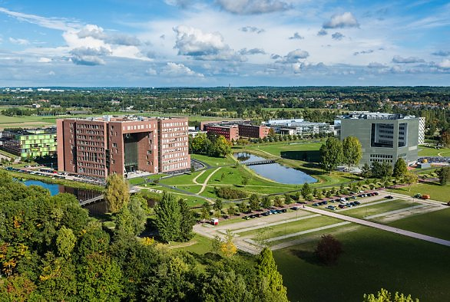
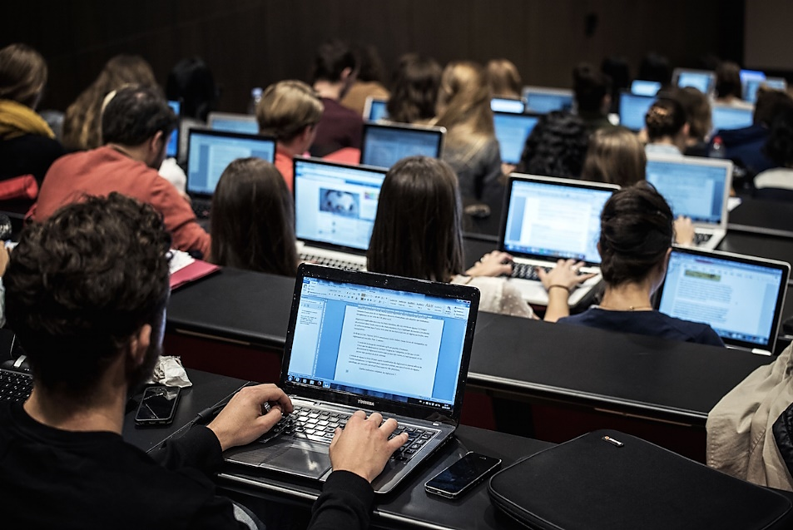
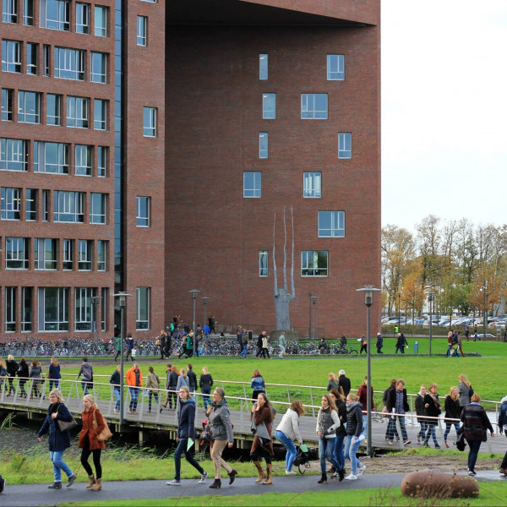
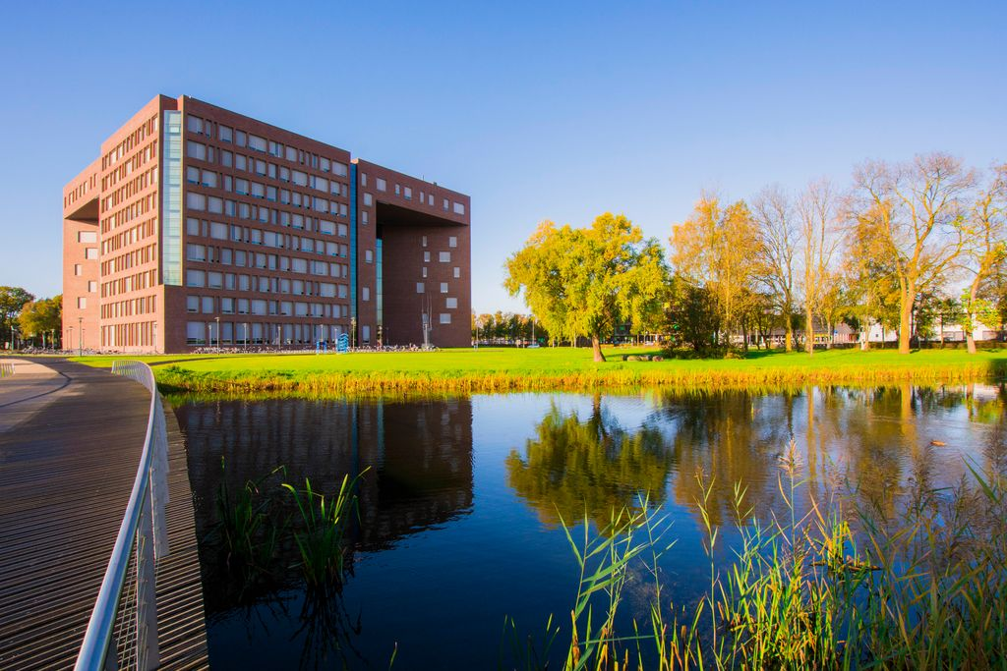


WUR Education: Transition Period/Post-Covid
Kazem Banihashem; Omid Noroozi; Harm Biemans; Perry den Brok
Education and Learning Sciences Group
Wageningen University & Research
1/11

Slide 2
Background
It’s time to gradually move to post-Covid-19 education
Online education is likely to stay next to F2F education
WUR is developing policy on online/F2F/blended education for the long-term
Exploring students’ and teachers’ perceptions and experiences with blended education
Exploring students’ and teachers' preferences
Identifying differences with Covid-19 time
Lessons for future?
2/11

Slide 3
WUR data collection
Emergency period (during Covid/fully online):
April, June, October 2020
Teachers: N = 521; FGDs (N = 6); Interviews (N = 14)
Students: N = 1251; FGDs; Interviews; Interactive sessions
Transition period (post-Covid/mainly blended):
September 2021-February 2022
Teachers: N = 307; FGDs (N = 6); Interviews (N = 14)
Students: N = 534; FGDs (N = 5); Interviews (N = 8)
3/11

Slide 4
Perceptions and experiences #students #1
Students were mainly positive about blended education
  Positive: Flexibility, freedom, time saving, recorded lectures
  Negative: technical issues, low attendance rate, interaction issues
Students’ workload/stress was low
  Low: Flexibility, recorded lectures, time saving
  High: Technical issues, online exams
Students’ well-being/motivation was high
  High: Flexibility, freedom, comfortableness
  Low: Lack of physical interaction, less engaging
Students’ perceptions of teaching performance was low
  Low: Low motivation, lack of digital literacy and pedagogical knowledge to teach online/blended
  High: Dedicated, good use of online tools
4/11

Slide 5
Perceptions and experiences #students #2
Students’ perceptions of learning performance was high
  High: Flexibility, self-discipline, recorded lectures
  Low: Home distractions, online exams
5/11

Slide 6
Perceptions and experiences #teachers #1
Teachers were mainly positive about blended education
  Positive: Flexibility, accessibility, online facilities, knowledge clips
  Negative: Technical issues, low motivation, interaction issues, home distractions
Teachers’ workload/stress was high
  High: Work/life balance, online exams, technical issues, class management
  Low: In advance preparation, knowledge clips, digital tools
Teachers’ well-being/motivation was low
  Low: Shortage of physical touch/interaction, high workload, balance challenging
  High: Flexibility, internal motivation
Teachers’ perceptions of teaching performance was low
  Low: Students population, interaction issues, difficulty to teach complex skills
  High: Freedom and flexibility
6/11

Slide 7
Perceptions and experiences #teachers #2
Teachers’ perceptions of learning performance was low
  Low: Students population, lack of attendance and interaction
  High: Freedom and flexibility
7/11

Slide 8
Preferences #students #teachers
Students prefer both blended and F2F education
2021-2022
Preference
Teachers were in favor of F2F education.
8/11

Slide 9
Transition period vs. emerging period
Students
Stress was low and decreasing
Workload was still high and slowly increasing
Motivation was high and increasing
Teachers
Stress was still high and increasing
Workload was still high and (but less fast) increasing
Motivation was still low but increasing
9/11

Slide 10
Discussion points
How to interpret these trends?
  Effects of getting tired of constant change of context and policy (increasing stress and workload)?
  Effect of more F2F education and less opportunity to 'hide’ (increased workload, more motivation)?
  Do students weigh their options differently than before Covid-19? Only come to campus for sufficient amount of F2F education?
  Happiness with more direct contact/more F2F education (increasing motivation)?
What does it mean for future education policy/vision?
10/11

Slide 11

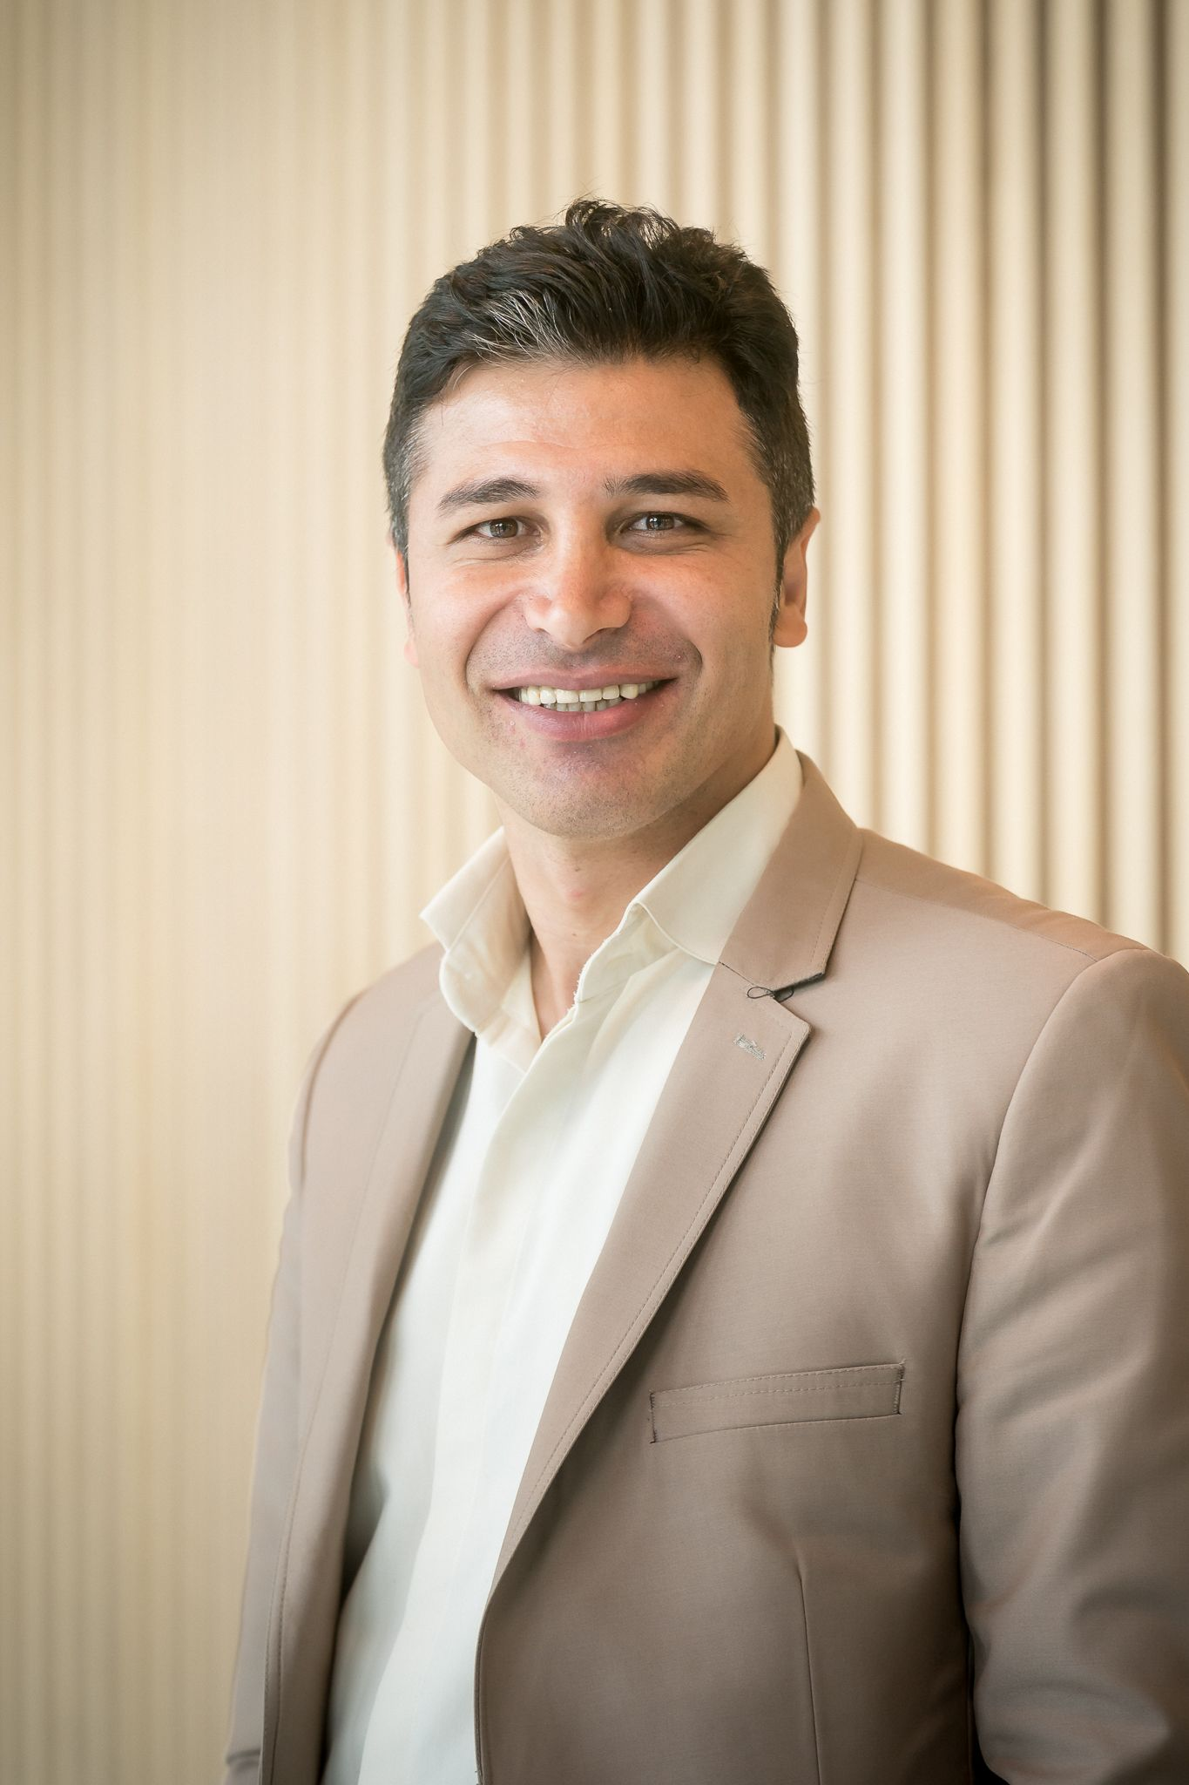


Thank you! ☺
Dr. Kazem Banihashem
Dr. Omid Noroozi
Dr. Harm Biemans
Prof. dr. Perry den Brok
Education and Learning Sciences Group
Wageningen University & Research
More info on this study later via:
https://www.4tu.nl/cee/innovation/project/13042/the-transition-to-online-education-during-the-corona-crisis-situation
11/11

