Slide 1
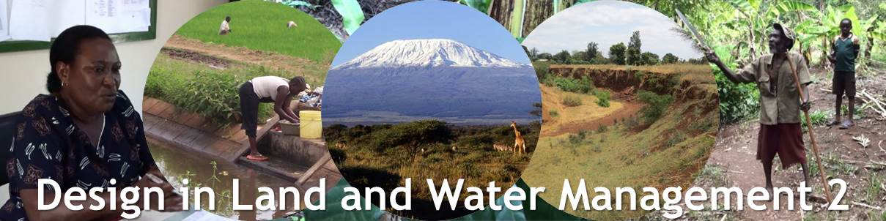
WRM21312
Introduction
20 March 2017
Pieter van Oel
A cooperation between WRM & SLM

Slide 2
Basic Features of the course
Course runs from 20 March till 9 June (2 periods)
12 ECTS, 336 hours
Teamwork→ help each other to excel!
Building on BIL courses: Application and Integration

Slide 3
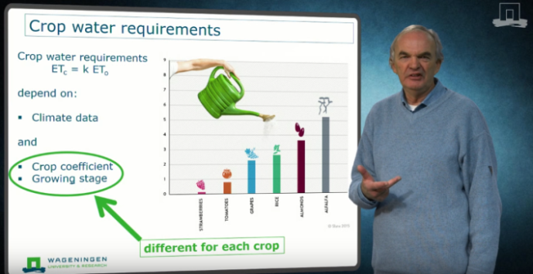
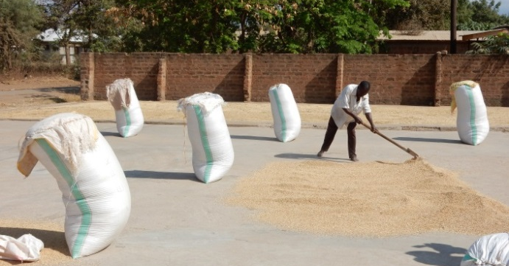
Course plan
7 weeks
5 weeks
E-module 2
Design assignment
(teams: 6 students)
E-module 3
Presentation
& Report
E-module 1
Exam
E-module 4
E-module 5
BASIC KNOWLEDGE:
Orientation & identification
Climate & hydrology
Agricultural water management
Irrigation & the water system
Erosion risk assessment
YOU DO ALL
(1,2,3,4 and 5)
PERSPECTIVES FOR DEVELOPMENT
Climate change
Population Growth
Urbanization
Globalization & Trade
Food production
Reduce, reuse, recycle
YOU PICK ONE
(A,B,C,D,E or F)

Slide 4






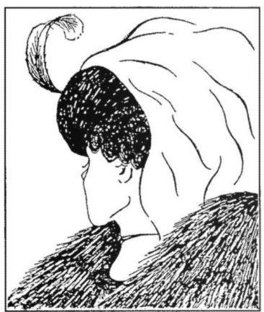
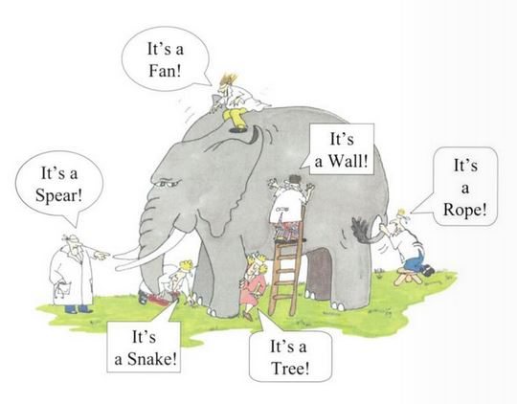
Perspectives

Slide 5
Course plan
7 weeks
5 weeks
E-module 2
Design assignment
(teams: 6 students)
E-module 3
Presentation
& Report
E-module 1
Exam
E-module 4
E-module 5
BASIC KNOWLEDGE:
Orientation & identification
Climate & hydrology
Agricultural water management
Irrigation & the water system
Erosion risk assessment
YOU DO ALL
(1,2,3,4 and 5)
PERSPECTIVES FOR DEVELOPMENT
Climate change
Population Growth
Urbanization
Globalization & Trade
Food production
Reduce, reuse, recycle
YOU PICK ONE
(A,B,C,D,E or F)

Slide 6
Course plan
7 weeks
5 weeks
E-module 2
Design assignment
(teams: 6 students)
E-module 3
Presentation
& Report
E-module 1
Exam
E-module 4
E-module 5
Knowledge clips
Feedback Fruits
Feedback sessions (flipped classroom)
Every student does:
1,2,3,4 AND 5 + A,B,C,D,E OR F

Slide 7
Our team
5 Staff Members of WRM and SLM
2 Technical Advisors
2 Resource persons from Tanzania
2 Student assistants
5 Coaches

Slide 8
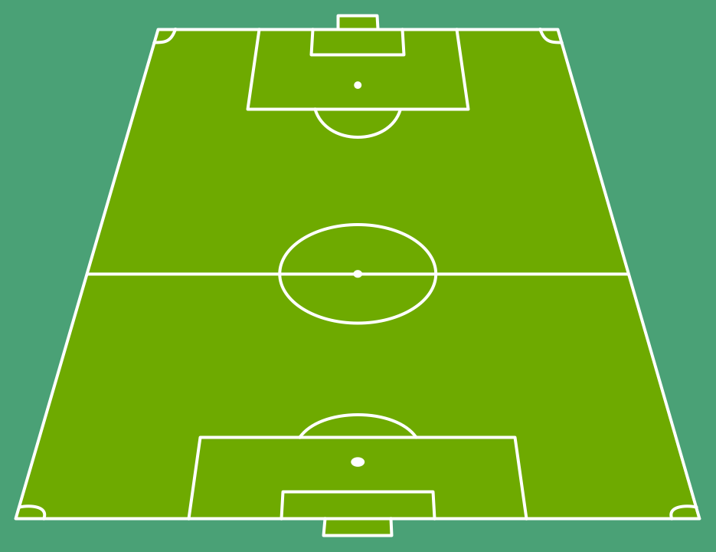



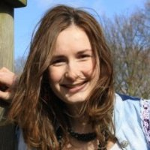
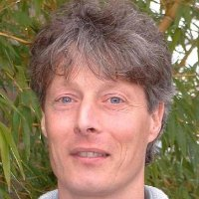
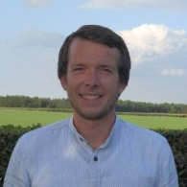
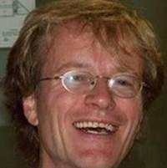
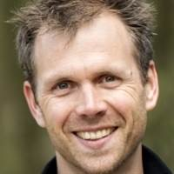
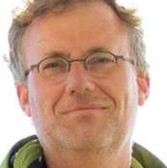
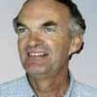
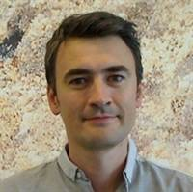
Pieter van Oel (C)
Henk Ritzema
Michel Riksen
Klaas Metselaar
Gert Jan Veldwisch
Daniel Levelt
Ferko Bodnar
Mathijs Wessels
Linda Groot Nibbelink
Eng. Anenmose Maro
Dr. Peter Mjata

Slide 9




Course plan
7 weeks
5 weeks
E-module 2
Design assignment
(teams: 6 students)
E-module 3
Presentation
& Report
E-module 1
Exam
E-module 4
E-module 5
BASIC KNOWLEDGE:
Orientation & identification
Climate & hydrology
Agricultural water management
Irrigation & the water system
Erosion risk assessment
YOU DO ALL
(1,2,3,4 and 5)
FEEDBACK SESSIONS
PERSPECTIVES FOR DEVELOPMENT
Climate change
Population Growth
Urbanization
Globalization & Trade
Food production
Reduce, reuse, recycle
YOU PICK ONE
(A,B,C,D,E or F)
DISCUSSION SESSIONS

Slide 10
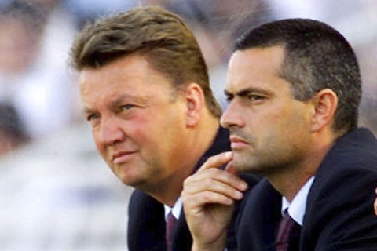
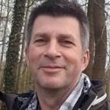

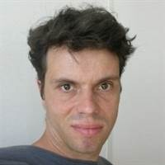

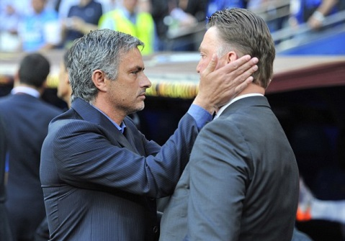
Coaches
Bert Bruins
Didi Stoltenborg
Harm Gooren
Teun Vogel
Matthijs Wessels

Slide 11
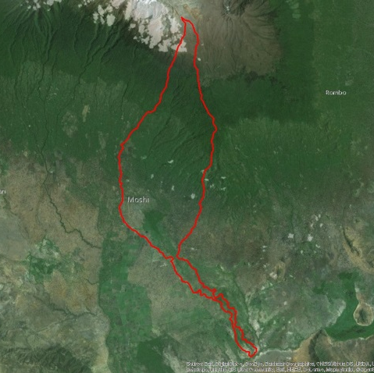
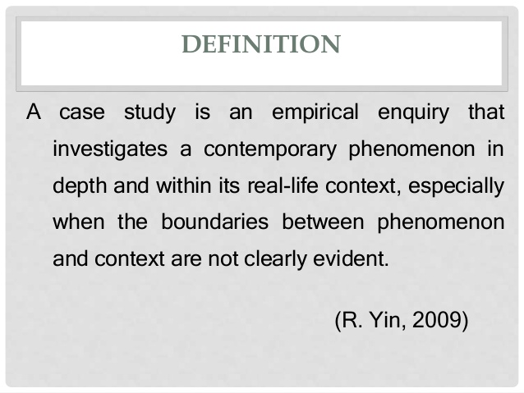
Case study area

Slide 12

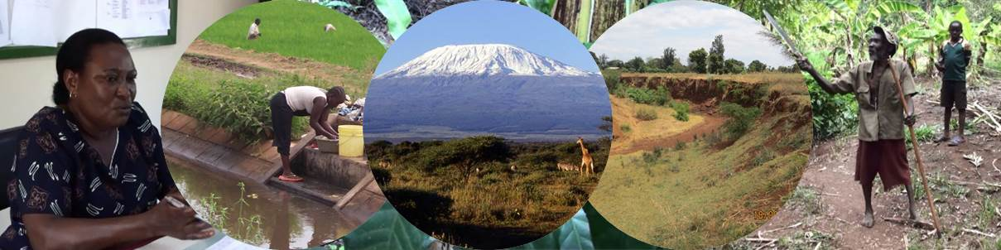
Case study assignment
Rau River Catchment, Tanzania

Slide 13
Assignment
Intervention plan including detailed designs
Integrated approach, building on a clear vision
Technical design in a socio-economic context
250 million Tanzanian Shillings (roughly 100,000 EUR) annually, for the next five years.

Slide 14
Learning outcomes
At the end of Period 5, you will be able to:
Interpret a ‘real-world’ demand.
Formulate design criteria for technical measures.
Appraise the current situation in the project area.
Draft a team contract and implement it.
Define, implement and assess different roles in your team.
  Articulate knowledge needs, integrate these in appraisal report.

Slide 15
Learning outcomes (cont.)
At the end of Period 6, you are able to:
Design measures to improve land and water management.
Assess the expected performance of these measures.
Present and defend the intervention plan to professionals.
Reflect on the work process.

Slide 16
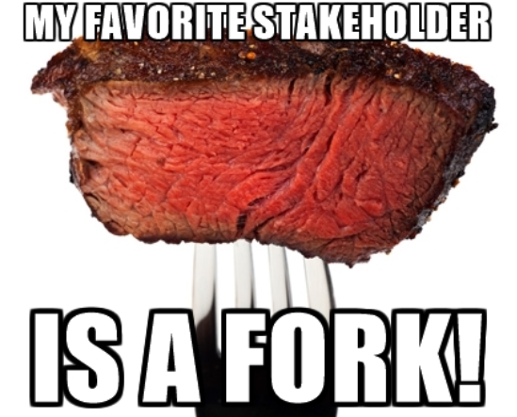
BIL-competencies:
Identification and analysis of various problems at play with regard to use, distribution and management
Identification of stakeholders and their interests
Development and design of alternatives and improvements, together with relevant stakeholders
Problem-oriented and interdisciplinary attitude

Slide 17
Approach: Demand-driven Education
YOU are supposed to actively demand for knowledge and skills
YOU can develop knowledge in a flexible manner
YOU will work on ”real demands” from the Kilimanjaro Region in Tanzania

Slide 18
Outputs, assessments and marking
Period 5:
Appraisal report (team product 25% of final mark)
Individual exam – close book (15%) * (Mark > 5.5)
Period 6:
Final report (team product 35%)
Individual defence and exam (25%)
Exam on 2 May
Re-exam 9 May, if you fail no final mark!!

Slide 19
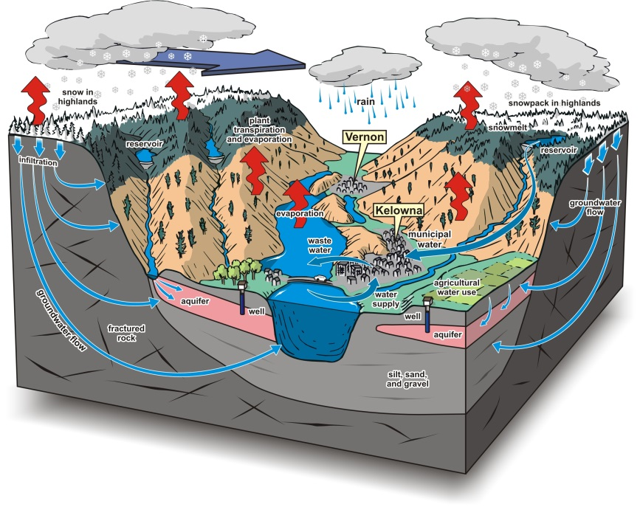
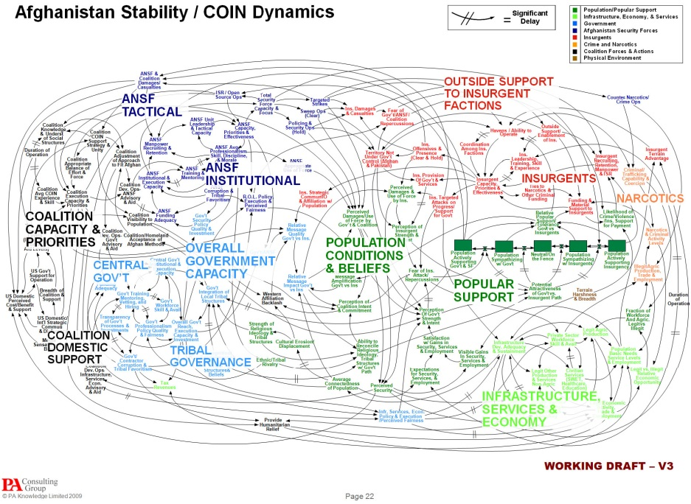
Program Block 2 (period 6, whole day)
16 May Poster presentations of ‘Basic plans’

Slide 20
Period 5 – Activities (mornings only)
Today: Self-test ➔ Personal Development Plan
Tomorrow: Formation of teams ➔ team contract
Module assignments; building blocks for appraisal report
Wednesdays: Feedback sessions 1-5 (free to choose)
Thursday: Discussion sessions A-F (6*10 students)
Working on Appraisal: agree with your own team
Team meeting with coach (on Monday morning)
Preparation of appraisal report, deadline: 23 April
2 May: Individual exam

Slide 21
Period 6 – Activities (whole day)
Preparation and presentation of Basic Plan poster
Consultations with experts: Resource Persons and CTA’s
Design interventions
Preparation of Final report, deadline: 2 June
7 June: Presentation of final report
8-9 June: Individual exam during panel discussion

Slide 22
Issues you know from the books
Design process
  Drainage
    Water delivery at tertiary level
      Canal Design
        Canal Structures
          Discharge assessment
            Crop and vegetation management
              Erosion risk assessment
                Erosion control
                Soil management

Slide 23


Team work
Each team consist of max. 6 persons
Each team is supported by a coach
Assignments made individually (you can help each other!)
Team responsible for the quality of its work, but workload can be divided
Each team member has to be able to defend the work individually

Slide 24
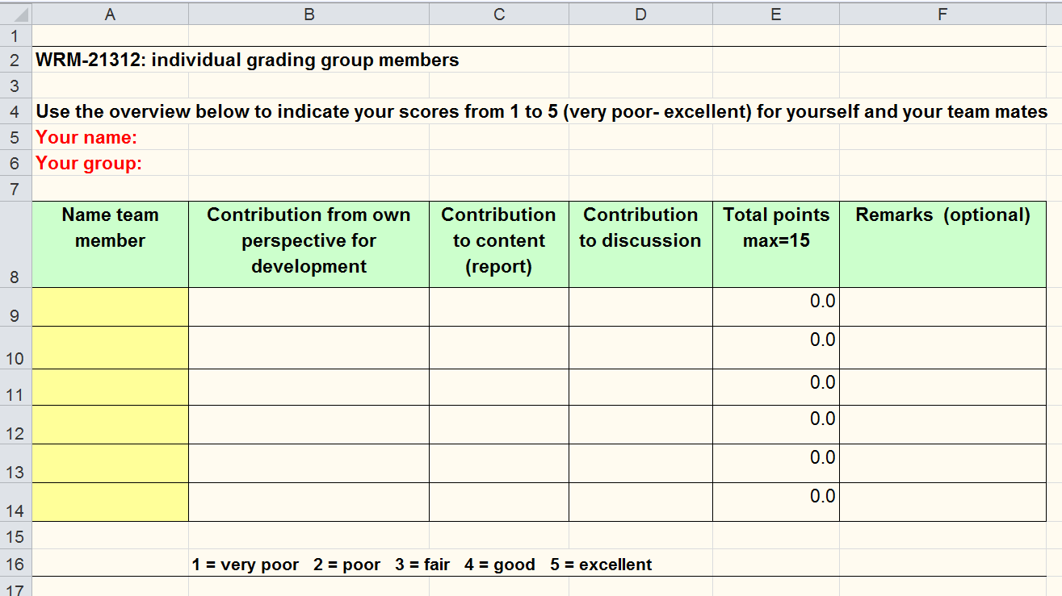
Differentiation on team products
(60% of the final mark)
Individual grading of your group members
You will practice with help of your coach
The weighting will be done before the final mark is known

Slide 25

E-module 2
Case study assignment
E-module 3
Presentation
& Report
Self test
Appraisal
Module 1
Exam
Poster
E-module 4
E-module 5
Knowledge clips
Feedback Fruits
Feedback sessions
Students are re-directed from Blackboard to FF
Dialog (basis for feedback sessions)
Share (movies and literature)

Slide 26
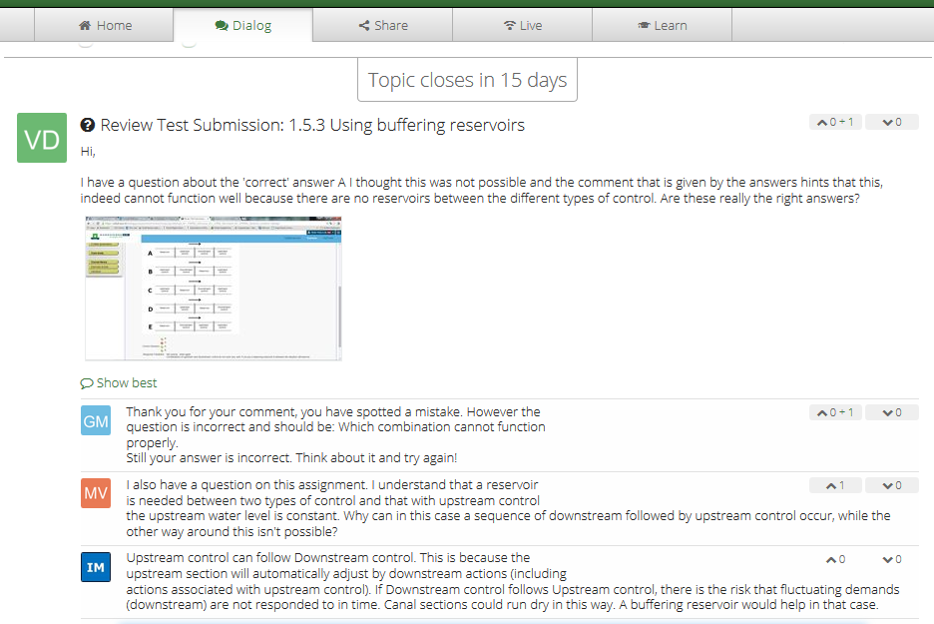
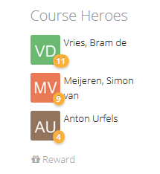
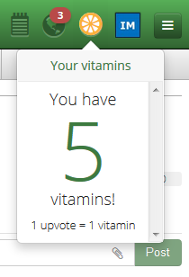

Slide 27
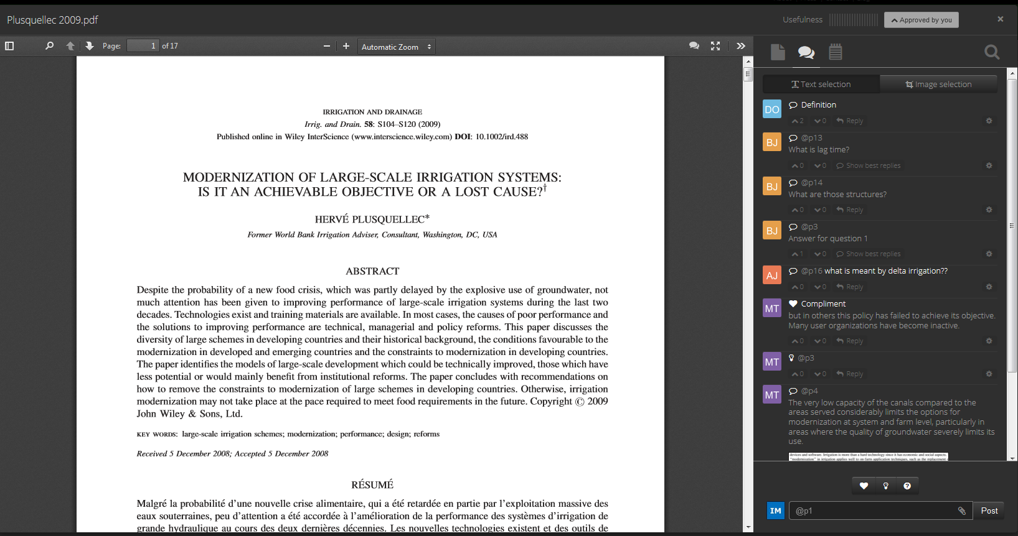

Slide 28
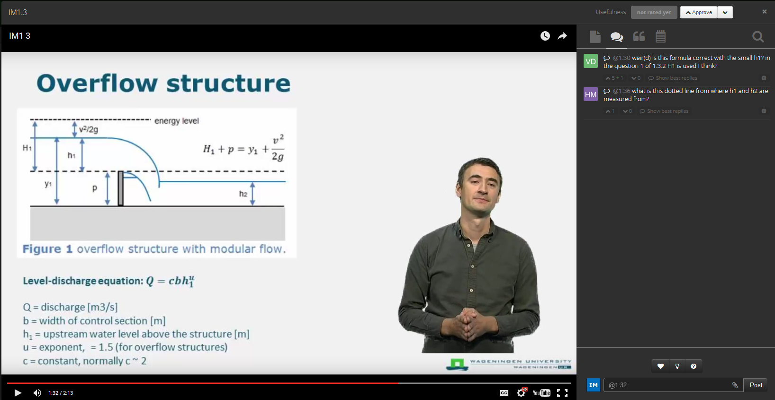

Slide 29
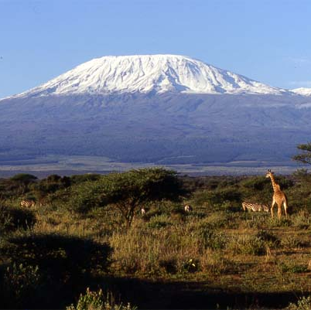
Good luck!

Slide 30
Program of today
Introduction to the course
Self-test
Reading: Course guide; Letter Ms. Bwana; Reports and Assessments; PDP
Perspectives A-F: pick your preferred perspective (tomorrow you can decide)

