Slide 1
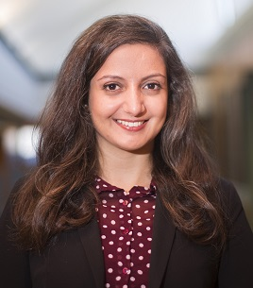
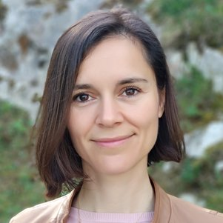
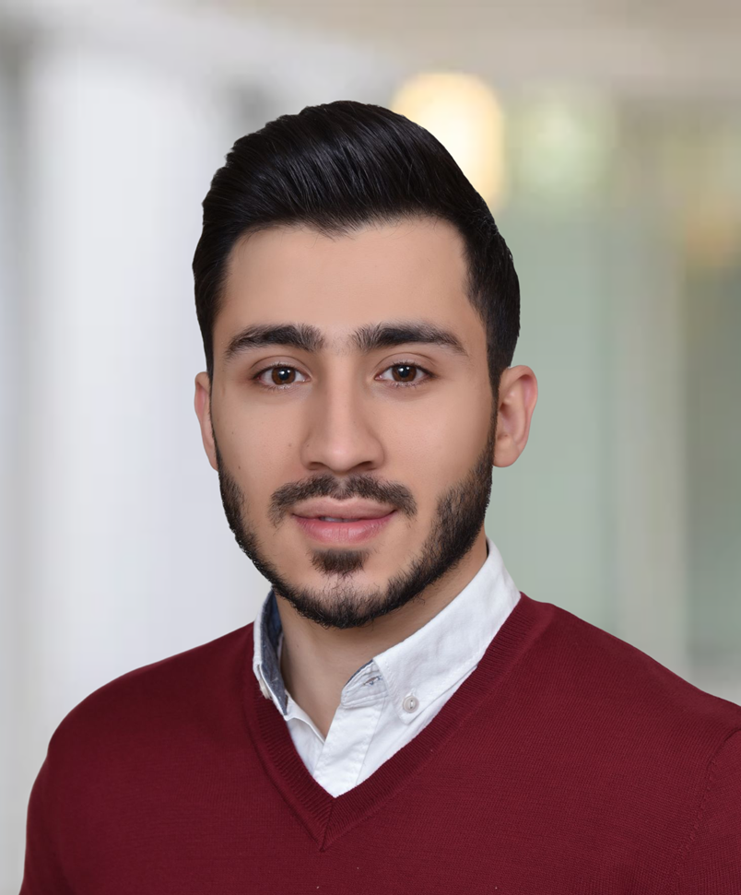
”The Other Side of the Resilience Coin”
Organized by
Hiba Baroud
Associate Professor of Civil and Environmental Engineering
Vanderbilt University (USA)
Littlejohn Dean's Faculty Fellow
hiba.baroud@vanderbilt.edu
Maria Nogal
Assistant Professor of Civil Engineering and Geosciences
TU Delft
M.Nogal@tudelft.nl
Omar Kammouh
Assistant Professor of Technology, Policy, & Management
TU Delft
O.Kammouh@tudelft.nl

Slide 2
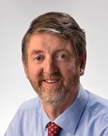
”The Other Side of the Resilience Coin”
Mark Stewart
Distinguished Professor of Civil Engineering
University of Technology Sydney (Australia)
Director of the Centre for Built Infrastructure Resilience at UTS
Former director of the Centre for Infrastructure Performance and Reliability at The University of Newcastle
Editor-in-Chief of Structural Safety, the leading journal in structural risk and reliability analysis

Slide 3
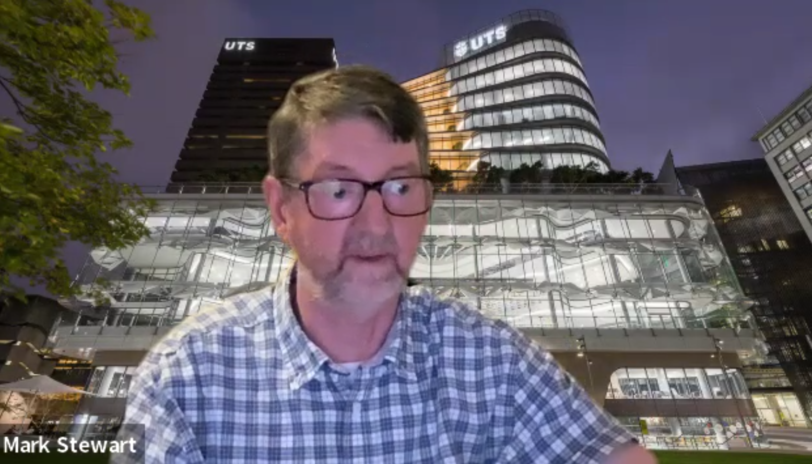
”The Other Side of the Resilience Coin”

Slide 4
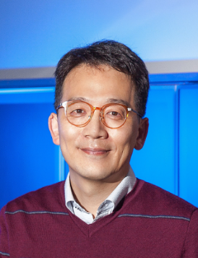
”The Other Side of the Resilience Coin”
Junho SONG
Professor in Structural/System Reliability
Seoul National University (S. Korea)
President of the International Civil Engineering Risk and Reliability Association (CERRA)
Former director of the convergence research center for disaster hazards resilience

Slide 5
”The Other Side of the Resilience Coin”
Junho SONG

Slide 6
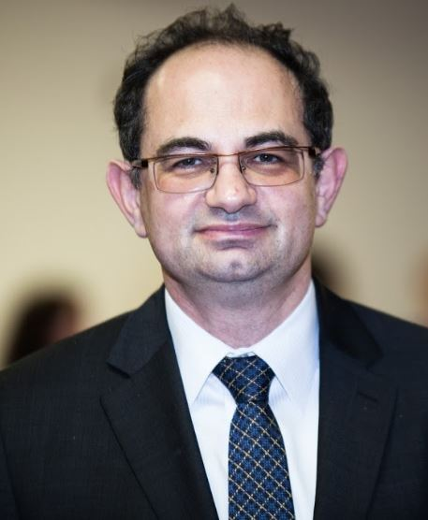
”The Other Side of the Resilience Coin”
Igor Linkov
U.S. Army Engineer Research and Development Center (ERDC)
Adjunct Professor at Carnegie Mellon University (USA)
Responsible for ERDC’s project portfolio in the areas of crises management and resilience.
Secretary of Deference Strategic Environmental Research and Development Program, and Cyber Resilience Technical Committee

Slide 7
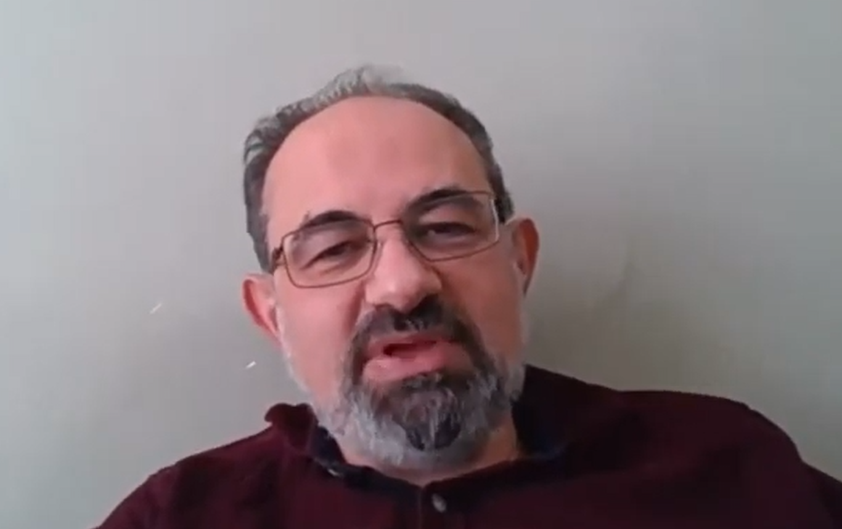
”The Other Side of the Resilience Coin”
Igor Linkov

Slide 8
”The Other Side of the Resilience Coin”
“Where do we go from here?”
(Igor Linkov)
“How can we animate infrastructure system to a resilience one?”
(Junho Song)
“Always look on the bright side of life”
(Statement taken from Monti Python summarizing Mark’s talk)

Slide 9
Resilience of Complex Systems: feed up, feed back, and feed forward
Now let’s go to the workshop
Organized by
Hiba Baroud, Maria, Nogal, and OmarKammouh
Same building on the 6th floor
Room 6.00

