Slide 1
The ABCD of resilient food systems
From theory to an assessment framework.
4-10-2022, Hubert Fonteijn

Slide 2
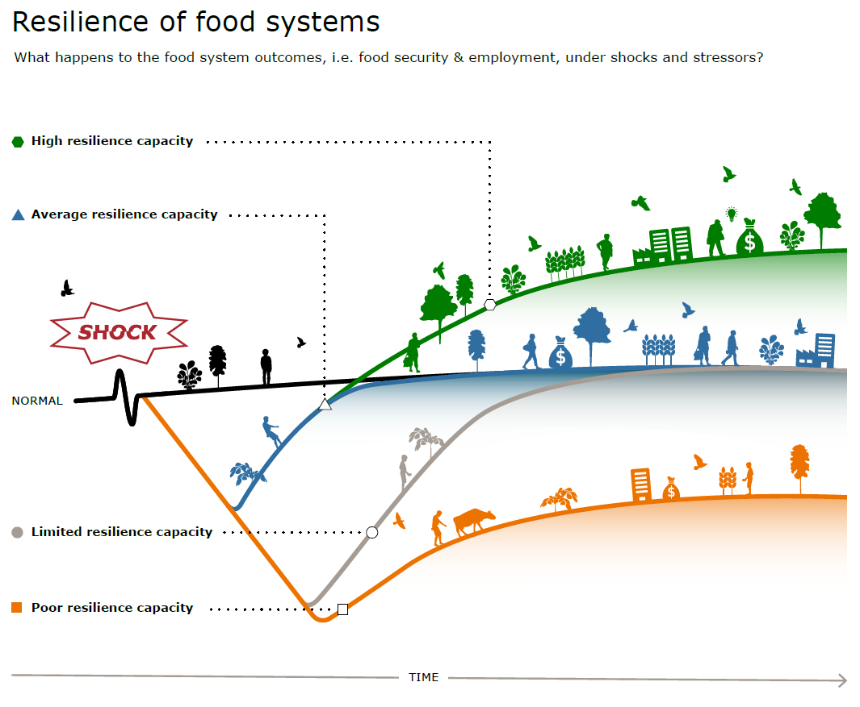

Slide 3
Assessing resilience is challenging
Definition of resilience: for whom, to what, where, when and why
Resilience measurement: return time, lowest level during shock, level after shock?
What system properties support resilience? What corresponding indicators?
Indicators will be a mixture of quantitative and qualitative. How to combine?
How to predict resilience after an intervention?

Slide 4
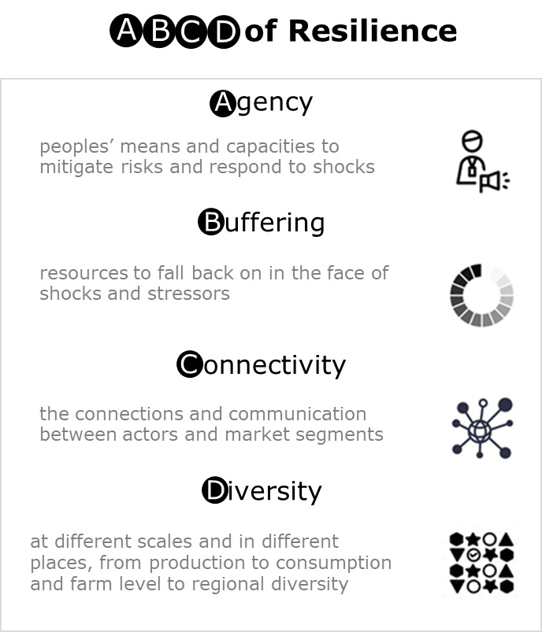

Slide 5
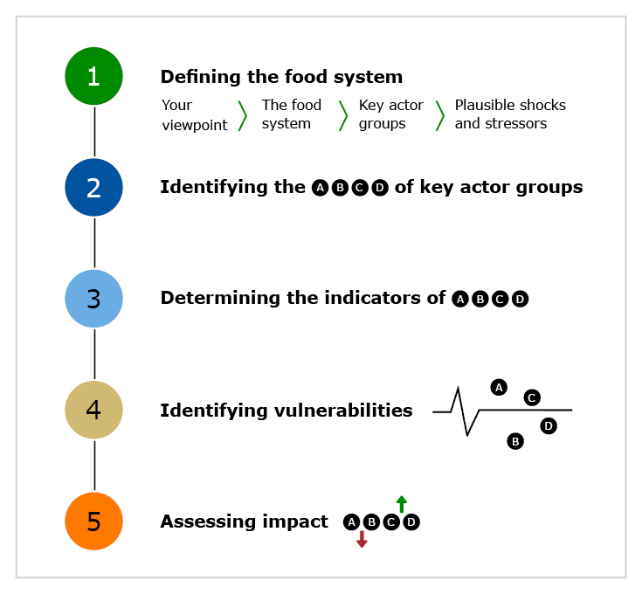
Resilience assessment based on ABCD

Slide 6
Step 1: System definition Index-based crop insurance case study
a. Viewpoint | Viewpoint from which food system resilience is formulated, including brief description of case | A development agency supported by an impact investor introduces crop insurance to protect smallholders against common production shocks, improving resilience directly, but also promoting the cultivation of high-risk high-yield crops and thereby economic viability. In this case study, the focus is on the resilience effect.
b. Food system description | What are the components/actors, their relationships, and what bounds the food system? | Smallholders, trade networks, including local traders and their consumers. Region within an LMIC dominated by smallholders. Not including urban populations or foreign producers/consumers of food, because food is predominantly locally produced and consumed.
c. Vulnerable groups | Groups vulnerable under current conditions or whose resilience is affected by intervention | 1. Smallholder households. 2. Households depending on food production by smallholders since both groups will struggle to source food if local food production decreases
d. Relevant shocks/stressors | Shocks and stressors of interest (production/trade/pandemic/climate change) | Productivity shocks: i.e., droughts, floods and pests.

Slide 7
Step 2: ABCD properties per actor group
 | Agency | Buffering | Connectivity | Diversity
Smallholder households | Opportunities for productivity development (investment), social status as a limiting factor | Own reserves (cash, livestock and food) | Local trade and social relationships | Off-farm income and crop diversity
Regional households depending on local production | Education and social factors enable job opportunities. Ability to migrate | Household cash/food stocks | Social relationships between households, trade with other communities, and large-scale trade | Diversity of local production across farmers and local job opportunities

Slide 8
Step 3: Indicators of the ABCD properties for each actor group
 | Agency | Buffering | Connectivity | Diversity
Smallholder households | Profitability/acre, time to travel to agricultural education center | Average savings and lowest quintile of savings, livestock, food reserves | What % of production is traded and to whom (only one-on-one, or one-to –many and many-to-one?), distance to market (in space and time), prior use of social relations in food crises | Off-farm income, number of available sources for off-farm income, number of crops in cropping system (/year)
Regional households depending on local production | Years of education, social status, gender | Average and lowest quantile of savings and food reserves | Prior use of social relations in food crises, existence of trade between other communities (villages), and larger production/trade centers | Number of different crops across farmers (/year), number of different job opportunities

Slide 9
Step 4: Vulnerabilities of actor groups for each ABCD property
Green = positive contribution |  |  | Red = negative contribution
 | Agency | Buffering | Connectivity | Diversity
Smallholder households | Low profitability limits other options | Low reserves | Social relationships protect food security during crises | Diverse cropping systems protect against local shocks
 |  |  |  | Large dependence on own food production
Regional households depending on local production | Low education limits employability | Low reserves | Social relationships protect food security during crises | Diversity of crops across farmers
 |  |  | The trade network is local, so high vulnerability against local production shocks | Low diversity in job opportunities

Slide 10
Step 5: Assessment of the impact of the intervention of each of the ABCD properties for each actor group
Positive change |  | Negative change |  | No change
 | Agency | Buffering | Connectivity | Diversity
Smallholder households | Improved profitability | Crop insurance buffers against production shocks | Social relationships might become strained by increased inequality | Diverse cropping systems protect against local shocks
 |  | Potential to improve reserves
 | Uptake of insurance by richer farmers increases inequality | Uptake of insurance by richer farmers increases inequality and thereby ability to build reserves |  | Large dependence on own food production
Regional households depending on local production |  | More/cheaper food makes it easier to build reserves | Social relationships protect food security during crises | Diversity of crops across farmers
 |  |  | Trade network is local, so high vulnerability against local production shocks | Low diversity in job opportunities

Slide 11
Assessing ABCD in practice
Each use case will require specification of ABCD
ABCD indicators will be qualitative and quantitative: difficult to combine
Trade-offs between ABCD properties within/between groups and between spatial/tempoaral scales

Slide 12
Assessing ABCD in practice
Well received
Further development/testing in practice is necessary
Conceptual tool vs evaluation method

Slide 13
George van Voorn
Geerten Hengeveld
Bart de Steenhuijsen Piters

Slide 14
Food system resilience. Towards a joint understanding and implications for policy
https://edepot.wur.nl/549244
Assessing the impact of interventions on food systems resilience
https://research.wur.nl/en/publications/assessing-the-impact-of-interventions-on-food-systems-resilience
Questions?
hubert.fonteijn@wur.nl

