Slide 1
DeSIRE Conference 2022 ’Facets of Resilience’: Water and Networks session
Water in a changing world
How do governments respond?
Florence Metz
University of Twente
Department of Governance and Technology for Sustainability
3. November 2022

Slide 2


Structure
Governance resilience
My research
1
2
3
4
Networks
Water & beyond

Slide 3
Structure
Governance resilience
My research
1
4
2
3
Networks
Water & beyond

Slide 4
A systems perspective on policy inter-dependencies
Typical research questions
What are the trade-offs and co-benefits within social-ecological systems, related to water and beyond?
How to achieve the indivisible goals of the global Sustainable Development Goals Agenda?

Slide 5
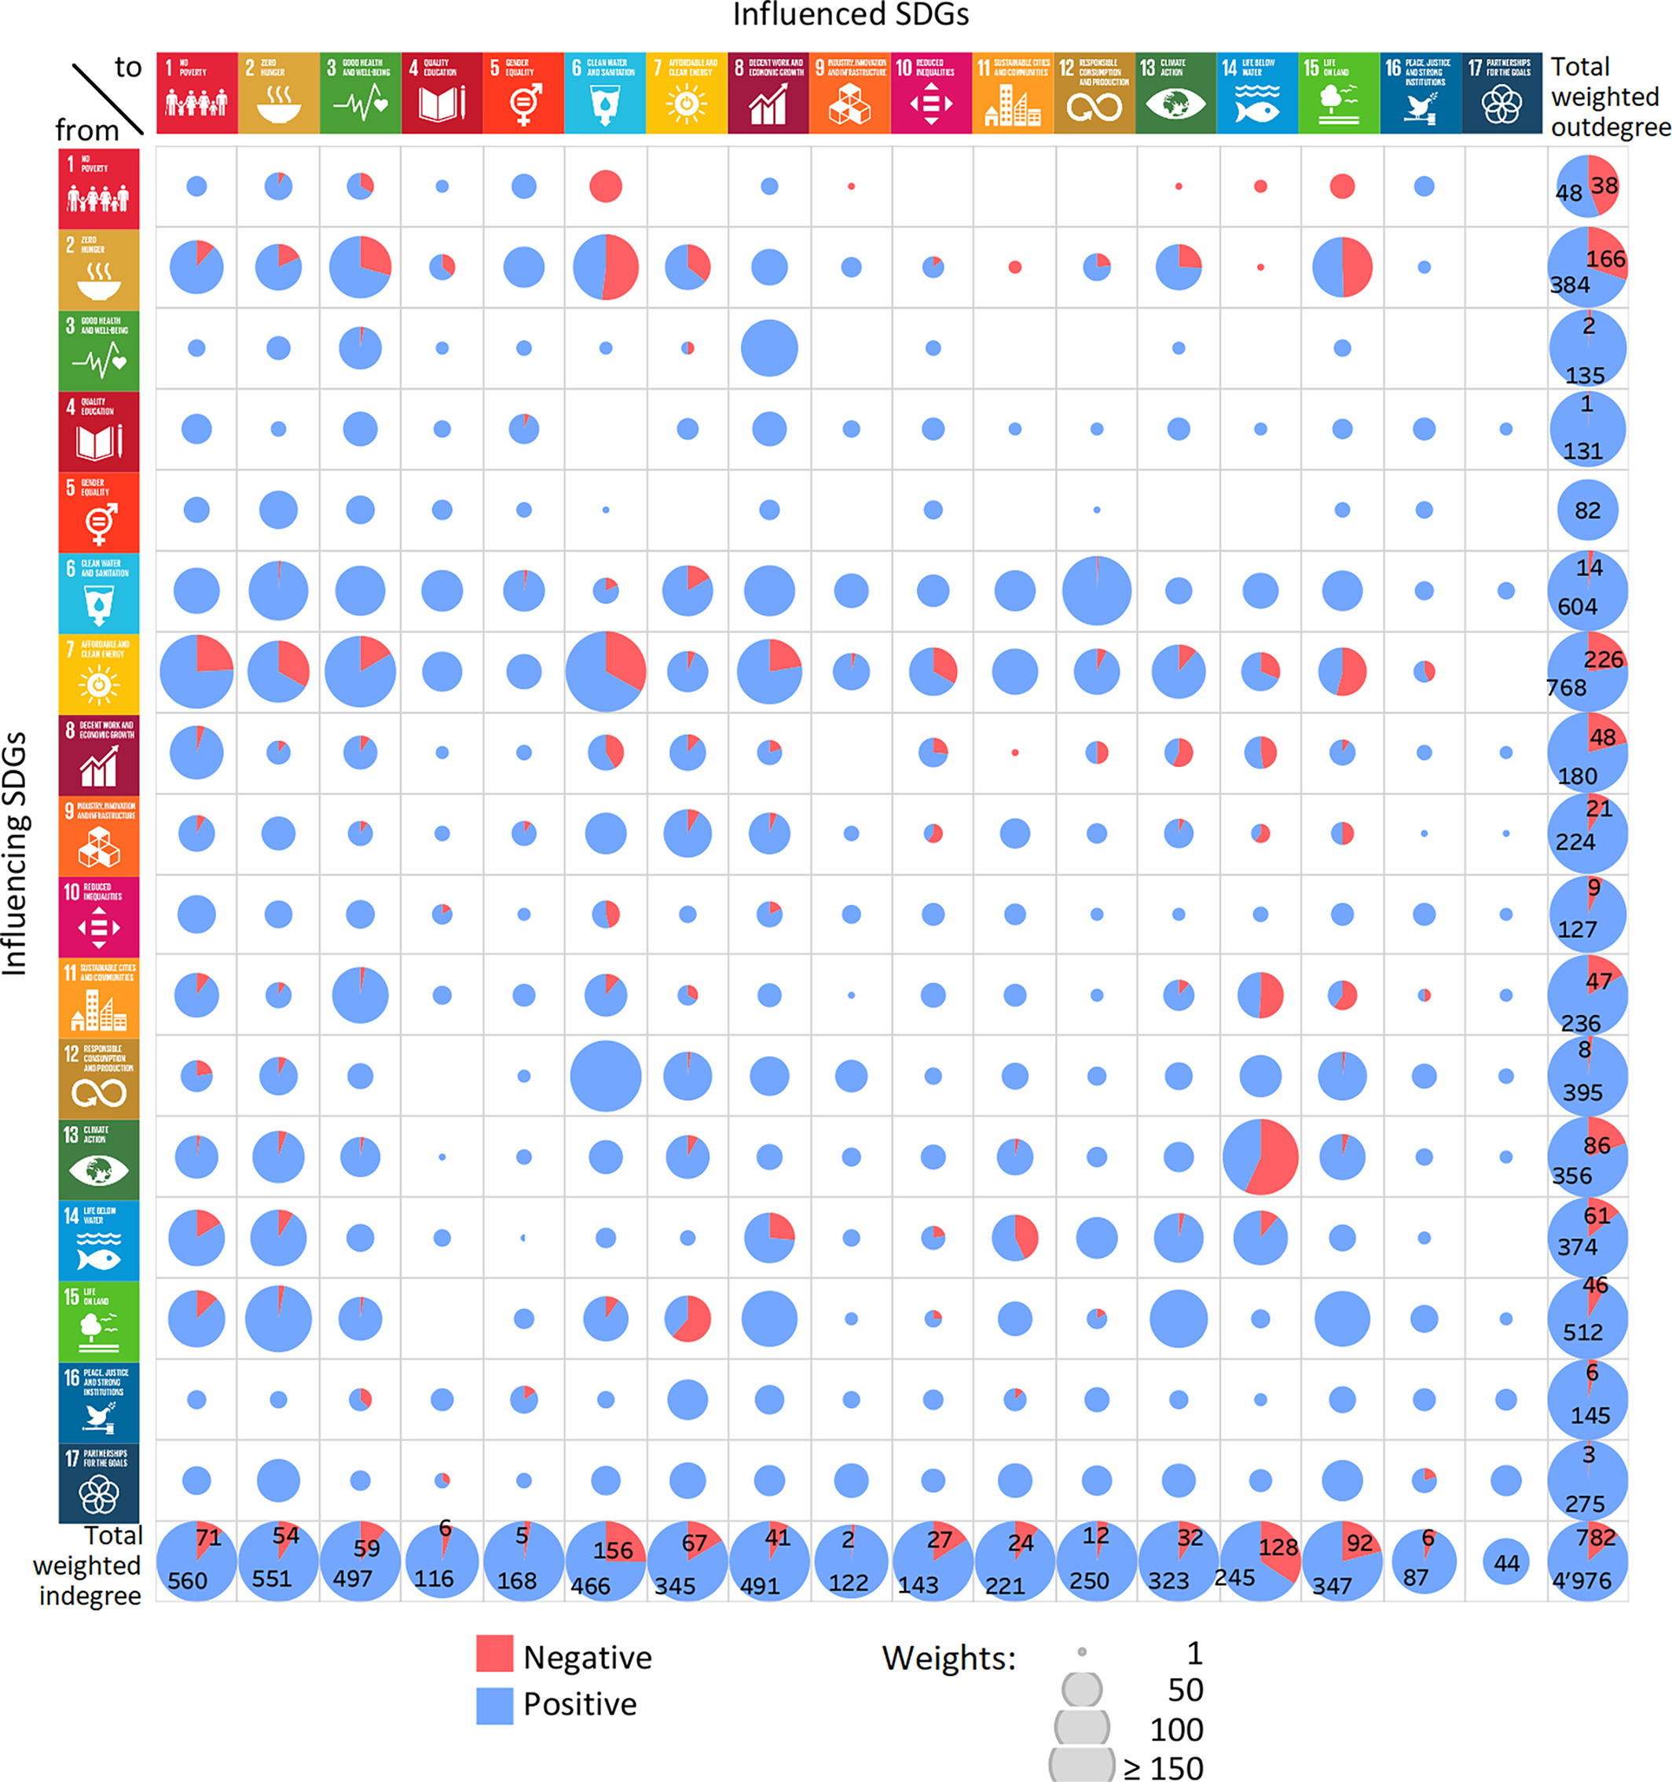
What trade-offs and co-benefits?
Interdependencies among SDGs on a global scale
Systematic literature review
SDG level interactions
  Size = weight of interaction / amount knowledge
  Row = impacting others
  Column = impacted by others
  Blue = positive interactions
  Red = negative interaction
Pham-Truffert, Metz &
et al. 2020: Sustainable Development
Notes:
65 UN reports and international scientific assessments (e.g., IPCC, IPBES)
112 scientific articles

Slide 6
Important water-related interactions
Water-energy-food (WEF) nexus
  Food (SDG 2) > water (SDG 6)
  Energy (SDG 7) > water (SDG 6)
Pham-Truffert, Metz &
et al. 2020: Sustainable Development

Slide 7
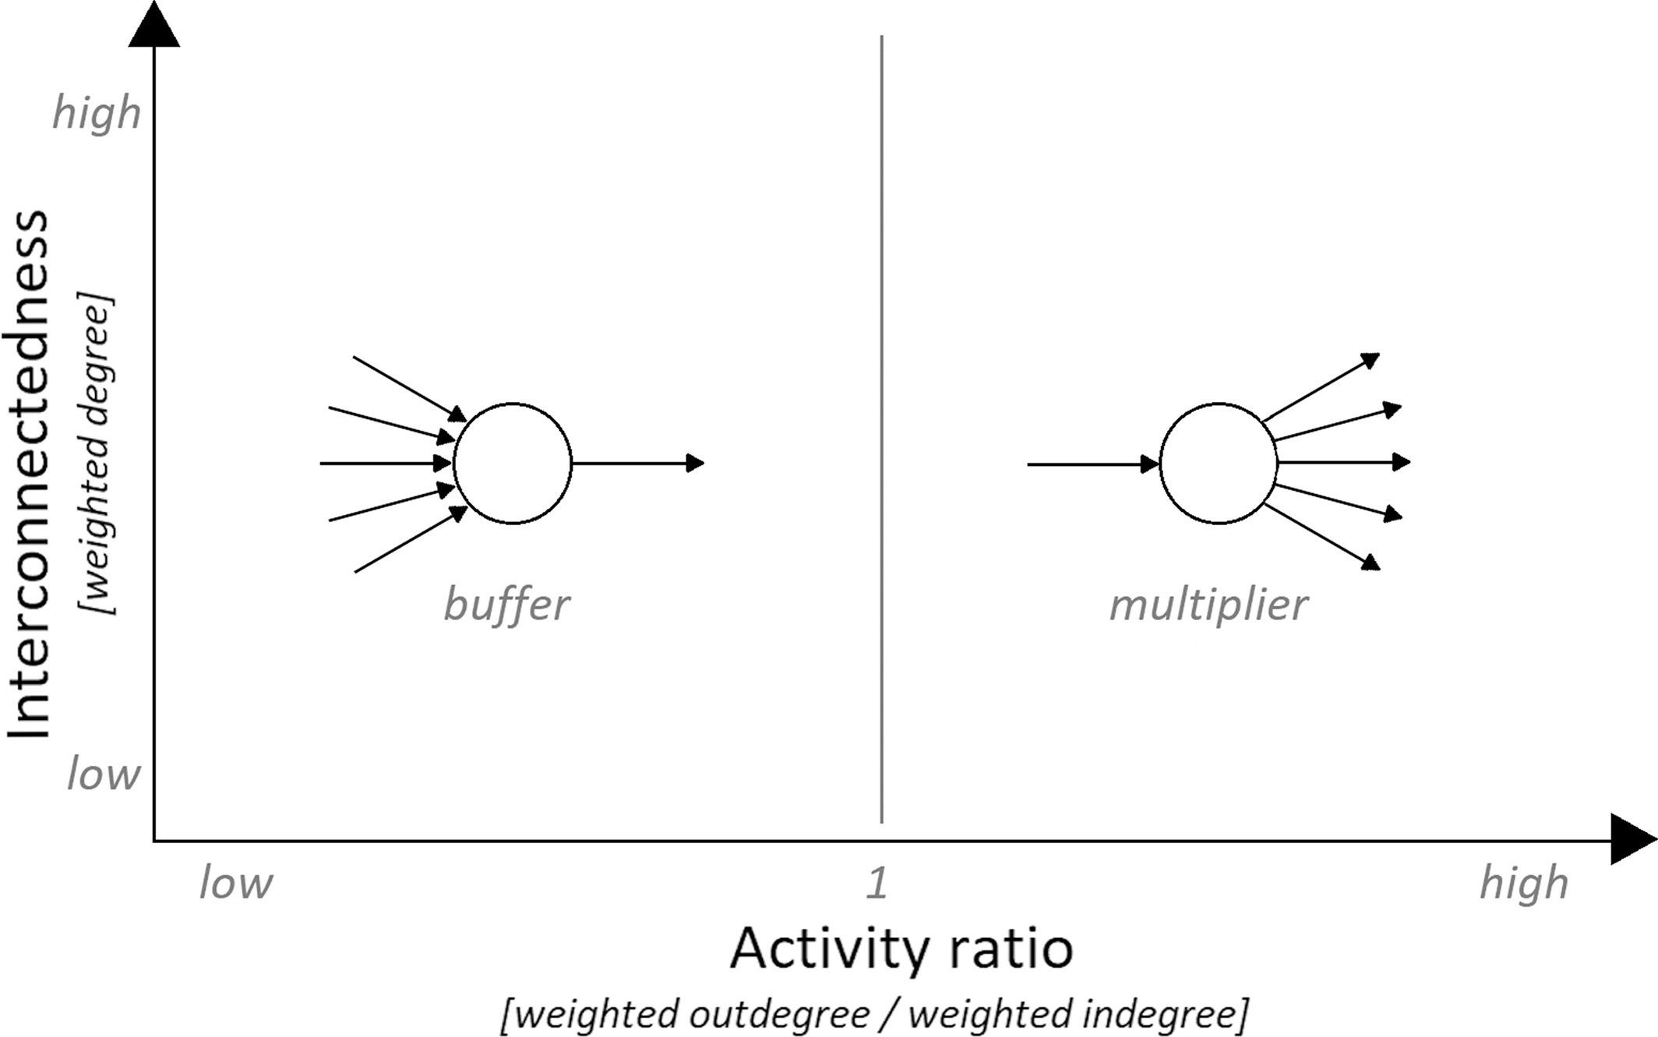
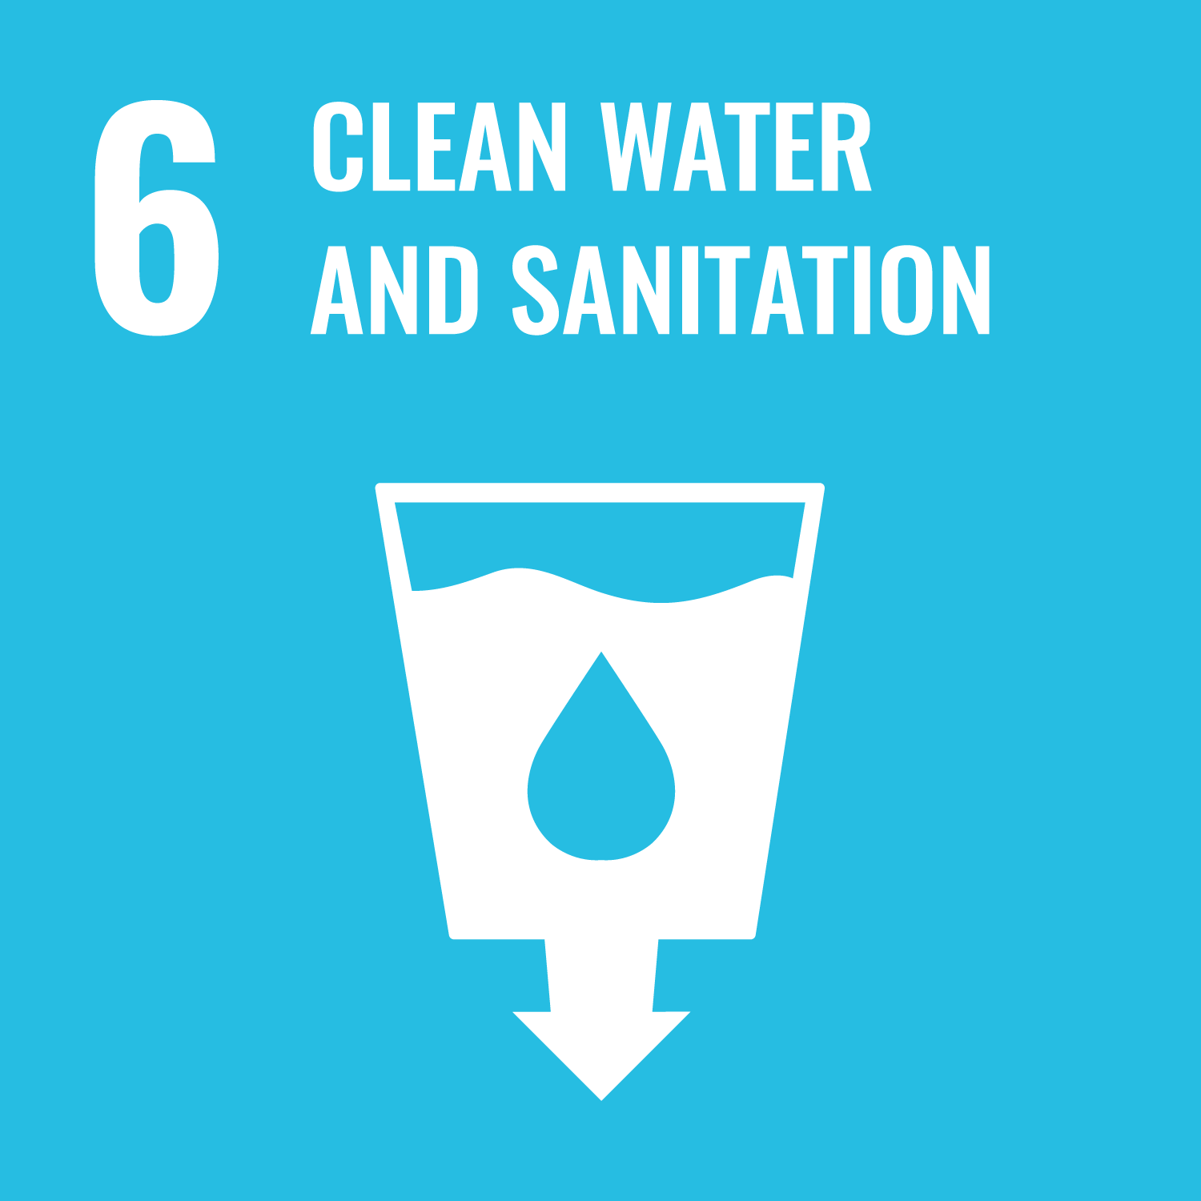
How to achieve SDG goals?
Typology of systemic buffers and multipliers
Prioritize policy action
++ Multiplier of positive and buffer of negative interactions, e.g.,:
Pham-Truffert, Metz &
et al. 2020: Sustainable Development
Notes:
++ Multiplier of positive and buffer of negative interactions, e.g.,:
sustainable consumption and production (SDG 12)
ecosystems (SDG 15)
-- Buffers of positive & multiplier of negative interactions:
economic growth (SDG 8)
food (SDG 2)

Slide 8
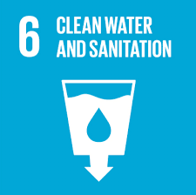

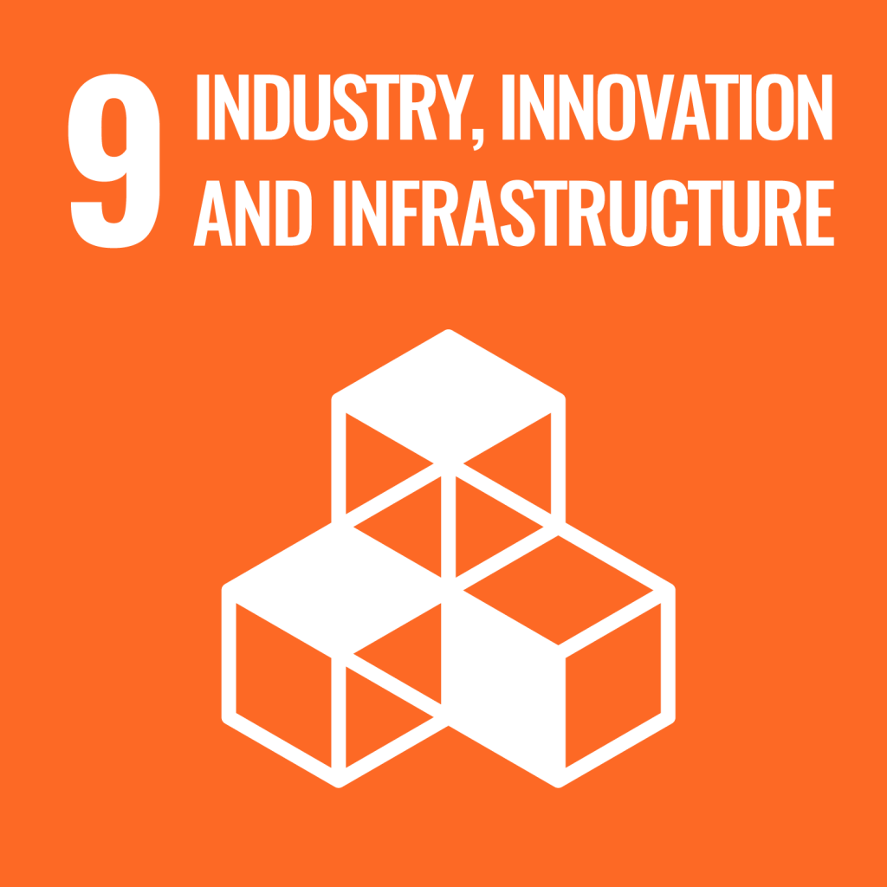
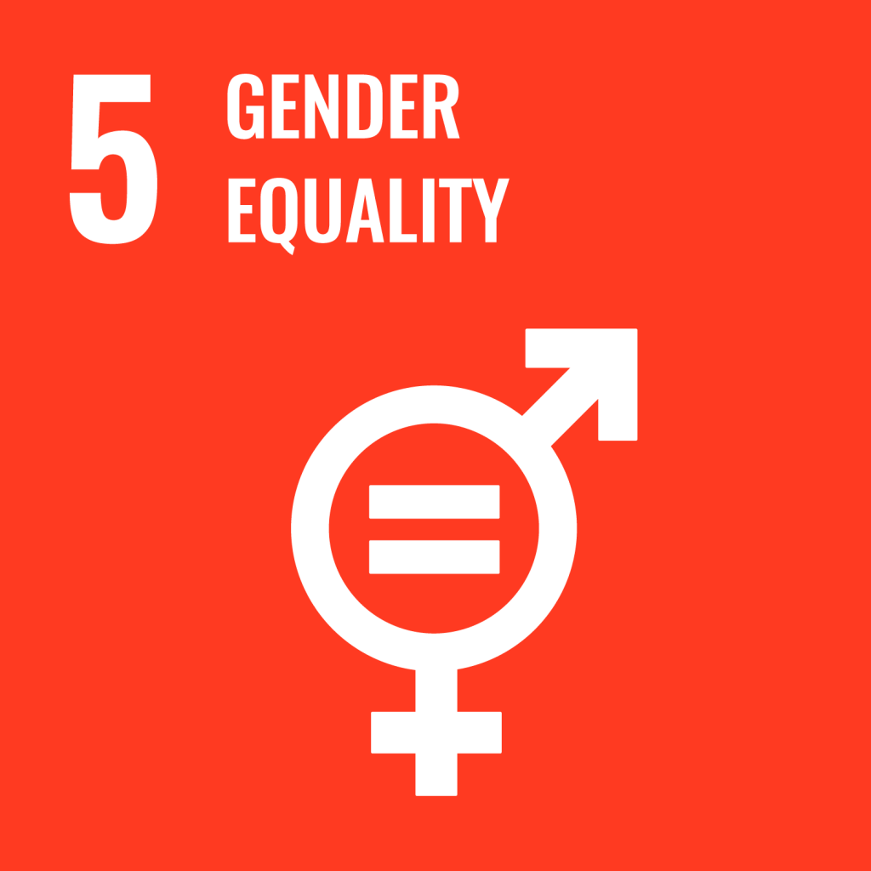
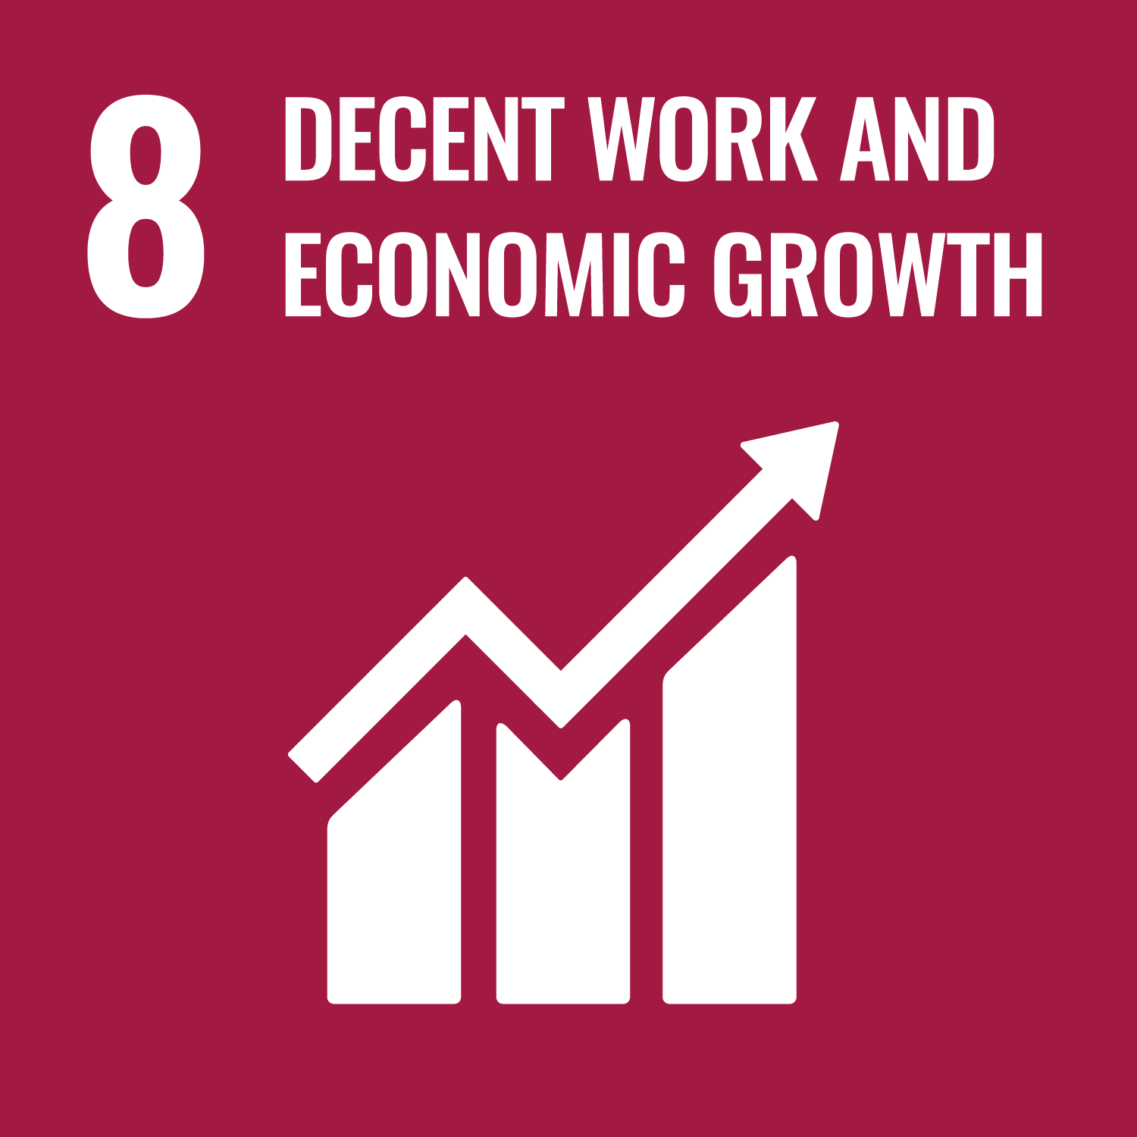
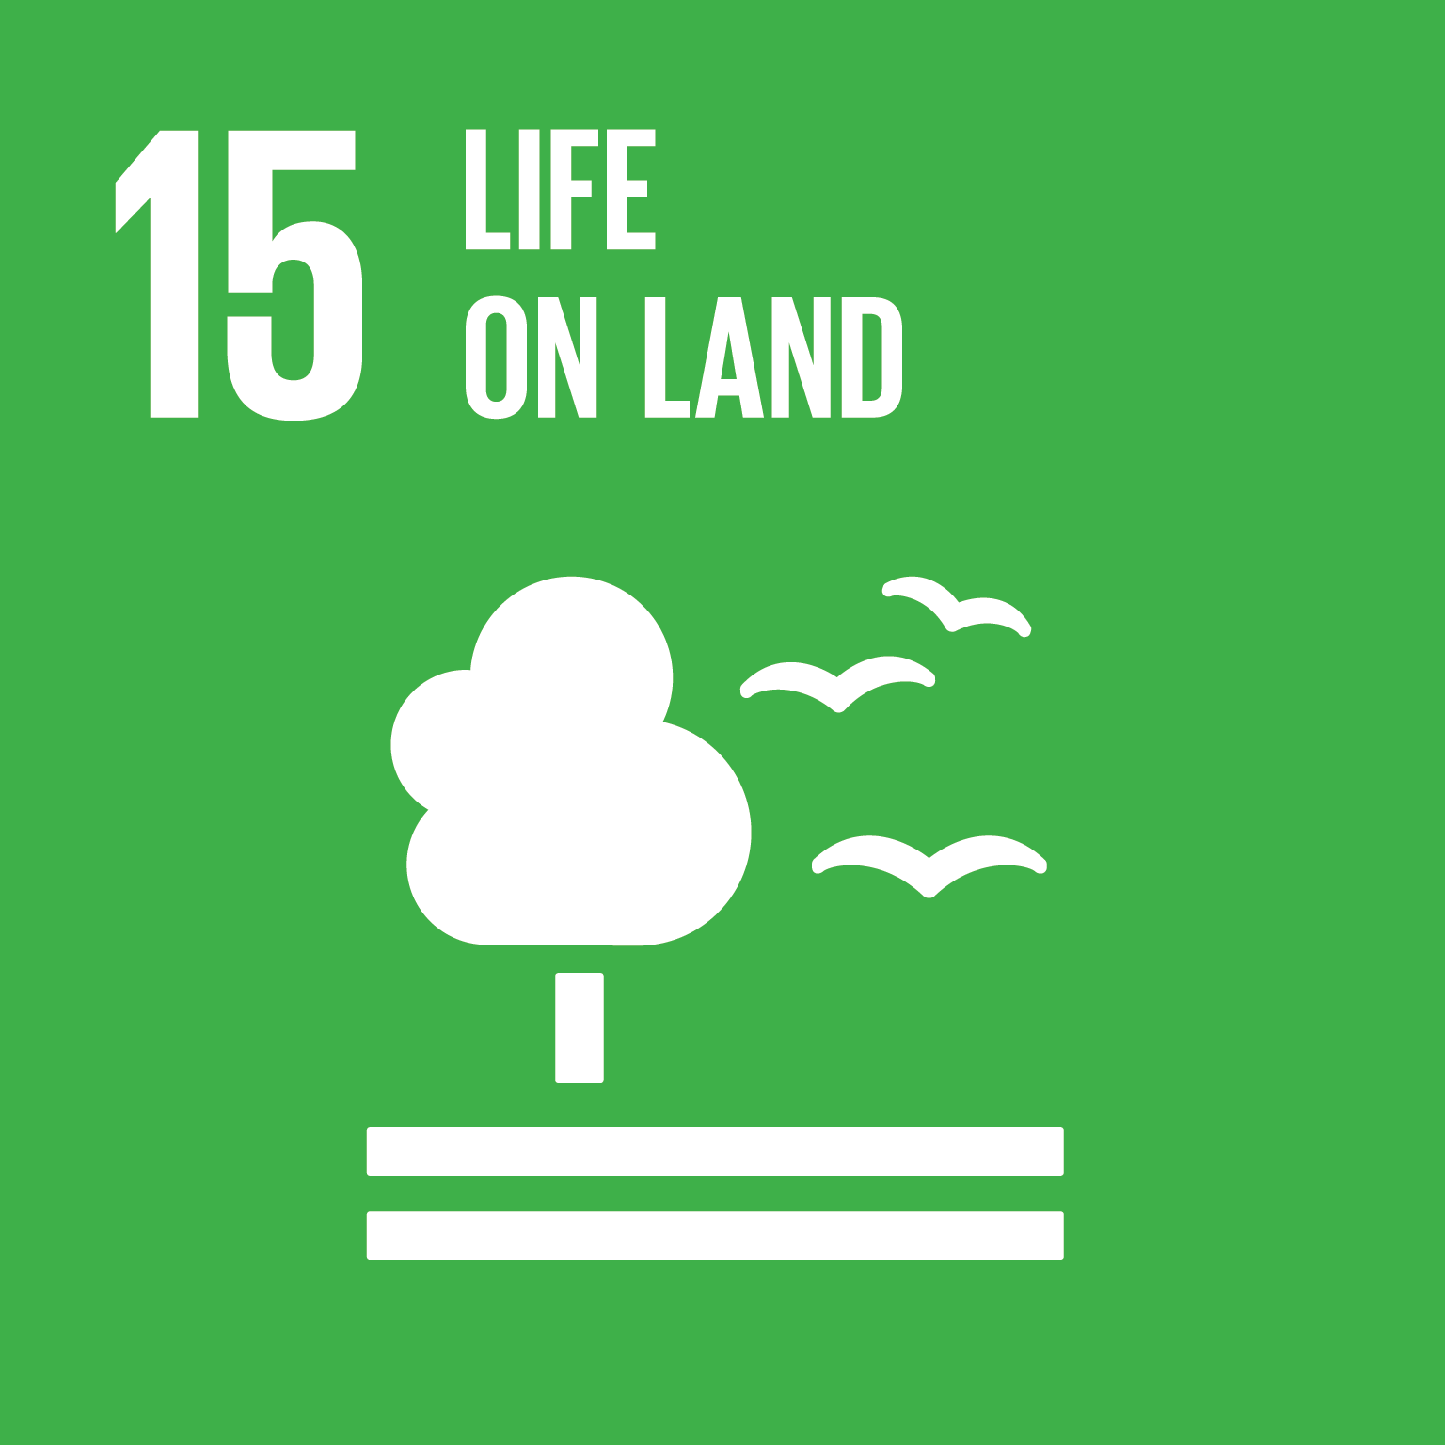
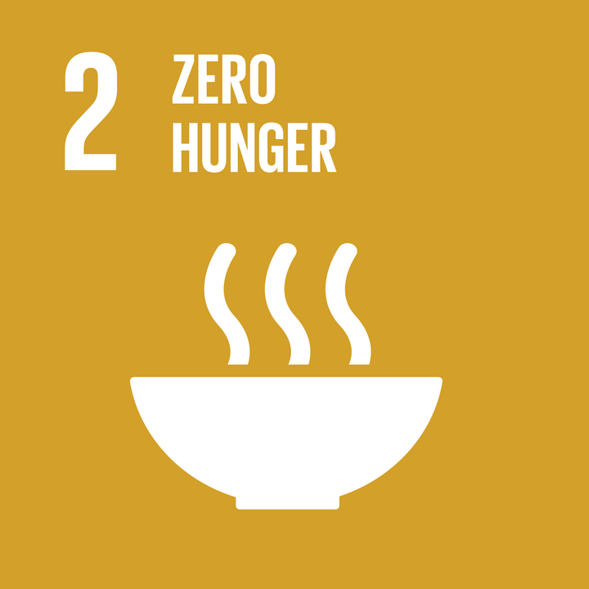
Addressing water problems requires a systems perspective
Integrated governance across policy sectors

Slide 9
Structure
Governance resilience
My research
1
2
3
4
Networks
Water & beyond

Slide 10
The politics of integrated governance
Typical research questions
How is water governed? Who are the political actors involved?
Do actors collaborate on interdependent issues?
What is the structure of the governance network?

Slide 11


The politics of integrated governance
Test governance innovations
Definition Contextually new modes of social steering (e.g., hierarchical, participatory)
Integrated governance
Central coordinator
coordinate
Model &
simulate
coordination
strategies
Social-ecological systems
Notes:
Factors affecting collaboration across government agencies on interdependent SDG challenges
Model and simulate the impact of diverse coordination strategies (e.g., central coordination vs. polycentricity) on integrated governance.
Test governance innovations = contextually new modes of social steering (e.g., hierarchical, participatory, autonomous)
In global South and North
Network management strategies
Model & simulate the impact of diverse coordination strategies (e.g., central coordination vs. polycentricity) on cross-sectoral collaboration
The precise difficulties in coordinating across public sectors remain poorly understood.
On the one hand, conflicting goals and languages across public admin- istrations may foster the siloization of the public sector.
On the other hand, public administrations play a key role as change agents, brokers and entrepreneurs, who bridge across sectoral divides in public policy processes. In my empirical observations, some civil servants could even be described as network managers, who attempt to coor- dinate different actors across sectors, scales and geographical boundaries.
In an ongoing project together with Örjan Bodin and Johanna Hedlund from Stockholm Resilience Center (SRC), I analyze such network management strategies. More precisely, we model and then simulate the impact of diverse coordination strategies (e.g., central coordination vs. polycentricity) on cross-sectoral collaboration.

Slide 12
Structure
Governance resilience
My research
1
2
3
4
Networks
Water & beyond

Slide 13
Policymaking processes
Typical research questions
Who are the decision makers participating in policymaking processes?
What role do political alliances play to create change for system transformation?
Are there change agents who play a specific role in mediating across alliances?

Slide 14
Who?
Who participates in policymaking?
Example: Water protection policy
Survey and in-depth interviews with state and non-state organizations participating in policymaking
Metz and Brandenberger 2022: American Journal of Political Science
Definition policy network:
social maps of policymaking processes
overview of the actors involved in policymaking
Interactions of actors
Power dependencies
Notes:
April 2013 – August 2014

Slide 15
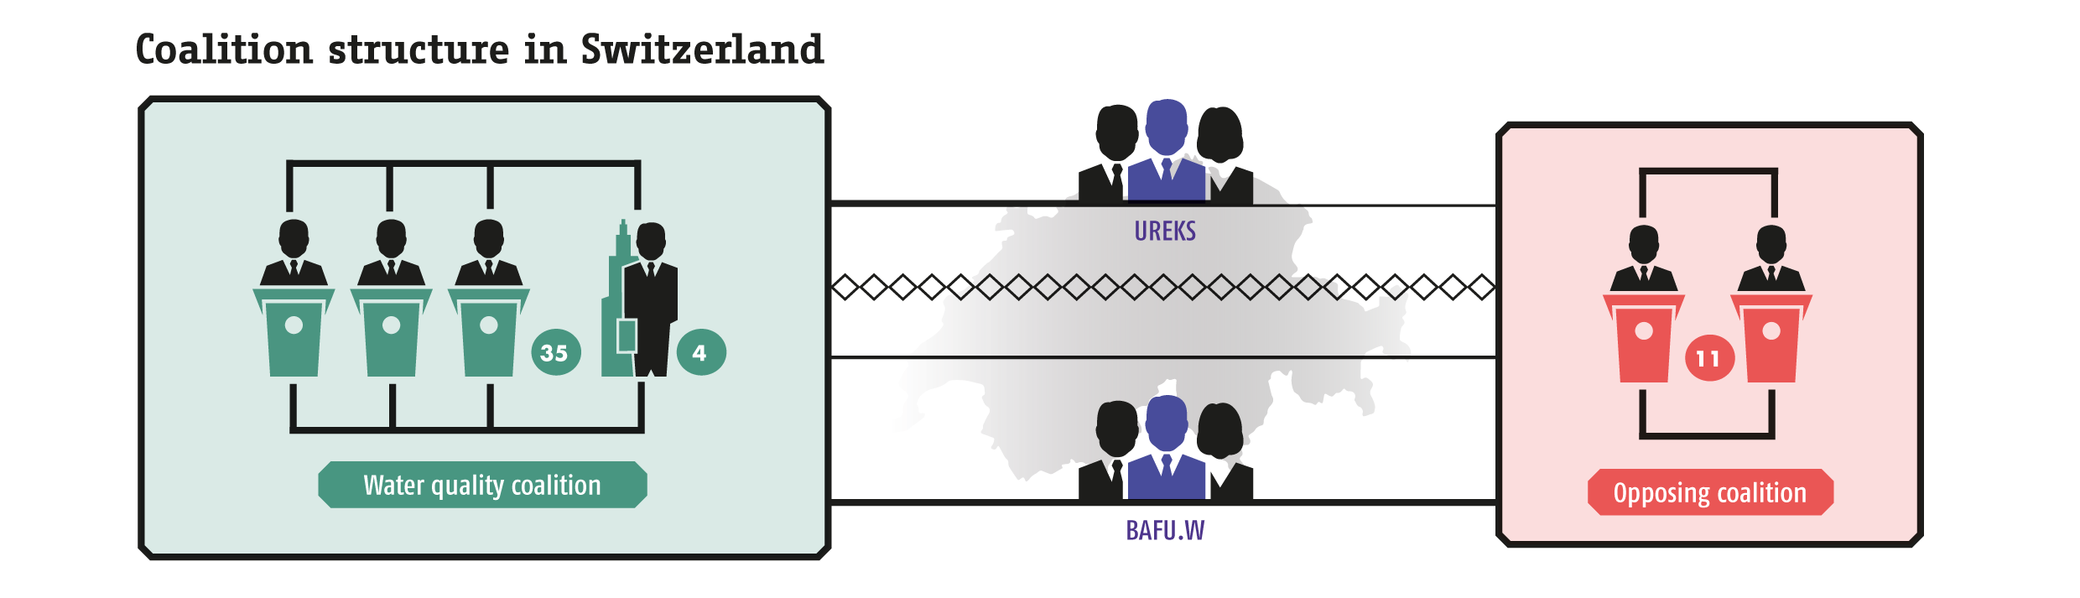
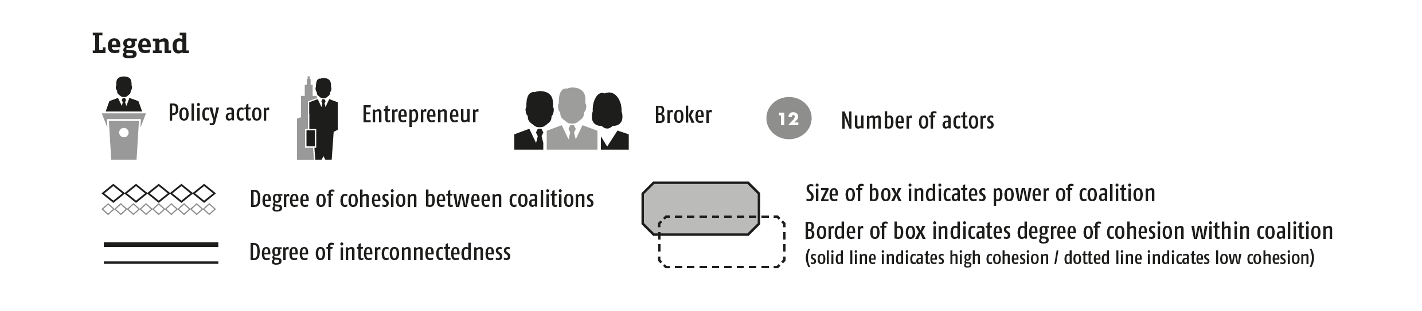
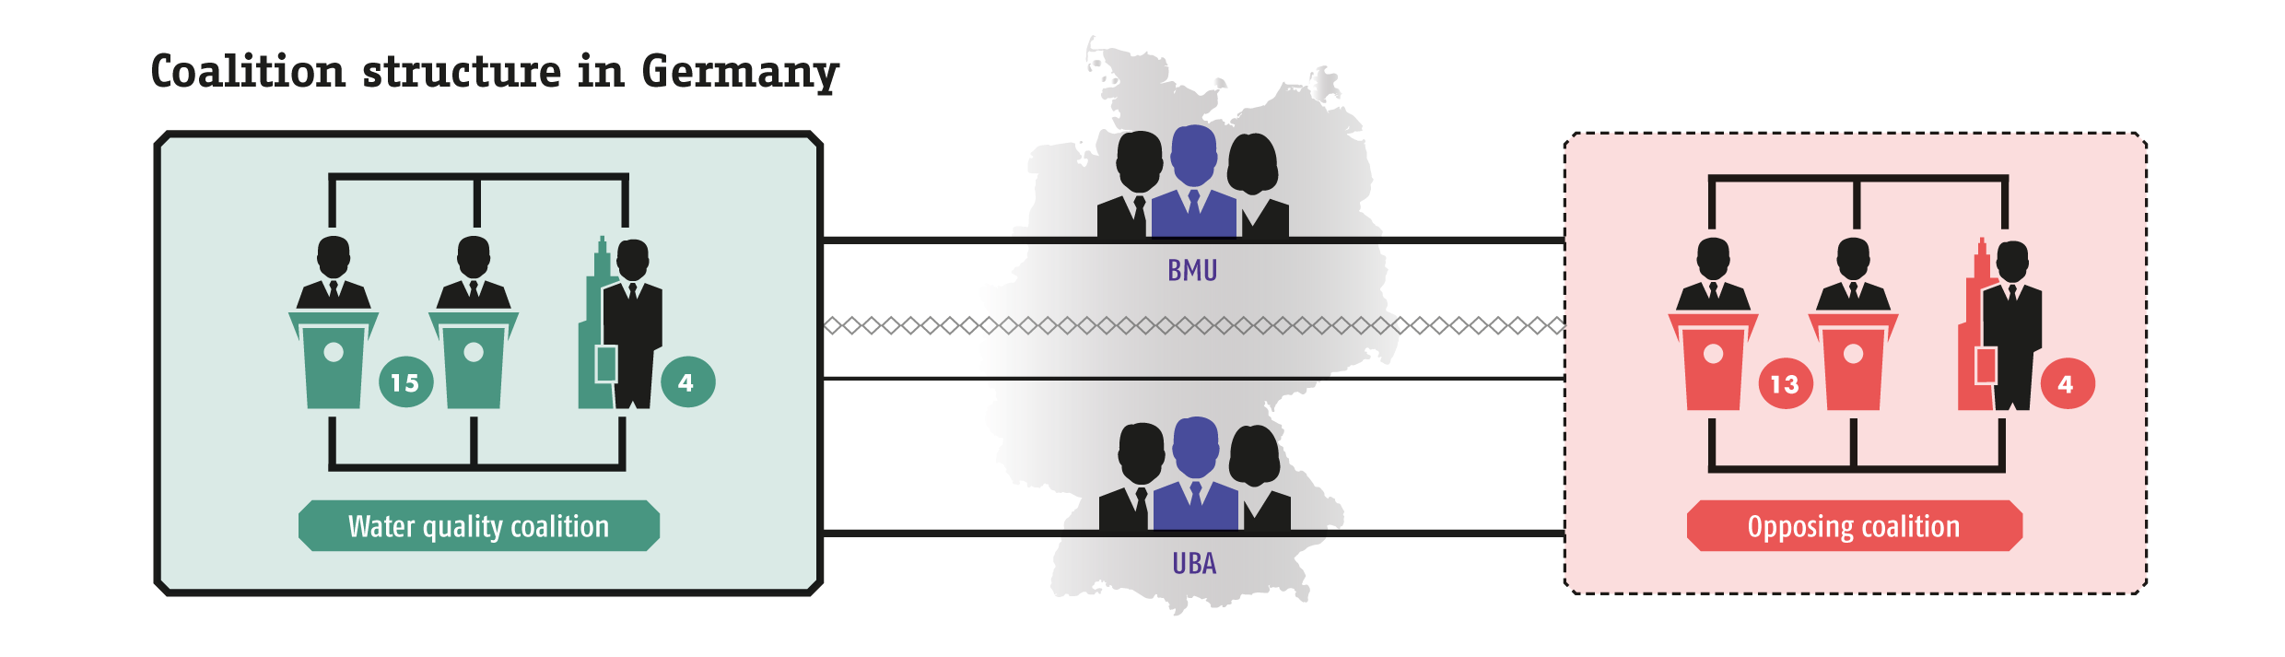
Alliances & mediators?
Analysis of network structures
Advocacy coalitions and brokers matter for policy change
E.g., Cluster analysis to identify advocacy coalitions
E.g., Degree centrality to identify mediators
Definition advocacy coalition:
Groups of actors
Shared beliefs
Coordinate their actions
Influence policy
Metz 2017: Springer

Slide 16
Structure
Governance resilience
My research
1
2
3
4
Networks
Water & beyond

Slide 17
Policy / knowledge diffusion
Typical research questions
Which solutions help to increase resilience?
How do people learn about solutions?
How to scale-up, or diffuse solutions beyond the local?

Slide 18
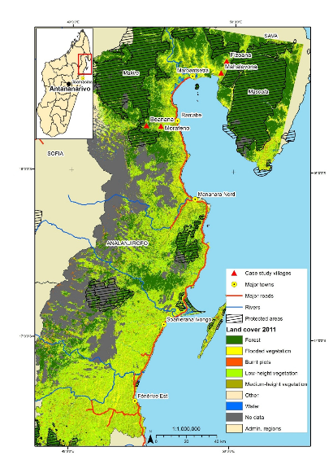
SCALING UP
Social learning drives diffusion of innovations
Evidence from a training to increase farmers’ resilience
 | N° Ties
 | 74
 | 16
Social learning
Imitation
North-Eastern Madagascar
Analanjirofo region
Notes:
Social learning drives diffusion of innovations, even when controlling for other effects, like:
Social selection (same agricultural activity, traditional knowhow)
Or age, same gender/religion, different age group (there is an age effect)
Type of learning & Ties
Social learning by teaching
pilot farmer to farmer & 42
new PACT practitioner to farmer & 4
Social learning by requesting information
farmer to pilot farmer & 28
farmer to new PACT practitioner & 0
Imitation
16
Total ties
90

Slide 19
Thank you for your attention!
Governance resilience
My research
1
A systems perspective on policy inter-dependencies
2
The politics of integrated governance
3
Policymaking processes
4
Policy / knowledge diffusion
Networks
Water & beyond

