Slide 1

Balancing online and face-to-face teaching and learning activities
Emiel van Puffelen
Leader Centre for Engineering Education
E-mail: emiel.vanpuffelen@wur.nl

Slide 2

Developing cycle for university courses
design
evaluate
build
execute

Slide 3
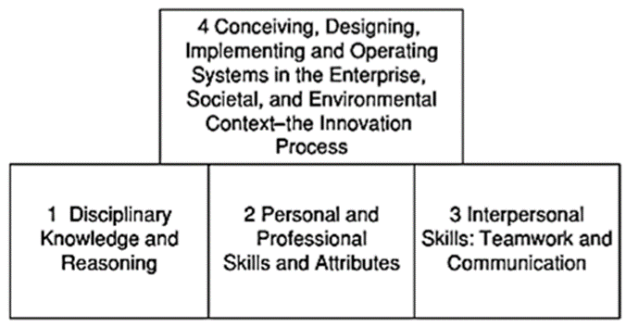
Design of Blended Courses
Start: well-constructed curriculum and properly formulated intended learning outcomes (ILOs).
Four levels of ILOs
Crawley, E.F., Malmqvist, J., Östlund, S., Brodeur, D.R. and Edström, K.,2014

Slide 4
ILOs: starting point for creating Teaching and Learning Activity’s (TLAs) and Assessment
hopefully we all know:
ILOs, TLAs and Assessment should be aligned
Based on Biggs and Tang 2011
ILO
TLAs
Assessment

Slide 5
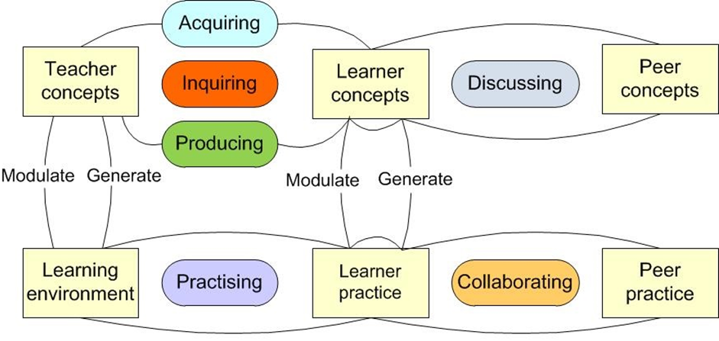
Types of learning targeted by TLAs (based on Laurillard, 2012, 2016)

Slide 6
Combine TLAs! often a large part of the TLA overview is needed
One ILO might require different types of TLAs and the course set of ILOs might require more.
A workflow of TLAs (like reading, developing evidence-based output, debating) might be needed for an ILO, especially for engineering.
Differences in learning styles and learning theories point in the direction of combining TLAs.
Combining TLAs is necessary to engage students and keep them surprised!

Slide 7
One option: flipping of the classroom
Information-gathering activities for students,
Devote class time to discussions, peer interactions, and the assimilation of knowledge
(Mazur, 2009).
This requires the provision of media to support students in their information gathering.

Slide 8

traditional media such as books are increasingly being supplemented with online media.
Online media can be used to restrict face-to-face interactions to situations in which they are really needed, such as follow up on learning using media or activities aimed at higher-level learning outcomes.
The result is that online TLAs require a larger part of student learning time
Consequences ?

Slide 9
Some literature indications
Christiansen et al. (2017): students achieved lower scores on quizzes performed at home compared with in class. Survey feedback showed a strong preference for taking quizzes in class and indications that take-home quizzes demotivated attendance and the pre-class watching of videos.
Pfeiffer, Scheiter, and Gemballa (2012) found that students who had prepared for a task using digital videos were less motivated than students who were trained in class, although a combination of both approaches was best

Slide 10
MOOCs can be restricted to 100% online TLAs
Hew & Cheung (2014): many MOOCs have a structure equivalent to university courses, using video lectures, examinations and/or individual final projects, and online discussions. But:
MOOCs have larger and more diverse student enrolment, higher drop-out rates and a relative lack of instructor presence or support.
MOOCs suffer from a lack of student response in online discussion and, for the teachers, the sense of speaking into a vacuum because of the absence of student immediate feedback.
These findings could indicate that learning is less effective with MOOCs due to a lack of face-to-face interaction.

Slide 11
MOOCs have low completion rates
This might also be partially explained by the selection and intentions of MOOC students. Since most users of MOOCs are not part of a study programme, completing the whole MOOC is not necessary (Hew & Cheung, 2014; Jordan, 2015).
Conclusion: it is wise to investigate student perception when increasing the use of online activities in university courses, as well as the possible limitations.

Slide 12
Combining knowledge clips (short video on a single topic) with other TLAs.
Long, Logan, and Waugh (2016): pre-class videos should be combined with other activities to ensure students have learned the knowledge covered in the videos and are prepared for the in-class activities.
Fabregat-Sanjuan et al. (2017) successfully used out of class self-assessment in combination with online video clips to achieve this
Moos and Bonde (2016) found that embedding prompts in the video had a positive effect, causing students to better self-regulate their learning.

Slide 13

Wageningen University
Introduction of knowledge clips and other online TLAs, in several second-year food technology courses.
Partial shift from face-to-face to online activities for acquiring, inquiring and practicing activities.
Evaluation at course level; two second-year bachelor’s courses with different TLA combinations: Food Microbiology and Mathematical Concepts for Food Technology.

Slide 14
Methods
Student questionnaires:
statements about TLAs; 5-point scale
‘strongly disagree’ (1) to ‘strongly agree’ (5).
Attendance and the percentage of exercises completed; 5-category scale: 0–20% (1), 20–40% (2), 40–60% (3), 60–80% (4) and 80–100% (5)
Semi-structured group interview one month after the course; questionnaire was discussed in detail

Slide 15
Results:

Slide 16

Conclusions and recommendations
TLA combinations
knowledge clips seem to work well in general, but students prefer to combine knowledge clips with other TLAs. Besides preference, there seem to be two reasons for that: watching a large amount of clips requires a considerable amount of discipline and face-to-face meetings in between sets intermediate goals to work for. Also when knowledge clips are more difficult (e.g. explaining a calculation) and raise questions students prefer to work in a room with supervision.
The large standard deviations show that students differ in preference for all the online and face-to-face TLAs used in the courses. Boelens, De Wever, and Voet (2017) formulated four goals for the design of blended courses: (1) incorporating flexibility, (2) stimulating interaction, (3) facilitating students’ learning processes and (4) fostering an affective learning climate. It seems that the two courses reached at least the goals 1 and 3 to some extend as all TLAs were scored as neutral or above despite differences in student preferences towards the various TLA types. This might indicate that the different TLA types offered, enabled most students to find TLA combinations that worked for them. strategies.

Slide 17

Conclusions and recommendations 2
Implementation
When online TLAs (such as knowledge clips) are introduced, students should receive guidance on how to work with them to reach the learning goals.
In that way, students can become familiar with the new TLAs, decide whether a learning activity is useful for them to attend, and understand how to make effective use of it.
Study programmes should slowly introduce knowledge clips; a sudden change from courses with only lectures and group work to courses with knowledge clips and digital learning material might confuse students in their learning strategies.

Slide 18
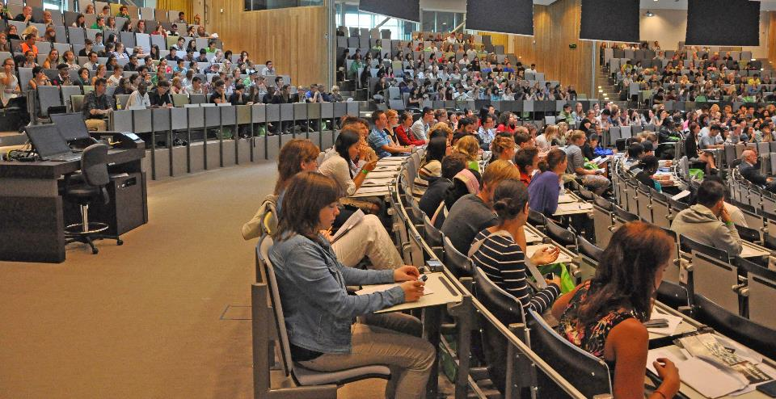
Thank you!
Your questions ... or the question below
1
Is this situation part of a good course design?

