Slide 1
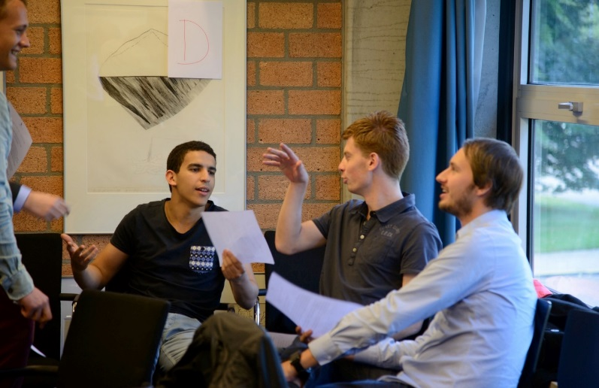
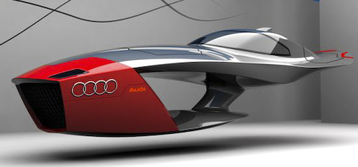
Instructing the right study effort
in 0SEUB0 ‘Patents, Design Rights and Standards’
Final presentation
Gunter Bombaerts 07/01/2016

Slide 2
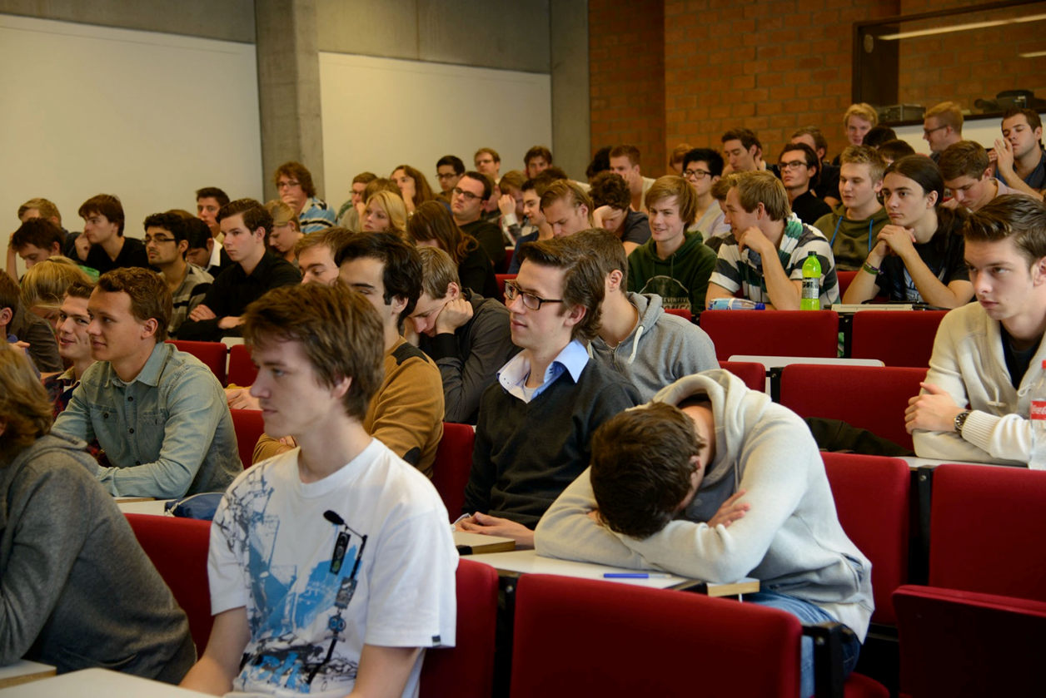
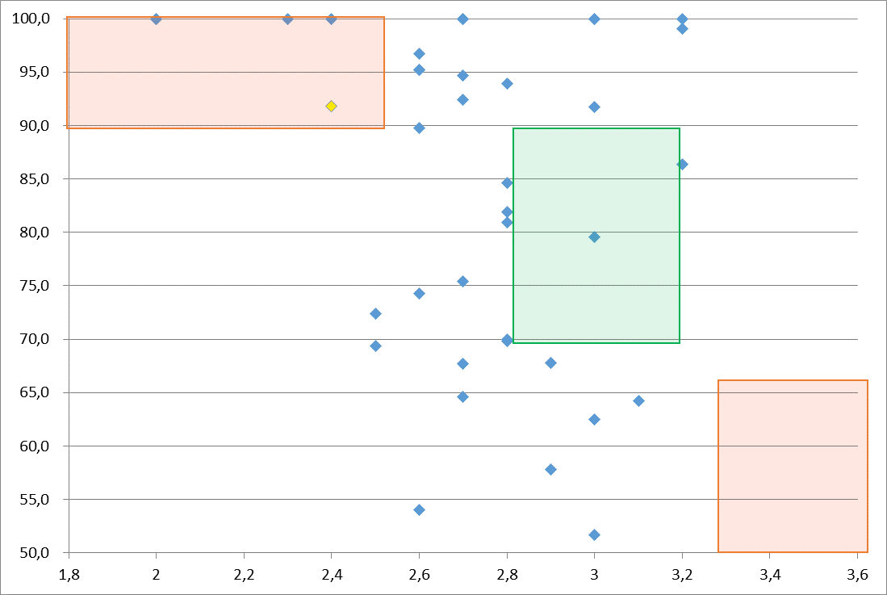
Challenges for USE: Motivation and study effort
Average course evaluation 6,4
Motivation
‘Did you enjoy taking the course’
Determines 45% final score
Average 3,4
Study effort is low, success rate is high

Slide 3
Ch2: Study-effort (x) versus success rate (y) for USE courses
0SEUB0 ‘Patents, Design Rights and Standards’

Slide 4
Three courses for full USE course sequence
Course (each 5 ECTS) |  | Focus
Explorative Course (0SEUB0) Focused at exploring, awareness, and understanding the basics | Q1 | Regular introductory lectures Guest lectures Essays/debating exercises Role playing game (Studium Generale program)
Specialized course (0SSUC0) Theoretical deepening, skills | Q2 | Lectures on selected topics, bit more paper / theory driven Tutorials + 3 assignments
Project (0SAUC0) Apply knowledge and skills | Q3, Q1 | Application of knowledge Choice of three projects Link with TU/e departments

Slide 5
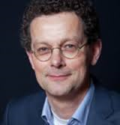
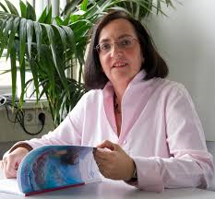
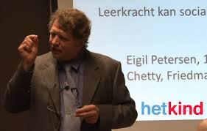
Method: Expert group meeting
Jan van Tartwijk (Utrecht)
Saskia Brand-Gruwel (Open U)
Ludo Heylen (KULeuven)
Marieke Thurlings (TU/e)
Rachelle Kamp (TU/e)
Ludo van Meeuwen (TU/e)
Lisa Struik (student)
Patrick Janssen (student)
Rudi Bekkers (teacher)
Gunter Bombaerts

Slide 6
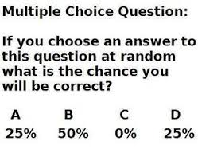
Evident and less evident conclusions
Multiple choice exam
Correction for guessing
Higher order thinking in MC
10 words question ←→ MC
Weekly clicker question
Teach students about USE questioning
Lower order thinking
Gives students ‘easy’ idea
Decreases intrinsic motivation

Slide 7
0SEUB0 evaluated as good course
0SEUB0 ‘Patents, Design Rights and Standards’
 | Course evaluation | Course design | orga nisation | Study guide | Study effort vs ECTS | Fun | Success rate
14-15 | 7.0(1.9) | 3.8(1.2) | 3.7(1.3) | 4.2(0.9) |  | 4.0(1.2)
15-16

Slide 8
0SEUB0 evaluated as good course, except …
0SEUB0 ‘Patents, Design Rights and Standards’
 | Course evaluation | Course design | orga nisation | Study guide | Study effort vs ECTS | Fun | Success rate
14-15 | 7.0(1.9) | 3.8(1.2) | 3.7(1.3) | 4.2(0.9) | 2.4(0.8) | 4.0(1.2) | 94%

Slide 9
0SEUB0 improved
0SEUB0 ‘Patents, Design Rights and Standards’
 | Course evaluation | Course design | orga nisation | Study guide | Study effort vs ECTS | Fun | Success rate
14-15 | 7.0(1.9) | 3.8(1.2) | 3.7(1.3) | 4.2(0.9) | 2.4(0.8) | 4.0(1.2) | 94%
15-16 | 7.1(1.5) | 3.9(0.8) | 3.9(1.1) | 4.2(0.8) | 2.7(?) | 4.0(1.2) | 80%

Slide 10
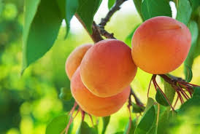
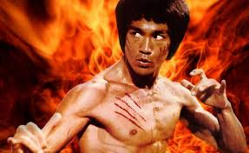
Project lessons learnt: “Intelligent course redesign”
“Low hanging fruit”
Evident course redesign
“Fruity insights”
Non-evident issues
Intelligent
“The less effort, the faster and more powerful you will be”
This time for teachers

