Slide 1

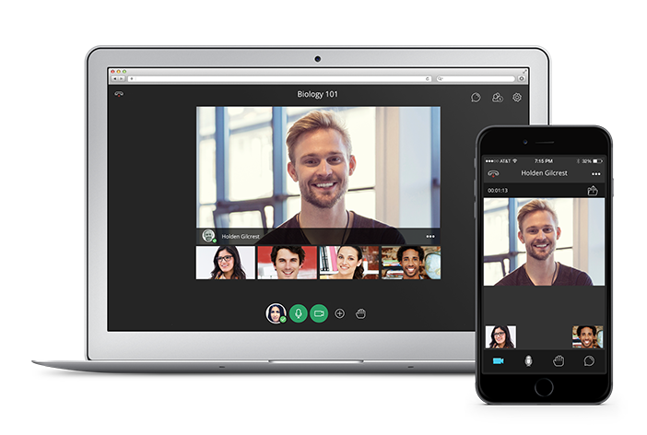
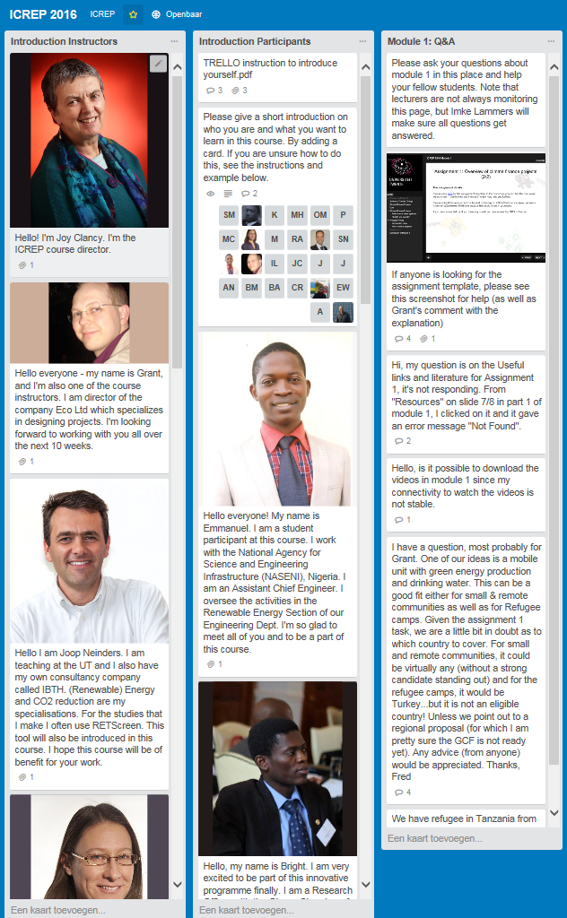
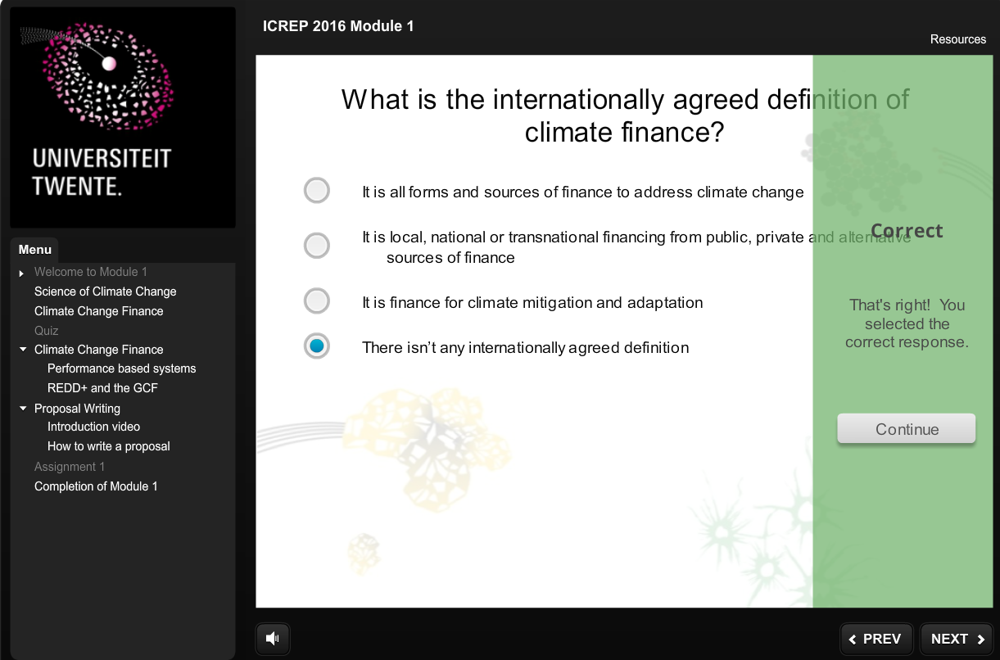
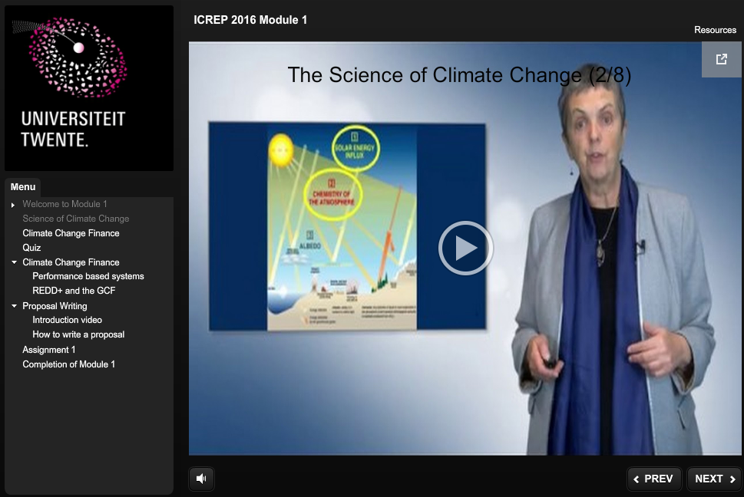
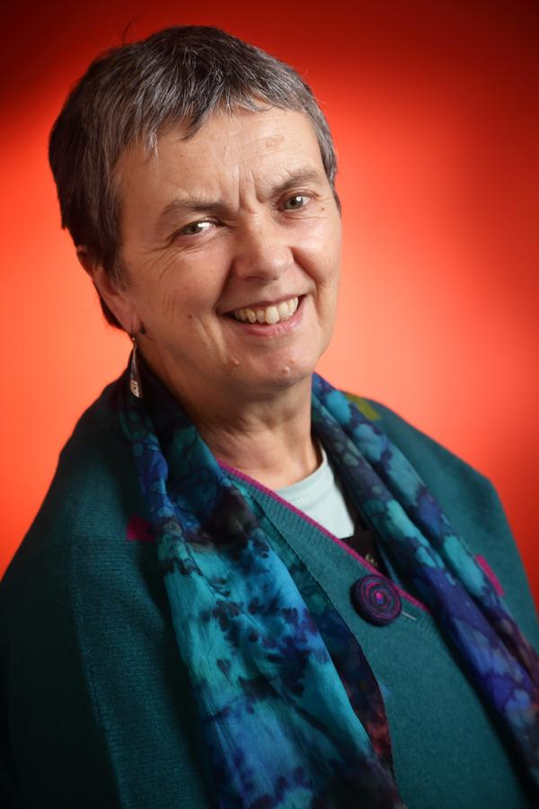

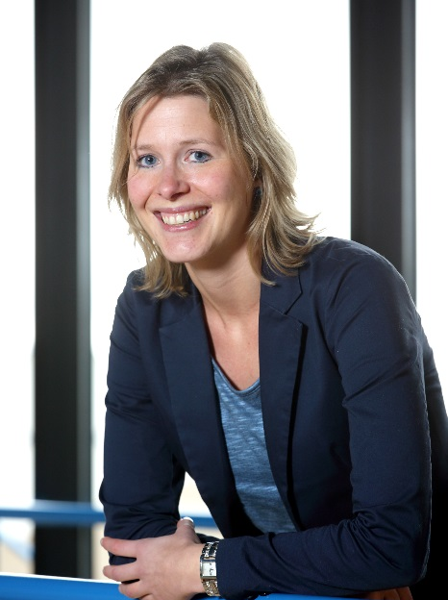
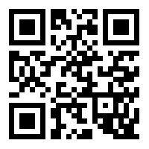
Does a blended design work for ICREP?
(Prof. dr. Joy Clancy, drs. Chris Rouwenhorst, Martine ten Voorde- ter Braack MSc)
4,9 out of 5
1. Introduction
On question:
‘I would recommend this course to others’
The International Course on Rural Energy Planning (ICREP) is offered by the department of Government and Technology for Sustainability (CSTM). In October 2015 a redesign has started in collaboration with the Centre of Expertise in Learning and Teaching (CELT).
2. Analysis
2. Analysis (evaluation)
ICREP has been provided by the University of Twente for 33 years, as an 8 week on campus program. During these years ICREP was run by an international teaching team and had high educated participants from all over the world, especially African countries.
A redesign process was started to make ICREP sustainable for the upcoming years. For sustainability a blended design was chosen.
At the University of Twente we had limited experience with solutions in designing a blended international course.
We could improve the analysis phase next time by doing a more in depth analysis of the current situation and the multiple stakeholders who were involved in the design and development process.
Because of problems with the integration of the intended technical solutions, a new analysis for other technical solutions was necessary during the course. This resulted in the systems used.
3. Design
3. Design (evaluation)
In the interpretation of Kerres and De Witt (2003) blended learning refers to the mix of different didactical methods and different delivery formats.
Besides this we choose a modular approach and we take care that the learning objective had a meaningful context. Also we choose suitable ICT systems to use in developing countries.
All of the above resulted in a:
-reduced amount of contact hours
-blended format (8 online modules, 2 weeks on campus)
Students and teachers were satisfied with the design of the course. The results of the student evaluation is visible below.
In this course we used a large variety in synchronous and a- synchronous (Piskurich, 2006) learning activities. These are offered in different delivery formats like face to face, video, text or images.
Figure 1: Course design (n=12)
Picture 1: Webinar – BlackBoard Collaborate Ultra
Picture 2: Quizzes – Articulate Storyline
According to Collis and Moonen (2001), blended learning is a hybrid of traditional face-to-face and online learning so that instruction occurs both in the classroom and online, and where the online component becomes a natural extension of traditional classroom learning.
“ICREP presented me with the opportunity to network among colleagues from different background and countries”
Picture 4: Discussion Board - TRELLO
Picture 3: Article – Microlecture format
There are points for improvement regarding the design of the course:
Formulate the learning objectives more specific and clear.
Skip all materials which not contribute to the learning objectives.
Involve students in the design process
Make the educational blueprint final
4. Development
4. Development (evaluation)
We ended up by a week by week development approach.
For each of the steps in the blueprint multiple stakeholders were involved.
The stakeholders had the following tasks:
Because of the week by week development approach, adaptive release was necessary. Due to the fact the materials were delivered late, there was nearly no time to provide didactical feedback on the materials. Students, however, found the materials consistent (4,3 out of 5, n=12) and professional (4,8 out of 5, n=12) We think there is still room for improvement for example using the multimedia principles of Mayer (2001).
Working with a student assistant in de development phase worked very well. Once the information is structured and you have clear tasks a student-assistant can do a lot of work.
Educational consultants:
Support in quality by providing manuals and feedback
Check the allignment with educational blueprint
Integrate the different parts in Blackboard to create a clear, well structured consistent learning experience.
Support in integration and adoption of the different systems
Teaching team
Creating the content of the materials
Student-assistant
Creating the Articulate e-learning modules based upon the educational blueprint and teachers materials.
5. Implement
During the implementation the teaching staff was leading. CELT provided some functional support on the use of the different systems.
5. Implement (evaluation)
Students used all the systems in this course and they felt well supported, as can be seen in the graph below.
6. Lessons learned
Figure 2: System support was sufficient (n=12)
A high variety of learning activities seems to have a positive influence on the course appreciation.
A high variety of different delivery formats seems to have a positive influence on the course appreciation.
Make clear arrangements with the stakeholders about the planning, the responsibilities and the way of communication.
Working with an international teaching team on distance is fun, but challenging.
Working with a student assistant is highly recommended.
Make clear arrangements about the quality of the products.
Prof. dr. Joy Clancy
drs. Chris Rouwenhorst
Martine ten Voorde- ter Braack MSc
For more innovation: http://www.utwente.nl/telt/
Contact c.rouwenhorst@utwente.nl m.tenvoorde@utwente.nl
References:
Kerres, M. & De Witt, C. (2003) A Didactical Framework for the Design of Blended Learning Arrangements, Journal of Educational Media, 28(2), 101-113, DOI:10.1080/1358165032000165653
Piskurich, G.M. (2006). Rapid Instructional Design. San Fransisco: John Wiley & Sons
Collis, B. & Moonen, J. (2001). Flexible learning in a digital world. London: Kogan Page limited.
Mayer, R.E. (2001). Multimedia Learning. Cambridge: Cambridge University Press.
UNIVERSITY OF TWENTE.

